Slide 1
Word choice

Slide 2
“You”
Or really any other pronouns for that matter
“You can’t see a ribosome with a light microscope.”

Slide 3
“You”
Or really any other pronouns for that matter
“You can’t see a ribosome with a light microscope.”
“Ribosomes cannot be seen using light microscopy.”

Slide 4
“Things” and “Stuff”
Too ambiguous. What “things”? What “stuff”?
“The cell surface membrane is responsible for keeping stuff inside or outside of the cell”
“Nuclear pores let things in and out of the nucleus.”

Slide 5
“Things” and “Stuff”
Too ambiguous. What “things”? What “stuff”?
“The cell surface membrane is responsible for keeping stuff inside or outside of the cell”
“The CSM is responsible for regulating what molecules enter and exit the cell.”
“Nuclear pores let things in and out of the nucleus.”
“Nuclear pores allow for particles, like ribosomes and mRNA to exit the nucleus, and for particles like hormones and nucleotides to enter the nucleus.

Slide 6
“Things” and “Stuff”
Words to use instead: molecules, macromolecules, the actual name for the “thing”, structure, vesicle

Slide 7
“Good” and “Bad”
Less ambiguous, but not appropriate for Cambridge level students in a formal paper
Good: beneficial, necessary
Bad: harmful, unwanted
What is considered “good” to one cell might be “bad” for another cell, so avoid these two words at all costs!

Slide 8
“Job”
Cells and organelles don’t have jobs (They can’t quite figure out how to type a resume yet)
“The job of the ribosome is to synthesize proteins”

Slide 9
“Job”
Cells and organelles don’t have jobs (They can’t quite figure out how to type a resume yet)
“The job of the ribosome is to synthesize proteins”
“The function of the ribosome is to synthesize proteins.”

Slide 10
Shape
Like “good” and “bad” it’s not that this word is ambiguous, but it is generally not used in Biology
Instead: structure, complex, organization

Slide 11
Metaphor, Simile, and Analogy
Fine for literature, but not for AICE Biology exams
“The mitochondria is the powerhouse of the cell.”
“The nucleus is like the brain of the cell.”

Slide 12
Metaphor, Simile, and Analogy
Fine for literature, but not for AICE Biology exams
“The mitochondria is the powerhouse of the cell.”
The mitochondria creates chemical energy for the cell in the form of ATP.
“The nucleus is like the brain of the cell.”
The nucleus controls the functions of the cell by transcribing DNA

Slide 13
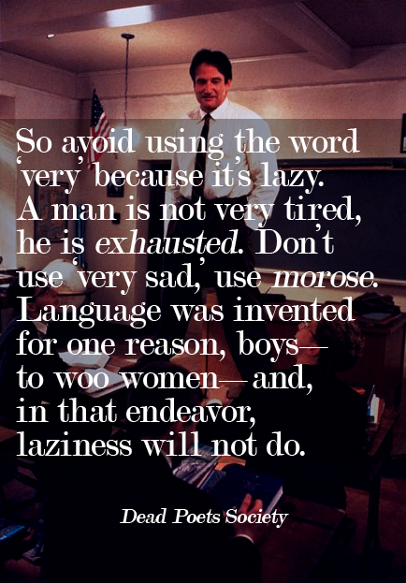
Other words to avoid
A lot
Many
Really
Very
Lots
Nice

Slide 14
Command Words
Commonly seen on Paper 2 and Paper 3

Slide 15
List and State
List: give a number of points, no elaboration is necessary
State: give a concise answer, no supporting argument
“State the advantages of using the light microscope, rather than using the electron microscope, in studies of tissues.”
“State the functions of structures P, Q and R.”

Slide 16
Define and Explain
Define: present a formal statement, probably learned by heart
Explain: accompanied by “… what is meant by”, is another way of asking for a definition

Slide 17
Outline and Describe
Outline: give the main steps or main points
Describe(1): give a step by step account of a structure or process; detail can be required
“Outline how red blood cells are involved in the transport of carbon dioxide.”

Slide 18
Describe(2) and Explain(2)
Describe(2): pick out key points from stimulus material such as a graph or a diagram
Explain: give reasons (often to follow up from describing). This will require knowledge of the underlying theory
“The leaves of the buttonwood trees at the exposed site were significantly smaller than those at the sheltered site. Describe three ways, other than small size, in which leaves are adapted to reduce the rate of transpiration.”
“Explain how capillaries are adapted for their function as exchange vessels.”

Slide 19
Discuss and Compare
Discuss: give a critical account – may often require two sides of an argument to be presented
Compare: give similarities and differences

Slide 20
Suggest(1) and Suggest(2)
Suggest(1): there is no unique answer
Suggest(2): use knowledge in a novel situation
“People who receive drug treatment for HIV take a mixture of drugs that act in different ways. Suggest the advantage of taking a mix of the drugs shown in Table 4.1.”

Slide 21
Measure, Determine, and Calculate
Measure: use a measuring instrument, e.g. protractor, ruler
Determine: in a practical situation, usually implies measuring and then calculating; it could also involve carrying out a procedure before measuring something
Calculate: use a mathematical process to find the answer from given or measured values; always show working

Slide 22
Predict and Deduce
Predict: make a logical connection between other pieces of information to produce the required answer
Deduce: make a logical connection between other pieces of information to produce the required answer and include a supporting statement

