Slide 1
Water Properties
Chapter 2

Slide 2
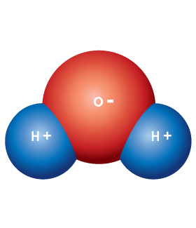
Polarity
Because of the angles of its chemical bonds, the oxygen atom is on one end of the molecule and the hydrogen atoms are on the other.
With 8 protons in its nucleus, an oxygen atom has a much stronger attraction for electrons than does a hydrogen atom with its single proton.

Slide 3
Polarity
There is a greater probability of finding the shared electrons in water close to its oxygen atom than near its hydrogen atoms.
As a result, the oxygen end of the molecule has a slight negative charge and the hydrogen end of the molecule has a slight positive charge.

Slide 4
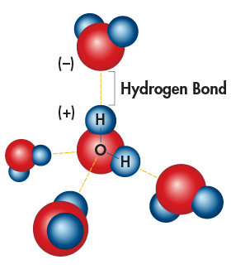
Hydrogen Bonding
Because of their partial positive and negative charges, polar molecules such as water can attract each other.
The attraction between a hydrogen atom on one water molecule and the oxygen atom on another is known as a hydrogen bond.

Slide 5
Hydrogen Bonding
Water is able to form multiple hydrogen bonds, which account for many of its special properties.
Hydrogen bonds are not as strong as covalent or ionic bonds, and they can form in other compounds besides water.

Slide 6
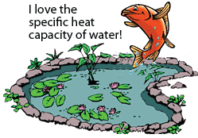
Heat Capacity
Because of the multiple hydrogen bonds between water molecules
Large amount of heat energy required to cause those molecules to move faster and raise the temperature of the water.
Large bodies of water, such as oceans and lakes, can absorb large amounts of heat with only small changes in temperature. This protects organisms living within from drastic changes in temperature.

Slide 7
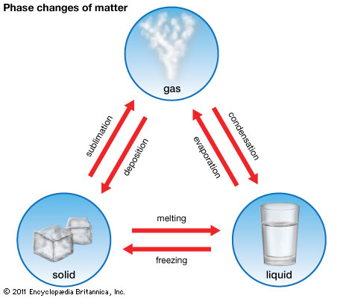
Phase Change
Reversible physical change that occurs when a substance changes from one state of matter to another

Slide 8
Types
Melting – solid to liquid
Freezing – liquid to solid
Vaporization – liquid to gas
Condensation – gas to liquid
Sublimation – solid to gas
Deposition – gas to solid

Slide 9
Temperature & Energy
The temperature of a substance DOES NOT change during a phase change!!
i.e. The temperature changes while either completely solid, liquid or gas
Energy is either absorbed or released
Endothermic – energy is absorbed
Exothermic – energy is released
Higher altitude = Lower required temps

Slide 10
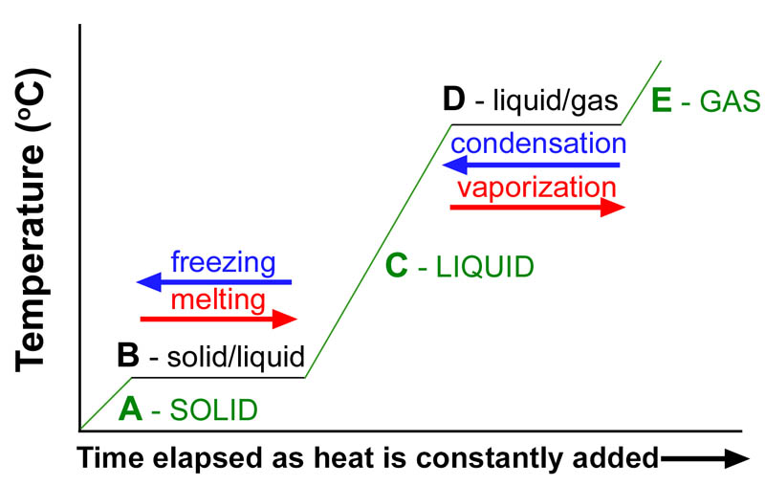
The temperature of a substance DOES NOT change during a phase change!!
Energy is used to change molecule position

Slide 11
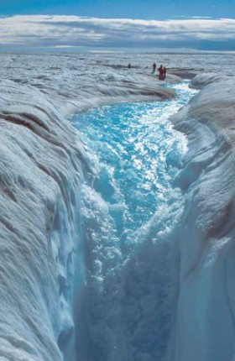
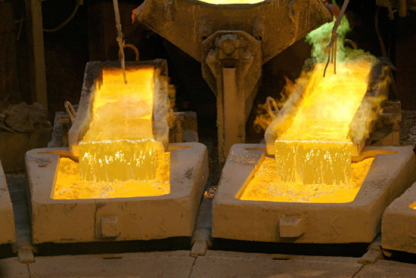
Melting
Solid to Liquid
Endothermic
Molecules move from fixed positions

Slide 12
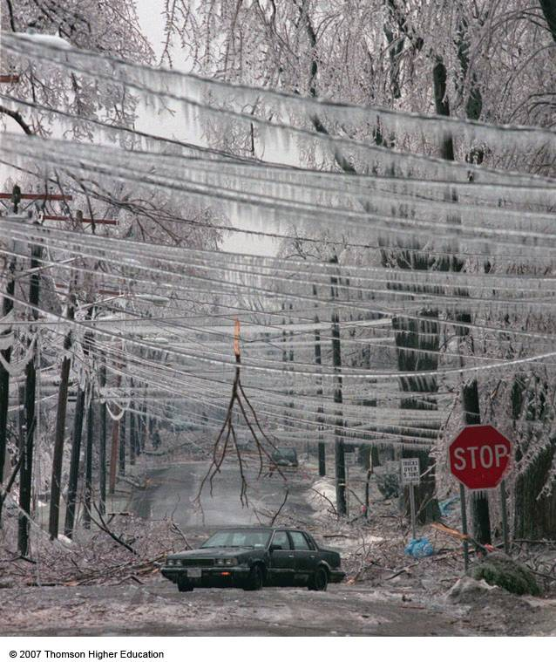
Freezing
Water = 0° C (32 ° F)
Liquid to Solid
Exothermic
Molecules are “frozen” to a fixed position
In the ocean, the water loses heat and thus the top layer freezes
Colder on top than below
Survival of fish?

Slide 13
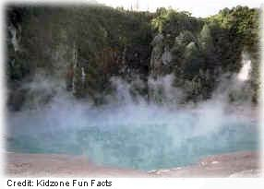
Vaporization
Water = 100 ° C (212 ° F)
Liquid to Gas
Endothermic
Boiling & Evaporation
Vapor pressure increases as temperature increases
In the ocean, heat is absorbed by water and ice melts

Slide 14
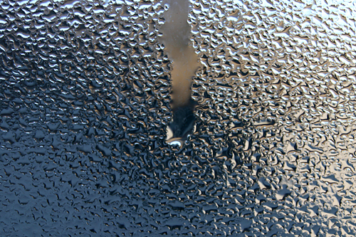
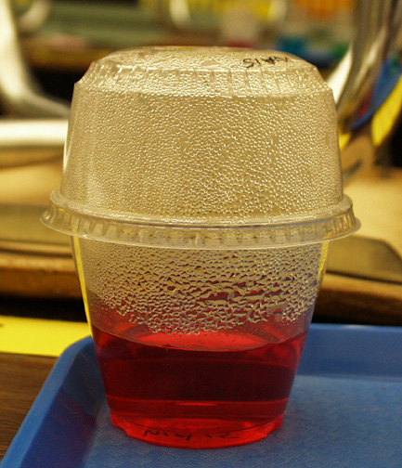
Condensation
Gas to Liquid
Exothermic

Slide 15
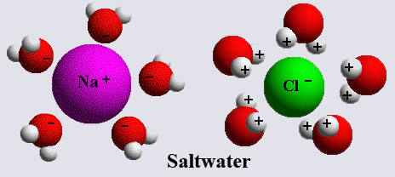
Salt Water
Higher Boiling Point
Lower freezing Point
Salt interacts with water to make it less “organized”

Slide 16
Density
Freshwater density = 1.00g/cm³
Saltwater density = 1.03 g/cm³
Why higher?
Volume is the amount of space taken up by an object.
Density is the ratio of an object’s mass to its volume:

Slide 17
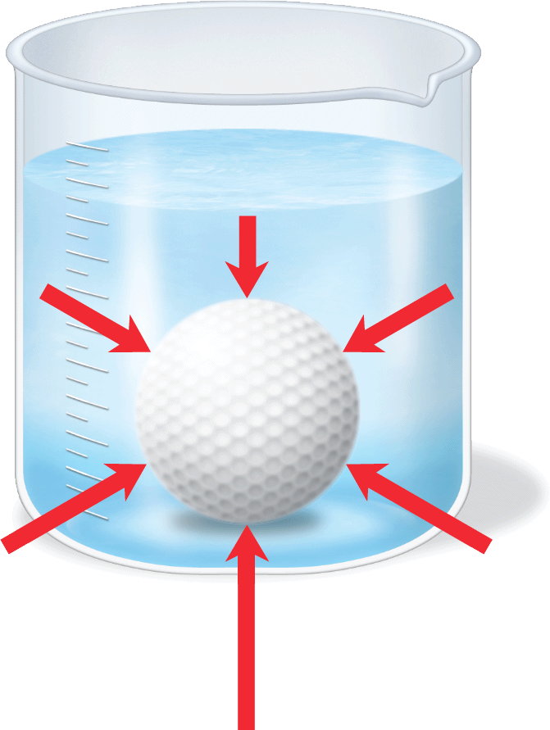
Buoyancy
The forces from pressure acting on the bottom of this golf ball are greater than those on the top.
This produces a net force—called the buoyant force—that acts upward on the ball.

Slide 18
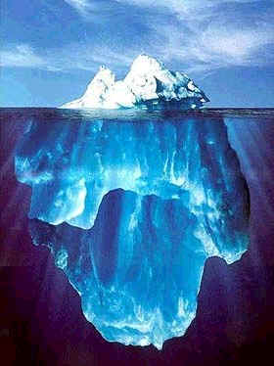
Buoyancy
Buoyancy is the ability of a fluid to exert an upward force on an object placed in it.
Buoyancy results in the apparent loss of weight of an object in a fluid.
A submerged object pushes aside, or displaces, a volume of fluid equal to its own volume.
A floating object displaces a volume equal to the volume of the part of the object that is submerged.

Slide 19
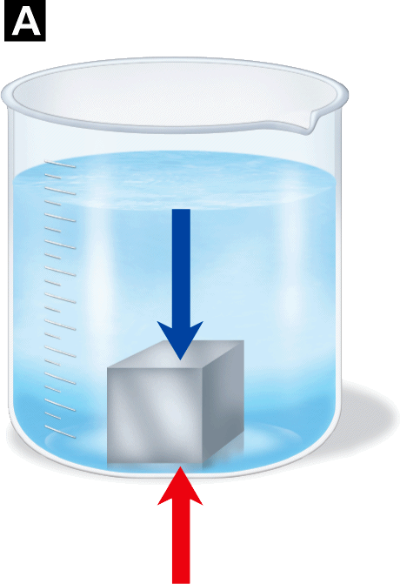
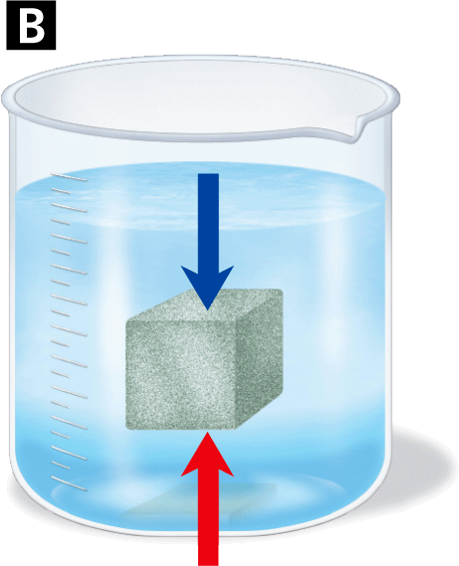
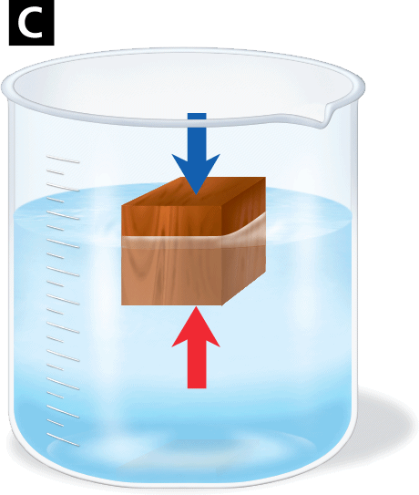
Floating vs sinking
How can you determine if an object will float or sink in a fluid?
If an object is less dense than the fluid it is in, it will float.
If the object is more dense than the fluid it is in, it will sink.
Weight
Weight
Weight
Buoyant force
Buoyant force
Buoyant force

Slide 20
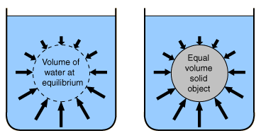
Forces again
Two forces act on every object in a fluid—weight and the buoyant force.
The force of gravity, equal to the object’s weight, acts downward on the object.
The buoyant force, equal to the weight of the volume of displaced fluid, acts upward on the object.

Slide 21
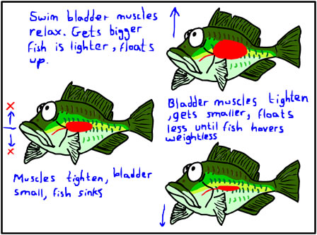
Density and Buoyancy
Suspended
An object that has the same density as the fluid it is submerged in will be suspended (it will float at any level) in the fluid.
The buoyant force acting on the suspended object exactly equals the object’s weight.
Submarines and some fish are able to suspend themselves in water partly by adjusting their density.
Neutral Buoyancy = Preventing movement up or down

Slide 22
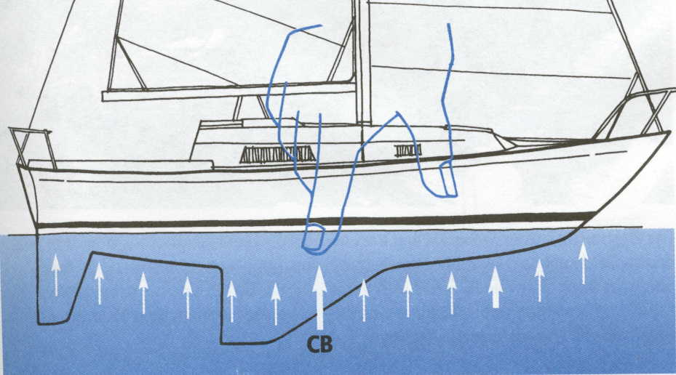
Floating
Floating
A solid piece of steel sinks in water. A heavy steel ship floats because of the shape of its hull.
The hull is shaped so that it displaces a large volume of water, creating a large buoyant force.

Slide 23
Density and Buoyancy
The weight and buoyant force determine if an object sinks or floats.
Weight
Weight
Weight
Buoyant force
Buoyant force
Buoyant force

Slide 24
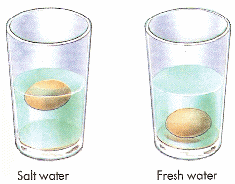
Dense Fluids
Objects also float more easily in dense fluids.
The denser the fluid is, the greater is the weight displaced. The greater displaced weight results in a greater buoyant force.
This is why it is easier for a person to float in very salty water. The dense salty water produces a larger buoyant force when displaced by the person's body.
Displace less water

