Slide 1
Water: The Chemical Basis of Life
Chapter 2

Slide 2
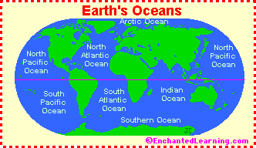
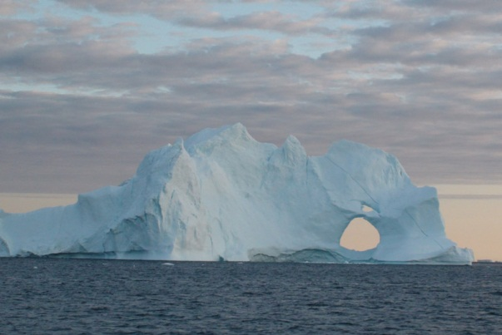
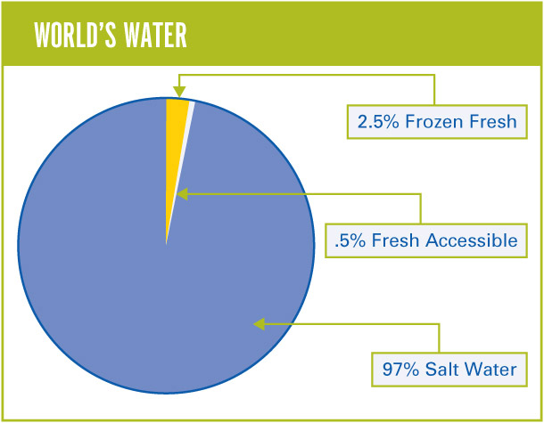
Water
4 primary oceans
Pacific, Atlantic, Indian, Arctic
Water that fills large areas between continents = Basins
97% of water is in the ocean
Only 3% is fresh
Only 1% of that is liquid
Much of that is in the ground
Marine organisms need water
80% water by mass

Slide 3
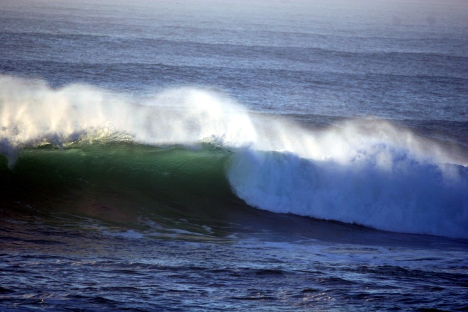
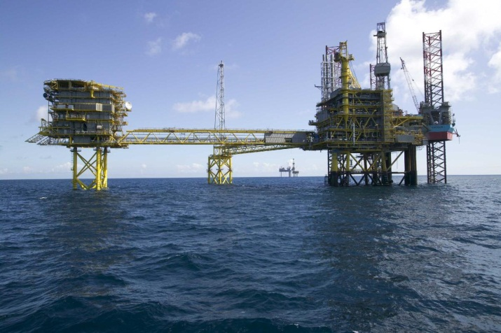
Oceans
Important resource for us
Source of food, transportation, energy, etc
Replenishes itself naturally over short periods
It is a RENEWABLE resource
Weathering, transport of sediments, weather, climate, storing and distributing heat in the ocean
Gas and oil are nonrenewable resource
Don’t replenish quickly

Slide 4
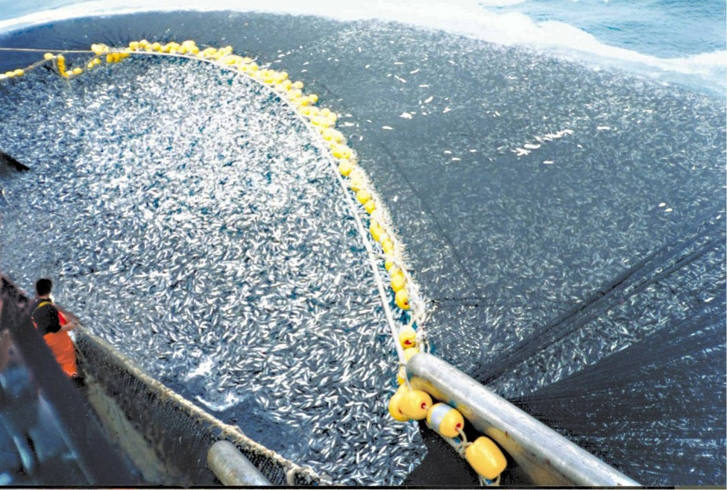
Water
Although renewable, we have to keep in mind how much of the resource we use
Overfishing is one of the largest problems facing ocean ecosystems
Fish are killed quicker than they can reproduce and grow
Have to be kind to our water, but first we need to understand water!

Slide 5
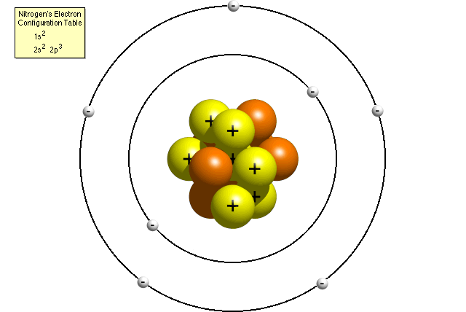
Basic Chemistry
Matter is anything that takes up space and has weight.
All matter, living or nonliving, is made up of elements.
Elements contain atoms.
An atom is the smallest unit of matter that can enter chemical reactions.

Slide 6
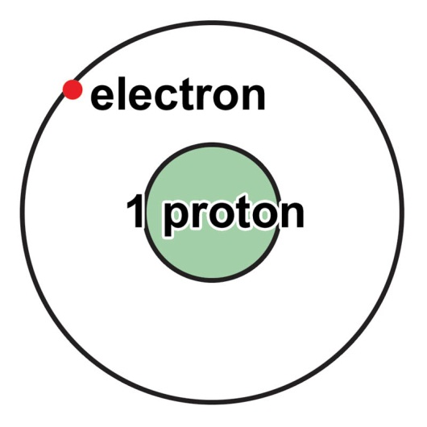
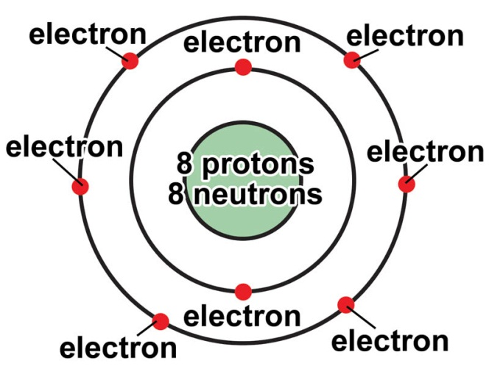
Atoms
Atoms have a central nucleus made up of protons and neutrons, and shells around the nucleus in which electrons orbit.
inner energy shell holds two electrons
outer energy shell holds eight electrons
Electrons in outer shell are VALENCE electrons
The number of electrons in the outer energy shell determines the chemical properties of the atom.

Slide 7
Subatomic Particles
Neutron (o)
Neutral subatomic particle found in the nucleus
Proton (+)
Positively Charged subatomic particle in the nucleus
Electron (-)
Negatively charged subatomic particle outside the nucleus
These can be distinguished by their mass, charge and location in an atom

Slide 8
Model of an Atom

Slide 9
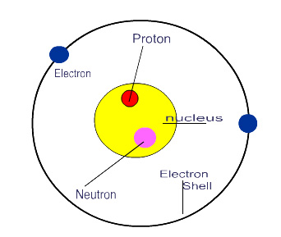
Reading the Periodic Table
Atomic Number = Number of protons
Since an element is neutral (no charge), the electrons = the number of protons
Mass number = sum of the protons and neutrons
What about electrons?
Mass number – Atomic number
Isotopes
Atoms of the same element that have different numbers of neutrons and different mass numbers

Slide 10
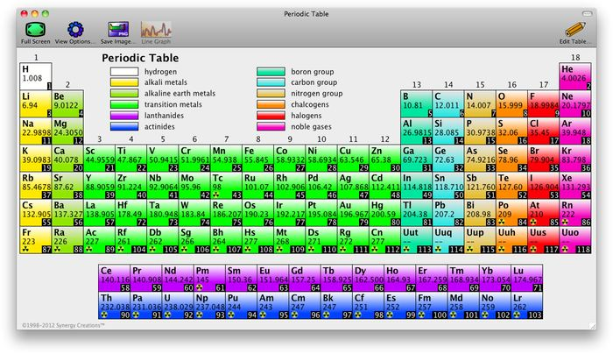
Elements
Elements are arranged in a periodic table:
horizontally in order of increasing atomic number
vertically according to the number of electrons in the outer shell

Slide 11
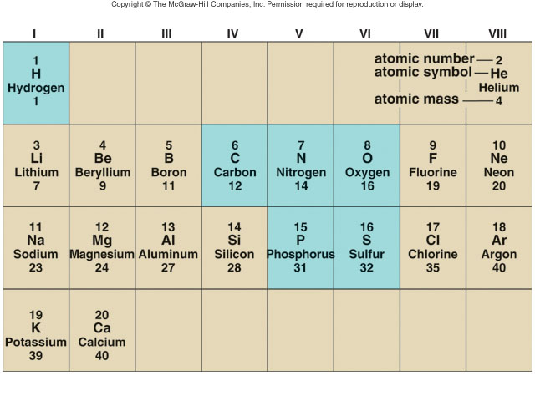

Slide 12
Atoms
Atoms have an atomic symbol, atomic number, and atomic mass.
Some atoms differ in their number of neutrons and are called isotopes.
Carbon has 3 isotopes:
Carbon 12 (most abundant)
Carbon 13
Carbon 14 (radioactive - unstable)
Notes:
Unstable isotopes are called radioisotopes or are referred to as radioactive. Radioactive isotopes are useful in medicine and research. The field of nuclear medicine employs the use of radiation for cancer treatment and medical diagnosis. The text explains the example of using radioactive isotopes to detect thyroid irregularities.
Radiation can also be deadly, as was the case for the Cherobyl nuclear accident. Exposure to radiation can also come in the form of X-rays, sun exposure, smoke detectors, and so forth.

Slide 13
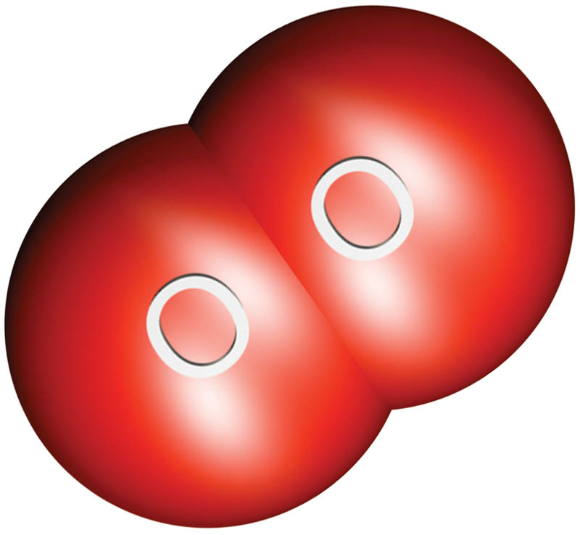
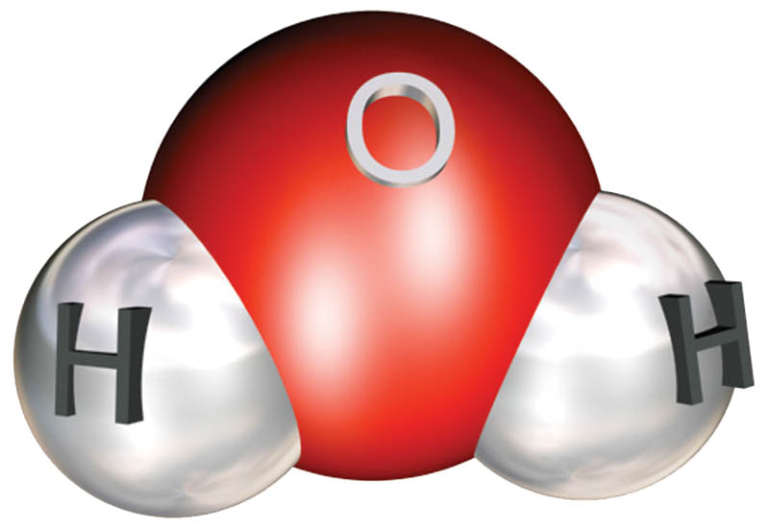
Molecule vs Compound
Atoms form bonds to fill the outer shell with electrons.
When atoms bond with other atoms, molecules are formed.
When atoms of different elements bond, a compound is formed.
Two types of bonds are ionic bonds and covalent bonds.

Slide 14
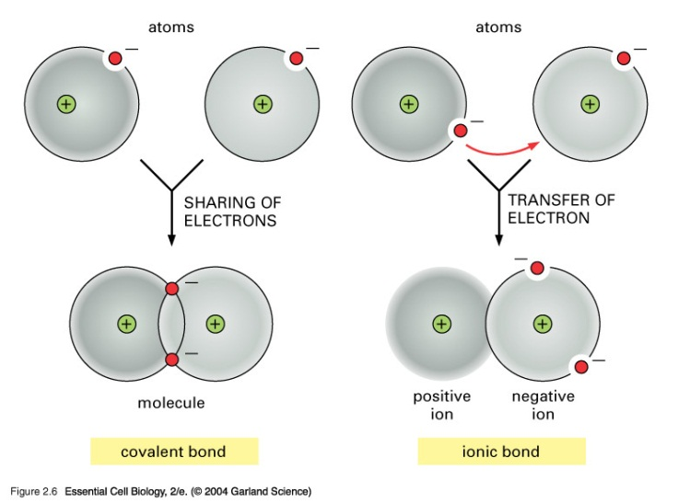
Ionic Bonds
In ionic bonding, atoms give up or accept electrons, resulting in ions.
Ions with opposite charges (- or +) are attracted to each other and form an ionic bond.
Notes:
The number of electrons in the outer shell determines how an atom will bond with other atoms.

Slide 15
Ionic Bonds

Slide 16
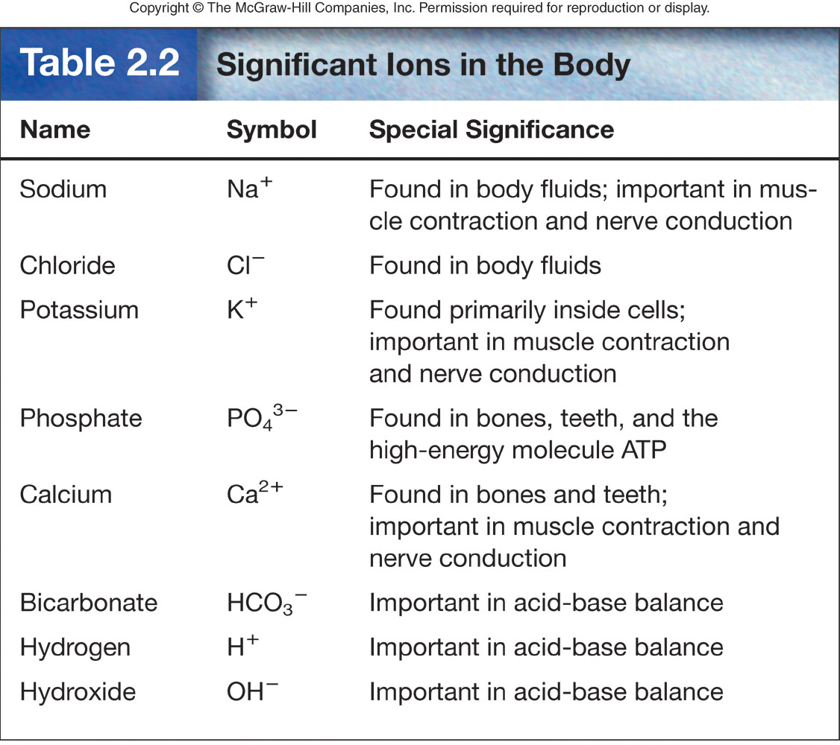
Ions can have important biological functions.

Slide 17
Covalent Bonds
In covalent reactions, atoms share electrons, resulting in covalent bonds.

Slide 18
Covalent Bonds
Aside from single covalent bonds, double, or triple covalent bonds can form.

