Slide 1
The Scientific Method

Slide 2
Why?
The scientific method is a process used by scientists to find answers to a question or to solve a problem.
It is used by scientists worldwide to study and discover the world around us.

Slide 3
Steps
Problem/Question/Observation
Research
Formulate a Hypothesis
Experiment
Collect and Analyze Results
Conclusion
Retesting
Communicate the Results

Slide 6
Observation and Question
Scientists make observations about their natural world and develop a question or problem that can be solved through experimentation.
Example: You notice that salamanders in your pond out back have curved tails and the salamanders at your school have straight tails. (observation) You wonder why that is. (question/problem)

Slide 7
Research
Research your topics of interest so you can make an informed hypothesis
This could be formal research (looking up information via the web) or informal (making more observations)
Example: You discover that the species of salamander you are observing have naturally straight tails.

Slide 8
Formulate a Hypothesis
A hypothesis is an educated guess or prediction that solves a scientific problem.
To be valid a hypothesis must be testable and predictive
Example: Salamanders that live in soil with high levels of pollutants will grow curved tails.
Non-example: Salamanders that live in my pond are magic. BAD BECAUSE IT IS NONTESTABLE AND IT DOES NOT MAKE A PREDICTION

Slide 9
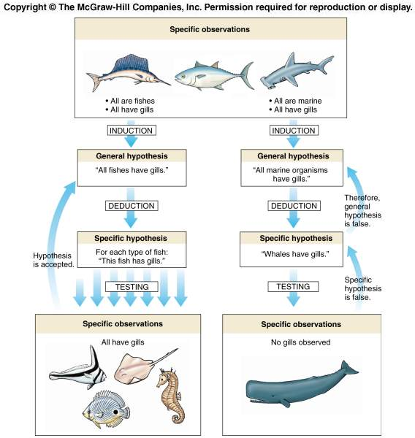

Slide 10
Experiment
An experiment is a procedure designed to test your hypothesis. The outcome must be measurable (quantifiable).
Your procedure should describe the steps you use
Each experiment should contain variables:
Independent variable
Control variable
Dependent variable

Slide 11
Variables
Independent variable – variable or condition being manipulated or changed in an experiment. It is very important that and experiment contains ONLY ONE independent variable. Ex: levels of pollutants in soil
Dependent variable – variable or condition that is being measure in an experiment. Ex: shape of salamander tail
Control variable – anything that is kept constant or unchanged in an experiment. Ex: species of salamander, food being fed to salamanders, etc.

Slide 12
Variable
You want to find the fastest way to walk home. You have three possible routes: A, B, and C. You design an experiment where you will take each route home for one week each and time yourself on the walk.
What is the independent variable?

Slide 13
Variable
You want to find the fastest way to walk home. You have three possible routes: A, B, and C. You design an experiment where you will take each route home for one week each and time yourself on the walk.
What is the independent variable?
Think: What is being changed?

Slide 14
Variable
You want to find the fastest way to walk home. You have three possible routes: A, B, and C. You design an experiment where you will take each route home for one week each and time yourself on the walk.
What is the independent variable?
Think: What is being changed?
The route.

Slide 15
Variable
You want to find the fastest way to walk home. You have three possible routes: A, B, and C. You design an experiment where you will take each route home for one week each and time yourself on the walk.
What is the dependent variable?

Slide 16
Variable
You want to find the fastest way to walk home. You have three possible routes: A, B, and C. You design an experiment where you will take each route home for one week each and time yourself on the walk.
What is the dependent variable?
Think: what am I measuring?

Slide 17
Variable
You want to find the fastest way to walk home. You have three possible routes: A, B, and C. You design an experiment where you will take each route home for one week each and time yourself on the walk.
What is the dependent variable?
Think: what am I measuring?
The time it takes to get home!

Slide 18
Variable
You want to find the fastest way to walk home. You have three possible routes: A, B, and C. You design an experiment where you will take each route home for one week each and time yourself on the walk.
What are the control variables?

Slide 19
Variable
You want to find the fastest way to walk home. You have three possible routes: A, B, and C. You design an experiment where you will take each route home for one week each and time yourself on the walk.
What are the control variables?

Slide 20
Variable
You want to find the fastest way to walk home. You have three possible routes: A, B, and C. You design an experiment where you will take each route home for one week each and time yourself on the walk.
What are the control variables?
Think: What do we need to keep the same?

Slide 21
Variable
You want to find the fastest way to walk home. You have three possible routes: A, B, and C. You design an experiment where you will take each route home for one week each and time yourself on the walk.
What are the control variables?
Think: What do we need to keep the same?
The person walking, time of day taking route

Slide 22
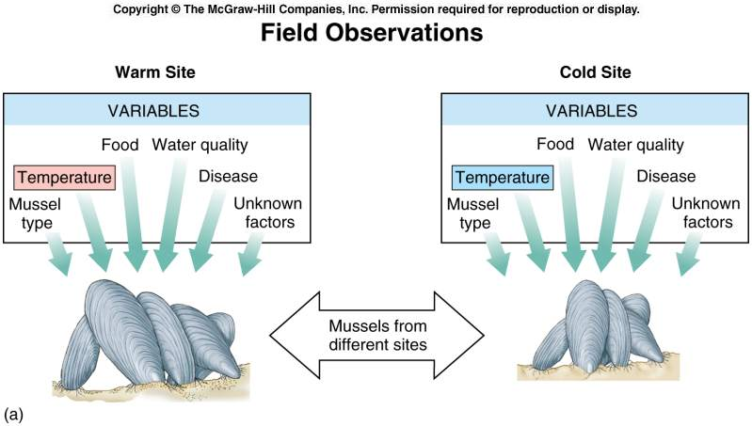

Slide 23
Collect and Analyze Results
Data can be qualitative or quantitative
Qualitative data describes qualities or characteristics (Ex: curliness of salamander tails)
Quantitative data describes numbers or amount (Ex: time required to walk home)
Modify the procedure if needed.
Confirm the results by retesting.
Include tables, graphs, and photographs.

Slide 24
Data
In your INB, list:
3 examples of QUANTITATIVE data
3 examples of QUALITATIVE data

Slide 25
Conclusion and Retesting
After an experiment, scientists write a conclusion which summarizes their experiment and results
Include a statement that accepts or rejects the hypothesis.
Make recommendations for further study and possible improvements to the procedure.
Sometimes scientists make mistakes or errors and need to repeat experiments. It is always a good idea to retest 3 times.
Remember: Your hypothesis is NEVER “wrong”, it either supported or not supported by the data from your experiment

Slide 26
Communicate the Results
Be prepared to present the project to an audience.
Expect questions from the audience.

