Slide 1
The Science of Marine Science
Ms. Carlson
Marine Science Honors

Slide 2
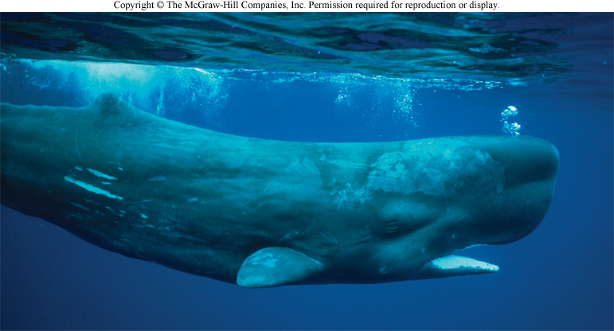
Marine Biology
Definition: is the scientific study of the plants, animals, and other organisms that live in the ocean.
Marine Science
Definition: The study of the ocean, its ecosystems, and life forms

Slide 3
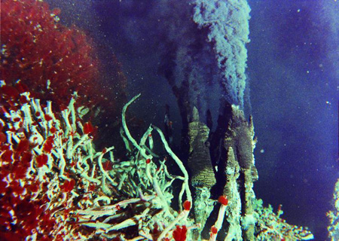
Marine biology incorporates many other sciences as well such as:
Geology
Chemistry
Physics
Meteorology
Zoology
Oceanography
Notes:
Oceanographers study the physical aspects of the ocean including tides, currents, waves and the chemical make-up of seawater. (non-living environment)

Slide 4
Why study Marine Science/Biology?
Studying marine life forms can provide clue about early life on earth.
Many products come from the sea including.
Medicines
Food (fisheries)
Clothing
Agar
Building material

Slide 5
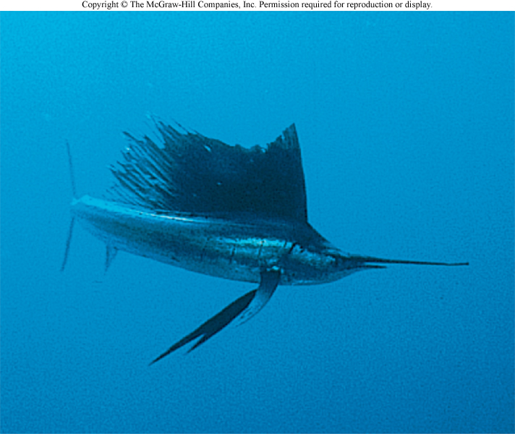
3. The marine environment and its habitats support recreation and tourism worldwide.
4. Marine organisms produce oxygen used by aerobic organisms, including humans.
5. Oceans help to regulate climate.

Slide 6
6. Marine organisms can cause problems directly to human life or their property.
7. Humans impact the health of the oceans:
Sea level rise
Marine pollution
Coral bleaching
Depletion of fisheries

Slide 7
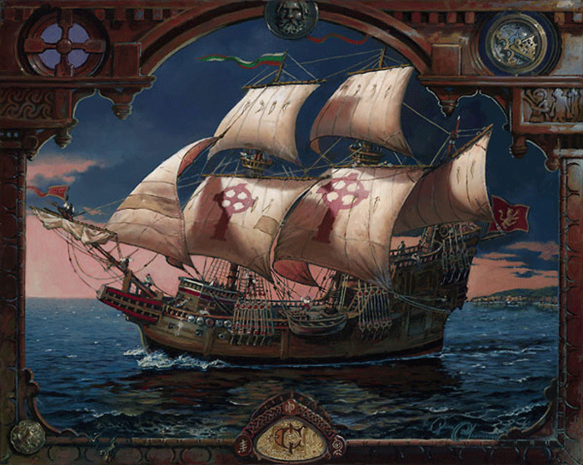
Marine Biology History
Explorers:
Vikings
Phoenicians
Polynesians
Columbus
Magellan
Cook

Slide 8
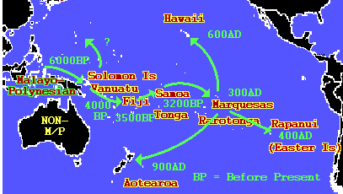
Marine Biology History
Pacific Islanders had strange three dimensional maps of the Pacific Ocean made of shells and sticks.
Phoenicians were the first accomplished Western navigators. By 2000 B.C. they were sailing around the Mediterranean Sea, Red Sea, eastern Atlantic Ocean, and Indian Ocean.

Slide 9
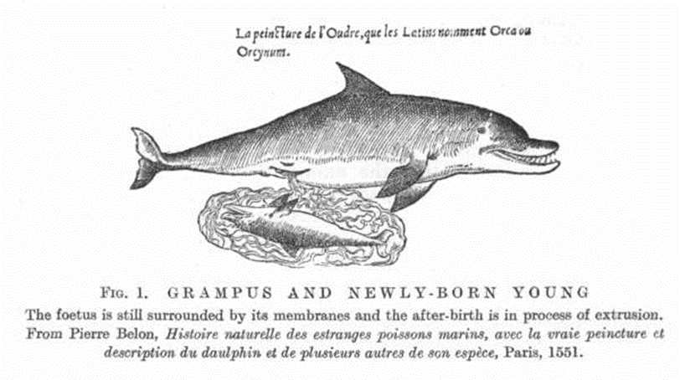
Aristotle (384-322 B.C.)
Scientific method (observation, inductive reasoning)
Described hundreds of marine species
Dolphin is a mammal
The earth is round
Biology (spontaneous generation)
Notes:
Aristotle excelled at marine biology and identified 500 different species of sea life.
Determined a dolphin was a mammal
Aristotle became a teacher in a school on the coast of Asia Minor. He spent two years studying marine biology on Lesbos. In 342 BC, Philip II invited Aristotle to return to the Macedonian court and teach his 13-year-old son Alexander.
that specific references to marine life were recorded. Aristotle identified a variety of species including crustaceans, echinoderms, mollusks, and fish. He also recognized that cetaceans are mammals, and that marine vertebrates are either oviparous (producing eggs that hatch outside the body) or viviparous (producing eggs that hatch within the body). Because he is the first to record observations on marine life, Aristotle is often referred to as the father of marine biology.
Written records of significant biological observations concerning marine organisms began with the early Greek philosophers, most notably Aristotle. Aristotle (384-322 BC) was the most famous student of Plato's. Plato considered intuition as the basis of knowledge. Aristotle, however, disagreed with his teacher and the Platonic school, and felt that accurate observation and description of nature, as well as inductive reasoning and interpretation, were the only way to advance understanding of the natural world. Thus although Aristotle made many observations that were relatively accurate, his greatest contribution to science was his approach, which was the forerunner of the modern scientific method. More remarkably, Aristotle had no real teachers, predecessors, or body of scientific knowledge to build on, - he was literally the first (of record) to begin such studies, thus earning the title of "Father of Natural History". He himself was quite aware of his position as one of the first of his kind, and also of the humble nature of these first studies, - he wrote:
" I found no basis prepared; no models to copy... Mine is the first step, and therefore a small one, though worked out with much thought and hard labor. It must be looked at as a first step and judged with indulgence." Aristotle made a number of important contributions to oceanography and marine biology. The second book of his Meteorology begins with what is essentially a treatise on oceanography. He regarded the earth as a sphere (contrary to the popular view at the time that the earth was circular), since things gravitated towards the center, and because of the shadow cast by the earth during eclipses. Aristotle was also the first to record speculations about the bathymetry of the various seas. He also recognized that the seas and continents are slowly changing through time, remarking that the Sea of Azov was slowly filling and would eventually become land. Aristotle also described and named 24 species of crustaceans and annelid worms, 40 species of molluscs and echinoderms, and 116 species of fish (all from the Aegean Sea). He recognized cetaceans (dolphins, whales, etc.) as mammals, and accurately described many groups of vertebrates as oviparous or viviparous.

Slide 10
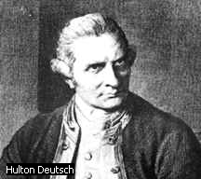
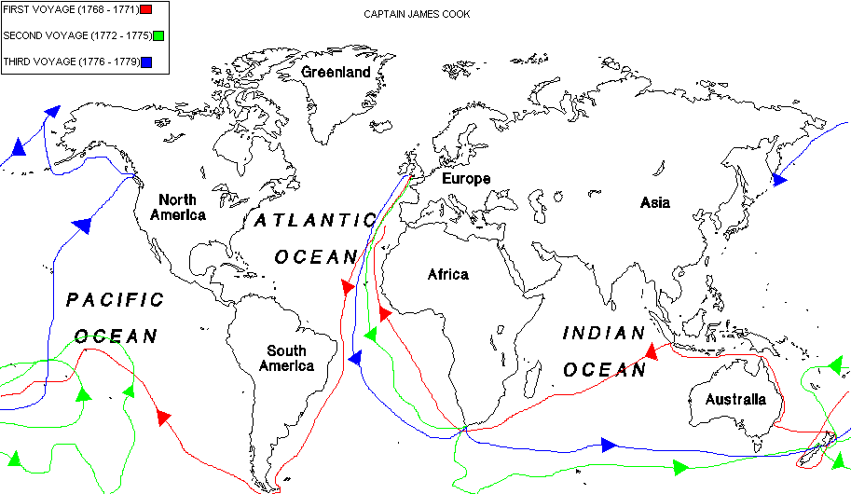
Cook (1700’s)- sailed twice around the world 1st European to visit Hawaii
One of the first to make scientific observations along his journey and to include a full time naturalist among his crew.

Slide 11
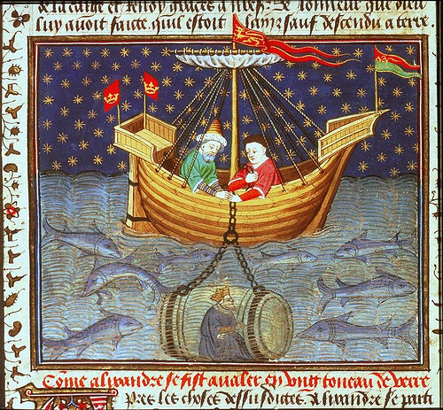
Notes:
This image shows Alexander being lowered into the sea in a glass barrel to observe marine life (Aristotle's influence, perhaps?) From the old French prose Alexander Romance manuscript, Rouen, 1445

Slide 12
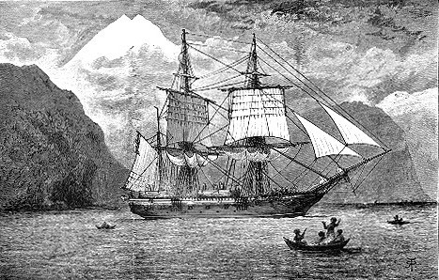
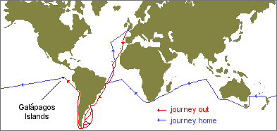
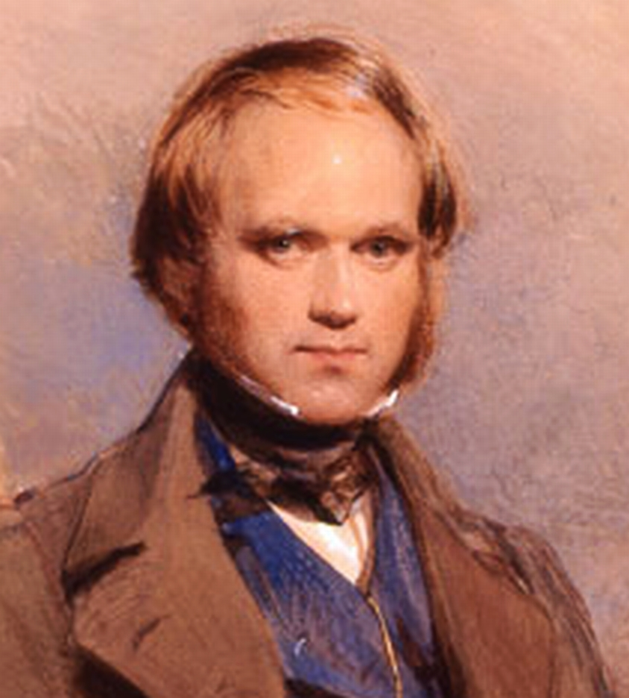
Voyage of the HMS Beagle
Darwin (1831):
Subsidence theory of coral reef formation (atolls) & origin of species
Notes:
The primary mission of the Beagle was to map the coastline of southern South America and take oceanographic measurements (currents, bathymetry, etc) as well. Darwin's job as ship's naturalist was to observe everything, write it all down and collect as many specimens as possible. It was his job to record the weather, geological features, plants, animals, fossils, rocks, minerals, indigenous people and anything else that he saw. Specimens had to be packed and labeled very carefully. In preparing for the voyage, Darwin made a list of things that he would need, including 12 new shirts and other clothing; slippers; light walking shoes; a folding, portable dissecting microscope; a geological compass; a case of pistols and a rifle; a Spanish-English dictionary; a book on taxidermy; reading material (Humboldt and Milton); his favorite geology text, Lyell's Principles of Geology; a Bible; a pair of binoculars; a magnifying glass; and jars of "Spirit" (probably alcohol) for preserving specimens. (I wonder what his dad thought of that list...Thanks, Dad!)
Like any expedition, there were space limitations. The Beagle was not an exceptionally large vessel by any means. Measuring only ninety feet in length, she carried a crew of 74 people, "including the Captain, three officers, the crew, a doctor, an artist, and the naturalist. Darwin shared the poop cabin (at the back of the ship) with two officers. Their space was so cramped that Darwin had to remove a drawer each night so that he would have room for his feet."
David Likely tells the story of how the ship's Captain Robert Fitzroy almost refused to let Darwin sail because his nose did not appear to be that of a man with character. Darwin had to get testimonials that he was suitable for dining at the Captain's dinner table. Apparently, Darwin and the Captain, a fundamentalist Christian, didn't always see eye to eye (Darwin was once banned from the dinner table for several days), which has led some to speculate that this relationship even further hardened Darwin against religion.
After more than two months delay (the ship was to leave October 24, 1831), the ship attempted a departure on December 10 but ran into bad weather. Finally, on December 27 at 2:00 pm, Darwin and the Beagle left Plymouth harbor on what was to become most revolutionary oceanographic expedition of our time.
Immediately upon sailing, Darwin's enthusiasm for the voyage was severely dampened by sea-sickness. He writes:
"...the misery I endured from sea sickness is far beyond what I ever guessed at. The real misery only begins when you are so exhausted that a little exertion makes a feeling faintness come on -- I found that nothing but lying in my hammock did any good.
Three and a half weeks later, on January 16 1832, they reached the Cape Verde Islands off the coast of south Africa. It was here that Darwin's innate ability to observe in great detail and think "large" began to assert itself. In St. Jago, he correctly surmised the African origins of dust that created the hazy atmosphere of the islands, he wrote about "reckless destruction" of the forests and offered the following observations on octopus:
I was much interested by watching the habits of an Octopus, or cuttle-fish. By means of their long arms and suckers, they could drag their bodies into very narrow crevices; and, when thus fixed, it required great force to remove them. These animals escape detection by a very extraordinary, chameleon-like power of changing their color. They appear to vary their tints according to the nature of the ground over which they pass. These changes were affected in such a manner that clouds, varying in tint were continually passing over the body. Any part, being subjected to a slight shock, became almost black.
While not the first to observe cephalopod chromatophores, the detail with which he describes them belies his fascination with nature. Indeed, the enthusiasm with which he carried out his observations and collections can be found in his diary entries upon exploring South America:
I have been wandering by myself in the Brazilian forest: amongst the multitude it is hard to say what set of objects is most striking; the general luxuriance of the vegetation bears the victory, the elegance of the grasses, the novelty of the parasitical plants, the beauty of the flowers, the glossy green of the foliage, all tend to this end...To a person fond of Natural History such a day brings with it pleasure more acute than he ever may again experience" [Barlow 1933: 39-40]. And the next day, "I can only add rapture s to the former raptures" [Barlow 1933: 40].[Journal of Syms Covington, Darwin's assistant]
Overtaken with such "treasures", Darwin felt that he needed an assistant. He got permission to hire Syms Covington, the ship's "fiddler and boy to the poop cabin" [where the officers lived], who helped with the time-consuming task of cataloguing and shipping Darwin's specimens. Covington kept his own journal [Journal of Syms Covington] which offers interesting reading about Darwin and his relationship with others on board.

Slide 13
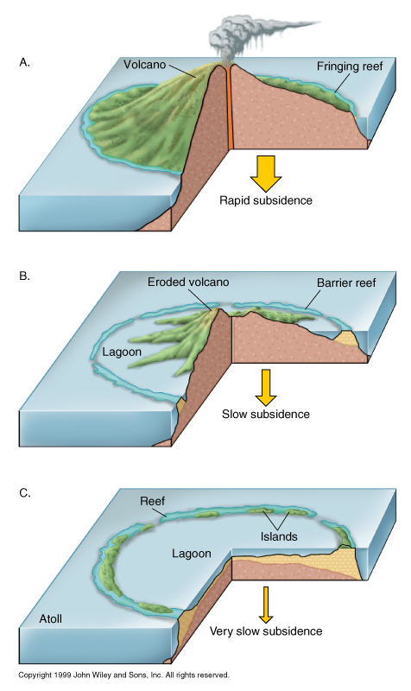
Darwin’s Theory of Coral Atoll Formation: Subsidence Theory
Fringing Reef- boarders coastline closely
Island subsides
Barrier Reef- separated from
land by a lagoon
Atoll- coral ring with central lagoon
lagoon is a shallow area with a sandy floor, patch reefs, and patches of seagrass

Slide 14
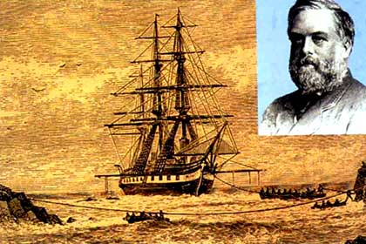
Voyage of the HMS Challenger (1872-1876)
collected thousands of biological and sea bottom samples
traveled in every ocean except arctic
cruise directed by Charles Wyville Thompson
362 stations, 715 new genera, 5000 new species
discovered Mariana Trench and Mindarniad (34,000 ft deep)
Notes:
On 21 December 1872 the 2306 ton steam assisted corvette HMS Challenger sailed from Portsmouth on a 3-year voyage of marine exploration which laid the foundations of almost every branch of oceanography as we know it today.
Her naval complement was headed by Captain G S Nares, an experienced survey officer, while the Director of her scientific staff was Charles Wyville Thomson, Professor of Natural History at the University of Edinburgh. These two men were responsible for an extremely wide-ranging programme of research into the physical and biological characteristics of the deep sea, for when the Challenger sailed the scientific investigation of the open oceans had hardly begun and many basic questions were still unanswered. What was the nature of the animal life in the very greatest depths? Indeed, did animals exist at all over wide areas of the sea bed? (Only a few years previously it had been widely assumed that life was untenable in the perpetual darkness, enormous pressures and intense cold of the abyssal depths.) What was the shape of the bottom of the great ocean basins, the composition of the bottom sediments and their source? And what of the sea water itself? Would a knowledge of its temperature variation with depth as well as its specific gravity give clues to the nature and causes of the complex system of sub-surface currents of which scientists were becoming aware?
To enable her to probe into these and many other problems, Challengers guns had been removed, her spars reduced, and laboratories, extra cabins and a special dredging platform installed. She was loaded with thousands of specimen jars, alcohol for preservation, microscopes and chemical apparatus, trawls and dredges, thermometers and water sampling bottles, sounding leads and devices to collect sediment from the deep sea bed and great lengths of rope with which to suspend the equipment into the ocean depths. In all she was supplied with the staggering total of 181 miles of best Italian hemp for sounding, trawling and dredging.
During the 68890 mile voyage the naval staff was responsible for taking a wide variety of magnetic and meteorological observations, and for the actual working of the sampling gears at the 354 official stations where the vessel stopped to make detailed studies. The work of the scientists, or 'philosophers' as they were nicknamed aboard, began with the arrival of the samples on deck. The water samples were examined by the chemist, John Young Buchanan, while the contents of the nets and dredges were the responsibility of Wyville Thomson and his three young naturalist assistants. All of the naturalists were involved in the documentation of the thousands of samples and their preparation for dispatch back home, but they also had their own particular research interests. H N Moseley, for instance, took particular interest in the corals and sea squirts, the young German, Rudolf von Willemoes Suhm, was mainly concerned with the crustaceans, while John Murray dealt with the pelagic organisms and the ocean deposits. The final member of the civilian staff, the Swiss J. J. Wild, acted as secretary to Wyville Thomson and artist to the expedition.
The voyage was an orderly and unhurried affair, with the ship proceeding mainly under sail at the somewhat matronly rate of about 100 miles a day, generally using her engine only to maintain position when she stopped to work a station every two or three days. For the period, the expedition was also a very healthy one, for only 10 fatalities occurred amongst the total complement of 243 during the whole voyage. One of these was Willemoes Suhm's tragic death from erysipelas while the ship was in the Pacific.
But they lost a further 61 ratings through desertion, evidently caused in part by a desire for a cheap passage to Australia as well as by the arduous and tedious routine of the sounding and dredging operations which often took many hours. The ratings were not the only ones affected, for many of the officers became discontented with their lot long before the voyage was over, and even amongst the scientists only Wyville Thomson seems to have retained his enthusiasm to the end.
Yet the expedition was not all tedium, for of the 1281 days spent away from home, 568 were spent in harbours in all quarters of the world. During these shore breaks the officers and scientists made extensive zoological, geological and ethnological collections and socialised with all manner of 'locals' ranging from the King of Portugal to recently cannibalistic Fijian natives!
By the time the ship returned to Spithead in May 1876, the expedition had already provided answers to some of the significant oceanographic questions which had been posed at the outset. There was now a much clearer idea of the form of the great ocean basins down to the greatest depth sounded at 4475 fathoms, including the important discovery of a submarine ridge running the length of the Atlantic Ocean. The varying types of sea-bed samples had been classified and it had been conclusively demonstrated that the deep-sea oozes were made up of the skeletons of tiny organisms which lived in the upper layers of the sea rather than on the bottom, a subject which had caused considerable controversy during the decade before the Challenger sailed. Ample evidence had been obtained of the existence of a rich and varied fauna in the very deepest regions, although there was no evidence that the ocean depths were occupied by 'living fossils' as some biologists had expected.
These results were apparent from the relatively cursory investigations which had been carried out on board, but the detailed examination of the massive collections of animals and plants, water and sea-bed samples, and of the vast quantities of numerical data had still to be accomplished. The mammoth task of organising the distribution of the material to the scientists who were to work on it and the publication of the results initially fell to Wyville Thomson. This involved him in a series of acrimonious exchanges with many individuals and institutions, including the Trustees of the British Museum who demanded that the specimens should go directly to the national collection instead of being separately distributed from an office in Edinburgh as Wyville Thomson wished. With the aid of the Royal Society Thomson eventually won this tussle, but the strain of the responsibility of establishing a style for the publication of the official reports with opposition from those who did not understand the requirements for accurate scientific investigations and illustrations, as well as the rigid accountability forced upon him, proved too much for his highly strung but unmethodical nature. He broke down first in 1879, and in 1881 when the initial five year grant from the Treasury came to an end he collapsed, resigned his professorship, and took to his bed to die in 1881. The reins were taken up by John Murray under whose forceful leadership the publication of the results was finally completed in 1895, almost a quarter of a century after the ship set sail. The fifty thick royal quarto tomes of the report, containing 29552 pages, were written by an international galaxy of scientists and many of these reports still form a starting point for specialist studies in oceanography. Similarly, many of the original samples on which the reports were based, including nearly 4000 new species of animals taken by the trawls and dredges, are still referred to by scientists from a11 over the world.
The reports were the tangible evidence of the achievements of the Challenger venture, but perhaps of much greater importance in the long term was the co-operation between scientists of many countries, inspired by Wyville Thomson's leadership, which set the young science of oceanography on the path to becoming the truly international discipline that it is today.
Postscript HMS Challenger's foray into oceanography interrupted an otherwise unremarkable career. In 1862 she had taken part in operations against Mexico, including the occupation of Vera Cruz, but otherwise the only action which she saw seems to have been a punitive operation in 1866 against some Fijian natives to avenge the murder of a missionary and some of his dependents. After her three years of glory, her fate was even more ignominious. Commissioned as a Coast Guard and Dril1 ship of Naval Reserves at Harwich in July 1876, she was finally paid off at Chatham in 1878. She remained in reserve until 1883, when she was converted into a receiving hulk in the River Medway, where she stayed until she was finally broken up for her copper bottom in 1921. Despite the great excitement which surrounded her middle years, virtually nothing, apart from her figurehead, now remains. This is on display in the foyer of Southampton Oceanography Centre.

Slide 15
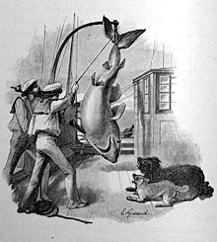
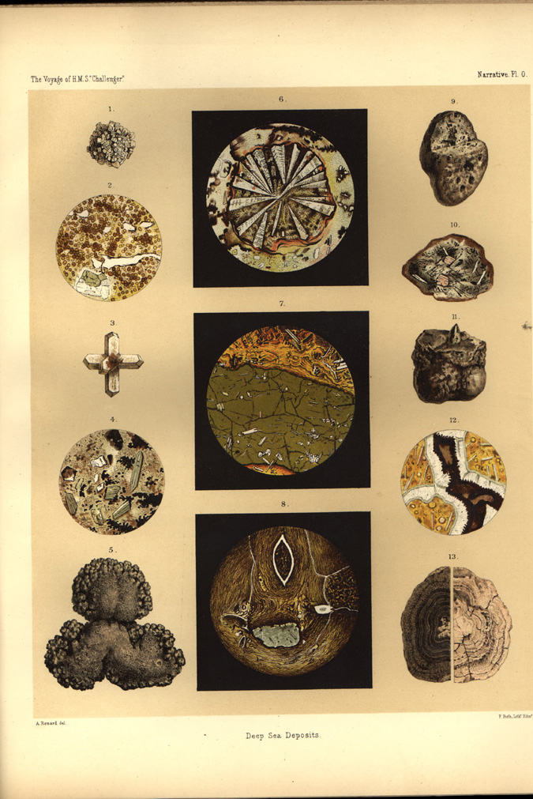
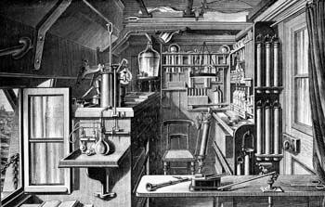
Voyage of the HMS Challenger (1872-1876)
Deep sea Collections
HMS Challenger's Chemical Laboratory
Notes:
During the 68890 mile voyage the naval staff was responsible for taking a wide variety of magnetic and meteorological observations, and for the actual working of the sampling gears at the 354 official stations where the vessel stopped to make detailed studies. The work of the scientists, or 'philosophers' as they were nicknamed aboard, began with the arrival of the samples on deck. The water samples were examined by the chemist, John Young Buchanan, while the contents of the nets and dredges were the responsibility of Wyville Thomson and his three young naturalist assistants. All of the naturalists were involved in the documentation of the thousands of samples and their preparation for dispatch back home, but they also had their own particular research interests. H N Moseley, for instance, took particular interest in the corals and sea squirts, the young German, Rudolf von Willemoes Suhm, was mainly concerned with the crustaceans, while John Murray dealt with the pelagic organisms and the ocean deposits. The final member of the civilian staff, the Swiss J. J. Wild, acted as secretary to Wyville Thomson and artist to the expedition.
The voyage was an orderly and unhurried affair, with the ship proceeding mainly under sail at the somewhat matronly rate of about 100 miles a day, generally using her engine only to maintain position when she stopped to work a station every two or three days. For the period, the expedition was also a very healthy one, for only 10 fatalities occurred amongst the total complement of 243 during the whole voyage. One of these was Willemoes Suhm's tragic death from erysipelas while the ship was in the Pacific.
But they lost a further 61 ratings through desertion, evidently caused in part by a desire for a cheap passage to Australia as well as by the arduous and tedious routine of the sounding and dredging operations which often took many hours. The ratings were not the only ones affected, for many of the officers became discontented with their lot long before the voyage was over, and even amongst the scientists only Wyville Thomson seems to have retained his enthusiasm to the end.
Yet the expedition was not all tedium, for of the 1281 days spent away from home, 568 were spent in harbours in all quarters of the world. During these shore breaks the officers and scientists made extensive zoological, geological and ethnological collections and socialised with all manner of 'locals' ranging from the King of Portugal to recently cannibalistic Fijian natives!
By the time the ship returned to Spithead in May 1876, the expedition had already provided answers to some of the significant oceanographic questions which had been posed at the outset. There was now a much clearer idea of the form of the great ocean basins down to the greatest depth sounded at 4475 fathoms, including the important discovery of a submarine ridge running the length of the Atlantic Ocean. The varying types of sea-bed samples had been classified and it had been conclusively demonstrated that the deep-sea oozes were made up of the skeletons of tiny organisms which lived in the upper layers of the sea rather than on the bottom, a subject which had caused considerable controversy during the decade before the Challenger sailed. Ample evidence had been obtained of the existence of a rich and varied fauna in the very deepest regions, although there was no evidence that the ocean depths were occupied by 'living fossils' as some biologists had expected.
These results were apparent from the relatively cursory investigations which had been carried out on board, but the detailed examination of the massive collections of animals and plants, water and sea-bed samples, and of the vast quantities of numerical data had still to be accomplished. The mammoth task of organising the distribution of the material to the scientists who were to work on it and the publication of the results initially fell to Wyville Thomson. This involved him in a series of acrimonious exchanges with many individuals and institutions, including the Trustees of the British Museum who demanded that the specimens should go directly to the national collection instead of being separately distributed from an office in Edinburgh as Wyville Thomson wished. With the aid of the Royal Society Thomson eventually won this tussle, but the strain of the responsibility of establishing a style for the publication of the official reports with opposition from those who did not understand the requirements for accurate scientific investigations and illustrations, as well as the rigid accountability forced upon him, proved too much for his highly strung but unmethodical nature. He broke down first in 1879, and in 1881 when the initial five year grant from the Treasury came to an end he collapsed, resigned his professorship, and took to his bed to die in 1881. The reins were taken up by John Murray under whose forceful leadership the publication of the results was finally completed in 1895, almost a quarter of a century after the ship set sail. The fifty thick royal quarto tomes of the report, containing 29552 pages, were written by an international galaxy of scientists and many of these reports still form a starting point for specialist studies in oceanography. Similarly, many of the original samples on which the reports were based, including nearly 4000 new species of animals taken by the trawls and dredges, are still referred to by scientists from a11 over the world.
The reports were the tangible evidence of the achievements of the Challenger venture, but perhaps of much greater importance in the long term was the co-operation between scientists of many countries, inspired by Wyville Thomson's leadership, which set the young science of oceanography on the path to becoming the truly international discipline that it is today.
Postscript HMS Challenger's foray into oceanography interrupted an otherwise unremarkable career. In 1862 she had taken part in operations against Mexico, including the occupation of Vera Cruz, but otherwise the only action which she saw seems to have been a punitive operation in 1866 against some Fijian natives to avenge the murder of a missionary and some of his dependents. After her three years of glory, her fate was even more ignominious. Commissioned as a Coast Guard and Dril1 ship of Naval Reserves at Harwich in July 1876, she was finally paid off at Chatham in 1878. She remained in reserve until 1883, when she was converted into a receiving hulk in the River Medway, where she stayed until she was finally broken up for her copper bottom in 1921. Despite the great excitement which surrounded her middle years, virtually nothing, apart from her figurehead, now remains. This is on display in the foyer of Southampton Oceanography Centre.

Slide 16
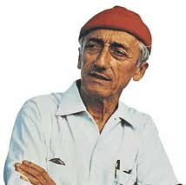
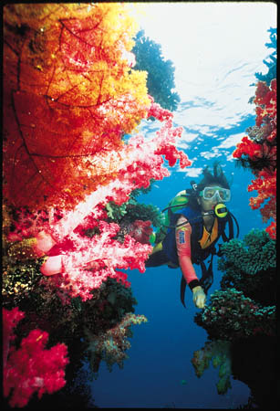
Jacque Cousteau (1910-1997)
Navy officer, explorer, film maker, inventor of scuba (1947)
"From birth, man carries the weight of gravity on his shoulders. He is bolted to the earth. But man has only to sink beneath the surface and he is free.”

Slide 17
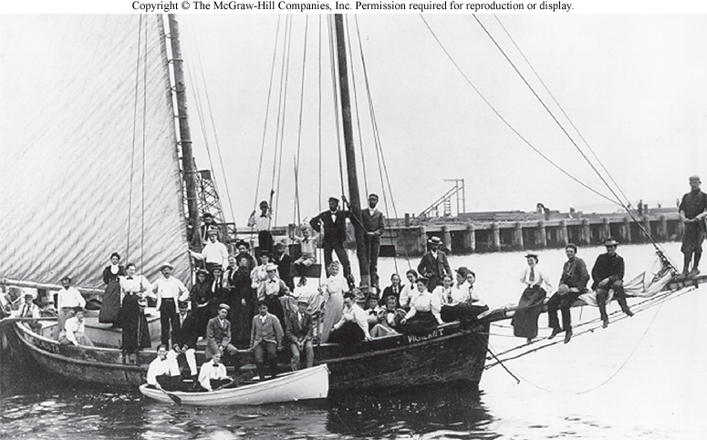
The Growth of Marine Labs
1826: Two Frenchmen pioneer the practice of observing sea life in the controlled conditions of a lab, Henri Milne Edwards, and Victor Andouin.
The laboratory of the Marine Biological Society of the UK was founded in 1879.
The Marine Biological Lab at Woods Hole, Mass. Was founded in 1888.

Slide 18
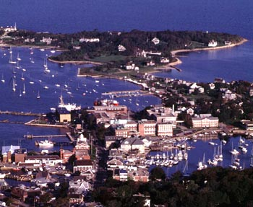
All this science led to the formation of some pretty cool stuff!!!
The Marine Biological Lab at Woods Hole, Mass. Was founded in 1888.
Woods Hole 1888.
Woods Hole, Today

Slide 19
Technology of Marine Biology/Science
Sonar-sound navigation ranging was introduced after World War II as an important tool of marine biology.
Scuba-Invented in 1943 by Jacques Cousteau and Emile Gagnan. It stands for Self Contained Underwater Breathing Apparatus. It is limited to shallow water.
ROVs- Remotely Operated Vehicles. They have greatly extended the depth at which humans can explore the ocean.
Satellites- allow us to track many different conditions within the oceans. Salinity, temp, water clarity, algae growth, and pollution.

Slide 20
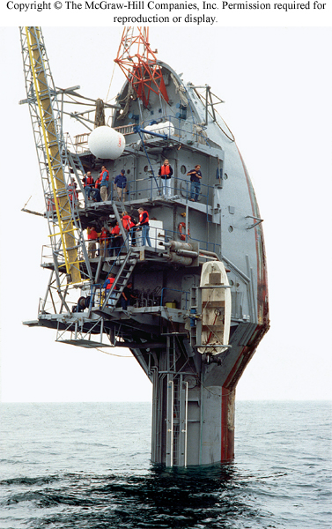
R/V FLIP (floating instrument platform)

Slide 21
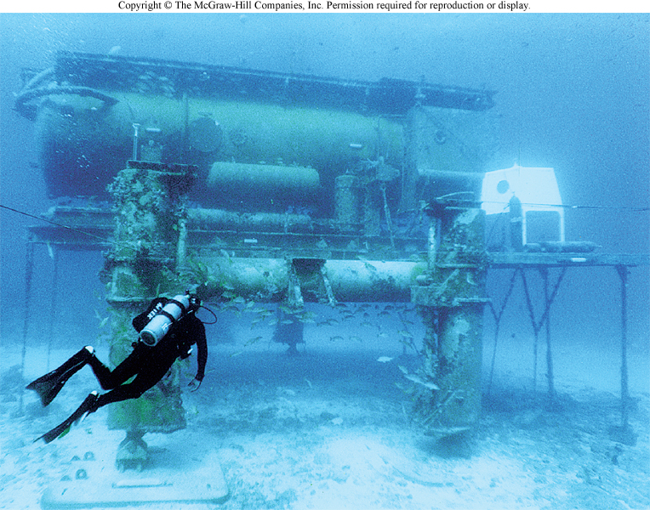

Slide 22
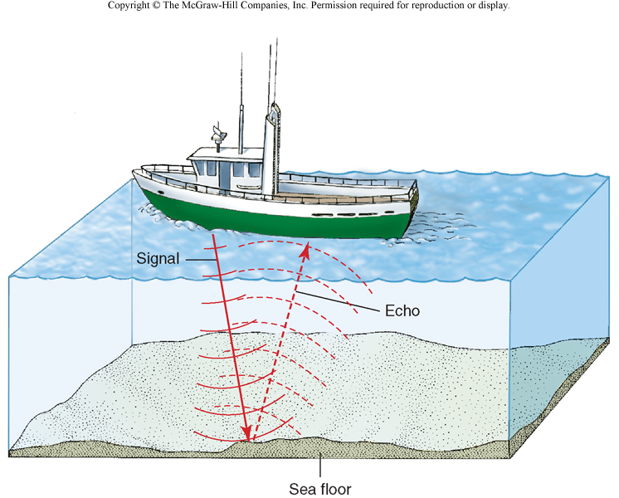

Slide 23
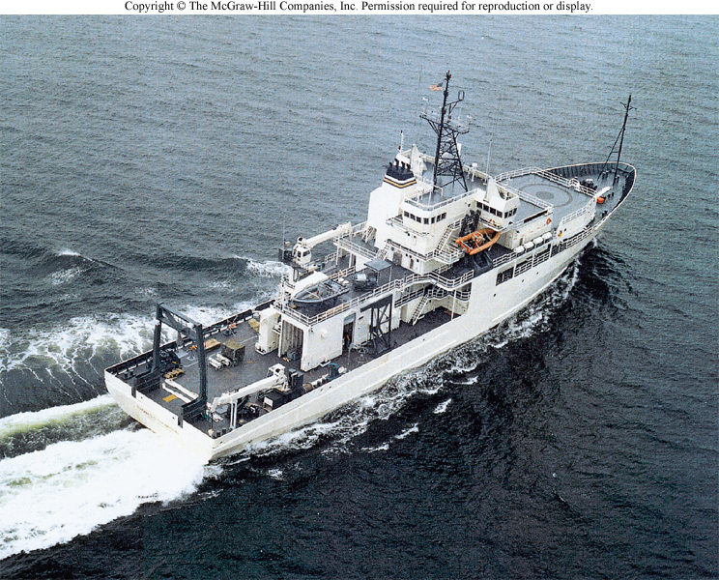

Slide 24
