Slide 1
REVIEW FOR EVOLUTION AND CLASSIFICATION

Slide 2
The Basics
Who is Charles Darwin? What did he do?
  Father of Evolution.
  Wrote Origin of Species
What does his theory explain?
  How modern organisms evolved from a common ancestor

Slide 3
Natural Selection
What is Natural Selection?
  Survival of the Fittest
  The organisms best suited for their environment will be the ones that survive and reproduce
What does it mean to be “fit?”
  To be able to survive and reproduce

Slide 4
Natural Selection
Under what condition does natural selection occur?
  Struggle for existence – individuals produce more offspring than can survive
  Variation and Adaptation
    Natural inheritable variations
    Adaptation – any inheritable variation that increases fitness
  Survival of the Fittest
    There is competition for resources and the best suited to the environment survive and pass on adaptations.

Slide 5
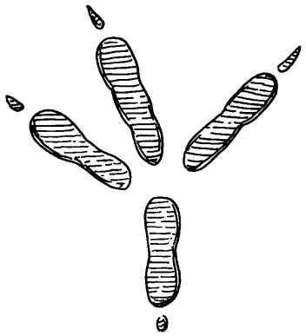
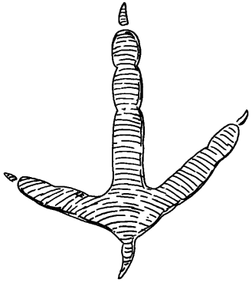
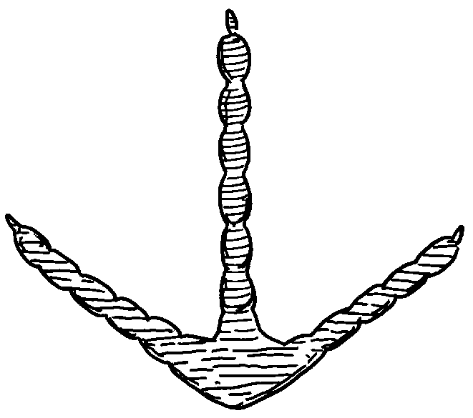
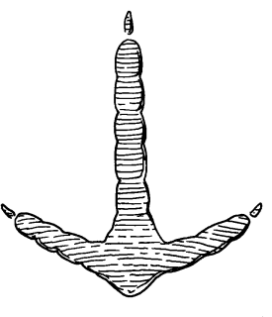
PRACTICE QUESTION
These feet belong to different birds. Three of the birds spend most of their time on the ground, while one bird rarely walks on the ground. Which foot belongs to the bird that is best adapted
for grasping branches?

Slide 6
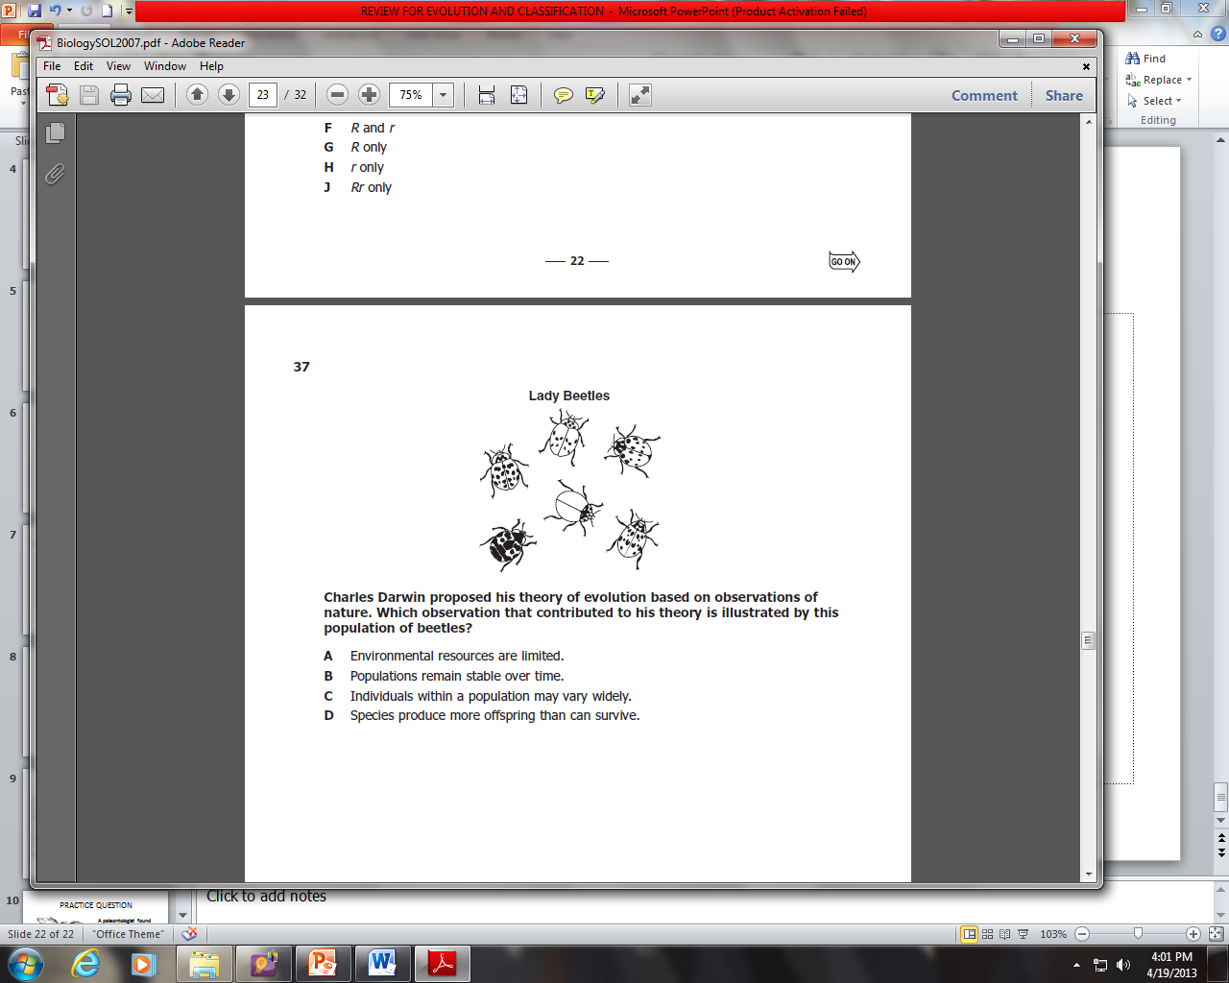
PRACTICE PROBLEMS
Which of the following statements describes the process of natural selection?
A Farmers select animals with desirable
variations for breeding.
B Populations sharing the same gene pool interbreed and create new species.
C Individuals survive that have inherited traits adapted to their environment.
D New species are formed via genetic engineering.
c

Slide 7
PRACTICE PROBLEMS
Bacteria adapt more quickly than elephants to environmental changes. Which
best explains this difference?
F Bacteria reproduce more rapidly.
G Individual bacteria grow more steadily.
H Bacterial populations are more isolated.
J Individual bacteria have more genes.

Slide 8
Evidence for Evolution
List some evidences for evolution
  Biogeography – study of where animals live now and in the past
  Fossils
  Comparative Structures
    Homologous
    Analogous
    Vestigial Structures
  Embryology
  Molecular Biology

Slide 9





Fossils
Give two similarities between each of the skulls that might lead to the conclusion that these are all related species.
Equus (modern horse) | Pilohippus | Merychippus | Mesohippus | Eohippus (Dawn Horse)
Similar jaw shape
Eyes on the same side of the head
Similar shape of skull

Slide 10
PRACTICE QUESTION
Scientists found the fossilized remains of a canine’s jaw and leg. What information must first be obtained before the scientists can place the fossils in the ancestral time line of the dog?
A The rest of the skeleton
B The continent where the fossils were found
C The age of the fossils
D The population trends for the species
Giant fossil ferns have been found in Canada. Which conclusion can be drawn from this discovery?
F Canada once had a much warmer climate.
G Giant dragonflies once lived among the ferns.
H Canada was once covered by an ancient sea.
J Dinosaurs once lived in Canada.

Slide 11
Comparative Anatomy: Let’s compare and contrast homologous structures and analogous structures
Homologous Structures
  Similar structures
  Different Uses
  Shows common ancestor
Analogous Structures
  Different structures
  Similar Uses
  Shows adaptations to environment

Slide 12
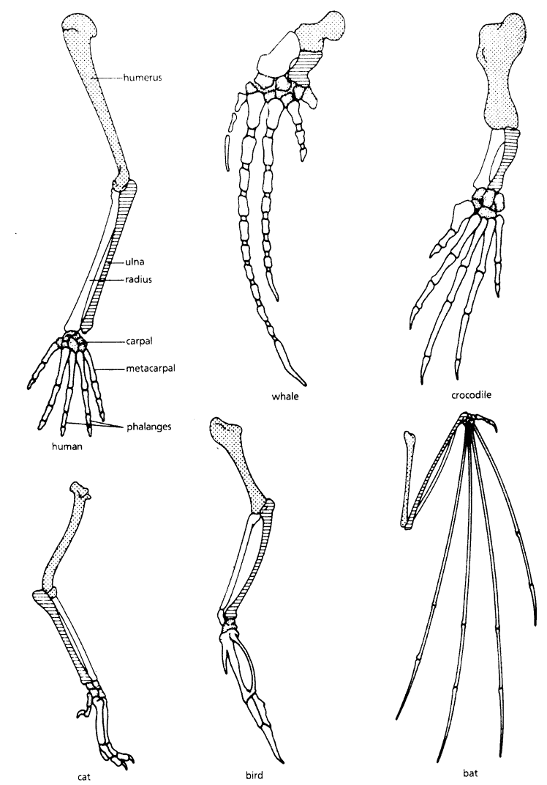
PRACTICE QUESETION
How does comparing the skeletons of these animals provide support for the scientific theory of evolution?
A. It provides information about the organisms’ habitats.
B. It shows possible common ancestry between organisms.
C. It provides information to determine the organisms’ ages.
D. It shows possible chromosomal similarities between organisms
B

Slide 13
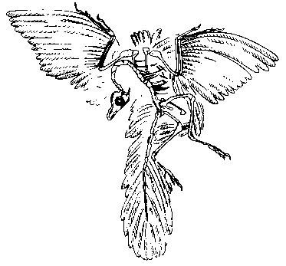
PRACTICE QUESTION
A paleontologist found this fossil. The paleontologist could say that this organism was a
F mammal
G vertebrate
H plant
J protist

Slide 14
EMBRIOLOGY
How does embriology show evidence of evolution?
  There are many similarities in the development of embryos in different species.

Slide 15
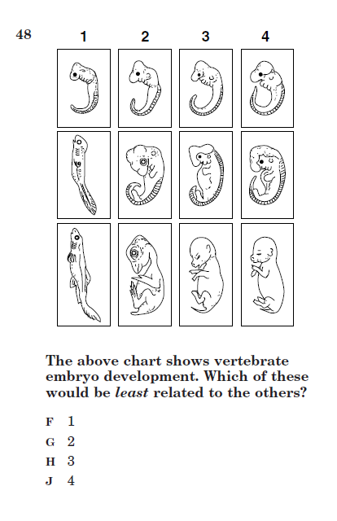
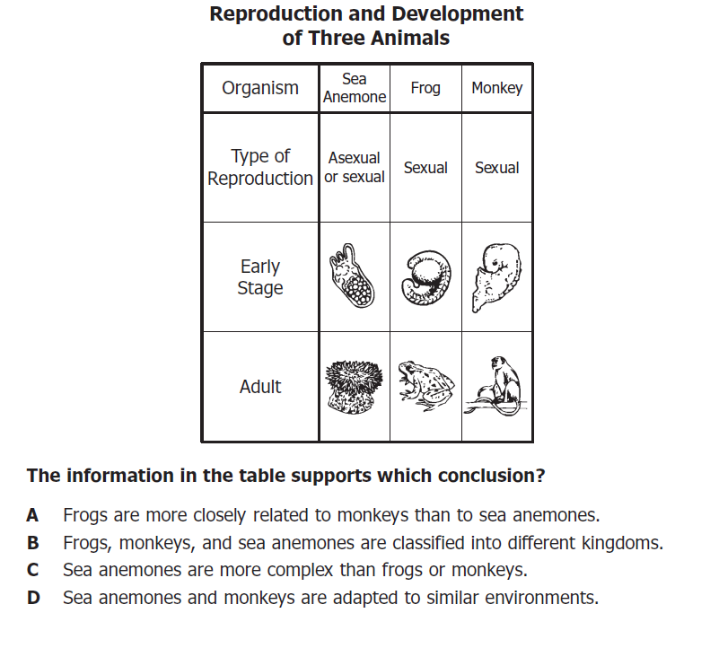
PRACTICE PROBLEMS
1
A

Slide 16
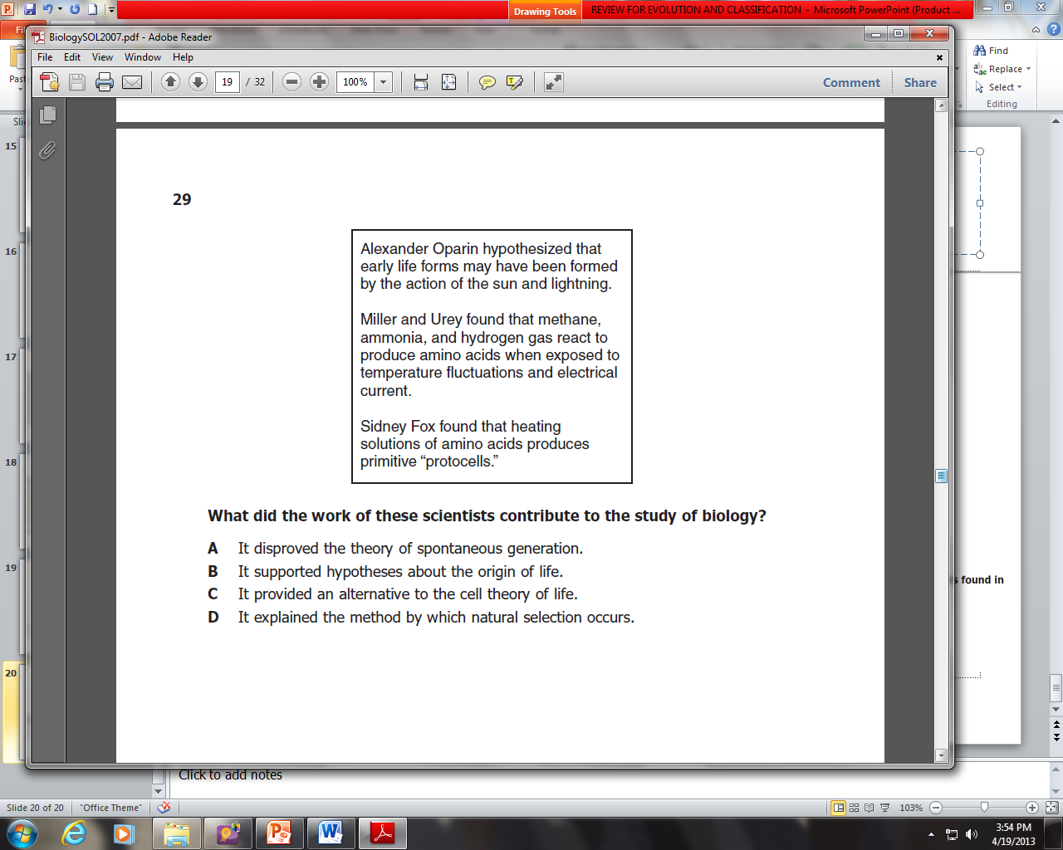
PRACTICE PROBLEMS
Some snake embryos have small buds resembling limbs. These buds disappear at later stages of embryo development. These findings suggest that these snakes —
A had a parent with limbs
B have functional limbs as adults
C will have offspring with limbs
D evolved from an ancestor that had limbs
B

Slide 17
Molecular Biology
How does molecular biology show evidence for evolution?
  There are many, many similarities in the DNA of different species.

Slide 18
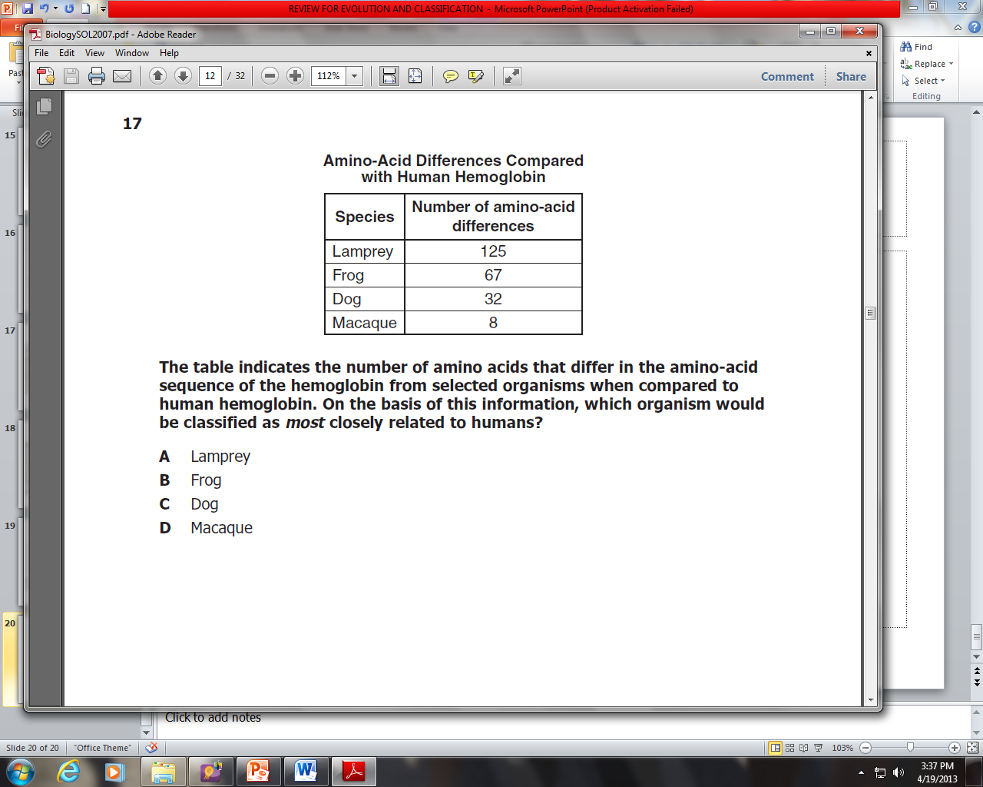
PRACTICE PROBLEMS
Which of the following is evidence to support the idea that two different species might have a common ancestor?
F Their fossils were discovered in the same location.
G Many of their genes are the same.
H Their methods of respiration are alike.
J They use the same means of locomotion.
D

Slide 19
What conditions can cause evolution to occur?
Sexual Selection
Small Population Size
Immigration or Emigration
Mutations
Natural Selection

Slide 20
CLASSIFICATION
What is taxonomy?
  The study of classification systems
What is binominal nomeclature?
  The 2 name system we use for scientific names.
Why do we need scientific names?
  Regional differences in names (an animal having more than 1 name
  Some names refer to more than 1 animal.

Slide 21
Classification
What is the first word in the name?
  Genus
What is the 2nd word in the name?
  Species
What does a dichtomous key do?
  Help you identify organisms.
Genus, Species
Smith, James

Slide 22
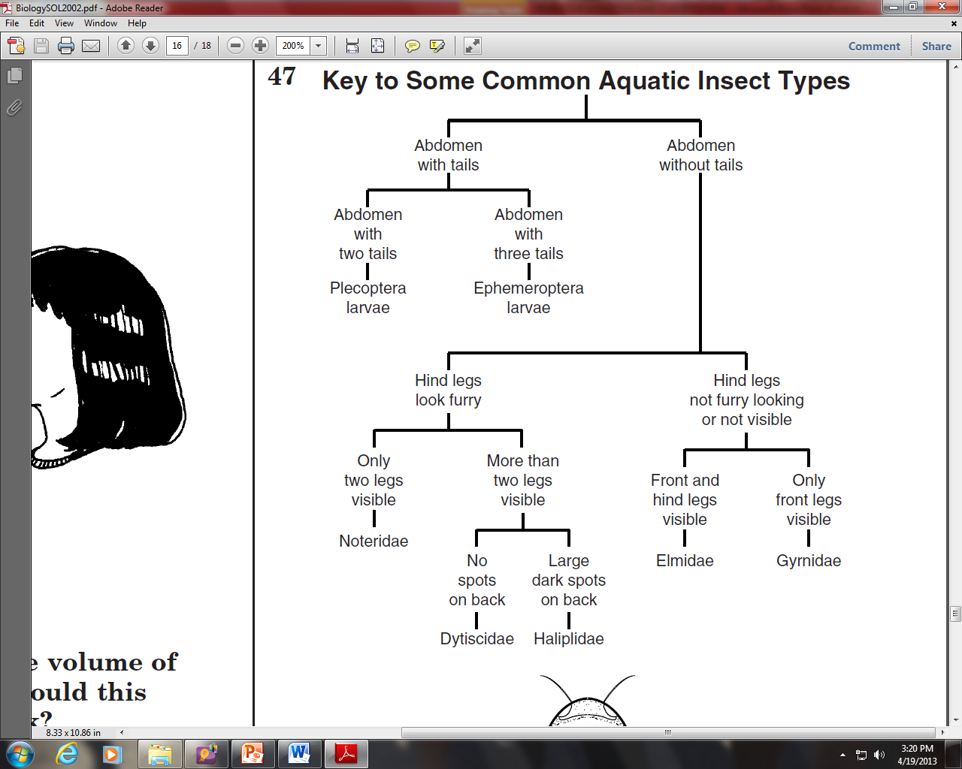
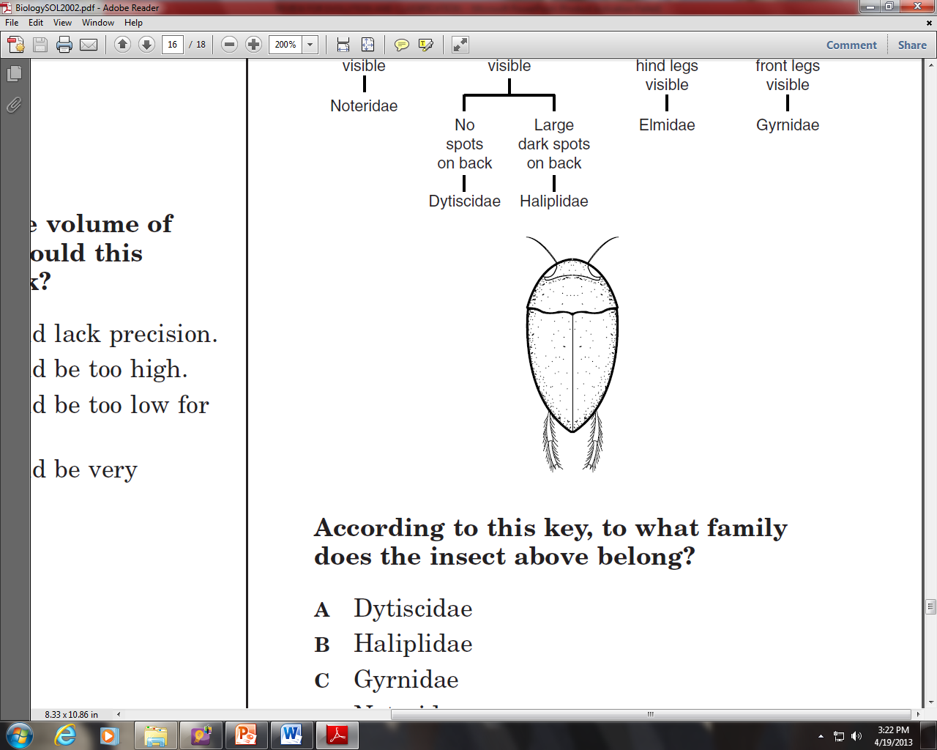
According to this key, to what family does the insect above belong?
A Dytiscidae
B Haliplidae
C Gyrnidae
D Noteridae

Slide 23
PRACTICE QUESTION
Which of these species is most closely related to Felis rufus?
A Acer rubrum
B Selasphorus rufus
C Felis concolor
D Canis rufus
Which of the following would most likely change the current classification of two closely related flower species to a single species?
A The discovery of a new, related species
B An analysis of the DNA sequence of each species
C An analysis of photosynthesis for each species
D The collection of seeds from each species

Slide 24
PRACTICE QUESTION
One of the accepted scientific theories describing the origin of life on Earth is known as chemical evolution. According to this theory, which of the following events would need to occur first for life to evolve?
onset of photosynthesis
origin of genetic material
synthesis of organic molecules
formation of the plasma membrane

Slide 25
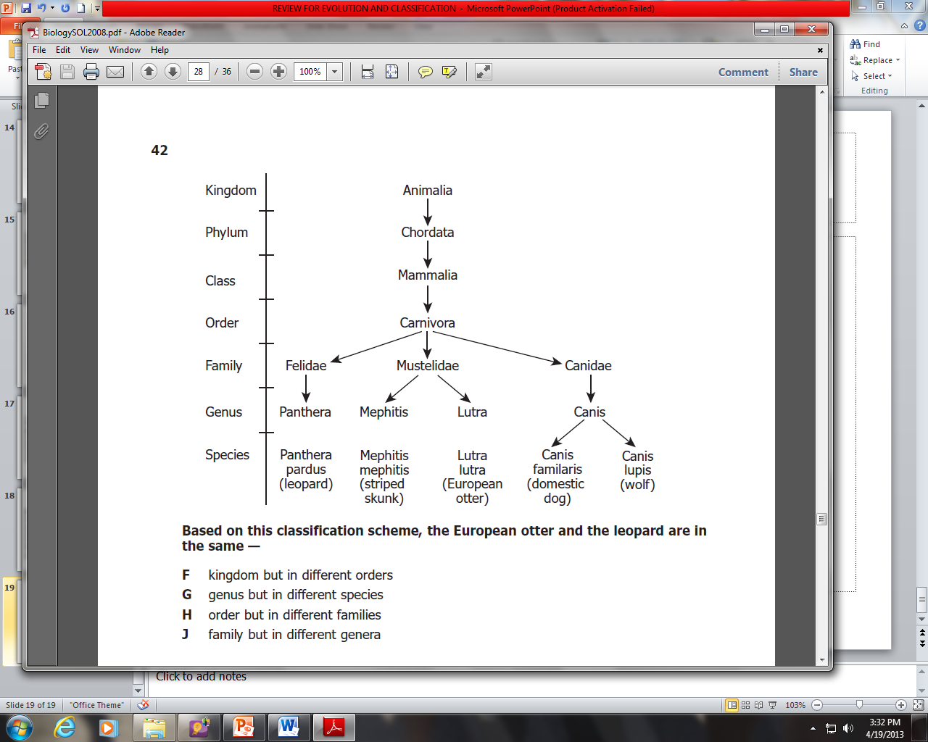
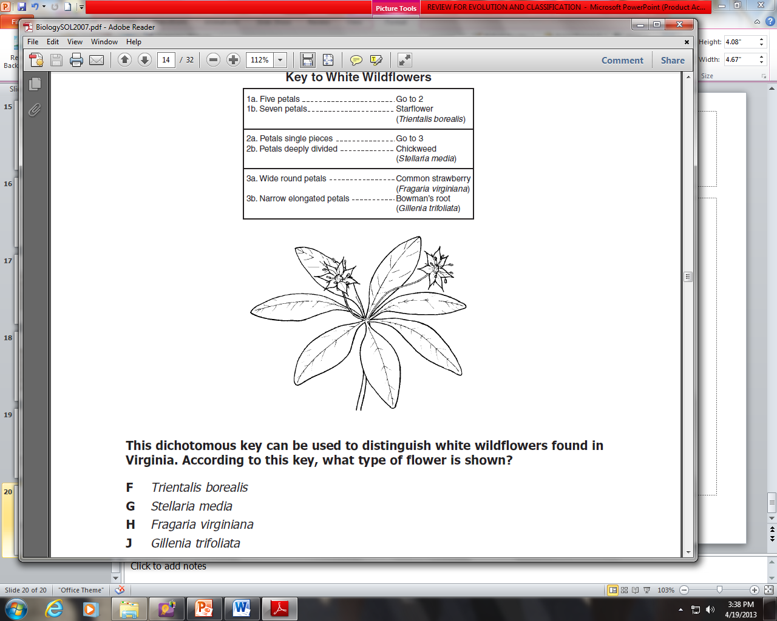
PRACTICE PROBLEMS
J
F

Slide 26
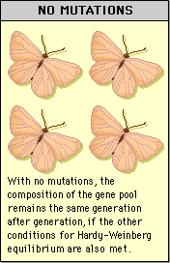
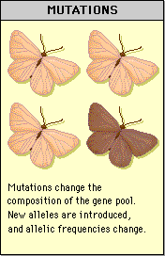
Evolution as Genetic Change in Populations
How does natural selection affect single-gene traits?
  Causes a change in the allele frequencies

Slide 27
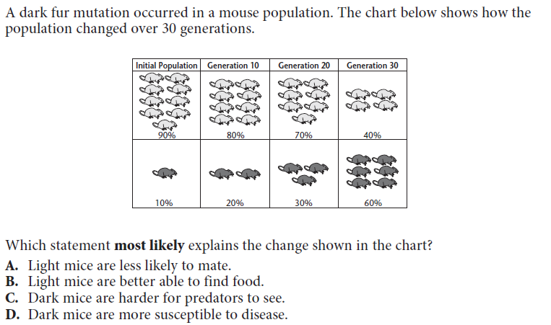
PRACTICE PROBLEMS
C

Slide 28
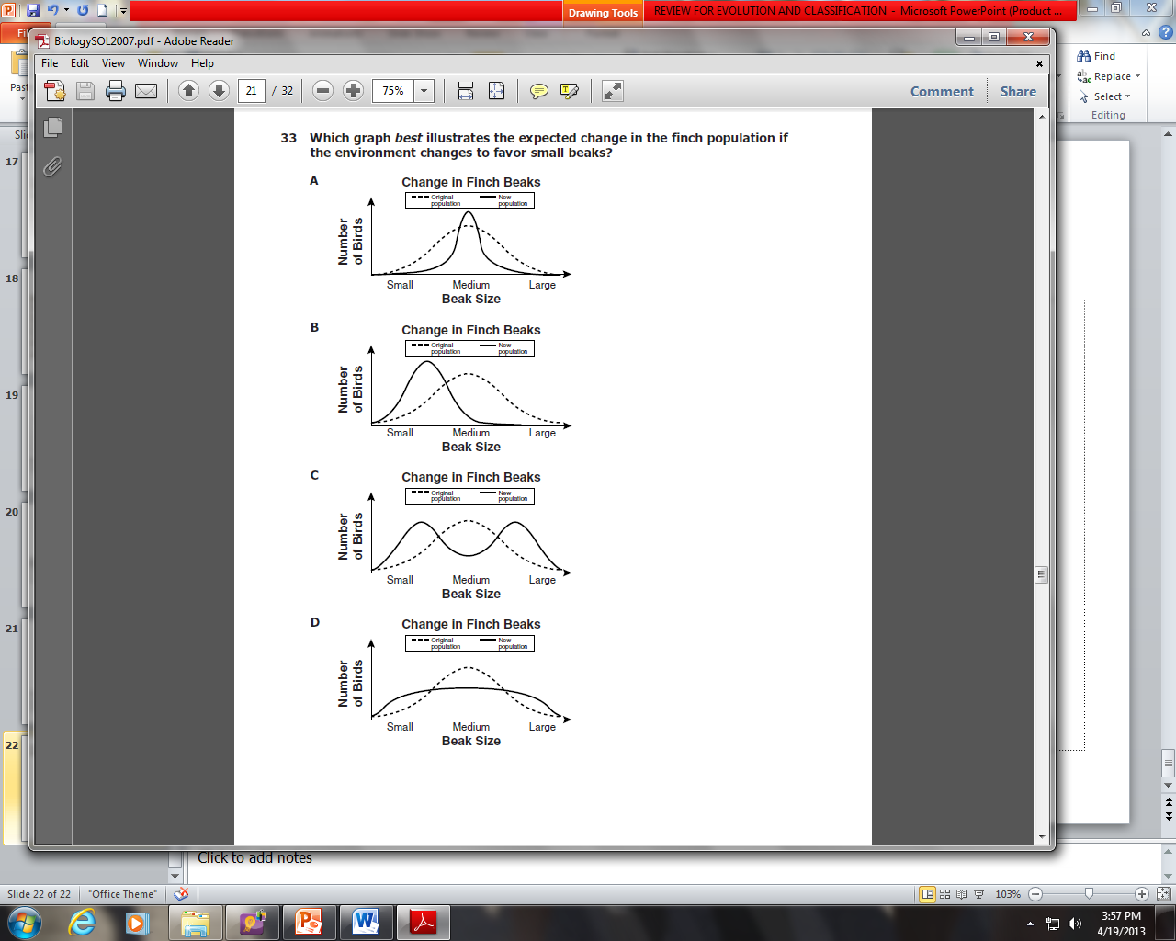
Natural Selection on Polygenetic Traits
What is Directional Selection? What does the graph look like?
  It is where natural selection favors the offspring on one side of the curve.
  It moves the curve (has a dotted line)

Slide 29
Natural Selection on Polygenetic Traits
What is stabilizing selection?
  Natural selection favors the offspring in the middle of the curve
  Ex: birth size in human babies

Slide 30
Natural Selection on Polygenetic Traits
What is disruptive selection?
  Individuals at the ends of the curve have a higher fitness than the individuals in the middle of the curve
  If pressures are strong enough and last long enough, it can cause the curve to split into to different phenotypes

Slide 31
Which graph best illustrates the expected change in the finch population if the environment changes to favor small beaks?

Slide 32
Human Evolution
What is an anthropoid?
  A group of humanlike primates
  Examples include monkeys, great apes, and humans
What are hominoids?
  Great Apes
  Our closest ancestors

Slide 33
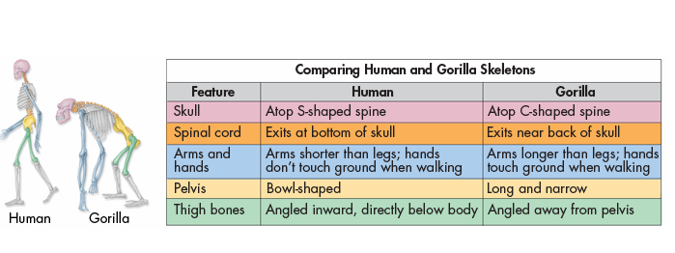
Human Evolution

Slide 34
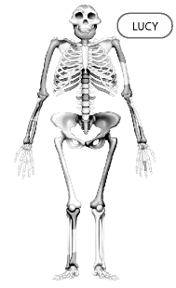
Practice problem
Researchers concluded from the leg bones of the fossil shown in Figure 26–2 that Lucy was bipedal. Which of the following would also indicate that this hominine was bipedal?
broad rib cages
opposable thumbs
skulls with flat faces
bowl-shaped pelvises

Slide 35
Practice problems
Having a thumb that can move against the other fingers makes it possible for a primate to
hold objects firmly.
display elaborate social behaviors.
merge visual images.
judge the locations of tree branches
Suppose a paleontologist discovered a fossil skull that he believes might be distantly related to primates. Unlike true primates, the face is not quite flat and the eyes do not face completely forward. The paleontologist would most likely conclude that the animal lacked
the ability to form extended family groups.
the ability to grip branches precisely.
the ability to manipulate tools.
the ability to judge the location of tree branches.

Slide 36
Human jaw and skull video, if time
<object width="560" height="315"><param name="movie" value="http://www.youtube.com/v/g0D_k4lYrdo?hl=en_US&amp;version=3"></param><param name="allowFullScreen" value="true"></param><param name="allowscriptaccess" value="always"></param><embed src="http://www.youtube.com/v/g0D_k4lYrdo?hl=en_US&amp;version=3" type="application/x-shockwave-flash" width="560" height="315" allowscriptaccess="always" allowfullscreen="true"></embed></object>

