Slide 1
Mitosis and Meiosis EOC Review
Created by L. Skorich

Slide 2
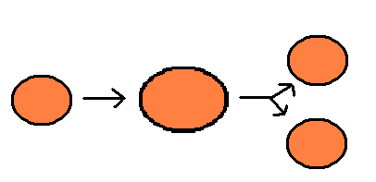
MITOSIS
What is mitosis?
A cell divides to make 2 cells
The 2 new cells are called “daughter” cells
They are both exact copies of the 1st cell.
What type of cells use mitosis?
Unicellular organisms – reproduction
Multicellular organisms – cell reproduction and groweth

Slide 3
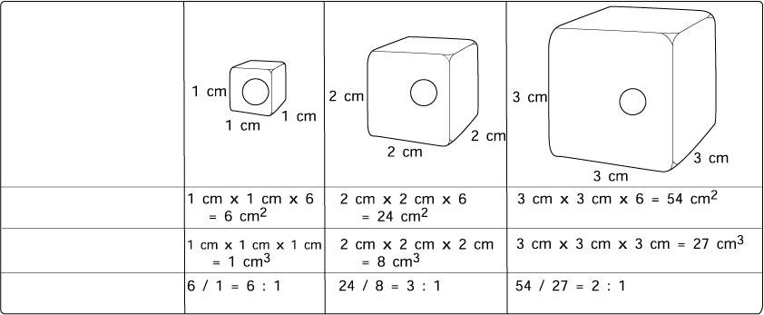
MITOSIS
Why does a cell divide?
DNA overload
Cell transport can’t keep up

Slide 4
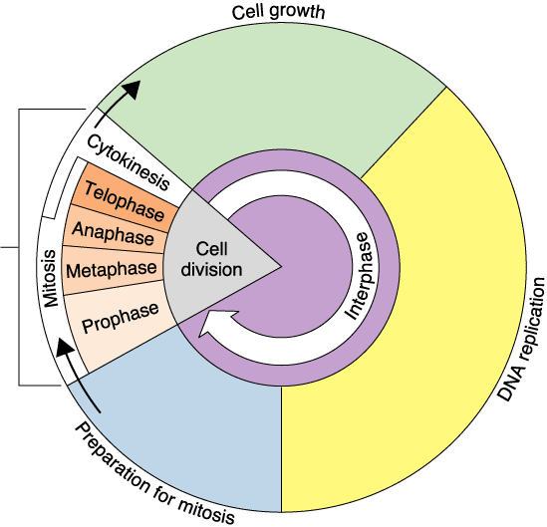
Mitosis – the Cell Cycle
What is the longest part of the Cell Cycle? Why?
Interphase – the cell is doing its job
Which is the shortest?
M phase (mitosis) – the cell is vulerable
What is the difference in CHROMOTIN and CHROMOSOMES?
CHROMOTIN is DNA spread out in a non-dividing cell
CHROMOSOMES is DNA bundled up and packaged in a dividing cell

Slide 5
MITOSIS – Cell Cycle
When in the cell cycle is the DNA spread out as CHROMOTIN?
Interphase
When in the cell cycle is the DNA packaged into CHROMOSOMES?
Mitosis

Slide 6
Cell Cycle
Cells are not constantly dividing
Interphase is the period between divisions
Makes up most of a cell’s life
Period of growth and replication of all cell parts
Includes G1, S, and G2 phases

Slide 7
Gap 1 (G1) Phase
First phase of interphase
When cells do most of their growing
New proteins and organelles are synthesized

Slide 8
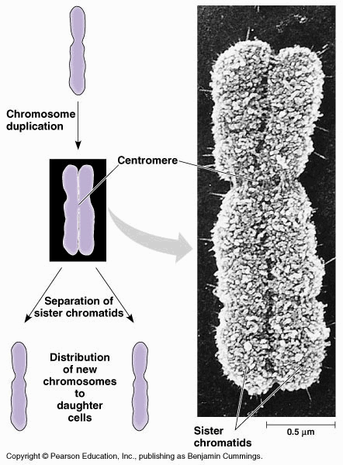
Cell Cycle– S phase
DNA and key proteins synthesized
Chromosomes replicated

Slide 9
Gap 2 (G2) Phase
Shortest phase of interphase
Structures and organelles necessary for cell division are produced

Slide 10
M Phase
Includes mitosis and cytokinesis
During mitosis the nucleus is replicated
Cytokinesis physically separates the parent cell into two identical daughter cells

Slide 11
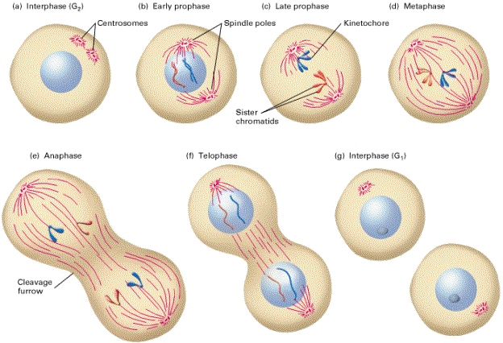
M phase

Slide 12
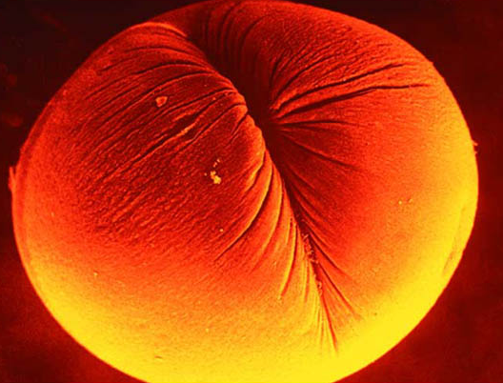
Cytokinesis
What is the difference in cytokinesis in a plant and animal cell?

Slide 13
Prokaryotes use Binary Fission

Slide 14
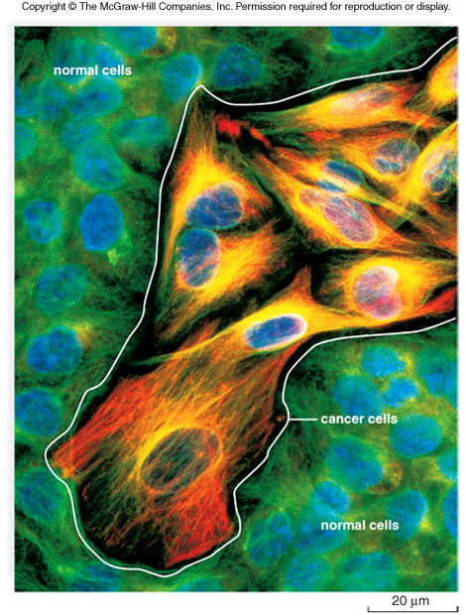
Cancer
What is cancer?
Unregulated cell groweth.
What causes cancer?
The cell not being able to stop reproducing
What type of cell can become a cancer cell?
Almost any type of body cell.

Slide 15
EOC PRACTICE

Slide 16
EOC PRACTICE
A, B, D, C
C, B, A, D
B, A, D, C
D, C, B, A

Slide 17
EOC PRACTICE
People who have been exposed to excessive radiation often experience mutations. If these mutations only occur in somatic (body) cells, these people may ? —
pass on these mutations to their offspring
experience an increased risk of cancer
develop entirely new DNA sequences in all cells
experience difficulties replicating RNA

Slide 18
EOC PRACTICE
Anaphase
Metaphase
Prophase
Telophase

Slide 19
EOC PRACTICE
Plant
Virus
Animal
bacterium

Slide 20
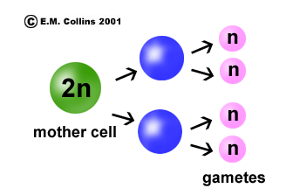
What is the difference in mitosis and meiosis?
Mitosis
Meiosis
Makes 2 identical daughter cells
Makes diploid cells
Used in asexual reproduction
Makes daughter cells
Divides 1 time
Makes 4 genetically different cells
Makes haploid cells
Used in sexual reproduction, only
Makes gametes
Divides 2 times

Slide 21
What is the difference between sexual and asexual reproduction?
Sexual
Asexual
Genetic Diversity
Takes longer
Exact copies
Is very quick

Slide 22
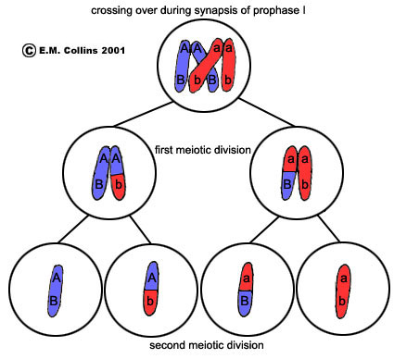
Meiosis
Prophase 1: Each chromosome duplicates and remains closely associated. These are called sister chromatids. Crossing over occurs, exchanging alleles (genes)

Slide 23
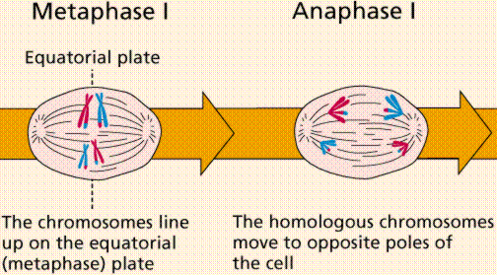
Meiosis
Metaphase 1: Homologous pairs of chromosomes align at the center of the cell. (#1’s together, #2 together.)
Anaphase 1: Chromosome pairs separate with sister chromatids remaining together.

Slide 24
Independent Assortment at Anaphase 1
Lots of different combinations are possible!
This is why you don’t look exactly like your brothers and sisters even
though you share the same parents!

Slide 25
Independent Assortment

Slide 26
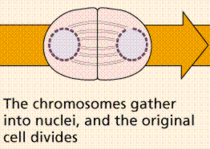
Meiosis
Telophase 1: Nuclear membrane forms in both daughter cells.
http://everyschool.org/u/logan/cellreproductionx/rogersa/research/meiosis.html

Slide 27
Second Division of Meiosis
Prophase 2: DNA does not replicate. Cell does not form tetrads
Metaphase 2: Chromosomes line up at the center of the cell
Anaphase 2: Centromeres divide and sister chromatids move separately to each pole.
Telophase 2: Cell division is complete.
Cytokinesis: Four haploid daughter cells are formed.

Slide 28
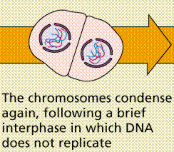
Second Division of Meiosis

Slide 29
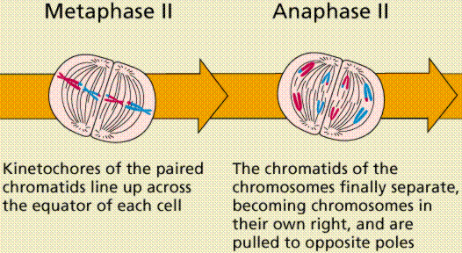
Second Division of Meiosis

Slide 30
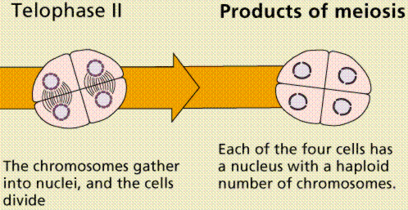
Second Division of Meiosis

Slide 31
Summary of Meiosis

Slide 32
Meiosis Summary

Slide 33
EOC PRACTICE
Meiosis is the process by which gametes are produced. In which of the following human organs does meiosis occur?
Testes
Liver
Pancreas
Skin

Slide 34
EOC PRACTICE
Replication
Internal Fertilization
Cytokinesis
Crossing Over

Slide 35
EOC PRACTICE
Gametes must be haploid because ? —
gametes are small and can hold only the haploid number of chromosomes
two gametes will unite during fertilization to create a diploid cell
the gametes’ chromosomes will be replicated prior to cell division
fertilization results with a haploid zygote

