Slide 1
Migrations in the Sea
Chapter 5
https://sites.google.com/a/jajags.com/kirkleyscienceelectives/home/marine-biology/marine-biology-notes

Slide 2
Vocabulary Chart
Baleen
Uplink
Downlink
Natural satellite
Artificial satellite
Remote sensing
Polar satellites
Geostationary satellites
SPOT tag
Pop up Archival Tag
SRDL (Satellite Relay Data Logger
Pixel
Root Words:
cyt-
Ge-
Terr-
Phot-
Sal-
Hal-

Slide 3
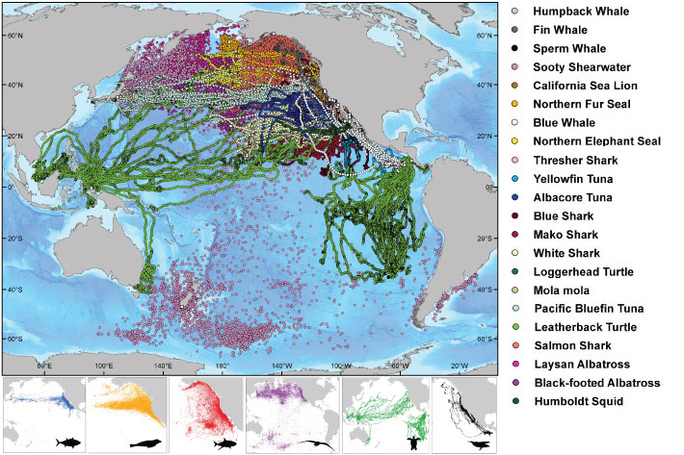
Ocean
Remember: Ocean covers 70% of the earth’s surface
Habitat for many organisms
Many travel VERY long distances, others very short

Slide 4
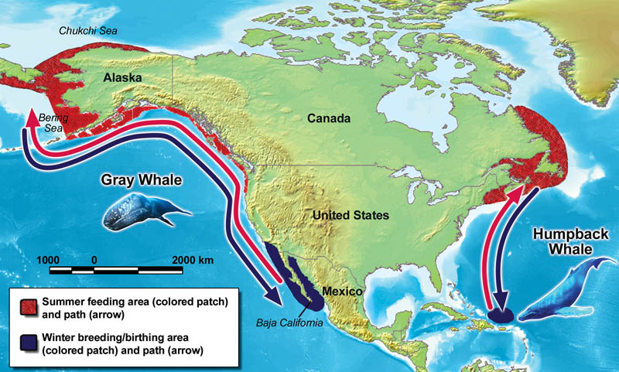
Why?
A lot of energy to travel so far, so why?
Food
Breeding
Raising Young
Life revolves around these patterns

Slide 5
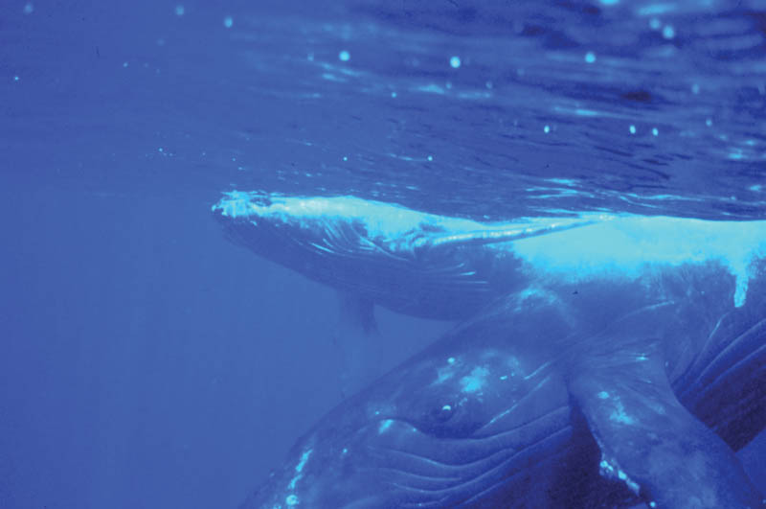
Humpback Whales
Found in Northern and Southern Hemispheres
Every ocean
Females slightly larger than males
~43 feet

Slide 6
Humpback Whales
Migrations are one of the longest for mammals
Longest recorded was 5100 miles
Costa Rica to Antarctica
Seven Animals (1 calf)
Just to feed on Krill
Shrimp-like animals at the surface

Slide 7
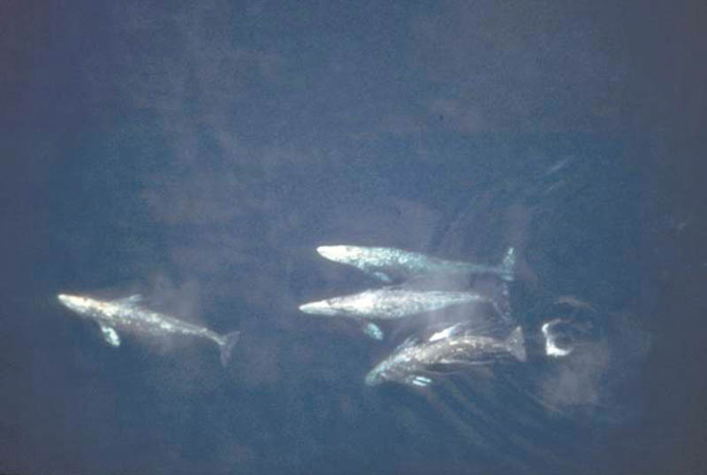
Gray Whales
~50 feet long
Long Migrations
Alone or in Groups
~10,000 miles during a year round trip adventure

Slide 8
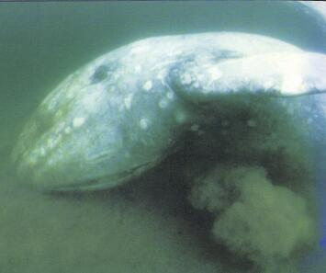
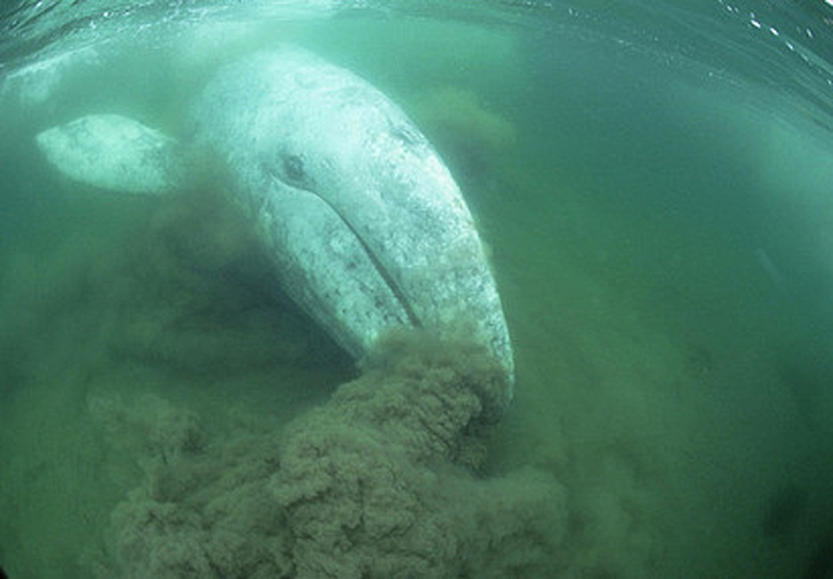
Gray Whales
Feed on the bottom, by filtering mud through their BALEEN plates
Strain out organisms this way
Take in a mouthful and push out the water through their teeth
Found in shallow coastal waters of the Pacific Ocean

Slide 9
Engage
#1 (a-d) in Complete sentences using the book to cite your reasoning.

Slide 10
Short Responses:
Label “Short Responses” under #1 in the Engage Section. This must be in complete sentences:
1. Other species of animals move around a great deal or migrate. According to the book, what other types of animals migrate ?
2. Speculate on the reasons for the time of year whales travel.

Slide 11
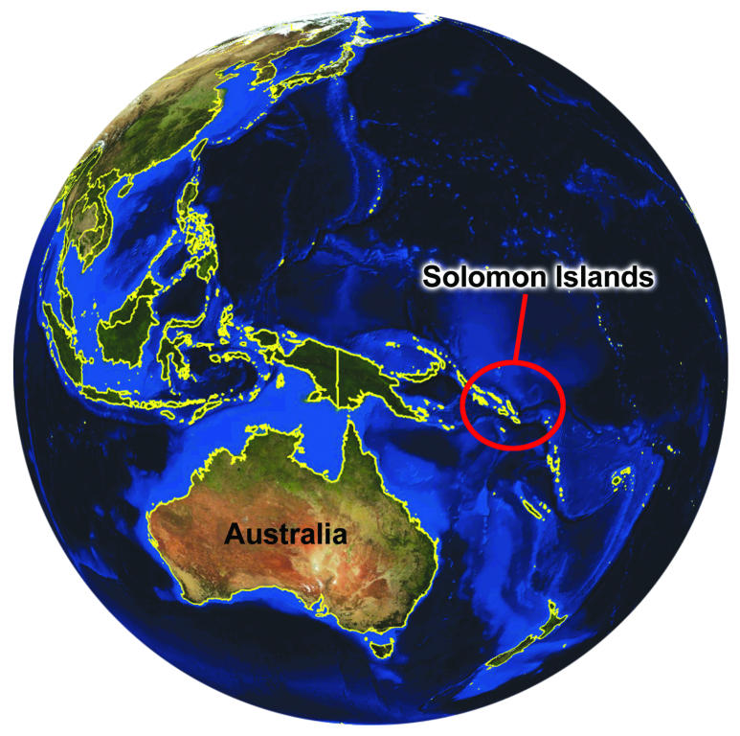
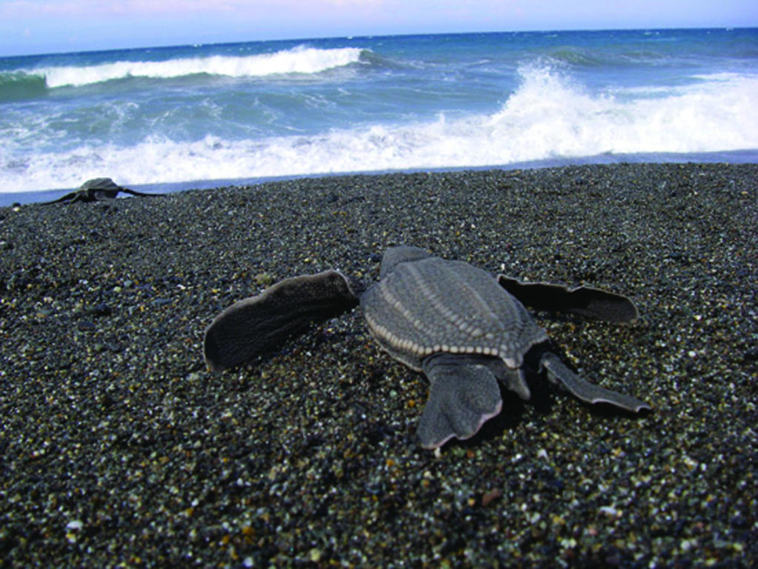
Explore: Leatherback Sea Turtle
Video! http://www.us-satellite.net/marinescience/resources_nat/lesson5.cfm

Slide 12
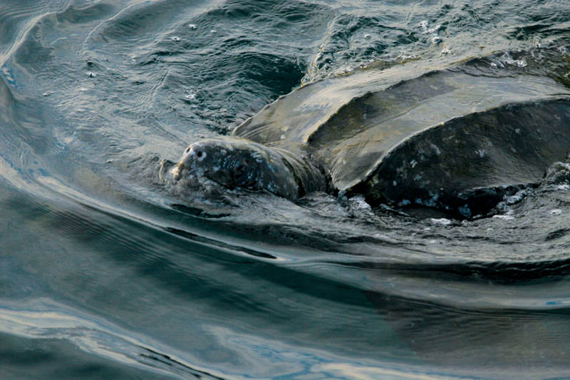
Leatherback Sea Turtle
One of the largest reptiles on Earth
~6 ½ ft long, ~2000 lbs
Leathery Skin that covers bony plates
Large front flippers increase speed
Help them travel faster and farther than any other turtle

Slide 13
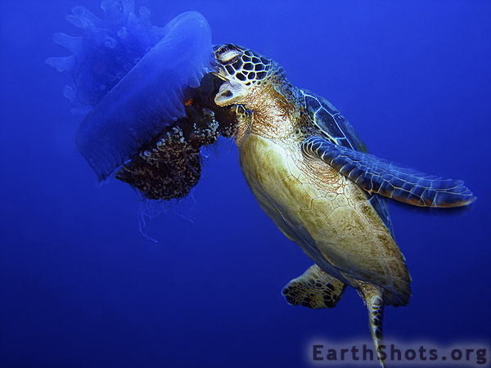
Leatherback Sea Turtles
Live in a wide variety of locations
Most spread out of sea turtles
Swim from nesting tropical areas to cooler temperate seas
Feed on Jellyfish and other floating organisms
On the coast, they will eat shrimp, mollusks and high protein foods

Slide 14
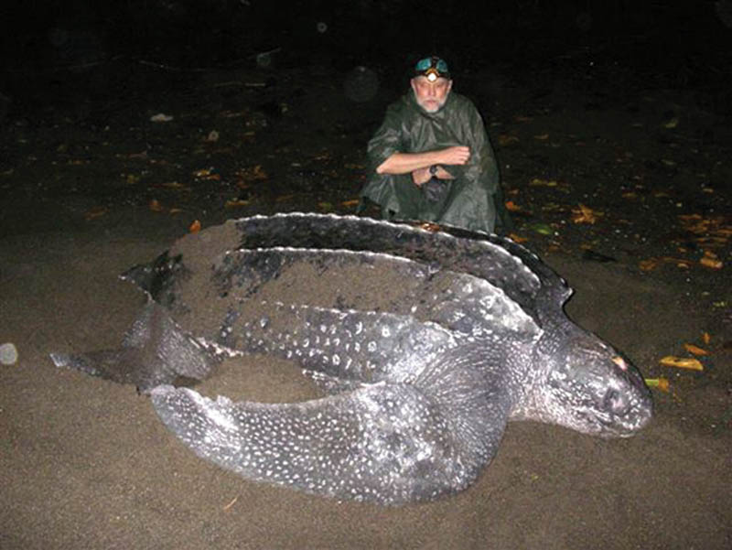
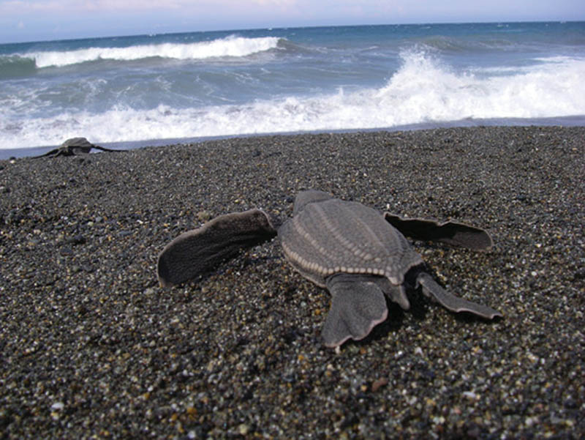
Leatherback Sea Turtles
Females return to same location every 2-3 years to build nests and lay eggs
100 eggs in each nest
New nest every 10 days
65 days in the nest, new offspring crawl to the ocean

Slide 15
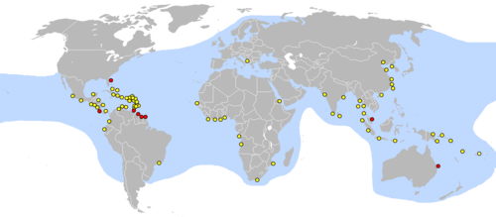
Leatherback Sea Turtles
Endangered Species
~35,000 nesting females
Males do not come to shore
Difficult to estimate
Video!! http://www.us-satellite.net/marinescience/resources_nat/lesson5.cfm

Slide 16
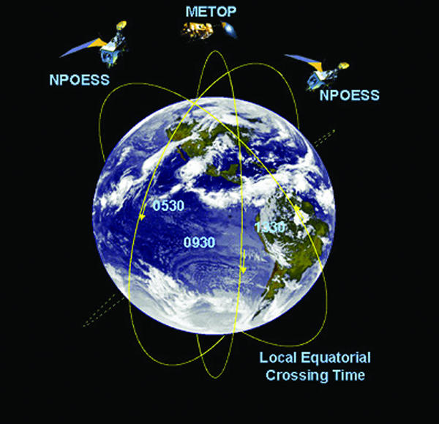
Explain: Tracking with Marine Science
Scientist must travel all over to attach satellite transmitters, or tags on animals
Satellites in turn relay the animal’s location to computers on ground
Factors scientists must consider while analyzing data:
Food
Temperature
Landforms
Human influences

Slide 17
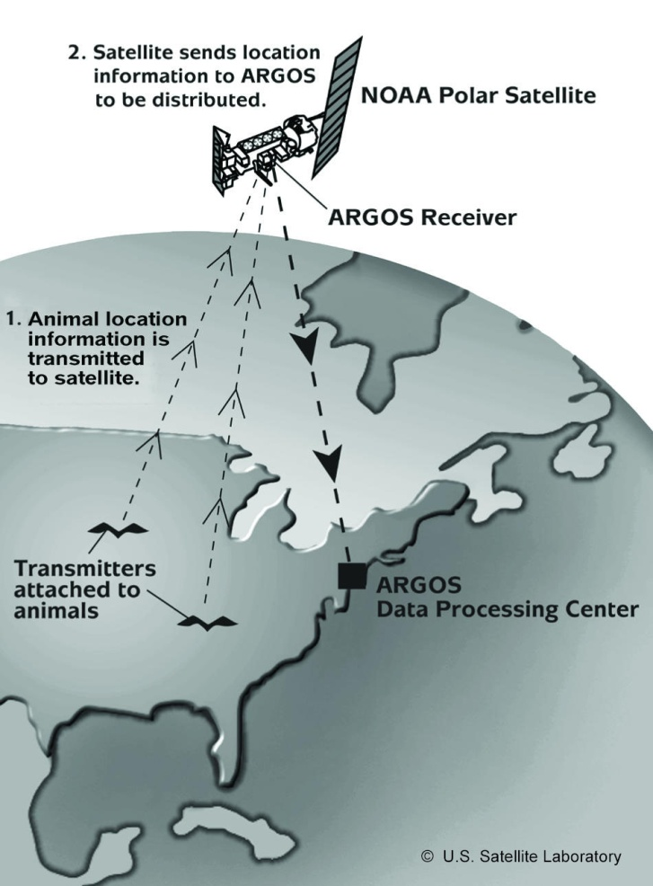
Transmitters and Satellites
Animals wear a transmitter in which VHF (very high frequency) signals are picked up by receivers
Old Technology: Once an animal is out of range the scientist can no longer pick up a signal-limits the amount of location data
New Technology: animals can be tracked much farther away as they migrate and have become much lighter and more efficient

Slide 18
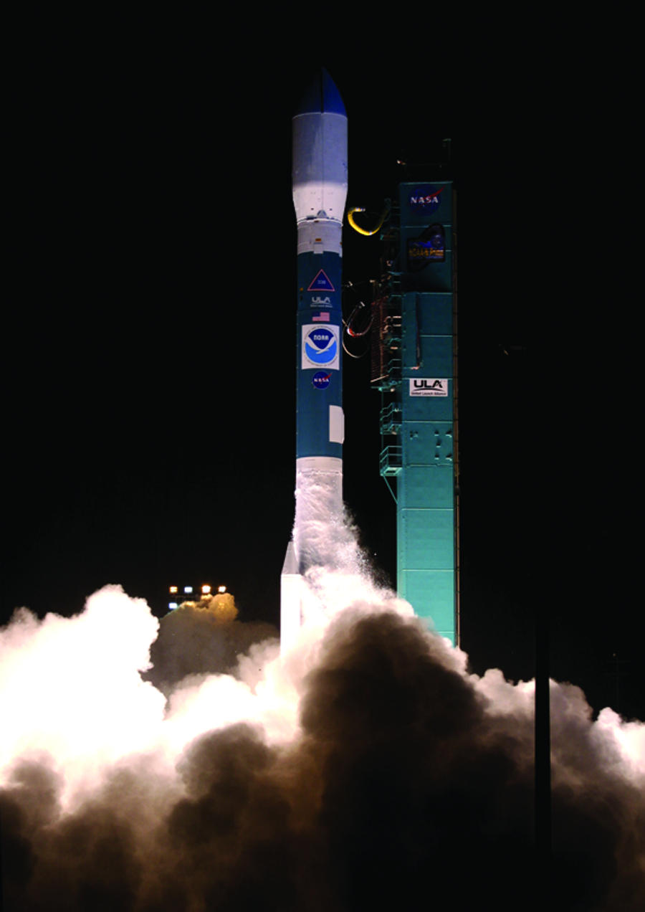
How does this process begin??
Scientist traps and then tags animals with transmitter
At regular intervals, the device transmits a higher-frequency radio signal to the Argos instrument which is onboard a NOAA polar orbiting satellites
A transmitting signal is sent up to a satellite-Uplink and then the connecting signal is sent down from a satellite to a ground station-Downlink
As the satellite passes over a ground or receiving station, the Argos system relays the information

Slide 19
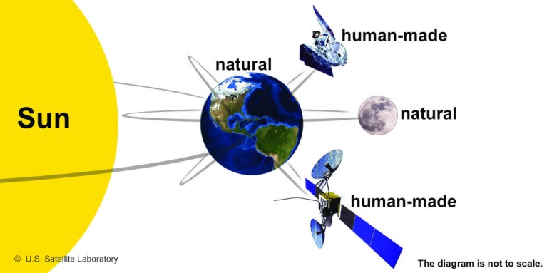
Natural and Human Made Satellites
Satellite: an object that orbits, or goes around another object
2 Types:
Natural satellite: a planet or moon that orbits around another celestial body
Artificial satellite: created by humans

Slide 20
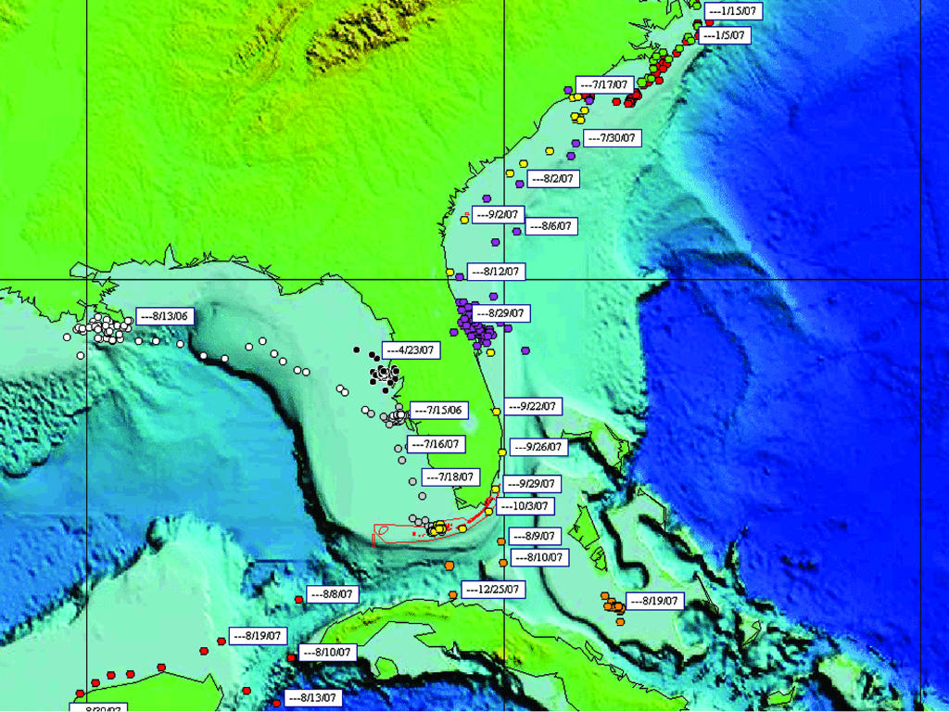
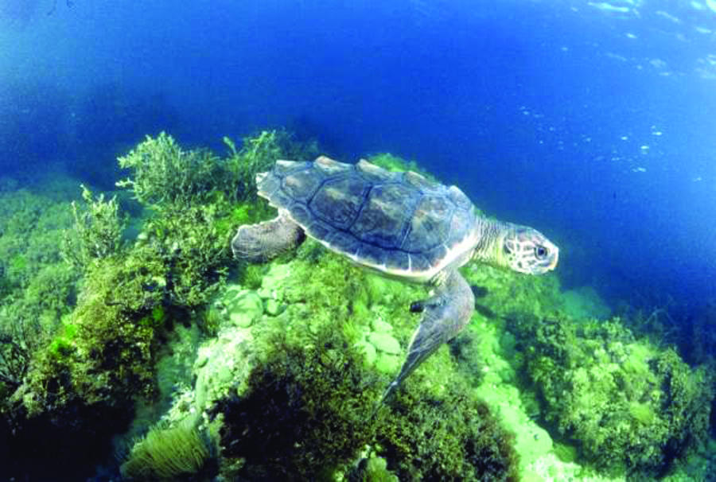
Artificial Satellites
Used to gather many types of data-scientific, weather, communications, navigation and military
Remote sensing satellites provide the data that is required to track and study marine animals
Includes tools that measure, survey and map our global environment
Converts this data into visual information that scientists use to follow animals

Slide 21
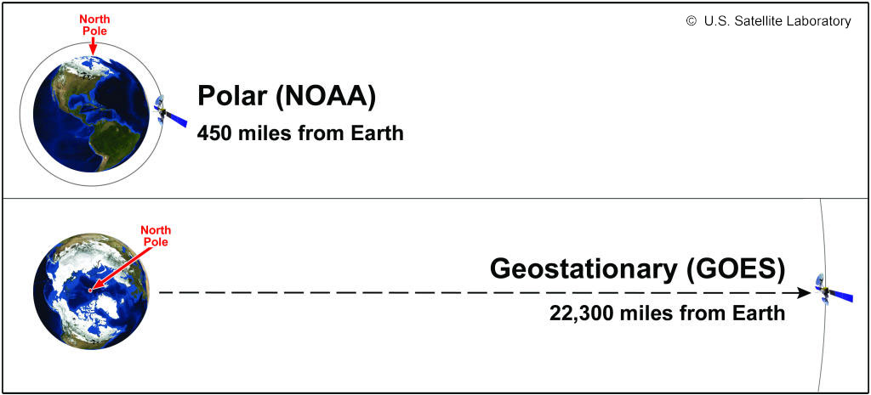
Polar and Geostationary Satellites
Two different remote sensing satellites take different paths as they orbit the Earth.
Those that orbit from pole to pole and help track animals are called polar satellites
Others that remain fixed above one specific location and orbit the Earth at a speed in tandem with the rotating Earth are called geostationary satellites

Slide 22
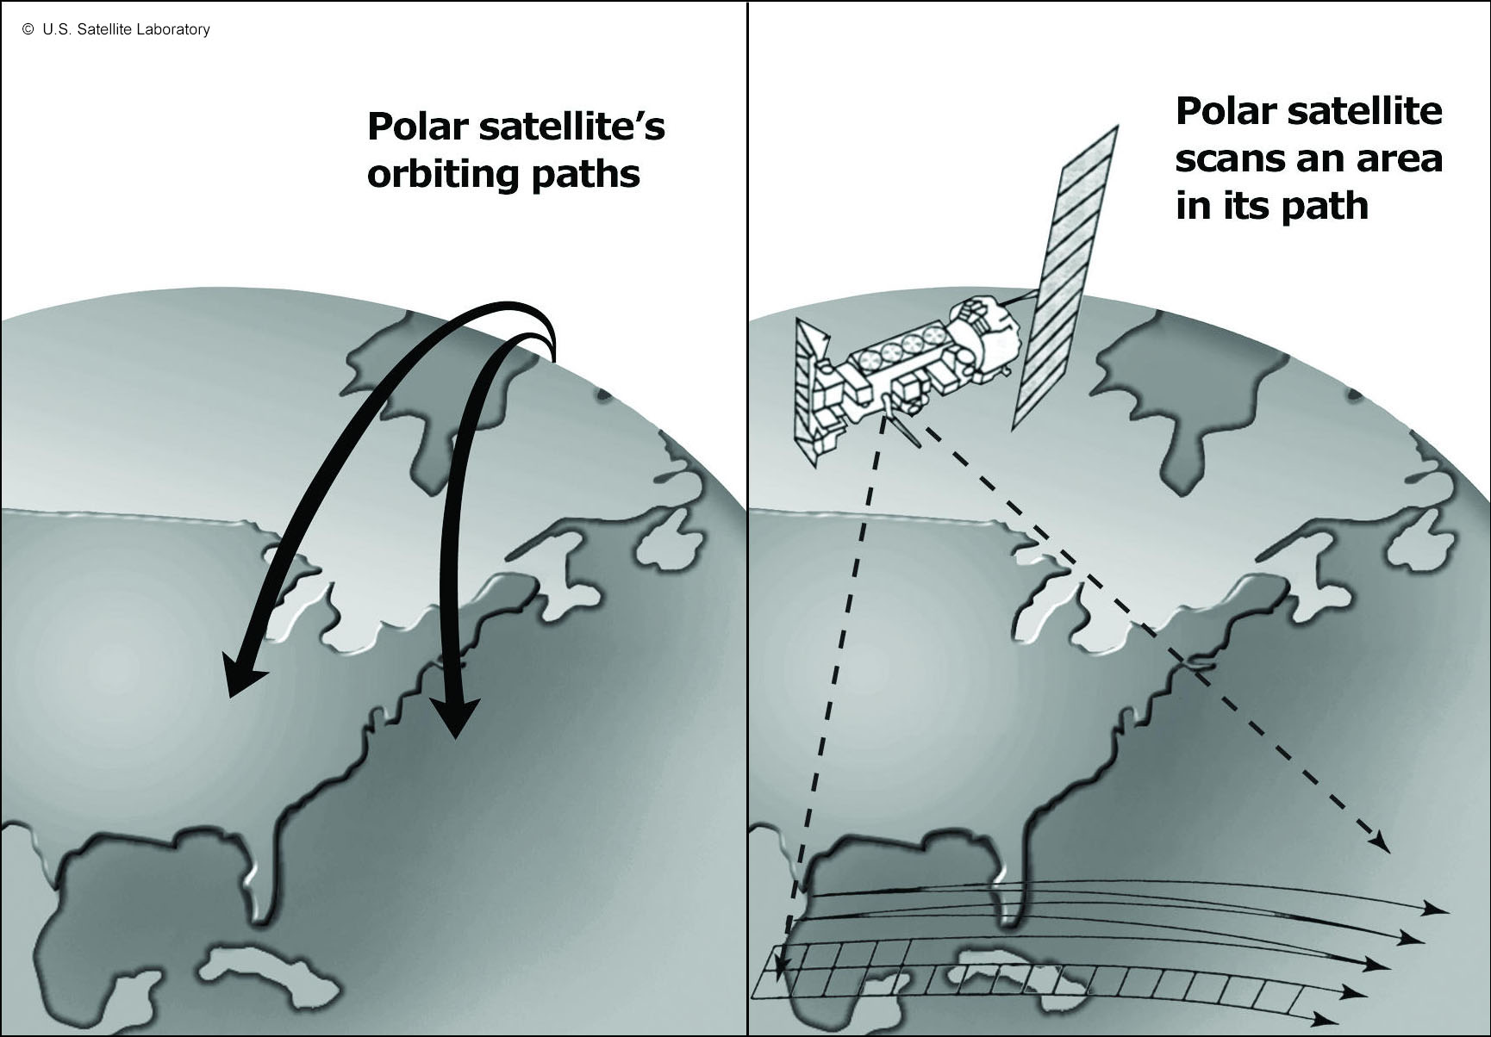
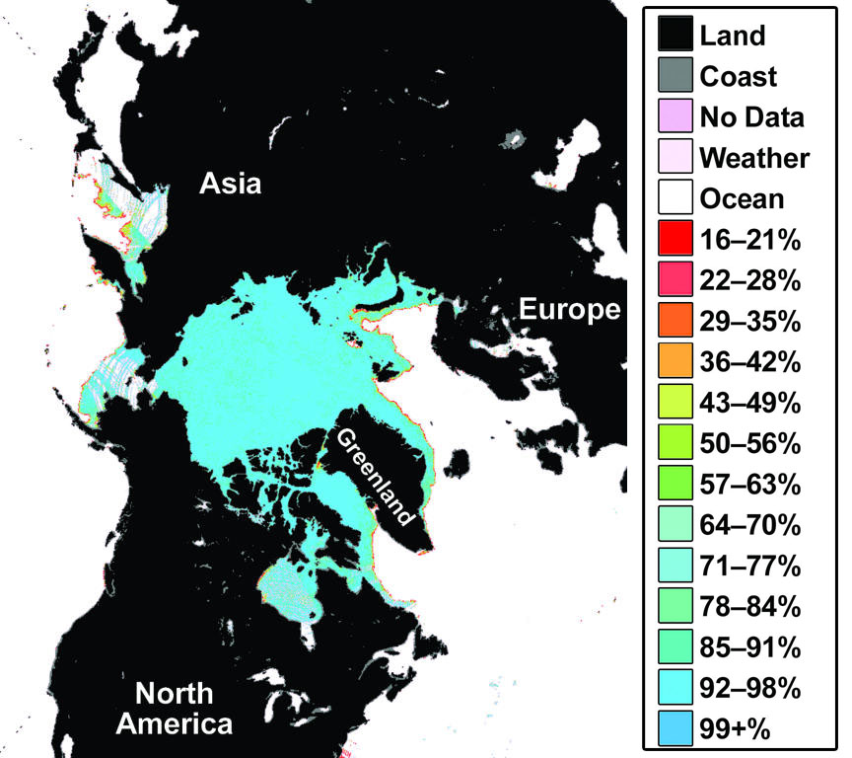
Polar Satellite
Orbit Earth over the north and south polar regions
Stay approximately 833 km (~518 miles) above Earth
Collect detailed views of Earth’s surface over time
Full orbit take more than 100 minutes (round trip) and will do this approximately 14 times each day!
Observes volcanoes, polar ice, bodies of water, specific ecosystems, rainfall and more.
Measure various wavelength energies

Slide 23
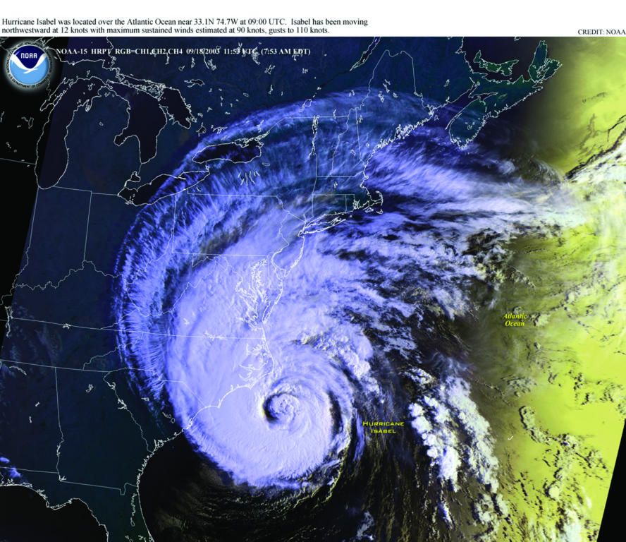
Geostationary Satellites
Orbit the Earth above the Equator
As the Earth rotates east, the satellite remains above the same location
Designed to monitor Earth’s changes over time from 50° N to 50° S
Stay in orbit about 36,000 km (~22,300 miles) from the Earth’s surface and they move at a constant rate as the Earth spins
Advantage of geostationary vs. polar is that they can record Earth images more often
The satellites are so far above the surface of Earth they can collect data from an entire hemisphere at a time
Helps scientist track weather systems like hurricanes

Slide 24
In your comp book: #6. Compare and contrast polar and geostationary satellites

Slide 25
Satellite Transmitters
There are several types of satellite transmitters available
Transmitters do not measure location only but record various factors that may be responsible for migratory patterns
Three main transmitters:
Smart Position or Temperature Transmitting Tags (SPOTs)
Pop-up Archival Tags
Satellite Relay Data Loggers (SRDLs)

Slide 26
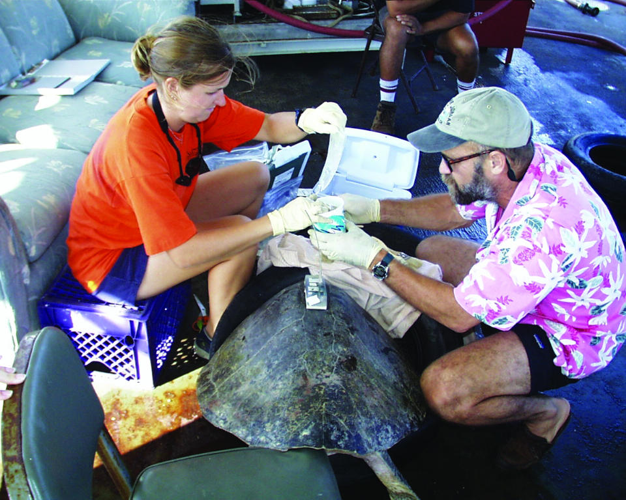
Smart Position or Temperature Transmitting Tags (SPOTs)
Used with animals that breathe at the ocean’s surface
A SPOT only uplinks when the antenna is out of the water
SPOTs are used on large, air breathing marine animals such as sea turtles, seals and whales

Slide 27
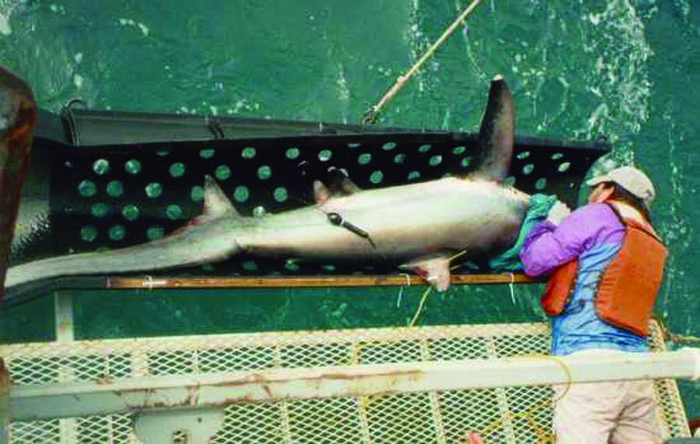
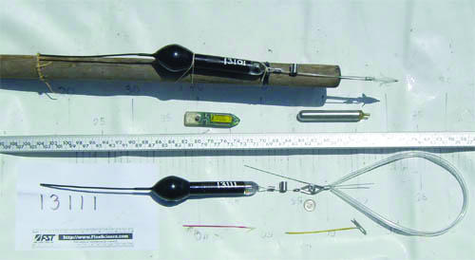
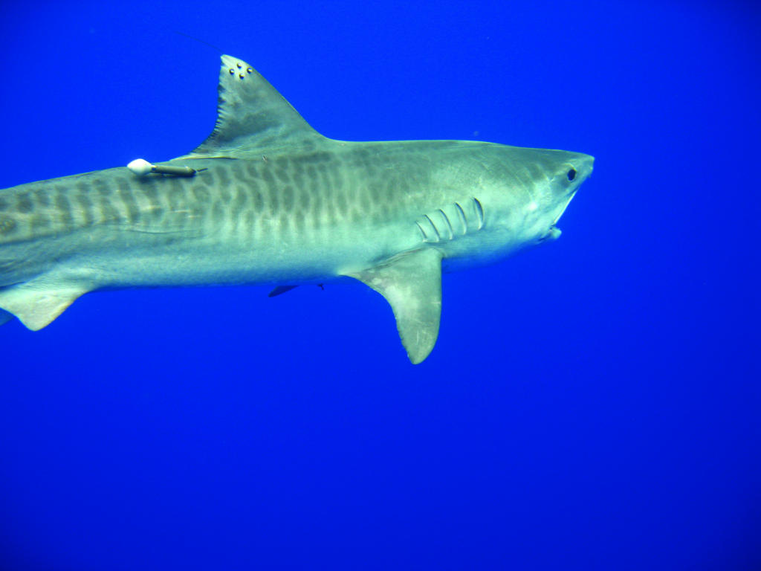
Pop-up Archival Tag
For large marine animals that do not spend much time at the ocean surface
Programmed to be released from the animal at a specific time
When released, the tag floats up to the ocean surface, transmits its data to a satellite and the data is then relayed to scientists
Used on fish such as tuna and sharks
Pop-up on shark

Slide 28
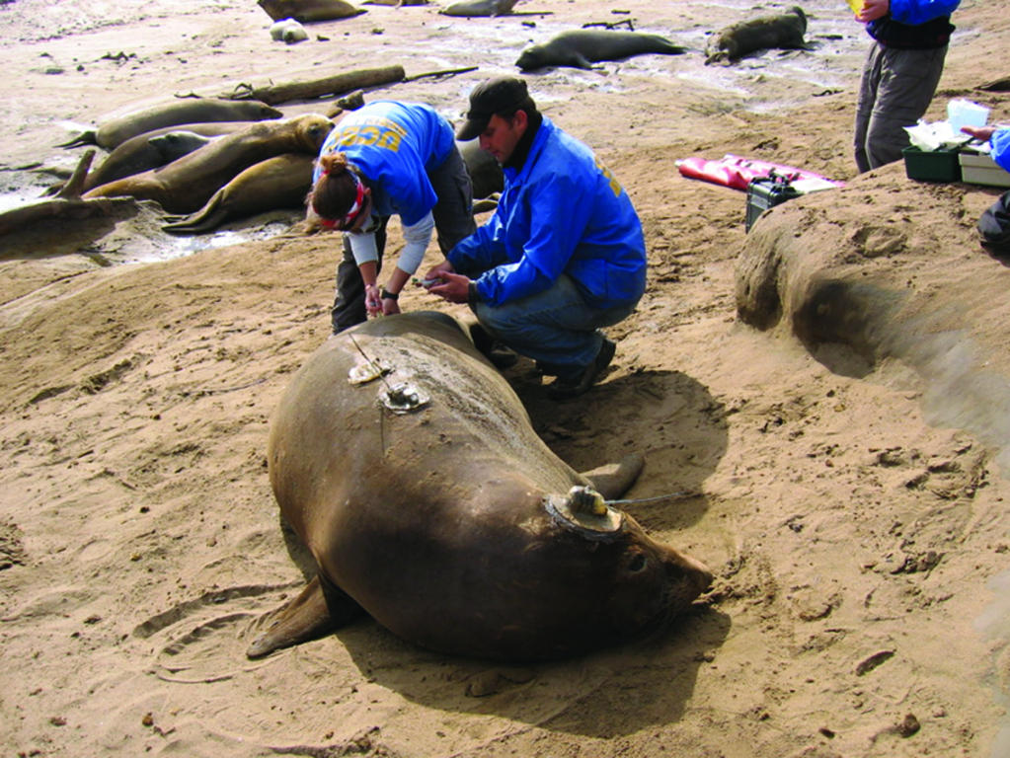
Satellite Relay Data Loggers (SRDLs)
Bulky- box shaped tag
Compresses more data than any other
Oceanographers use these to measure salinity, temperature and depth
Allows scientists to gain a better understanding of how ocean conditions affect animal movement
SRDLs are used on large marine animals that dive such as Elephant Seals, California sea Lions and Leatherback Sea Turtles

Slide 29
Satellite Imagery

