Slide 1
Cell Division
Chapter 10: Cell Growth and Division
Section 11.4: Meiosis

Slide 2
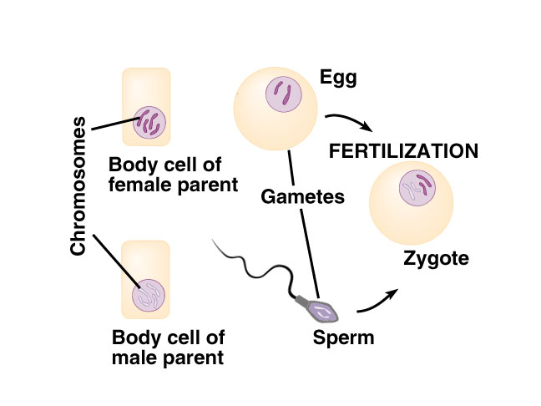
Sexual Reproduction:
Offspring are produced by the fusion of two sex cells – one from each of two parents. These fuse into a single cell before the offspring can grow.

Slide 3
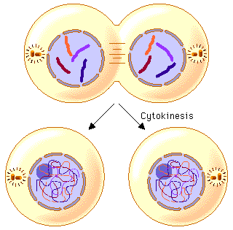
Mitosis:
Division of the nucleus
of a eukaryotic cell
Followed by cytokinesis –
division of the cytoplasm
The two daughter cells are
identical to the original cell

Slide 4
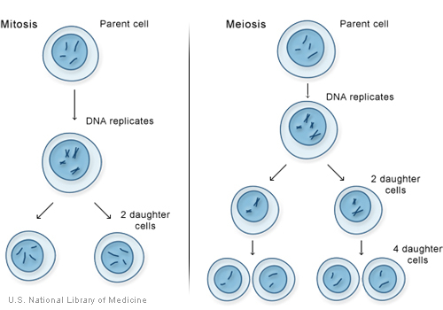
Meiosis:
Process that produces gametes from a diploid cell. A reductive division of the nucleus that produces four haploid gametes.

Slide 5
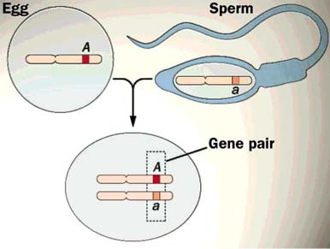
Diploid:
Cells having two sets of chromosomes
2N = 46
Examples: All human body cells
Except reproductive cells (sperm and egg)

Slide 6
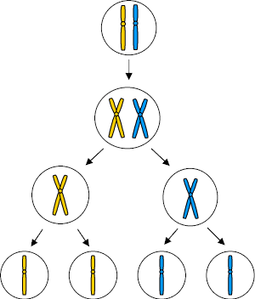
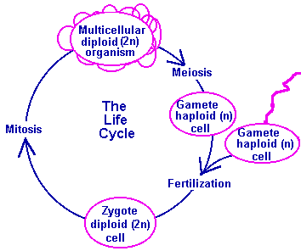
Haploid:
Cells containing only one set of chromosomes
N = 23

Slide 7
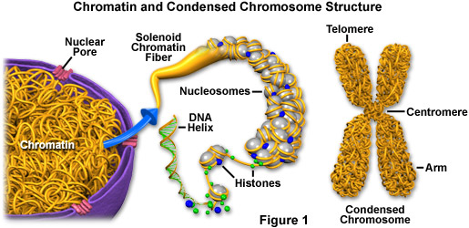
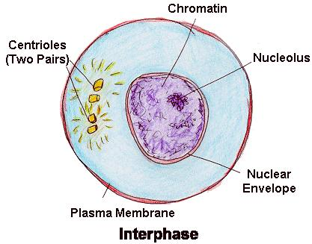
Chromatin:
DNA and protein (histones) in the nucleus of a non-dividing cell

Slide 8
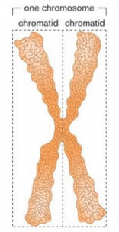
Chromatid:
One of the two identical parts of a replicated chromosome

Slide 9
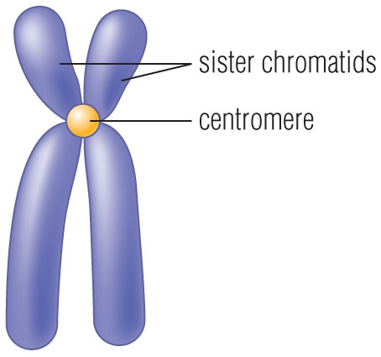
Centromere:
Point of attachment between sister chromatids

Slide 10
Histone:
Protein molecule that DNA wraps around during chromosome formation

Slide 11
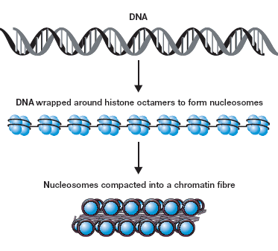
Nucleosomes:
The beadlike structures formed by DNA and histone molecules

Slide 12
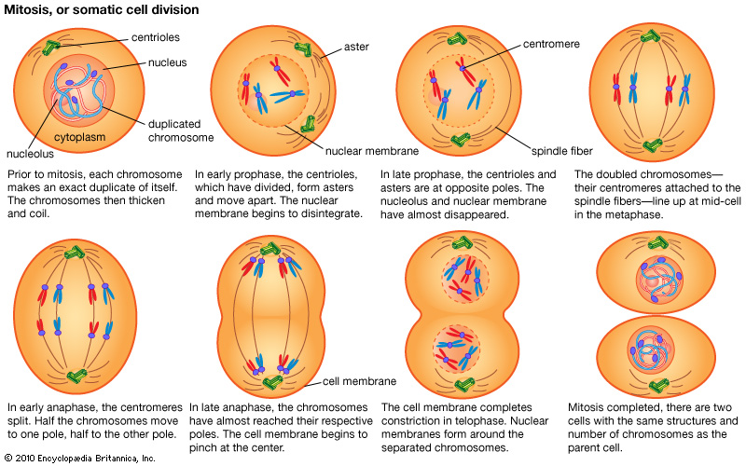

Slide 13
Meiosis
Section 11.4

Slide 14
Important Vocabulary
Meiosis
Diploid
Haploid
Gamete
Sexual Reproduction

Slide 15
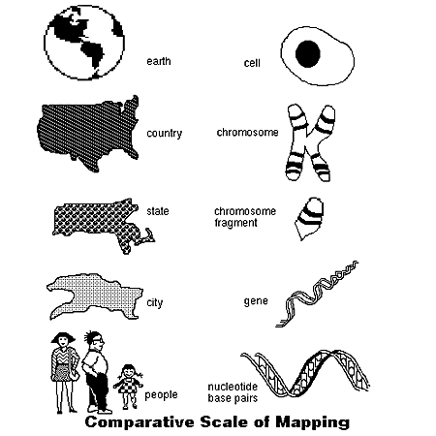
Chromosome Number
Chromosomes - strands of DNA and protein inside the cell nucleus - are the carriers of genes.
The genes are located in specific positions on chromosomes.
Meiosis (3:30)

Slide 16
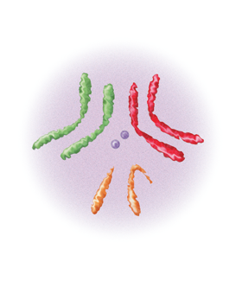
Homologous Chromosomes
A body cell in an adult fruit fly has eight chromosomes, as shown in the figure.
Four of the chromosomes come from its male parent, and four come from its female parent.
These two sets of chromosomes are homologous, meaning that each of the four chromosomes from the male parent has a corresponding chromosome from the female parent.
Biology Meiosis (2:57)

Slide 17
Diploid Cells
A cell that contains both sets of homologous chromosomes is diploid, meaning “two sets.”
The diploid number of chromosomes is sometimes represented by the symbol 2N.
For the fruit fly, the diploid number is 8, which can be written as 2N = 8, where N represents twice the number of chromosomes in a sperm or egg cell.

Slide 18
Haploid Cells
Some cells contain only a single set of chromosomes, and therefore a single set of genes.
Such cells are haploid, meaning “one set.”
The gametes of sexually reproducing organisms are haploid.
For fruit fly gametes, the haploid number is 4, which can be written as N = 4.

Slide 19
Zygote
Fertilized egg
Haploid sperm + Haploid egg = diploid zygote

Slide 20
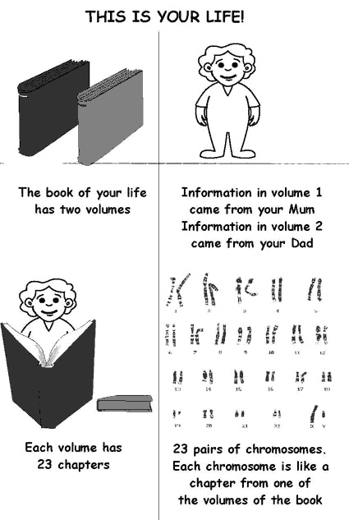
Meiosis the Great Divide (7:40) Ameoba Sisters

Slide 21
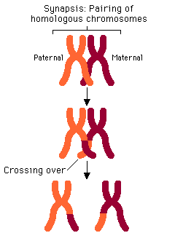
Synapsis and Tetrads
During synapsis, the homologuous chromosomes pair up, forming a structure called a tetrad, which contains four chromatids.

Slide 22
Crossing Over
As homologous chromosomes pair up and form tetrads, they undergo a process called crossing-over.
First, the chromatids of the homologous chromosomes cross over one another.
Then, the crossed sections of the chromatids are exchanged.
Crossing-over is important because it produces new combinations of alleles in the cell.

Slide 23
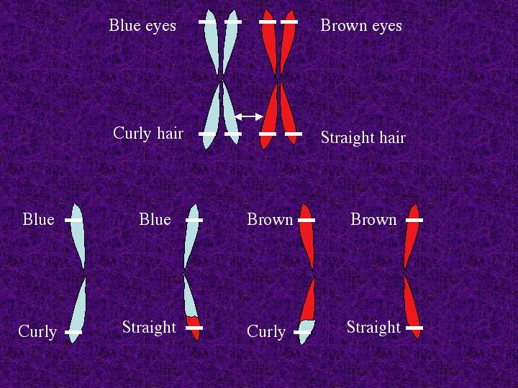
Independent Assortment
Genes for different traits can segregate independently during the formation of gametes.

Slide 24
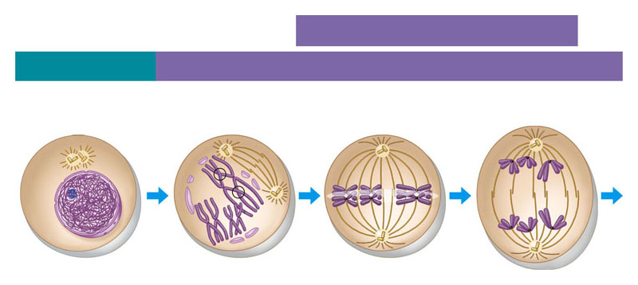
Meiosis I
MEIOSIS I: Homologous chromosomes separate
INTERPHASE PROPHASE I METAPHASE I ANAPHASE I
Sister chromatids remain attached
centrioles
Sites of crossing over
Spindle Fibers
Nuclear envelope
Sister chromatids
Homologous chromosomes separate
Chromatin
Tetrad

Slide 25
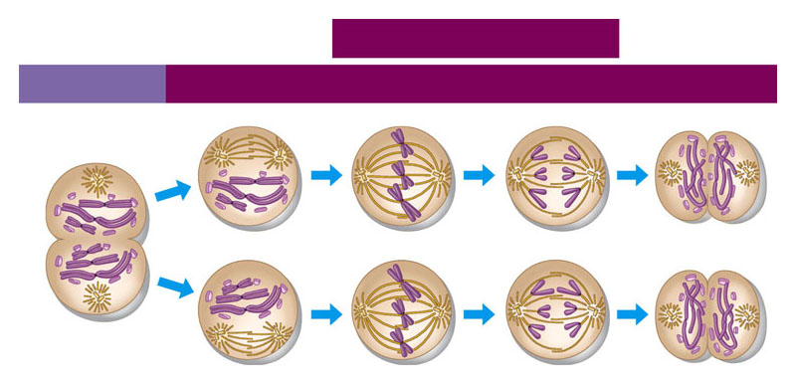
Meiosis II
MEIOSIS II: Sister chromatids separate
TELOPHASE I AND CYTOKINESIS
PROPHASE II METAPHASE II ANAPHASE II
TELOPHASE II AND CYTOKINESIS
Cleavage furrow
Sister chromatids separate
Haploid daughter cells forming
Animation of Meiosis (4 min)

Slide 26
Phases of Meiosis
Meiosis is a process in which the number of chromosomes per cell is cut in half through the separation of homologous chromosomes in a diploid cell.
Meiosis usually involves two distinct divisions, called meiosis I and meiosis II.
By the end of meiosis II, the diploid cell becomes four haploid cells.
Meiosis Square Dance Discovery Education (3:21)

Slide 27
Meiosis I: Interphase
Just prior to meiosis I, the cell undergoes a round of chromosome replication called interphase I.
Each replicated chromosome consists of two identical chromatids joined at the center.

Slide 28
Prophase I
The cells begin to divide, and the chromosomes pair up, forming a structure called a tetrad, which contains four chromatids.
As homologous chromosomes pair up and form tetrads, they undergo a process called crossing-over.

Slide 29
Metaphase I
During metaphase I of meiosis, paired homologous chromosomes line up across the center of the cell.

Slide 30
Anaphase I
During anaphase I, spindle fibers pull each homologous chromosome pair toward opposite ends of the cell.
When anaphase I is complete, the separated chromosomes cluster at opposite ends of the cell.

Slide 31
Telophase I
During telophase I, a nuclear membrane forms around each cluster of chromosomes.

Slide 32
Cytokinesis
Cytokinesis follows telophase I, forming two new cells.
Meiosis (1:49)

Slide 33
Meiosis I
Meiosis I results in two cells, called daughter cells.
Because each pair of homologous chromosomes was separated, neither daughter cell has the two complete sets of chromosomes that it would have in a diploid cell.
The two cells produced by meiosis I have sets of chromosomes and alleles that are different from each other and from the diploid cell that entered meiosis I.

Slide 34
Meiosis II
The two cells produced by meiosis I now enter a second meiotic division.
NOTE: Unlike the first division, neither cell goes through a round of chromosome replication before entering meiosis II.

Slide 35
Prophase II
As the cells enter prophase II, their chromosomes—each consisting of two chromatids—become visible.
The chromosomes do not pair to form tetrads, because the homologous pairs were already separated during meiosis I.

Slide 36
Metaphase II
During metaphase of meiosis II, chromosomes line up in the center of each cell.

Slide 37
Anaphase II
As the cell enters anaphase, the paired chromatids separate.

Slide 38
Telophase II
The nuclear envelope reforms around the chromatids.
In the example shown here, each of the four daughter cells produced in meiosis II receives two chromatids.

Slide 39
Cytokinesis
These four daughter cells now contain the haploid number (N)—just two chromosomes each.
Biology Meiosis (2:57)
Meiosis Square Dance (Full Version is 5:11)
This is repeated 2x in the video

Slide 40
Meiosis I
MEIOSIS I: Homologous chromosomes separate
INTERPHASE PROPHASE I METAPHASE I ANAPHASE I
Sister chromatids remain attached
centrioles
Sites of crossing over
Spindle Fibers
Nuclear envelope
Sister chromatids
Homologous chromosomes separate
Chromatin
Tetrad

Slide 41
Meiosis II
MEIOSIS II: Sister chromatids separate
TELOPHASE I AND CYTOKINESIS
PROPHASE II METAPHASE II ANAPHASE II
TELOPHASE II AND CYTOKINESIS
Cleavage furrow
Sister chromatids separate
Haploid daughter cells forming

Slide 42
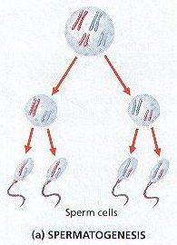
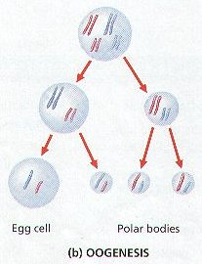
Formation of Gametes
Spermatogenesis
Oogenesis
Forms 4 haploid sperm
Forms 1 ovum (egg) and 3 polar bodies

Slide 43
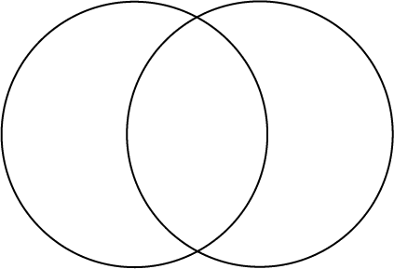
Mitosis vs. Meiosis
Mitosis Meiosis

