Slide 1
Which Way to The Sea?
Lesson 23
Marine Science Honors

Slide 2
Objectives
Identify a watershed and its boundaries
Explain that most watersheds flow into the ocean
Give examples of water quality parameters
Use scientific techniques and field data to assess water quality
Compare local water quality data with data from other regions of the state or country

Slide 3
Vocabulary-pgs. 458-476
Watershed
Contour lines
Wetlands
Flood plain
Headwaters
Aquifer
Springs
Delta
Parameters
Eutrophication
pH
Dissolved Oxygen
Riparian vegetation
Temperature
Turbidity
Secchi disk
Turbidity tube
Saltwater intrusion

Slide 4
Activate Prior Knowledge
http://www.youtube.com/watch?v=al-do-HGuIk
1. Where do clouds bring precipitation?
2. What are evaporation and condensation?
3. Which sources of water for the water cycle are mentioned in the video clip?
Precipitation
Condensation
Evaporation

Slide 5
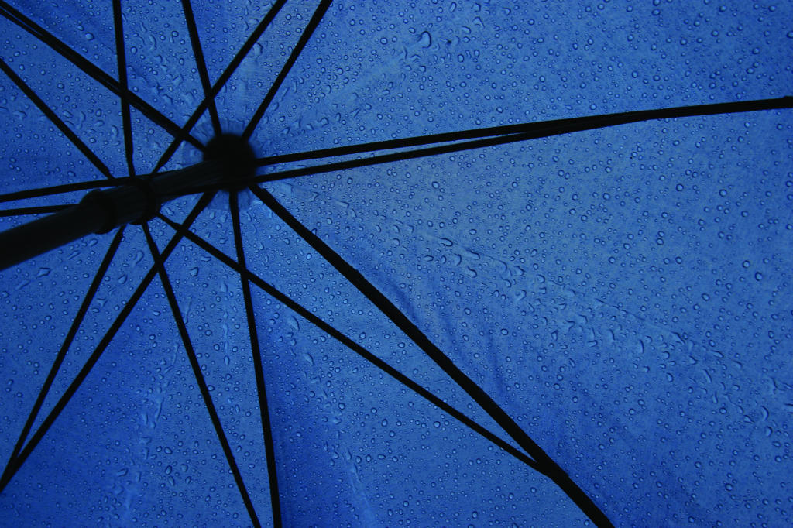
Engage: Where Does the Water Go?
What role does the ocean play in the water cycle?
How are freshwater systems connected to the ocean?
http://www.us-satellite.net/marinescience/resources/audio_video/lesson23/watercycle.cfm

Slide 6
Questions from the Bell Work
Think about where you live. When it rains in your backyard or on your school campus, where does the rainwater go?
Where does the water go from there?
Once the runoff joins these bodies of water, what can happen to it next?
Think back to Lesson 2. What properties of water come into play on its path to the ocean?

Slide 7
Explore: What is a Watershed?
No how far you live from an ocean, you are connected to its waters through your local environment.
Your everyday activities impact the ocean even if you live far from its shores.
The geographic land area on which runoff water from precipitation gathers and flows into a single body of water is called a watershed.
Smaller watersheds (i.e. area draining into a local stream or pond) are a part of larger watersheds
Eventually, the runoff water in many large rivers, from many larger watersheds, combines to drain into an ocean

Slide 8
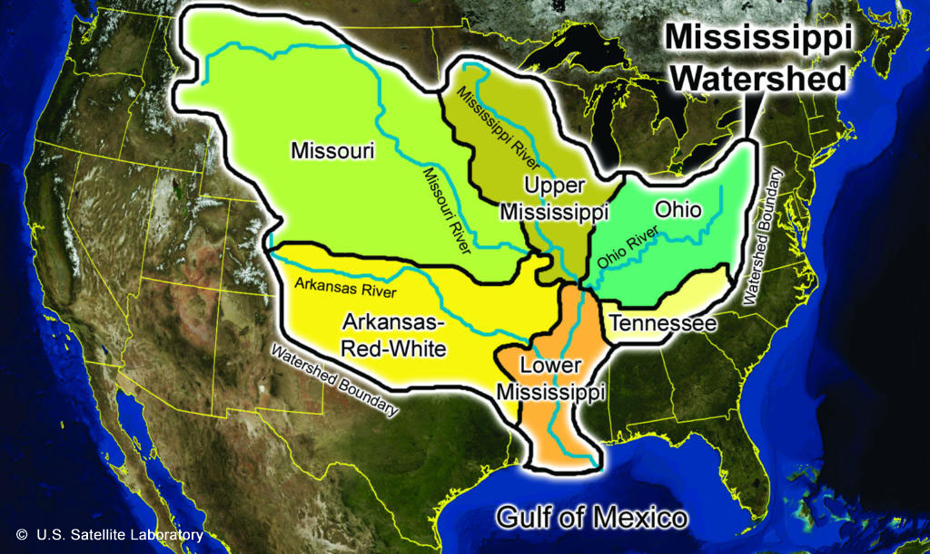
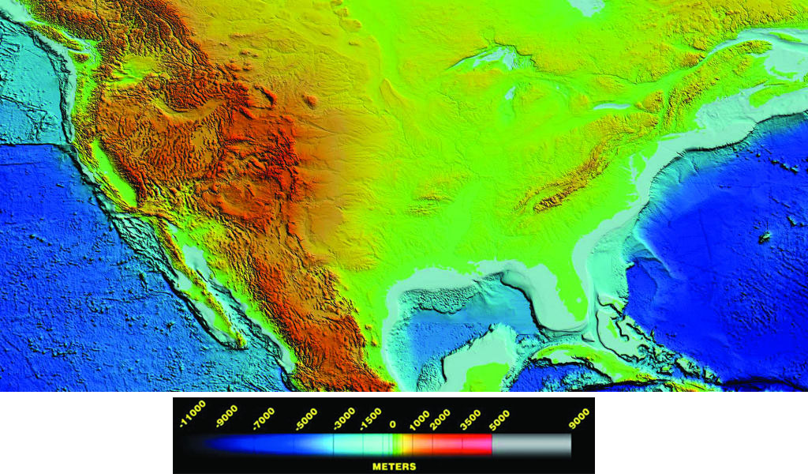
We ALL live in a watershed
Since Earth is covered by one big ocean, this means that all of us are connected to marine organisms through our own local watersheds.
Rain that flows from streets into storm drains empty directly into local bodies of water
Runoff flows into a stream and may end up at a lake
This water will continue to move towards the ocean
3. In your notebook, draw a sketch that illustrates the basic idea of a watershed and how watersheds are connected to the ocean.
There are several major watersheds in the United States. The Mississippi River watershed is the largest. Each major watershed consists of smaller watersheds. Every body of water has its own watershed.
Topographic image of the Continental U.S. shows vast differences in regional areas' elevation above sea level.

Slide 9
Complete Q’s in notebook page 459
Notice the landforms and the topography of the map. Think about where, if a raindrop fell, it would go if it didn’t seep into the ground at each of the following locations:
--On the western side of the Rockies
--On the eastern side of the Rockies.
--On the eastern side of the Appalachian
mountains.
2. Describe the locations of the following:
--Western most source of the Mississippi Watershed
--Eastern most source of the Mississippi Watershed
--The Northern most source of the South Atlantic Gulf
Watershed
3. Along the eastern edge of the Mississippi watershed, what would the highest ridge of the Appalachians be called?
4. What is this called in the Rockies?

Slide 10
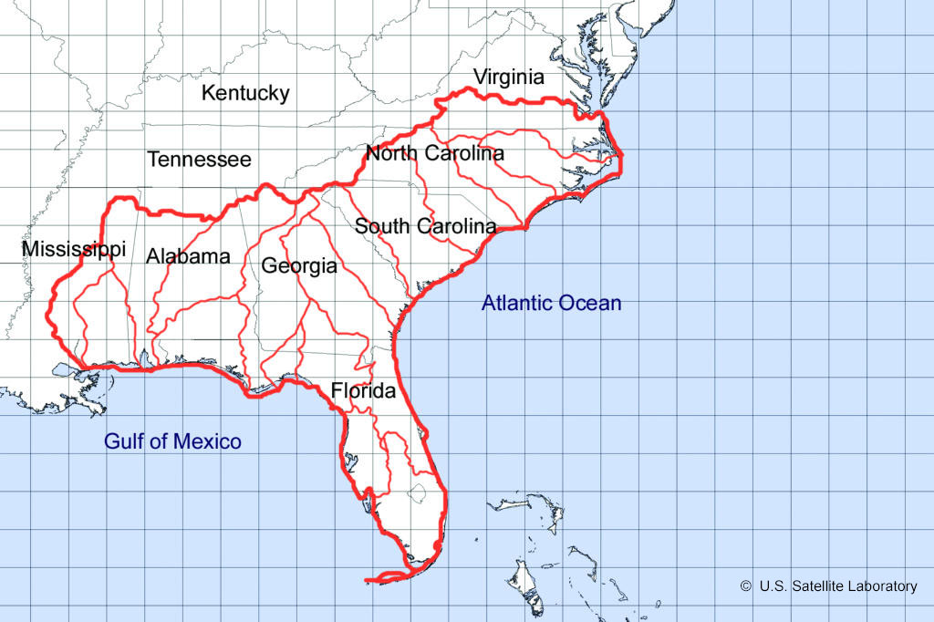
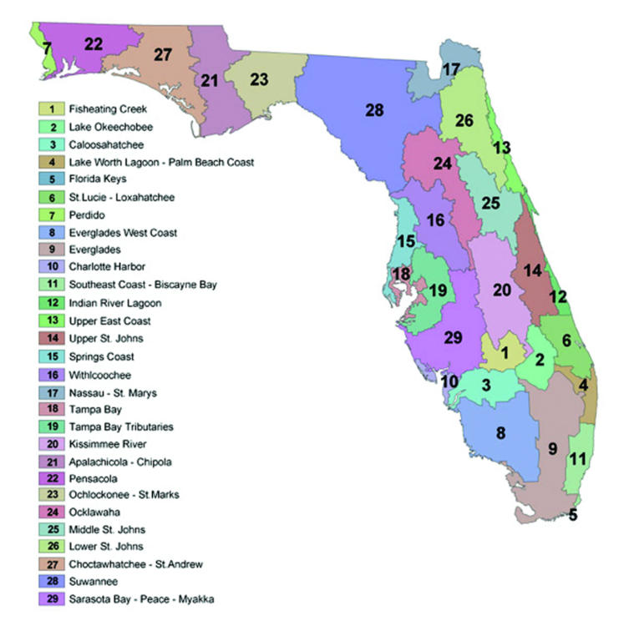
The South Atlantic Gulf Watershed is divided into many smaller watersheds. The watersheds on this map, in turn, are comprised of even smaller watersheds.
Local watersheds in the state of Florida are part of the larger South Atlantic Gulf Watershed.

Slide 11
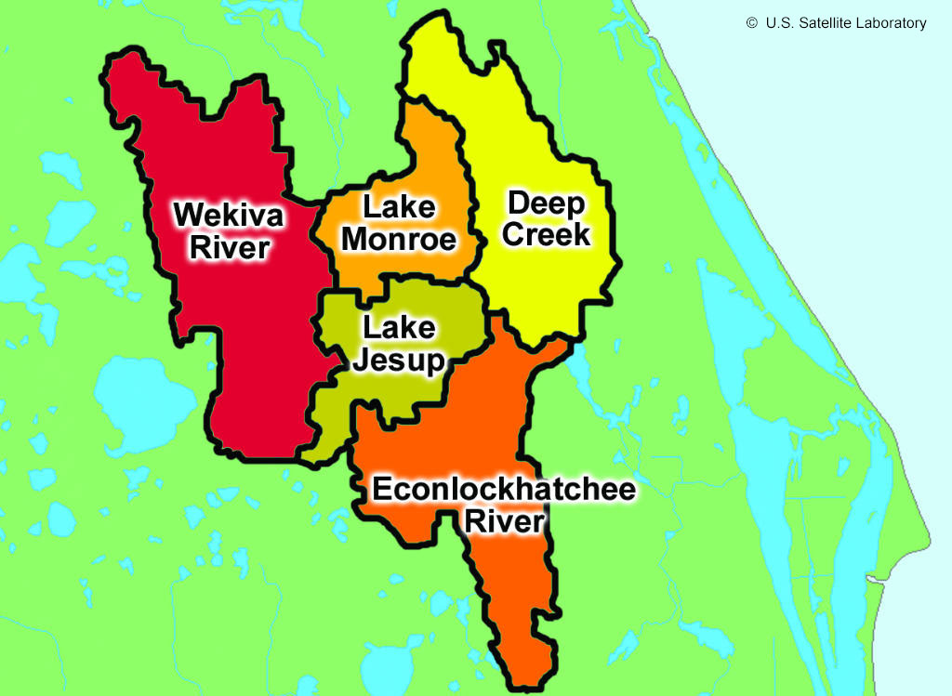
The map below shows some smaller watersheds within the South Atlantic Watershed:
4. In which watershed are we located?
Zoomed in view of the Middle St. Johns River Basin.

Slide 12
Each body of water has its local watershed.
Due to the flow of gravity, water from each local watershed flows to another (feeds into each other)
#5: What happens to rain that falls on the western slope of the Appalachian Mountains? Look at an atlas as needed.

Slide 13
Reading Topographic Maps and Modeling Water Flow
Topographic maps show all types of landforms:
Mountains
Hills
Valleys
Rivers
Streams
Lakes
Ponds
Oceans
Lines drawn on maps to connect points of equal elevation (or height above sea level) are called contour lines.

Slide 14
What does all of this mean?
The distance between contour lines indicates the slope of the land, the change in elevation over a given distance.
Lines far apart= the change in elevation occur over greater distance (slope is gradual)
Lines close together= a change in elevation over a shorter distance (steeper slope)

Slide 15
Questions to add: page 461
The map shows 29 different watersheds in Florida, as recognized by the Department of Environmental Protection. How do scientists know where to delineate (draw boundary lines) between each watershed?
How do scientists determine the boundaries of a watershed?
How do scientists determine what is a part of the Middle St. Johns River Basin watershed?
How does the South Atlantic Gulf watershed relate to the Middle St. Johns River Basin Watershed?

Slide 16
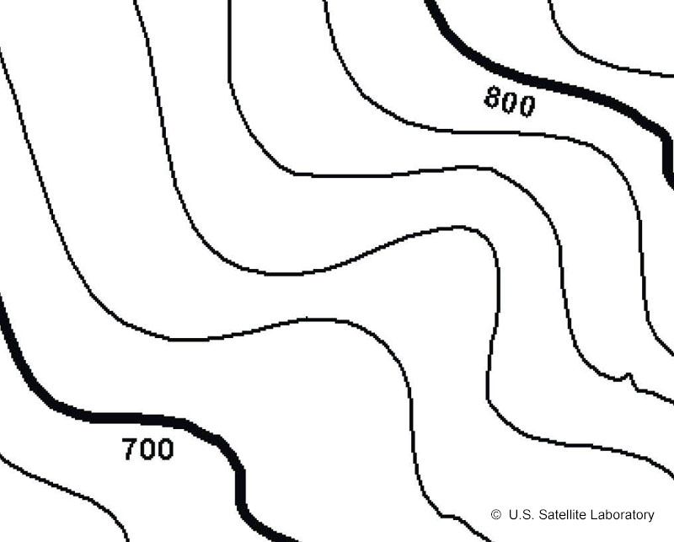
Not all maps provide contour lines at every 10 meters.
By using a topographic map, you can figure out the difference in elevation between the lines by using the information given.
For example: the segment of this map illustrates elevations for 800 meters about sea level and 700 meters above sea level
If you wanted to climb from 700 meters to 800 meters, you would have to cross 5 of the elevations represented by contour lines to do that.
You may divide the difference by the number of areas separating the given values:
100 m/5 areas= 20 meters per area
In the example below, each contour line represents 20 meters in elevation.

Slide 17
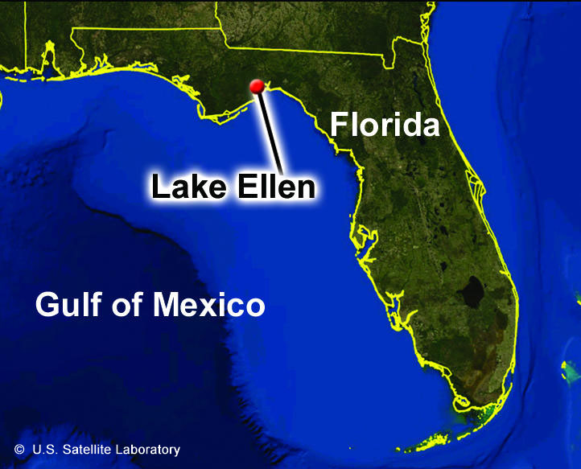
ACTIVITY: Page 463
This activity models water flow to help us understand the concept of a local watershed.
Complete #1-5 (ALL)
Attach the Lake Ellen map to your composition book.

Slide 18
Explain: Part 1 Freshwater Systems- Where Does Water Flow?
Freshwater=3% of Earth’s total water
Ice
Underground
Lakes
Ponds
Rivers
Streams
All bodies of water have a watershed

Slide 19
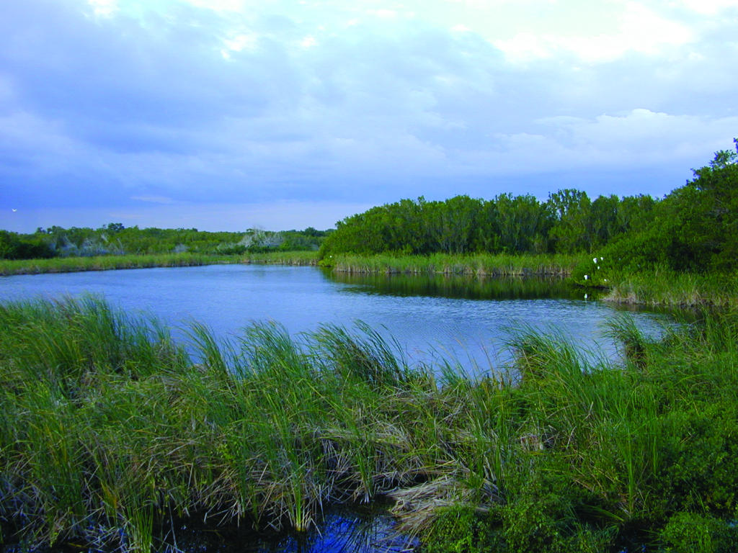
Difference between lakes and ponds
Lakes and ponds are freshwater systems that store water in depressions on the Earth’s surface
Lakes tend to be larger and deeper than ponds but there are exceptions to this rule.
Lakes may be huge (thousands of square kilometers) or considerably smaller (less than 20 acres)
If large enough like the Great Lakes, they can affect local climates like the oceans
In the lakes the water temperature is cooler with depth because sunlight will generally not reach the bottom
In ponds there is often little temperature difference throughout the water; sunlight will often reach the bottom (plant growth increases)
Pond in Everglades National Park, Florida. Ponds are important habitats for a variety of organisms. Some ponds are seasonal, and dry up completely during dry times.

Slide 20
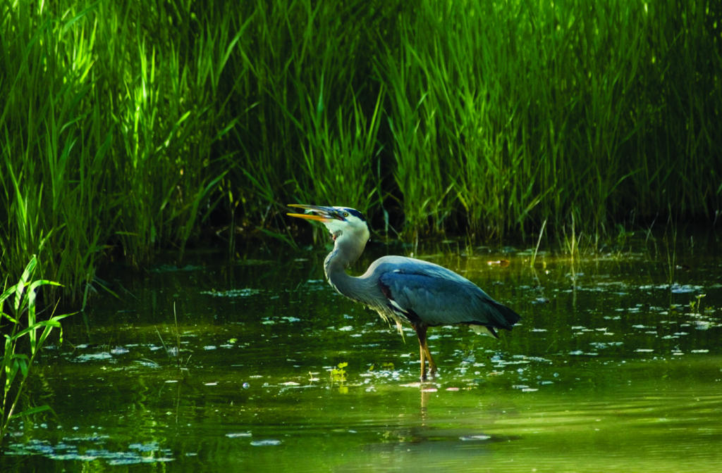
Wetlands
These are areas where the ground is saturated and water is apparent.
The abundance of water determines the nature of the soil and the range of living organisms.
Sometimes characterized as marshes, swamps or bogs
Differ in size and locations
Important habitats for a wide diversity of species
Prevalent in coastal areas near estuaries and alongside rivers and streams in floodplain areas
Coastal wetlands are home to a wide variety of organisms. In this image, a Great Blue Heron in a salt marsh eats a freshly-caught fish. This bird species is common throughout much of the United States.

Slide 21
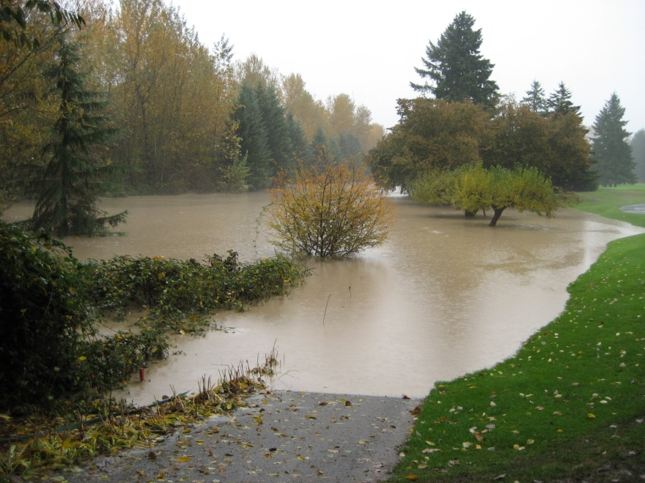
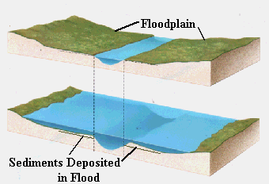
Wetlands
In floodplain areas water regularly flows over the banks of the river or stream
Wetlands exist in depressions where the contour of the land is low, and precipitation and runoff supply the water
Found where land dips below the level of the water table and sometimes forming spring-fed lakes or ponds
The amount of water varies depending on the season, weather and climate

Slide 22
Rivers
Rivers and streams are flowing bodies of water unlike ponds or lakes
Rivers are the larger of the two and flow into large lakes, bays or the ocean
Rivers may receive flowing water from smaller streams
Some streams may only exist only during rainy times
A rivers source of water from the surrounding land is referred to as headwaters, which may include a lake, a pond, a melting glacier or a spring

Slide 23
Spring Formation
View the Spring Formation Animation
http://www.us-satellite.net/marinescience/resources/audio_video/lesson23/springformation.cfm
6. Describe the formation of a spring.

Slide 24
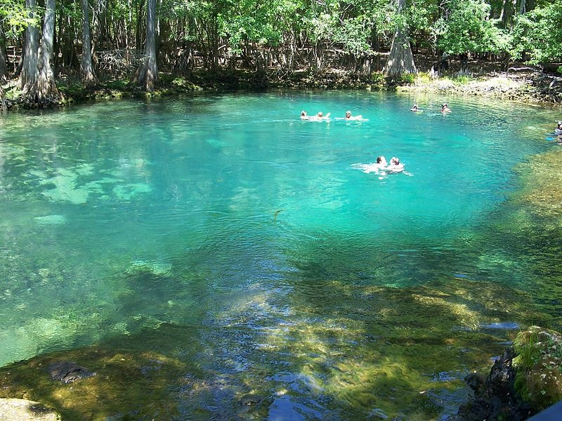
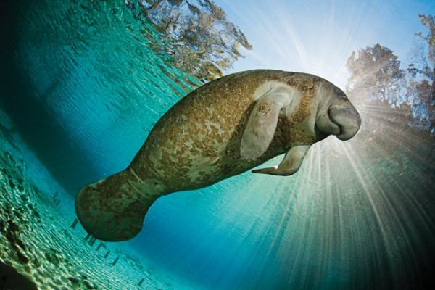
Springs
Florida has over 200 springs
Provides freshwater to the surface
Many are located in North-Central Florida where the Florida Aquifer is very close to the surface

Slide 25
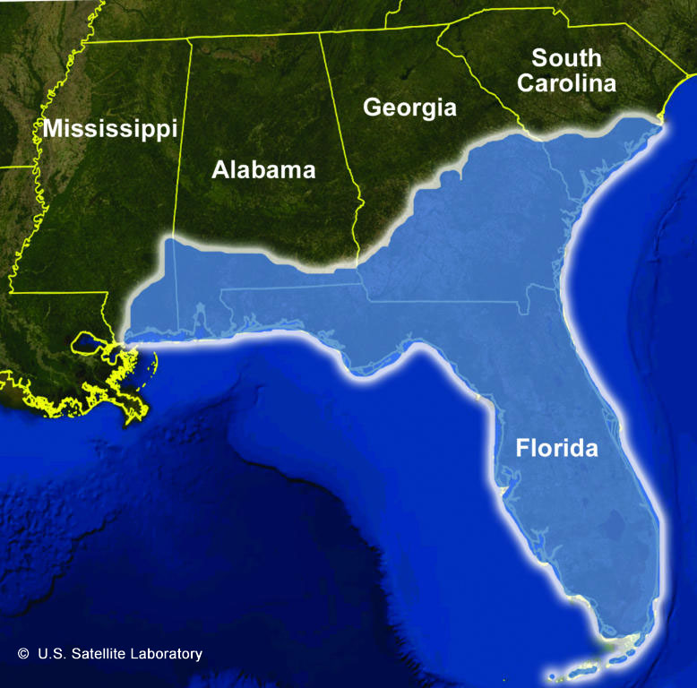
An aquifer stores groundwater that collects when precipitation falls to Earth’s surface and instead of running off, seeps down through layers of soil until it reaches rock
Springs will form when an aquifer cannot hold more water
When there is additional rainfall, spring water is forced to the surface of the ground in areas where weathering and erosion have dissolved and carried away rock
Aquifers are an important freshwater resource
https://www.youtube.com/watch?v=1qN8h8cj64s
The Floridian Aquifer provides water for a number of large cities including Savannah, Georgia and Jacksonville, Tallahassee, Orlando and St. Petersburg, Florida. It underlies parts of Florida, South Carolina, Georgia, Alabama and Mississippi.

Slide 26
Rivers and streams are dynamic systems in which they change as they flow from their sources and progress downhill to eventually meet the ocean
When looking at maps of rivers and streams, none of them flow in a straight line. Why??
The geology and the topography of the land through which water flows determine the path of the river

Slide 27
Rivers and streams will take a path with least resistance. What does that mean?
Well…
Rivers and streams at high, mid and low elevations share common characteristics
At higher elevations water tends to flow quickly and most directly down a steep slope. The river channel is narrow at this point
When a river flows over an area where the slope of the land is less severe, as in mid-elevation river, the river channel widens and the velocity slows. The river bends or meanders
Lower elevations, rivers typically have wide channels and form wide meanders

Slide 28
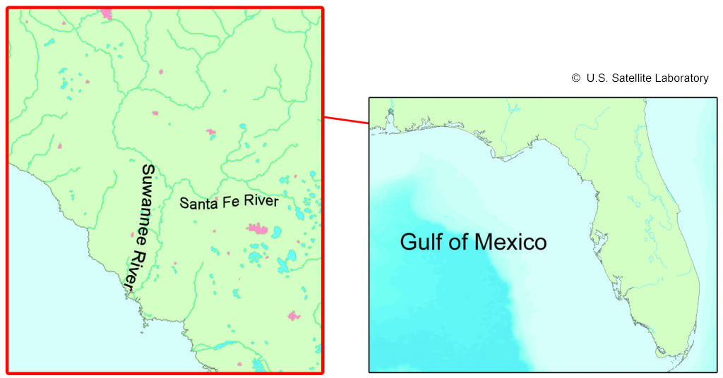
The Suwanee River in Northern Florida flows into the Gulf of Mexico. The Santa Fe River, a spring-fed river, is a tributary of the Suwanee.
7. Do you see evidence of the influence of topography on the Santa Fe River? Use the map to answer the question.
8. How would you investigate this question further?
9. Why are freshwater sources and aquifers important renewable resources?

Slide 29
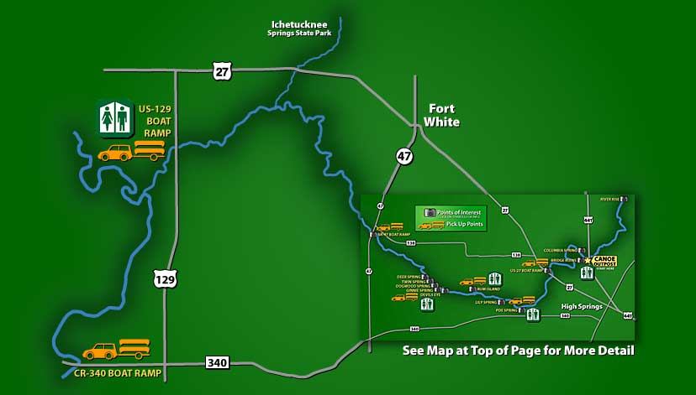
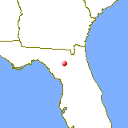
What do you think Florida’s rivers are classified as? High elevation or low elevation rivers?
Low-Elevation!!! This is because much of the state is barely above sea level and the slope from land to sea is minimal.
One slow-moving body of water-the Santa Fe River, flows into the Suwannee River (one of the largest in Florida)

Slide 30
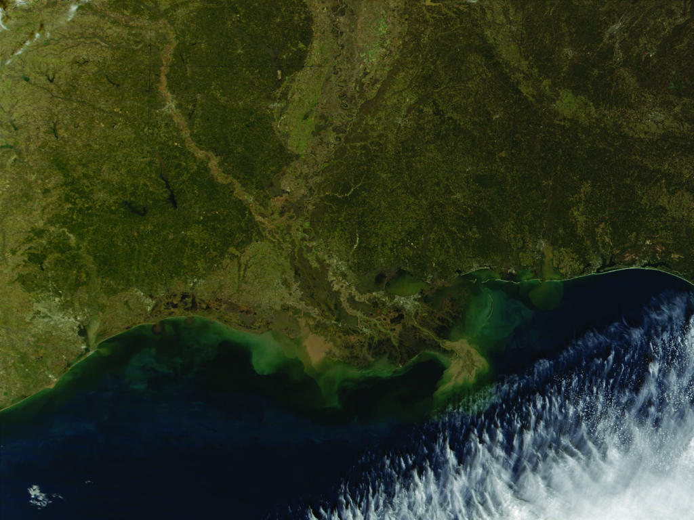
Read pages 466-467
Besides the flow of salts into the ocean, identify two other sources of salt in the ocean water, and explain why the water becomes increasingly salty over time.
Satellite image from the MODIS instrument shows sediment from the Mississippi River filling the delta as it spills into the Gulf of Mexico. Sediments flowing off of the land are the result of erosion.

Slide 31
Part 2: Why Sample the Water?
To study the health of the environment!!!
Scientist use biological, physical and chemical tests to obtain a broad survey of parameters, or the measurable characteristics of a body of water

