Slide 1
Diving Into ocean ecosystems
Chapter 1

Slide 2
Inside this lesson:
Marine Ecosystems Project
“Visiting’ and Defining Ecosystems
Changing Ecosystems
What are National Marine Sanctuaries?

Slide 3
The 5 “e’S”
Engage by observing the long migration routes of the Sooty Shearwater.
Explore by researching a specific marine ecosystem.
Explain by comparing the biotic and abiotic factors within various marine ecosystems.
Elaborate by describing how ecosystems undergo natural changes over time.
Evaluate by considering the components and processes of marine and land ecosystems.

Slide 4
Work to complete for Lesson 1
Read Lesson 1, pg. 4-16
Complete all vocabulary
Study root words
Story/Sentences using all vocabulary
Marine Ecosystems Project

Slide 5
Required note page for all vocabulary in the Lessons Please set up your note page like this
Name
Date
Period
Vocabulary
Words
Picture or key words to help you remember/ understand the concept.
Definitions

Slide 6
Vocabulary for lesson 1 + first 5 root words
Abiotic
Biotic
Biological community
Ecosystem
Organism
Succession
Benthic
mangroves
Whale fall
Coral reef
Mangrove forest
Deep sea
Open ocean
Kelp forest
Polar sea
Salt marsh
Rocky shore
National Marine Sanctuaries
-ology the study of
-it is inflammation
Arthr joint
Bio life
derm skin

Slide 7
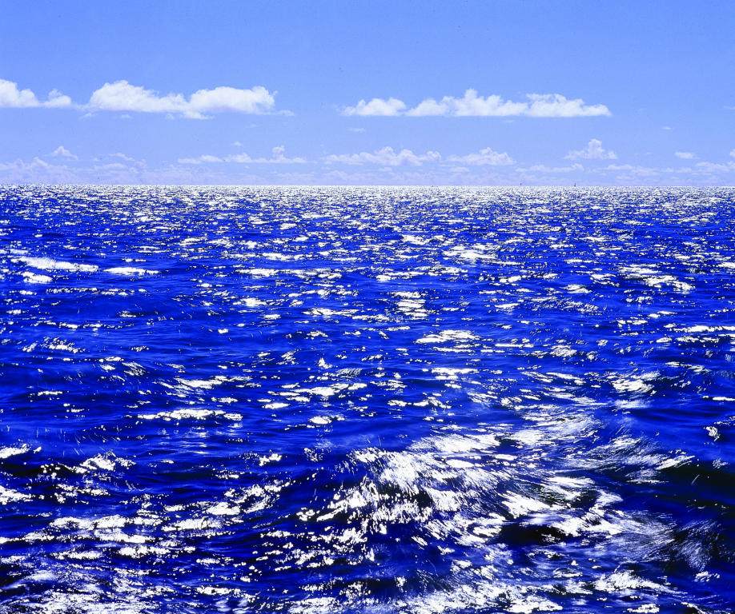
ENGAGE
The wide open ocean holds many mysteries. Physics, chemistry, biology and Earth science concepts and ideas help scientist solve them.
Scientists make observations and draw conclusions based on their observations.
Scientist use many tools to learn about the ocean and different strategies to report their findings.
Satellite technologies
Pictures
Animations
Satellite imagery and models.
One important aspect of scientific work is keeping an accurate record of questions, observations, results and new ideas to test-field notebook

Slide 8
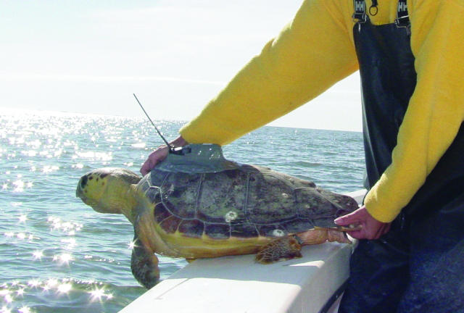
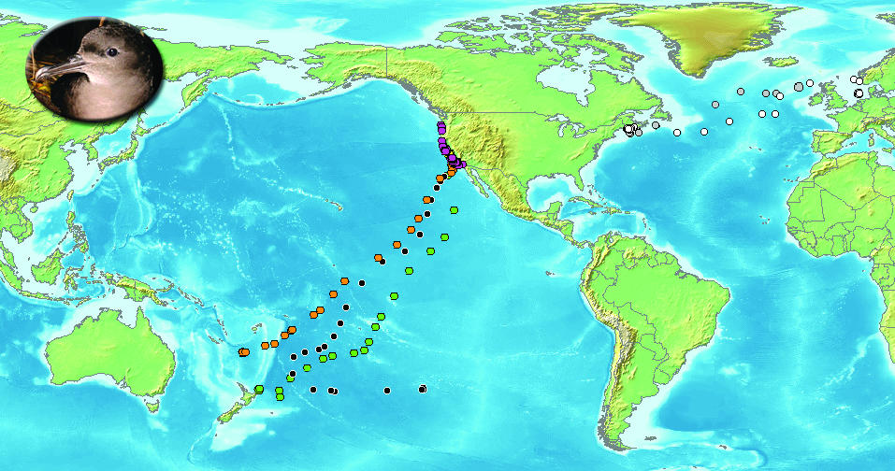
Many marine scientists will observe the movements of many marine animals that are tracked by satellite.
In most cases scientists attach a small satellite transmitter onto an animal so that they may observe its movements and learn about its behavior.
Notes:
Marine animals face many challenges, both natural and as a result of human activities. Studying and understanding their movements is the first step in learning to protect them. This loggerhead sea turtle is fitted with a satellite transmitter. Its release will provide scientists with data based on its movement through the sea.
Sooty Shearwaters. Each color represents one individual animal and its movement over time (two months). Observed over thousands of miles .
Describe the path of the animals
Why might the birds travel so far?
What differences in the ocean might these seabirds or others experience along their routes?

Slide 9
Engage Questions page 4 and 5
Think about what you already know about the ocean. What do you picture when you consider its waters? In your notebook, draw a sketch of what you think about when you picture the ocean.
Write 4-5 sentences about why you think the ocean is important.
Write at least tow questions that you have about the ocean. Your questions can be about anything ocean related, including living things, the makeup of the water, how water flows, places in the oceans, etc.

Slide 10
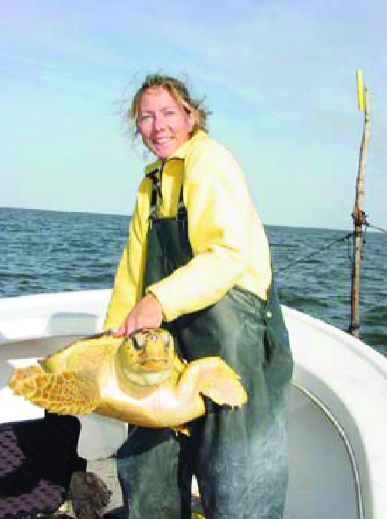
Explore- marine ecosystems project
The ocean covers more than 70% of our Blue Planet.
Includes many different ecosystems that range from the depths of the deep to the sunny surface, close to shore to thousands of miles away from the coast.
Each ocean ecosystem includes:
1. Biotic: living
2. Abiotic: non-living
There is a relationship between interdependent biotic organisms and the physical abiotic factors- very important to the health of the ecosystem and diversity of life

Slide 11
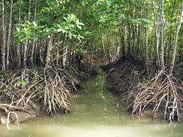
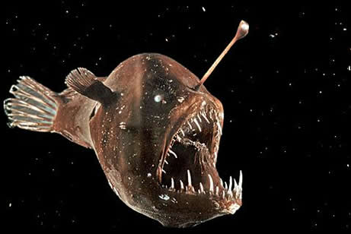
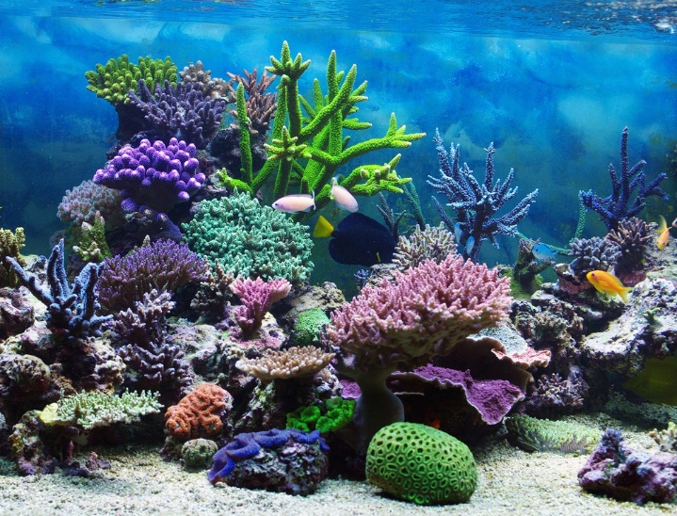
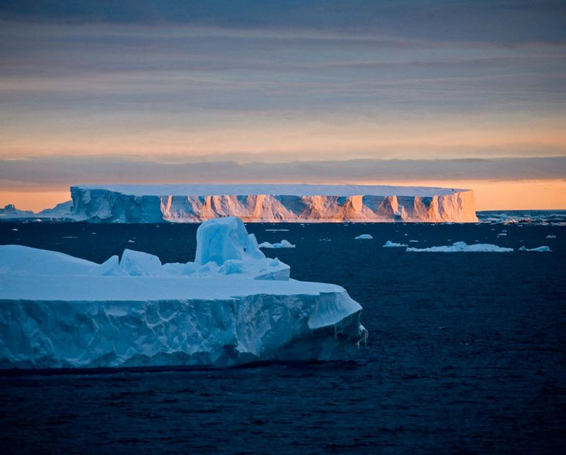
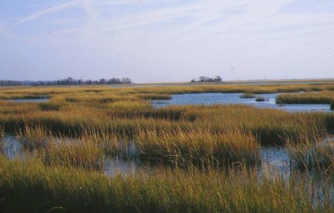
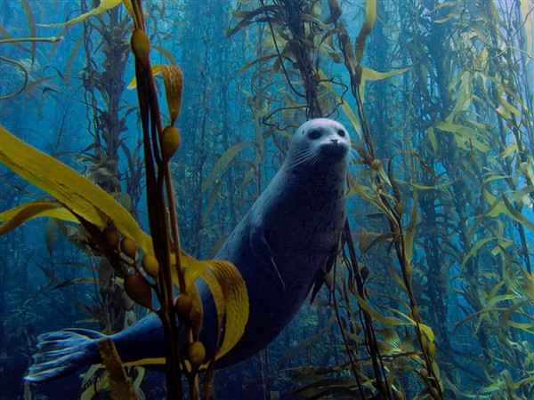
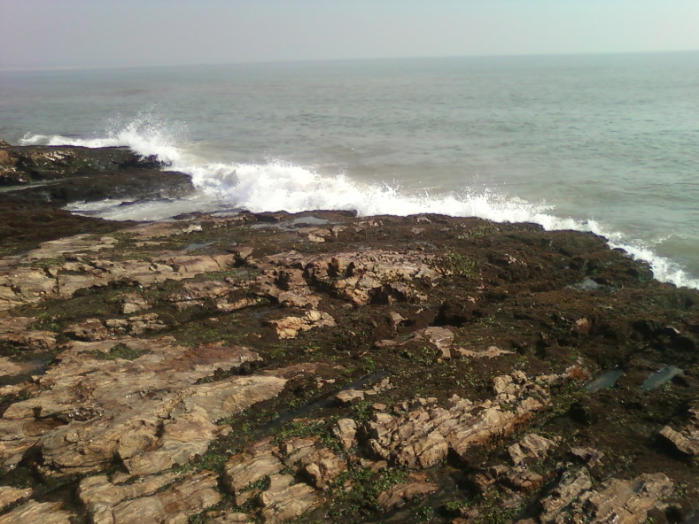
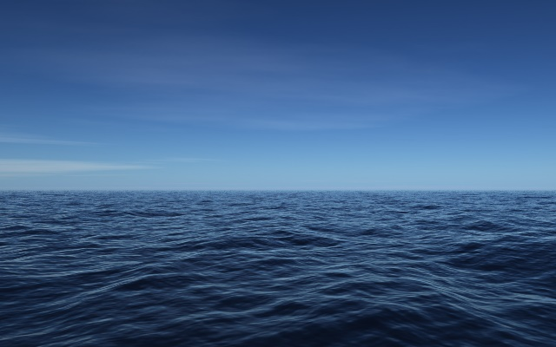
Ocean ecosystems
Coral Reef
Mangrove forest
Deep sea
Open ocean
Kelp forest
Polar Sea
Salt Marsh
Rocky Shore

Slide 12
Elaborate: Changing ecosystems
All of the living things within an environment make up a biological community.
The interaction of the living things (biotic factors) with the non-living things (abiotic factors), along with an energy source, create an ecosystem.
Changes that occur naturally and constantly in an ecosystem include:
1. Seasonal temperature fluctuations
2. changes in nutrient availability
3. life cycles of organisms
4. rise and fall of the tides
When one of the abiotic or biotic factors changes, or a new introduced, it can affect the rest of the ecosystem.
Notes:
As you study and track marine animals, why is it important to understand that the ocean comprises many different ecosystems?

Slide 13
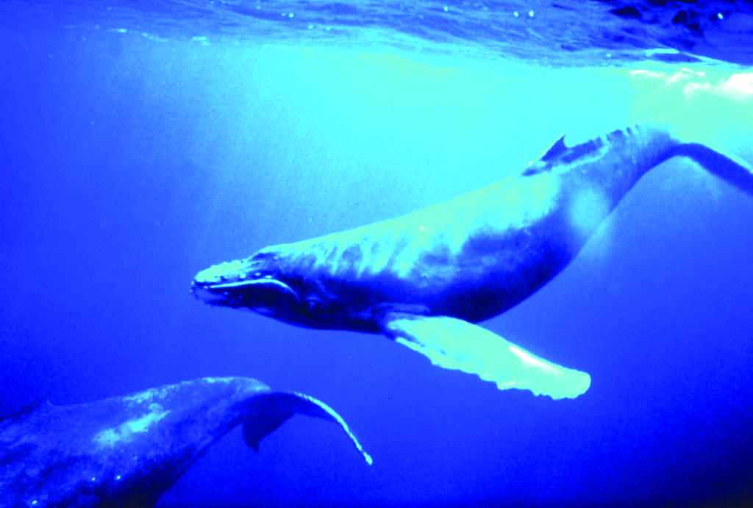
Case Study 1: Whale falls
The Blue Whale is the largest animal to have ever lived on Earth.
Longest migration of all mammals
Humpback, migrate more than 8,000 kilometers (~5000 miles)
Average life span is longer than that of humans and most other marine mammals.
http://www.us-satellite.net/marinescience/resources/audio_video/lesson1/WhaleFallCommunity2.cfm

Slide 14
What is a whale fall anyway???
Whale Falls- when a whale dies the carcass sinks to the seafloor.
This is one example of a change that affects the ecosystem by introducing nutrients to the seafloor.
The skeleton of a 90-ton whale contains 5 tons of oil
The animals body provides more nutrients to the tens of thousands of organisms that visit it.
~More than 400 animal species maybe more
Notes:
One example of a change that affects the ecosystem is called a Whale Fall
***When a whale dies the carcass sinks to the
sea floor.

Slide 15
Organisms that feed on whale falls
Scavengers are responsible for removing the flesh (soft tissue) from the whale include:
hagfishes, sleeper sharks, crabs and others
The colonizers are those that arrive and stay for extended periods of time, living off the tissue left by organisms in the first group:
Snails, slugs, worms, shrimp, crabs and other crustaceans
Organisms that are considered bone-eaters, are present for long periods, living off the oil contained in the bone
A very diverse group of organisms including worms that are able to break down the whale bone
What is left of the whale skeleton is decomposed by more bone eating worms, or nishers, or is covered by sediments on the seafloor
http://www.us-satellite.net/marinescience/resources/audio_video/lesson1/WhaleFallCommunity2.cfm

Slide 16
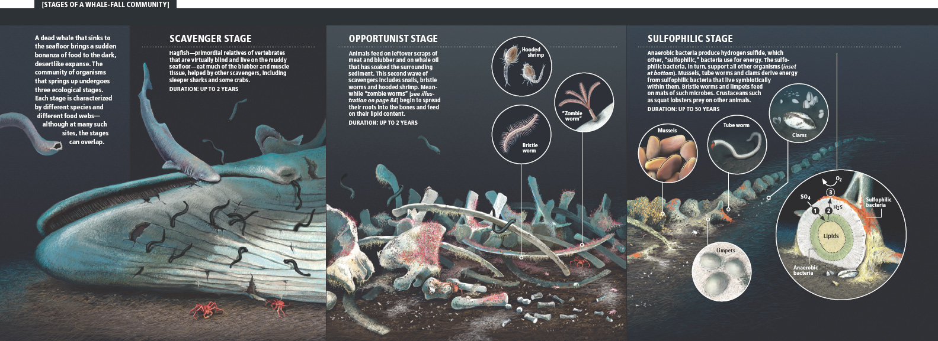

Slide 17
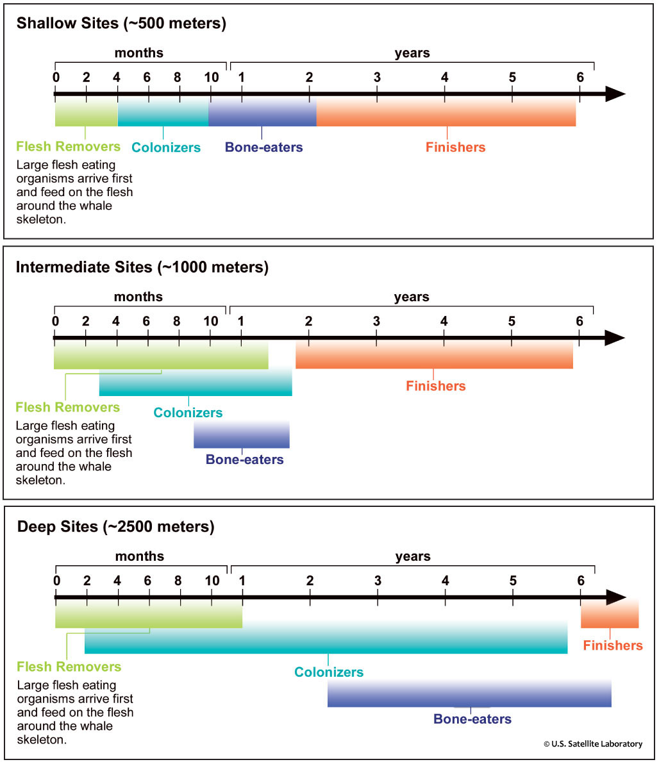
Let’s analyze Data
The varied species that break down the whale exist at all depths.
The specific species that arrive and perform the decomposition of the whale carcasses are different depending on the depth of the whale fall.
The time it takes for each stage can vary widely.
Notes:
The data presented on the next page represents examples, and are not necessarily generalized to all whale falls at the noted depths. Due to small sample sizes is the reason for uncertainity.

Slide 18
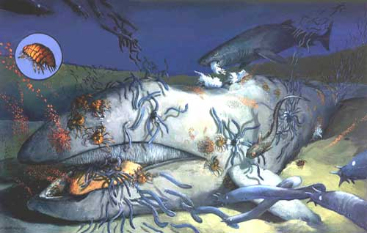
Succession
Whale falls are one example of how, after a change occurs in an ecosystem, species progressively replace one another until they reach a stable community-Succession.
In the case of a whale fall, what do you think is the stable community?
Seafloor-Benthic ecosystem

Slide 19
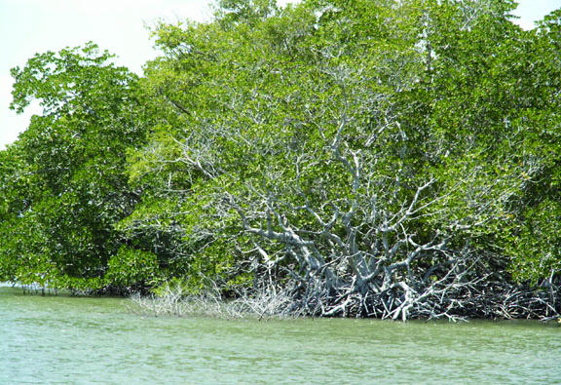
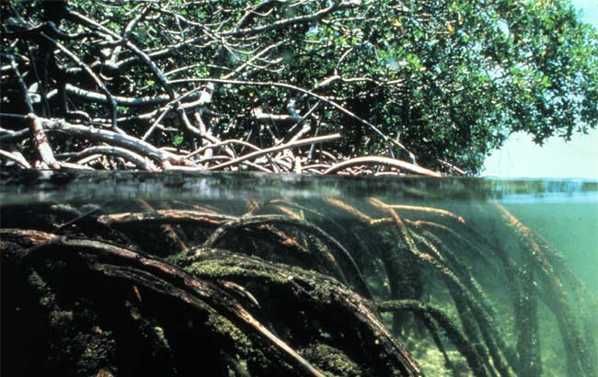
Case study 2: Mangrove Restoration
Mangrove forests are an important ecosystem for species of fish, plants, birds and other wildlife.
Found along the coast where freshwater meets saltwater from the ocean in subtropical and tropical latitudes near the Equator in areas such as Florida
Covers less than 8% of the Earth’s coastlines
Organisms that reside in the mangroves are able to tolerate water that is slightly salty (brackish)
Species rely on biotic and abiotic factors in this environment for breeding, raising young , finding food and protection
Considered one of the most diverse marine ecosystem
Mangroves are also a significant source of nutrients for marine food chains (fallen leaves)

Slide 20
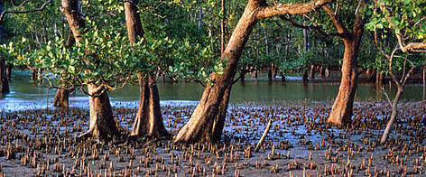
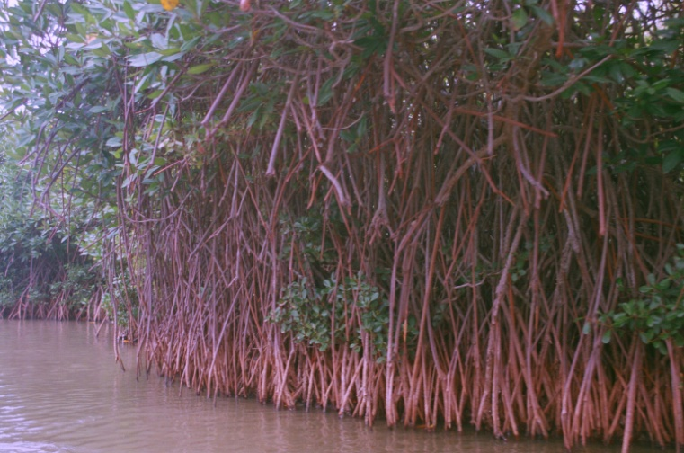
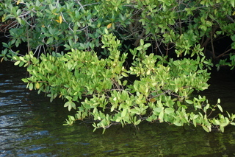
Very few trees make up the Mangrove forest in Florida.
The species of trees that grow in the mangrove ecosystem are called mangroves
Four main groups:
This community of plants provide a barrier between the ocean and the land
The plants stabilize the soil and reduce erosion form large storms and hurricanes.
Serve as filters for freshwater entering the ocean from the land.
Why would freshwater runoff need to be filtered?
Runoff can contain pollutants and excessive amounts of sediment that can harm ocean ecosystems
Mangroves trap sediments that contain pollutants such as heavy metals (e.g.. Mercury and lead) and prevents them from being washed into the ocean.
Red mangroves
Black mangroves
White mangroves
Buttonwoods

Slide 21
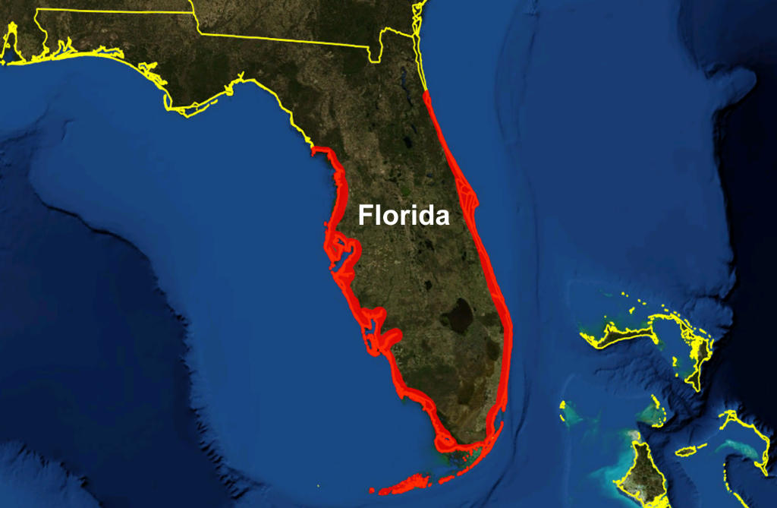
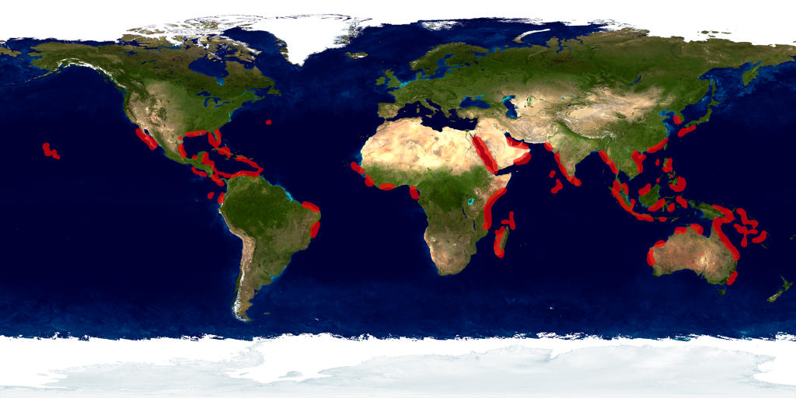
Distribution of mangrove forests in Florida indicated in red.
Global distribution of Mangrove Forests indicated in red on NASA Blue Marble image.

Slide 22
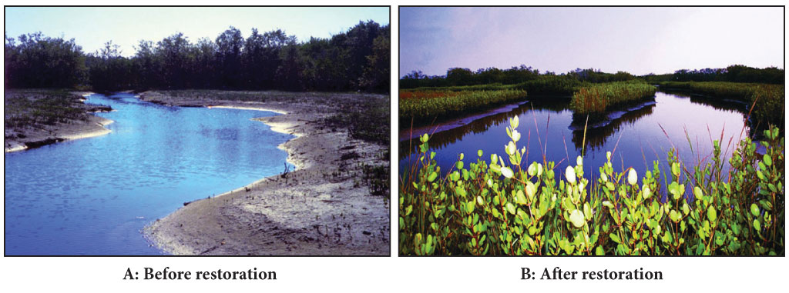
Page 14
#15. Copy the chart into your notebook. Compare the biotic and abiotic factors in the photographs above
#16. How do the differences observed between Photographs A and B demonstrate succession?
Photograph | Biotic Factors | Abiotic Factors
A
B

Slide 23
What are National Marine Sanctuaries?
America’s underwater treasures
System of 14 marine protected areas that encompass nearly 250,000 square kilometers (more than 150,000) of marine and Great Lakes waters from Washington State to the Florida Keys and from Lake Huron to America Samoa.
These areas have regulations that allow some human activities and do not allow others.
Sanctuaries allow both commercial and recreational fishing unless these fishing activities become destructive to habitats
Each sanctuary has different regulations and these rules protect these special habitats.
Scientists conduct formal research in sanctuaries to learn more about the ecosystems and the organisms that make them their homes.

Slide 24
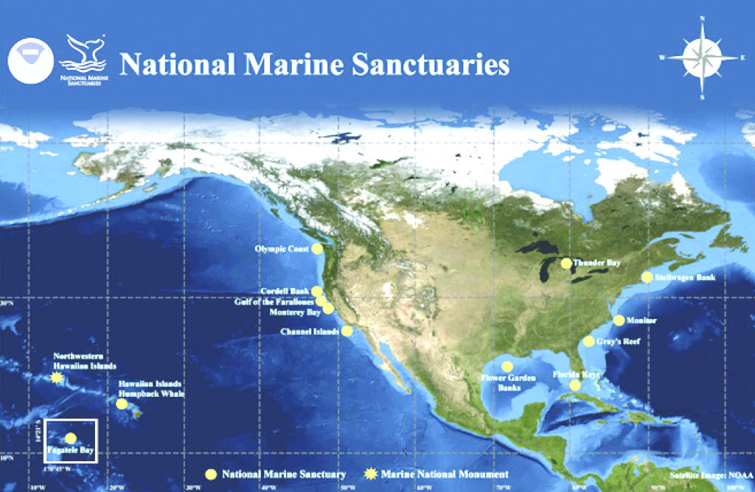

Slide 25
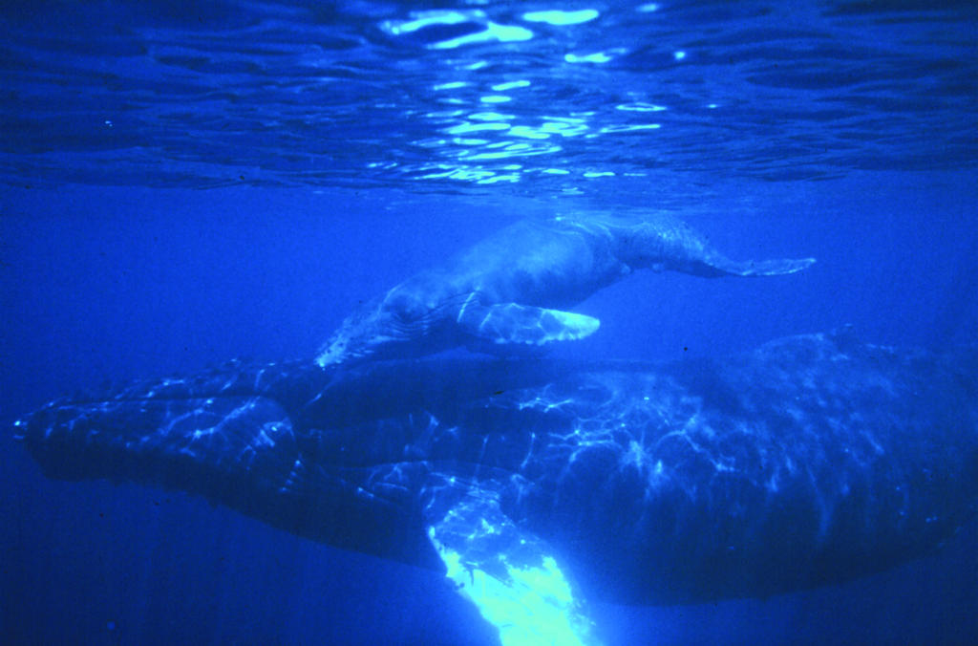
Page 15
#17. Why might the National Sanctuaries be important when studying the paths of marine animals?
Based on your research, what are some of the problems that living things in the ecosystem you studied have faced?
Humpback Whale mother and calf.

