Slide 1
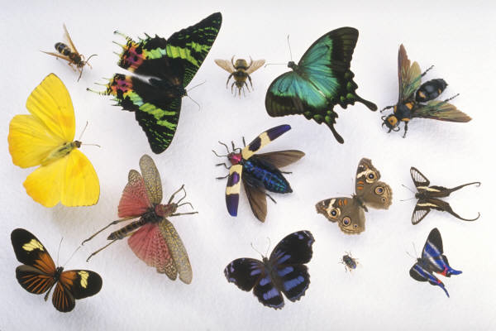
Classification & Dichotomous Keys
Notes:
http://www.kaycook.com/6_butterfly_html_26d9b7e5.jpg

Slide 2
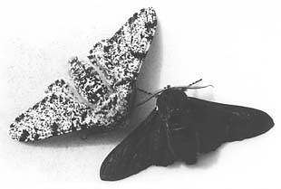
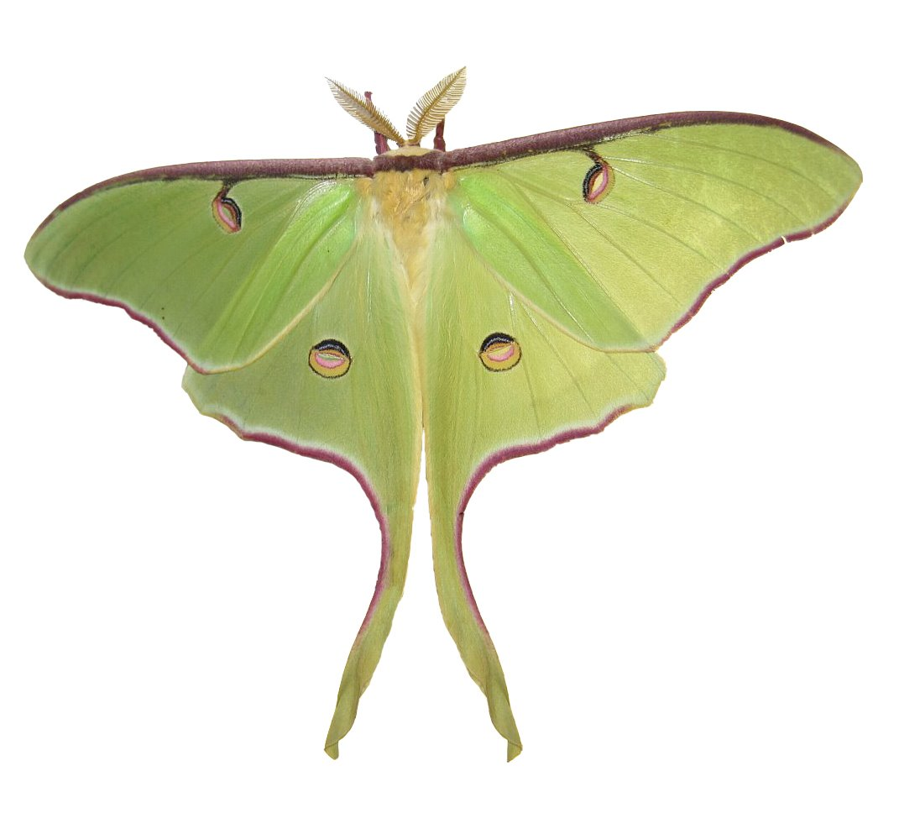
How do you differentiate between organisms?
Notes:
Left: http://www.csc.villanova.edu/~ysp/Teacher/Webpages/mstp_payne/Web_project/images/peppered_moth/2moths.GIF
Right: http://upload.wikimedia.org/wikipedia/commons/9/9c/Luna_Moth_by_Joey.jpg

Slide 3
Dichotomous keys: 2 choices, 1 correct answer
Used to describe organisms
Simple means of visual classification
Given 2 options (with wings, without wings) → choose the correct option, proceed as directed
Ex. “1a. Insect has 1 pair of wings → proceed to number 3.
1b. Insect has 2 pairs of wings → proceed to number 2.”
Narrows down possible organisms/groups one trait at a time
Not appropriate for individual species identification OR classifying very small organisms (bacteria, viruses, etc.)

Slide 4
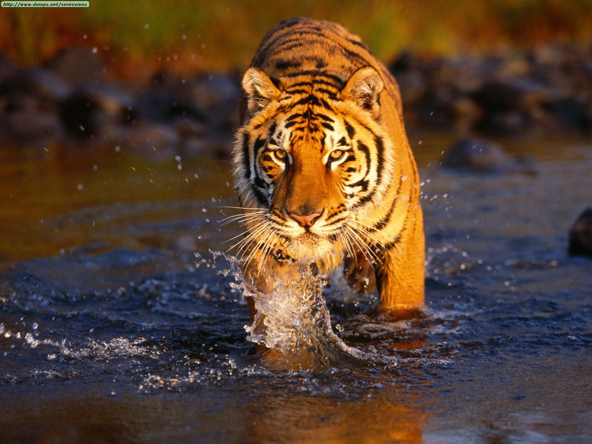
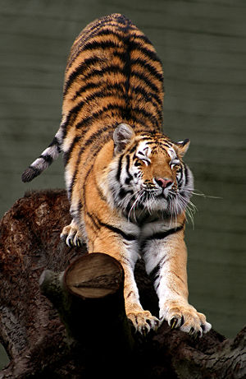
Are they the same species?
Notes:
Left: Bengal tiger - http://1.bp.blogspot.com/_W90V87w3sr8/TMbyfnBa7fI/AAAAAAAAAEE/c2Qk7tsdrw0/s1600/bengal+2.jpg
Right: Siberian tiger - http://us.123rf.com/400wm/400/400/enjoylife25/enjoylife250806/enjoylife25080600035/3122634-siberian-tiger--tiger-panthera-tigris-altaica-in-water.jpg

Slide 5
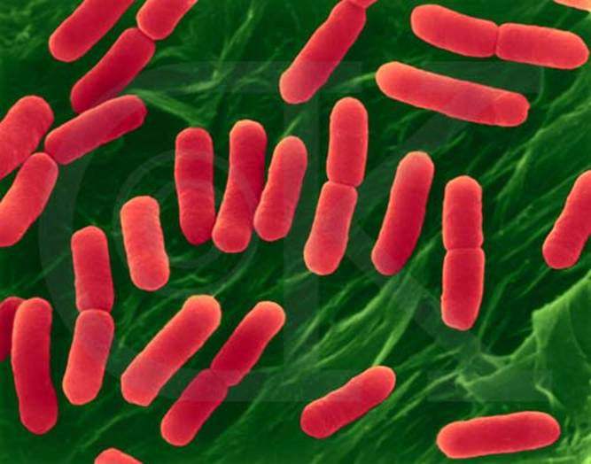
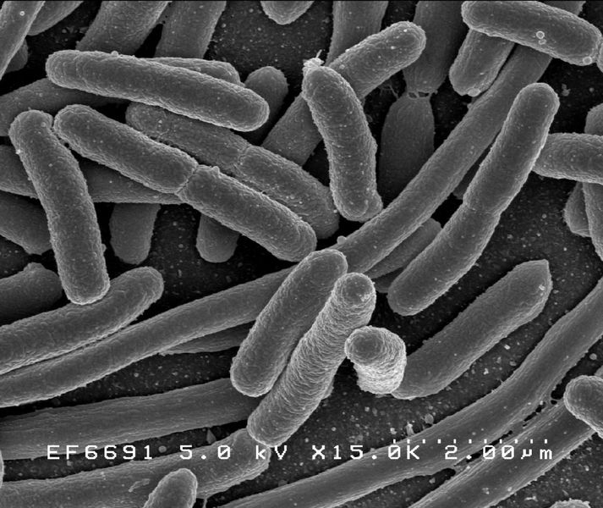
Are these the same organism?
Notes:
Left: E. coli - http://www.emc.maricopa.edu/faculty/farabee/biobk/96444c.jpg
Right: E. coli - http://upload.wikimedia.org/wikipedia/commons/thumb/3/32/EscherichiaColi_NIAID.jpg/210px-EscherichiaColi_NIAID.jpg

Slide 6
Dichotomous keys ARE good for…
Domain
Kingdom
Phylum
Class
Order
Family
Genus
Species
identifying down to the order or family
sometimes to the genus → depends on the org.
What are the levels of biological organization?

Slide 7
Practice: Using a simple key
1a. Has wings with feathers.
1b. Has leathery, scaly wings.
2a. Has a long, whip-like tail.
2b. Has a thick, bulky tail.
3a. Has a large, curved beak.
3b. Has a small, straight beak.
Proceed to 3.
Proceed to 2.
Order Drachoptera
Proceed to 4.
Order Phenotera.
Proceed to 5.

Slide 8
Today: 2 Activities
Activity 1: Shark Dichotomous Keys
Activity 2: Create your own Dichotomous Key

