Slide 1
Introduction to Genetics
Chapter 11

Slide 2
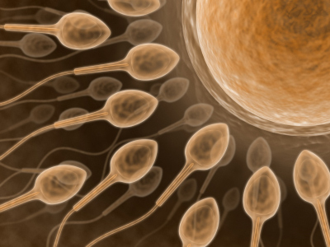
What we already know…
In sexual reproduction, gametes (sperm and egg) unite to form the first diploid cell (zygote)……

Slide 3
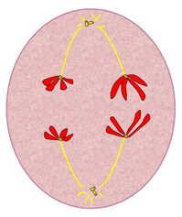
Back in Meiosis I……
During Anaphase I, homologous chromosomes separated……
Law of Independent Assortment - chromosomes assort independently, not individual genes

Slide 4
The Work of Gregor Mendel
Section 11.1
Mendel's Pea Plants
(start at 10 min)

Slide 5
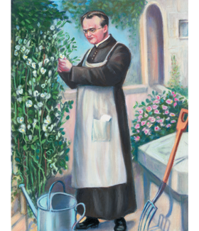
The Father of Heredity
The modern science of genetics was founded by an Austrian monk named Gregor Mendel.
Mendel was in charge of the monastery garden, where he was able to do the work that changed biology forever.

Slide 6
The Experiments of Gregor Mendel
Mendel carried out his work with ordinary garden peas, partly because peas are small and easy to grow. A single pea plant can produce hundreds of offspring.
Today we call peas a “model system.”

Slide 7
The Experiments of Gregor Mendel
By using peas, Mendel was able to carry out, in just one or two growing seasons, experiments that would have been impossible to do with humans and that would have taken decades—if not centuries—to do with other large animals.

Slide 8
Vocabulary:
Heredity
Genetics
Fertilization
Self-Pollination
Cross-Pollination
Traits
Alleles
Genotype
Phenotype
Dominant
Recessive
Homozygous
Heterozygous

Slide 9
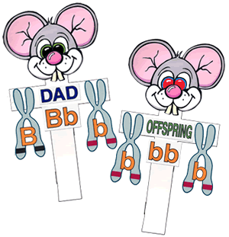
The Experiments of Gregor Mendel
Every living thing—plant or animal, microbe or human being—has a set of characteristics inherited from its parent or parents.
The delivery of characteristics from parent to offspring is called heredity.
The scientific study of heredity, known as genetics, is the key to understanding what makes each organism unique.
Mendelian Heredity 1 Teacher Tube
(stop at 5:30)

Slide 10
The Role of Fertilization
Mendel knew that the male part of each flower makes pollen, which contains sperm—the plant’s male reproductive cells.
Similarly, Mendel knew that the female portion of each flower produces reproductive cells called eggs.

Slide 11
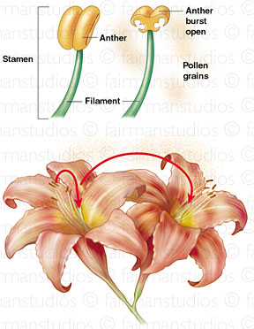
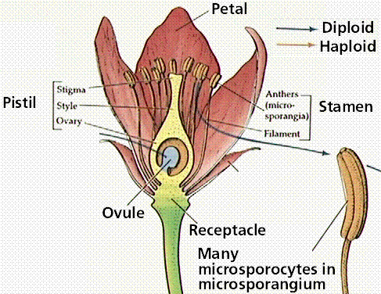
Pollination:
Occurs when pollen grains produced in the male reproductive parts of a flower, called the anthers, are transferred to the female reproductive parts of a flower called the stigma.

Slide 12
The Role of Fertilization
During sexual reproduction, male and female reproductive cells join to produce a new cell in a process known as fertilization.
In peas, this new cell develops into a tiny embryo encased within a seed.
Pea flowers are normally self-pollinating, which means that sperm cells fertilize egg cells from within the same flower.
A plant grown from a seed produced by self-pollination inherits all of its characteristics from the single plant that bore it.
In effect, it has a single parent.

Slide 13
The Role of Fertilization
Mendel’s garden had several stocks of pea plants that were “true-breeding,” meaning that they were self-pollinating, and would produce offspring with identical traits to themselves.
In other words, the traits of each successive generation would be the same.
A trait is a specific characteristic of an individual, such as seed color or plant height, and may vary from one individual to another.

Slide 14
The Role of Fertilization
Mendel decided to “cross” his stocks of true-breeding plants—he caused one plant to reproduce with another plant.
To do this, he had to prevent self-pollination. He did so by cutting away the pollen-bearing male parts of a flower and then dusting the pollen from a different plant onto the female part of that flower, as shown in the figure.

Slide 15
The Role of Fertilization
This process, known as cross-pollination, produces a plant that has two different parents.
Cross-pollination allowed Mendel to breed plants with traits different from those of their parents and then study the results.

Slide 16
The Role of Fertilization
Mendel studied seven different traits of pea plants, each of which had two contrasting characteristics.
Mendel crossed plants with each of the seven contrasting characteristics and then studied their offspring.
The offspring of crosses between parents with different traits are called hybrids.

Slide 17
Genes and Alleles
Each of the traits Mendel studied was controlled by one gene that occurred in two contrasting varieties.
These gene variations produced different expressions, or forms, of each trait.
The different forms of a gene are called alleles.

Slide 18
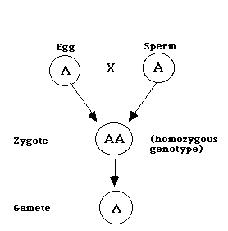
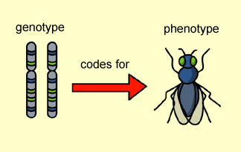
Genotype:
Genetic make-up of an organism
Examples: Aa, BB, cc

Slide 19
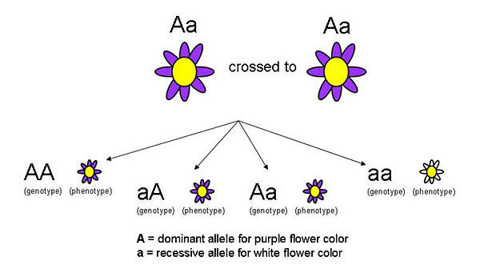
Phenotype:
Physical characteristics of an organism
Examples: blue eyes, brown hair, freckles

Slide 20
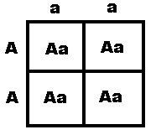
Dominant:
Form of a gene that is expressed even if present with a contrasting recessive allele.
Example: Aa A = dominant allele

Slide 21
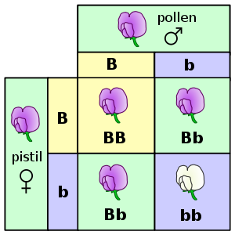
Recessive:
Form of a gene (allele) that is only expressed in the homozygous state.
Example: bb

Slide 22
Homozygous (Purebred):
Organism that has two identical alleles for a particular trait.
Examples: AA, bb, CC, dd

Slide 23
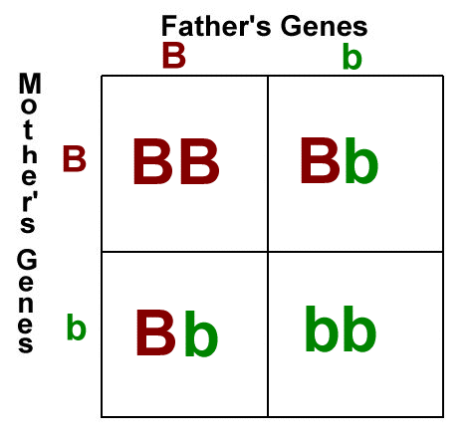
Heterozygous (Hybrid):
Organism that has two different alleles for the same gene.
Examples: Aa, Bb, Cc, Dd

Slide 24
Genes and Alleles
When doing genetic crosses, we call the original pair of plants the P generation, or the parental generation.

Slide 25
Genes and Alleles
Their offspring are called the F₁, or “first filial,” generation. The offspring of a cross between two F₁ individuals are called the F₂, or “second filial” generation.

Slide 26
Genes and Alleles
For each trait studied in Mendel’s experiments, all the offspring had the characteristics of only one of their parents, as shown in the table.

Slide 27
Genes and Alleles
In each cross, the nature of the other parent, with regard to each trait, seemed to have disappeared.

Slide 28
Genes and Alleles
From these results, Mendel drew two conclusions. His first conclusion formed the basis of our current understanding of inheritance.
An individual’s characteristics are determined by factors that are passed from one parental generation to the next.
Scientists call the factors that are passed from parent to offspring genes.

Slide 29
Dominant and Recessive Traits
Mendel’s second conclusion is called the Principle of Dominance. This principle states that some alleles are dominant and others are recessive.
An organism with at least one dominant allele for a particular form of a trait will exhibit that form of the trait.
An organism with a recessive allele for a particular form of a trait will exhibit that form only when the dominant allele for the trait is not present.

Slide 30
Dominant and Recessive Traits
In Mendel’s experiments, the allele for tall plants was dominant and the allele for short plants was recessive. Likewise, the allele for yellow seeds was dominant over the recessive allele for green seeds

Slide 31
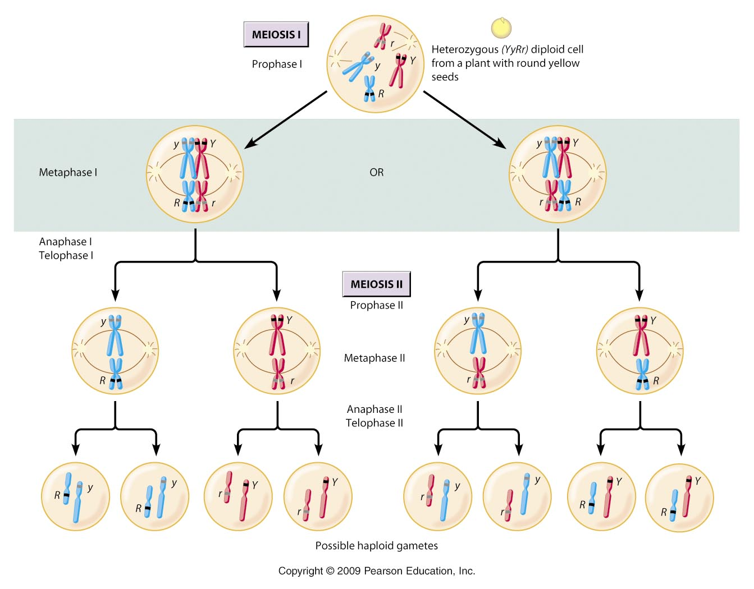
Segregation:
During gamete formation, the alleles for each gene segregate from each other, so that each gamete carries only one allele for each gene.

Slide 32
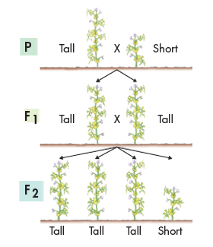
Segregation
Mendel wanted to find out what had happened to the recessive alleles.
To find out, Mendel allowed all seven kinds of F₁ hybrids to self-pollinate. The offspring of an F₁ cross are called the F₂ generation.
The F₂ offspring of Mendel’s experiment are shown.

Slide 33
The F1 Cross
When Mendel compared the F₂ plants, he discovered the traits controlled by the recessive alleles reappeared in the second generation.
Roughly one fourth of the F₂ plants showed the trait controlled by the recessive allele.

Slide 34
Explaining the F₁ Cross
Mendel assumed that a dominant allele had masked the corresponding recessive allele in the F₁ generation.
The reappearance of the recessive trait in the F₂ generation indicated that, at some point, the allele for shortness had separated from the allele for tallness.

Slide 35
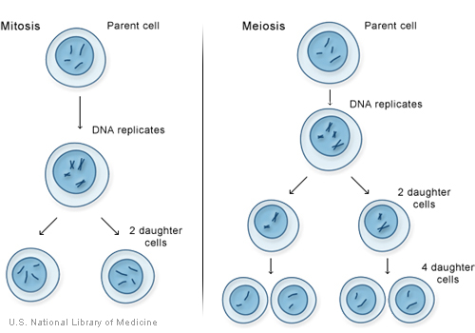
Explaining the F1 Cross
How did this separation, or segregation, of alleles occur?
Mendel suggested that the alleles for tallness and shortness in the F₁ plants must have segregated from each other during the formation of the sex cells, or gametes.

Slide 36
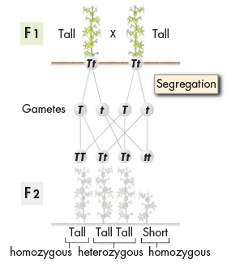
The Formation of Gametes
Let’s assume that each F₁ plant—all of which were tall—inherited an allele for tallness from its tall parent and an allele for shortness from its short parent (Tt).

Slide 37
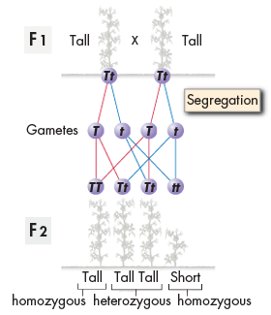
The Formation of Gametes
When each parent, or F₁ adult, produces gametes, the alleles for each gene segregate from one another, so that each gamete carries only one allele for each gene.

Slide 38
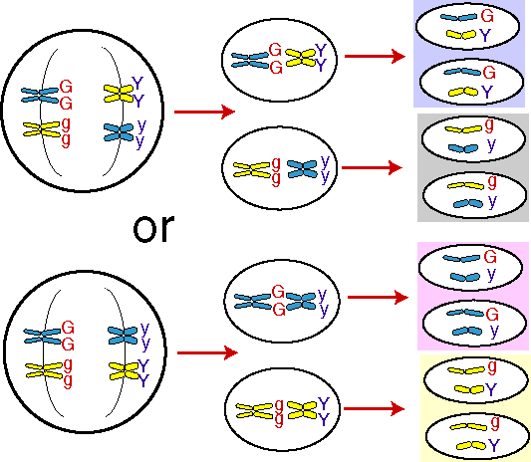
Independent Assortment
How do alleles segregate when more than one gene is involved?
The principle of independent assortment states that genes for different traits can segregate independently during the formation of gametes.
100 Greatest Discoveries (Genetics)
45 min – stop at 8 for Mendel

Slide 39
Applying Mendel’s Principles
Section 11.2

Slide 40
THINK ABOUT IT
Nothing in life is certain.
If a parent carries two different alleles for a certain gene, we can’t be sure which of those alleles will be inherited by one of the parent’s offspring.
However, even if we can’t predict the exact future, we can do something almost as useful—we can figure out the odds.

Slide 41
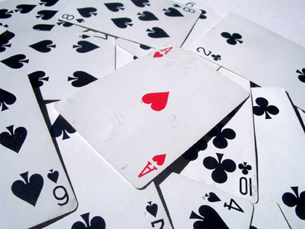
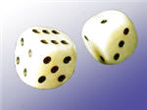
Probability and Punnett Squares
Mendel realized that the principles of probability could be used to explain the results of his genetic crosses.
Probability is the likelihood that a particular event will occur.
Probability = ________________________________________
Number of favorable outcomes
(ways it can happen)
Number of possible outcomes

Slide 42
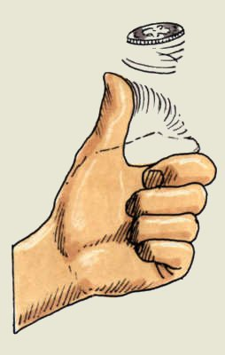
Probability and Punnett Squares
For example, there are two possible outcomes of a coin flip:
The coin may land either heads up or tails up.
The chance, or probability, of either outcome is equal. Therefore, the probability that a single coin flip will land heads up is 1 chance in 2.
This amounts to 1/2, or 50 percent.

Slide 43
Probability and Punnett Squares
Example: the chances of rolling a "4" with a die
Number of ways it can happen: 1 (there is only 1 face with a "4" on it)
Total number of outcomes: 6 (there are 6 faces altogether)

Slide 44
Probability and Punnett Squares
If you flip a coin three times in a row, what is the probability that it will land heads up every time?
Each coin flip is an independent event, with a one chance in two probability of landing heads up.
Therefore, the probability of flipping three heads in a row is:
½ x ½ x ½ = 1/8

Slide 45
Probability and Punnett Squares
As you can see, you have 1 chance in 8 of flipping heads three times in a row.
Past outcomes do not affect future ones. Just because you’ve flipped 3 heads in a row does not mean that you’re more likely to have a coin land tails up on the next flip.

Slide 46
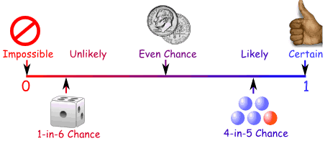
Using Segregation to Predict Outcomes
The way in which alleles segregate during gamete formation is every bit as random as a coin flip.
Therefore, the principles of probability can be used to predict the outcomes of genetic crosses.
Probability is always between 0 and 1

Slide 47
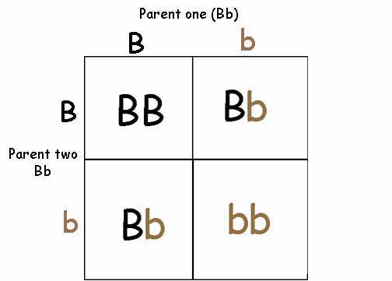
Using Punnett Squares
One of the best ways to predict the outcome of a genetic cross is by drawing a simple diagram known as a Punnett square.
Punnett squares allow you to predict the genotype and phenotype combinations in genetic crosses using mathematical probability.

Slide 48
How To Make a Punnett Square for a One-Factor (MONOHYBRID) Cross
Write the genotypes of the two organisms that will serve as parents in a cross.
In this example we will cross a male and female osprey that are heterozygous for large beaks. They each have genotypes of Bb.
Example: Bb and Bb

Slide 49
How To Make a Punnett Square
Determine what alleles would be found in all of the possible gametes that each parent could produce.
Bb
B b

Slide 50
How To Make a Punnett Square
Draw a table with enough spaces for each pair of gametes from each parent.
Enter the genotypes of the gametes produced by both parents on the top and left sides of the table.
 | B | b
B
b

Slide 51
How To Make a Punnett Square
Fill in the table by combining the gametes genotypes.
 | B | b
B | BB | Bb
b | Bb | bb

Slide 52
How To Make a Punnett Square
Determine the genotypes and phenotypes of each offspring. Calculate the percentage of each. In this example, three fourths of the chicks will have large beaks, but only one in two will be heterozygous.
 | B | b
B | BB | Bb
b | Bb | bb
Genotypic Ratio:
¼ BB, ½ Bb, ¼ bb
25% BB, 50% Bb, 25% bb
1 BB : 2 Bb : 1 bb
Phenotypic Ratio:
¾ large beaks, ¼ small beaks
75% large beaks, 25% small beaks
3 large beaks : 1 small beak

Slide 53
How To Make a Punnett Square for a Two-Factor (DIHYBRID) Cross
Determine what alleles are found in the possible gametes each parent could produce.
Example Parents: both are heterozygous for size (tall and short alleles) and pod color (green and yellow alleles).
TtGg x TtGg

Slide 54
How to Make a Dihybrid Punnett Square

Slide 55
How to Interpret a Dihybrid Punnett Square
Determine the phenotypic ratio of the possible offspring.
(You will not need to determine the genotypic ratio of a dihybrid cross.).
D= Dominant form of the trait
R= Recessive form of the trait
DD :DR :RD :RR

Slide 56
Other Patterns of Inheritance
Section 11.3

Slide 57
Vocabulary
Incomplete Dominance
Codominance
Multiple Alleles
Polygenic Traits

Slide 58
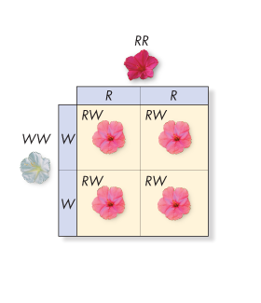
THINK ABOUT IT
Mendel’s principles offer a set of rules with which to predict various patterns of inheritance.
There are exceptions to every rule, and exceptions to the exceptions.
What happens if one allele is not completely dominant over another? What if a gene has several alleles?

Slide 59
Beyond Dominant and Recessive Alleles
What are some exceptions to Mendel’s principles?
Some alleles are neither dominant nor recessive.
Many genes exist in several different forms, and are therefore said to have multiple alleles.
Many traits are produced by the interaction of several genes.

Slide 60
Incomplete Dominance
A cross between two four o’clock plants shows a common exception to Mendel’s principles.
The F₁ generation produced by a cross between red-flowered (RR) and white-flowered (WW) plants consists of pink-colored flowers (RW), as shown.

Slide 61
Incomplete Dominance
In this case, neither allele is dominant. Cases in which one allele is not completely dominant over another are
called incomplete dominance.
In incomplete dominance, the heterozygous phenotype lies somewhere between the two homozygous phenotypes.

Slide 62
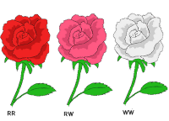
Incomplete Dominance
Example: Japanese four- o’clocks
RR = red flowers
RW = pink flowers
WW = white flowers

Slide 63
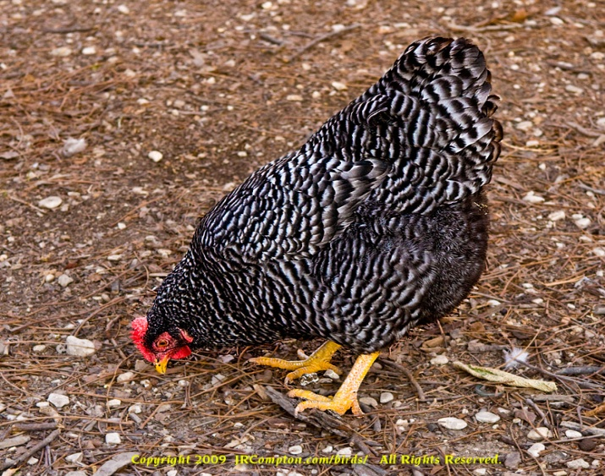
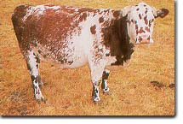
Codominance
Cases in which the phenotypes produced by both alleles are clearly expressed are called codominance.
For example, in certain varieties of chicken, the allele for black feathers is codominant with the allele for white feathers.

Slide 64
Multiple Alleles
A single gene can have many possible alleles.
A gene with more than two alleles is said to have multiple alleles.
Many genes have multiple alleles, including the human genes for blood type.
The ABO blood group, is determined by a gene with three alleles: I^{A}, I^{B}, and i.

Slide 65
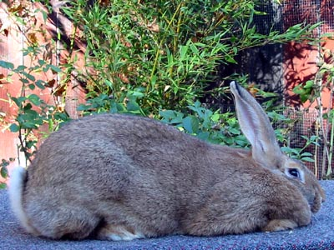
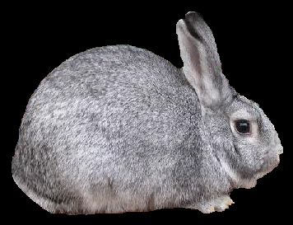
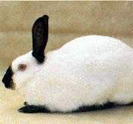
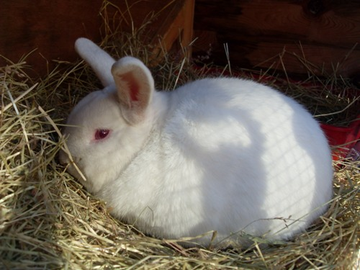
Multiple Alleles
Three or more alleles for the same gene
Examples:
Blood Groups
3 alleles
Rabbit Color
4 alleles

Slide 66
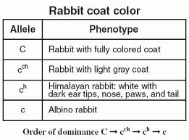
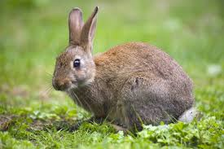
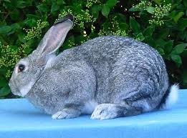
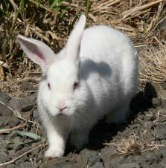
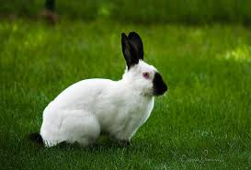

Slide 67
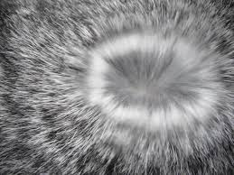
Multiple Alleles Examples:
Rabbit Color:
C = full color(wild): CC, Cc^{ch}, Cc^{h}, Cc
c^{ch} = chinchilla (black speckled white): c^{ch}c^{ch}, c^{ch}c^{h}, c^{ch}c
c^{h} = himalayan: c^{h}c^{h}, c^{h}c
c = albinism: cc

Slide 68
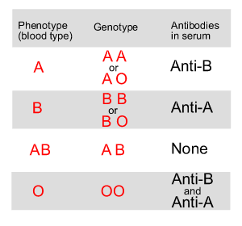
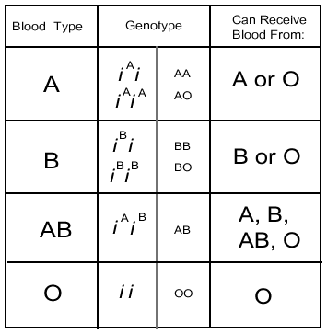
Multiple Alleles

Slide 69
Blood Types

Slide 70
Codominant and Multiple Alleles
Alleles I^{A} and I^{B} are codominant. They produce molecules known as antigens on the surface of red blood cells.
Individuals with alleles I^{A} and I^{B} produce both A and B antigens, making them blood type AB.

Slide 71
Codominant and Multiple Alleles
The i allele is recessive.
Individuals with alleles I^{A}I^{A} or I^{A}i produce only the A antigen, making them blood type A.
Those with I^{B}I^{B} or I^{B}i alleles are type B.
Those homozygous for the i allele (ii) produce no antigen and are said to have blood type O.

Slide 72
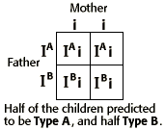
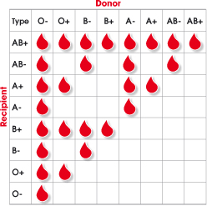
Multiple Alleles

Slide 73
Multiple Alleles Examples:
Blood Types
A I^{A} I^{A} I^{A} i
B I^{B} I^{B} I^{B} i
AB I^{A} I^{B}
O ii

Slide 74
Dominant and Recessive Alleles
A trait that displays simple dominance is the Rhesus, or Rh blood group.
The allele for Rh factor comes in two forms: Rh⁺ & Rh⁻.
Rh⁺ is dominant, so an individual with both alleles (Rh⁺/Rh⁻) is said to have Rh positive blood.
Rh negative blood is found in individuals with two recessive alleles (Rh⁻/Rh⁻).

Slide 75
Polygenic Traits
Traits controlled by two or more genes are said to be polygenic traits. Polygenic means “many genes.”
Polygenic traits often show a wide range of phenotypes.
The variety of skin color in humans comes about partly because more than four different genes probably control this trait.

Slide 76
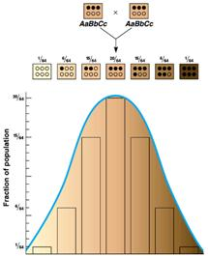
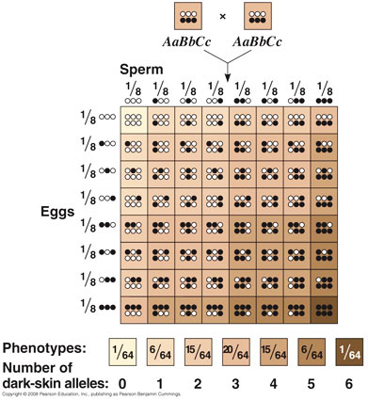
Polygenic Traits

Slide 77
Polygenic Examples:
Skin Color
Genotype %Pigmentation Color
aabb 0-11 white
Aabb, aaBb 12-25 light
AAbb,aaBB,AaBb 26-40 mulatto
AABb, AaBB 41-56 medium dark
AABB 57-78 dark

Slide 78
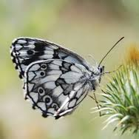
Genes and the Environment
The characteristics of any organism are not determined solely by the genes that organism inherits.
Genes provide a plan for development, but how that plan unfolds also depends on the environment.
The phenotype of an organism is only partly determined by its genotype.

Slide 79
Genes and the Environment
For example, consider the Western white butterfly. Western white butterflies that hatch in the summer have different color patterns on their wings than those hatching in the spring.
Scientific studies revealed that butterflies hatching in springtime had greater levels of pigment in their wings than those hatching in the summer.
In other words, the environment in which the butterflies develop influences the expression of their genes for wing coloration.

Slide 80
Genes and the Environment
In order to fly effectively, the body temperature of the Western white butterfly needs to be 28–40°C.
More pigmentation allows a butterfly to reach the warm body temperature faster.
Similarly, in the hot summer months, less pigmentation prevents the butterflies from overheating.

