Slide 1
EOC ECOLOGY REVIEW
CHAPTERS 3 - 6

Slide 2
CHAPTER 3 Vocab
What is ecology?
The scientific study of interactions among organisms and their environment
What is a population?
A group of the same organisms living in the same area at the same time
What is a community?
Different populations (different species) that live together in an area
What is an ecosystem?
all the organisms that live in a particular place, together with their physical environment
What is a biome?
A group of ecosystems that have similar climates and organisms

Slide 4
CHAPTER 3 Vocab
What is a biotic factor?
A living factor in the environment
Ex: A tree, grass, foxes, wolves, bunnies
What is an abiotic factor?
A nonliving factor in the environment
pH in soil, water, nitrogen in soil, rocks

Slide 5
EOC REVIEW
Which of the following are abiotic factors that shape ecosystems?
worms, plants and temperature
wind, precipitation, and soil type
niches, trees, and bacteria
sunlight, mushrooms, and wind

Slide 6
CHAPTER 3 Vocab
What are the two types of processes that autotrophs use to make food?
Photosynthesis and chemosynthesis
What is a Detritivores?
A consumer that feeds on dead matter (earthworm)

Slide 7
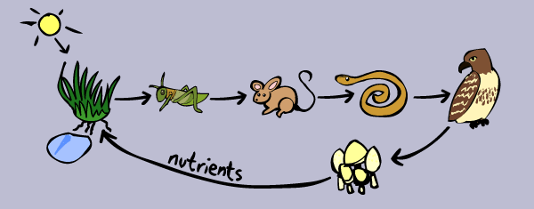
The Flow of Energy
Food Chain
Food Wed
A series of steps in which organisms transfer energy by eating and being eaten
A network of all the food chains in an ecosystem

Slide 8
The Flow of Energy
Each step in a food chain is called a __________.
Tropic level
Producers will always be at the bottom and consumers will always be at the top
Each consumer depends on the lower levels for food
There is less biomass and energy at the top levels

Slide 9
EOC REVIEW
A. There is less energy available in the producers because their tissues are less dense than those at higher trophic levels.
B. There is more energy available in the second trophic level because less energy is needed for hunting compared to the higher trophic levels.
C. There is more available energy in the birds of prey because they have greater muscle mass for storing energy than organisms in lower trophic levels have.
D. There is less available energy in the fourth trophic level because of the loss of energy through metabolism in each of the lower trophic levels.

Slide 10
EOC REVIEW
Hawk
Rabbit
Grasshopper
Mouse

Slide 11
Cycles of Matter
You will need to understand the water, carbon, nitrogen, and phosphorous cycles.
Carbon is important because all of the main molecules for life are based on it.
Nitrogen is needed to make proteins
Phosphorous is needed to make nucleotides and DNA (ADP, ATP, NADHP)
Humans affect these cycles
A limiting nutrient is a nutrient that can run low in supply and affect the ecosystem.

Slide 12
EOC REVIEW
Producers
Consumers
Decomposers
Inorganic nutrients

Slide 13
EOC REVIEW
Complete burning of plant material returns carbon primarily to the
herbivores.
water.
vegetation.
atmosphere.

Slide 14
EOC REVIEW
The framework of organic molecules essential to all organisms is composed mainly of carbon atoms. Which processes are involved in the cycling of carbon within an environment?
photosynthesis and respiration
evaporation and condensation
transcription and translation
diffusion and transpiration

Slide 15
EOC REVIEW
In a process called transpiration, plants get rid of excess water through pores in the leaves called stomata. This excess water is then released into the atmosphere as part of the water cycle. Which of the following terms best describes how the released water enters the atmosphere?
condensation
precipitation
evaporation
capillary action

Slide 16
Chapter 4: Ecosystems and Communities
What is the difference between weather and climate?
Weather is the condition of Earth’s atmosphere at a particular time and place
Climate is the average condition of temperature and precipitation in a region over long periods

Slide 17
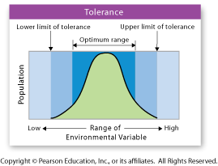
What is the difference between a niche and habitat?
A niche consists of all the physical and biological conditions in which a species lives and the way the species obtains what it needs to survive and reproduce
An organism’s niche must contain all of the resources an organism needs to survive. A resource is any necessity of life, such as water, nutrients, light, food, or space
A habitat is the location where the organism lives
The organism’s niche determines where the organism’s habitat will be.

Slide 18
No 2 species can share the same niche = competition exclusion principle.

Slide 19
Symbiosis
Occurs when two species live closely together in one of three ways:
1. Mutualism: both species benefit from the relationship
2. Parastism: one species benefits by living in or on the other and the other is harmed
3. Commensalism: one species benefits and the other is neither helped nor harmed

Slide 20
EOC REVIEW
How does the predator-prey relationship affect a population?
The predators and prey are in competition with each other.
Usually either the predator or the prey will become extinct.
The predator species usually has exponential growth.
The relationship controls the population size of both species.

Slide 21
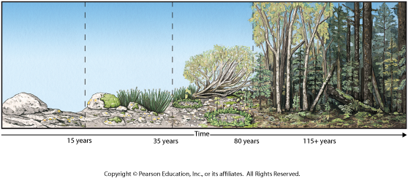
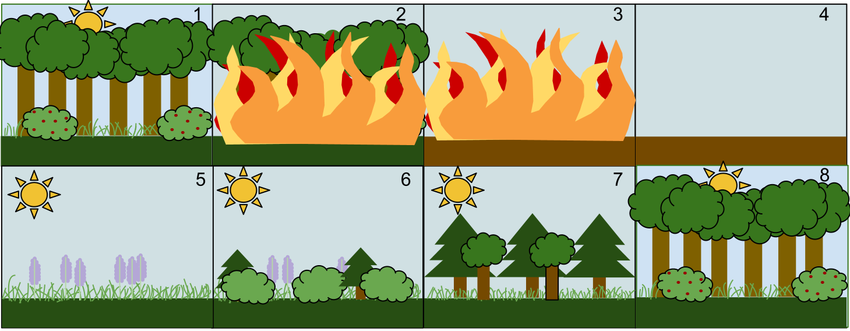
Succession
Primary
Secondary
Primary succession begins in areas with no remnants of an older community. It occurs on bare rock surfaces where no soil exists. The first species to live in an area of primary succession are called pioneer species
Secondary succession occurs when a disturbance (hurricane, fire, volcano) changes a community without completely destroying it
Is faster than primary

Slide 22
Chapter 5: Populations
What is a population?
A group of the same organisms living in the same area at the same time
What is a community?
Different populations (different species) that live together in an area
What is an ecosystem?
all the organisms that live in a particular place, together with their physical environment
What is a biome?
A group of ecosystems that have similar climates and organisms

Slide 23
Population Growth
Three important characteristics of a population are:
1. Geographic distribution, or range, is the area in which a population lives
2. Population density is the number of individuals per unit area
e.g. the number of people per square kilometer; 500 people/km2
3. Growth rate is how quickly a population increases or decreases in size

Slide 24
Population growth
What is the difference in emigration and immigration?
Immigration is Into the country, Emigration is Exiting the country
What other factors affect population growth?
Birthrate and death rate
What is the population growth rate if the initial population is 1200, and 500 are born, 250 died of predation, 300 immigrated and 100 emigrated?
450
What is the total population?
1650

Slide 25
EOC REVIEW
Data on the immigration and emigration of a fish species would be most helpful in determining which of the following?
biological magnification
interspecies competition
population of the species
predator-prey relationships

Slide 26
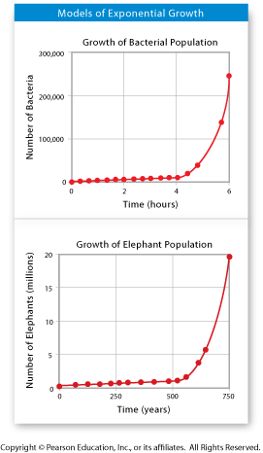
Exponential Growth
Exponential growth occurs when there are few limiting resources, predators, and disease and members of a population reproduce at a constant rate
This growth pattern is shown by a J-shaped curve.
As the population grows, the number of reproducing members keeps rising
The population grows faster and faster
How Did We Get So Big?

Slide 27
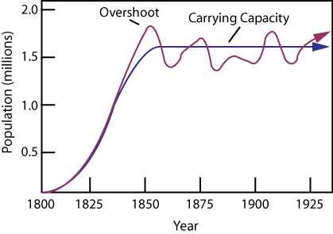
Logistical Growth
In nature, exponential growth does not occur for long (usually)
The growth will slow when the population size has reached its carrying capacity
The growth slowed because of limited resources, predator, disease, ect.
Population will
Fluctuate a little bit

Slide 28
EOC REVIEW
When an environment has reached its carrying capacity for a certain population, which of the following is true?
Growth and immigration rate is equal to death and emigration rate.
Growth and immigration rate is greater than death and emigration rate.
Growth and immigration rate is less than death and emigration rate.
Growth rate is exponential.

Slide 29
EOC REVIEW
Which of the following is a limiting factor in a population of organisms.
reproductive replacement
life spans of the members
fluctuations in atmospheric temperature
availability of food

Slide 30
Chapter 6: Humans in the biosphere
What is the difference in renewable and nonrenewable resources?
Healthy ecosystems produce or replace renewable resources.
Humans must be careful about the use of nonrenewable resources, such as fossil fuels, which cannot be replaced

Slide 31
Soil
Can be renewable, but if very damaged, it can take centuries to replace.
What is desertification and what causes it?
When all of the topsoil erodes away and becomes like a desert
In dry climates, farming and overgrazing change farmland into deserts
What is deforestation? What can it cause?
Deforestation is the loss of forests.
Because healthy forests hold soil in place, deforestation increases erosion
What are some sustainable practices?
leaving stems and roots of previous crops in place, crop rotation, contour plowing, terracing, selectively harvesting mature trees, and tree farms

Slide 32
Freshwater Water
It is a renewable, but limited resource (only 3% of water in world)
Water pollutants come from industrial chemicals, residential sewage, and other sources
Point pollution: Comes from ____________
Nonpoint pollution: Comes from __________________________________
A single source
Many smaller sources (like oil washed off road)

Slide 33
Atmosphere
Smog is a mixture of chemicals formed from emissions from cars and industry
Burning of fossil fuels releases compounds that join with water in air, forming acid rain
Greenhouse gases, such as carbon dioxide and methane, can cause global warming
Particulates are microscopic particles that cause health problems.
One way of sustaining air quality is controlling automobile emissions

Slide 34
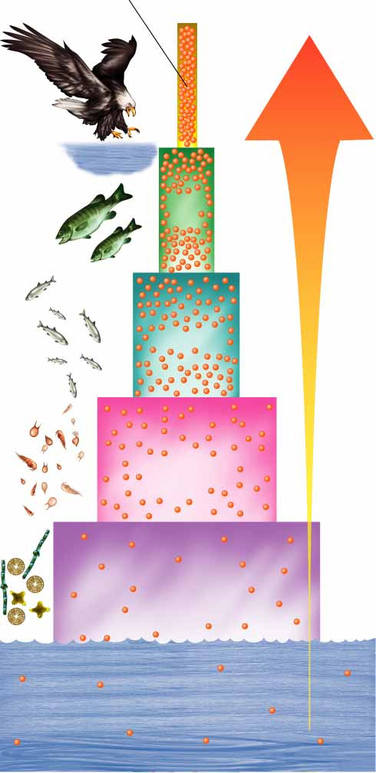
Biological Magnification
Toxic compounds build up in the tissues of organisms
These concentrations get larger in living things at higher trophic levels – biological magnification
Fish-Eating Birds
Magnification of
DDT Concentration
10,000,000
100,000
10,000
1,000,000
1
1000

Slide 35
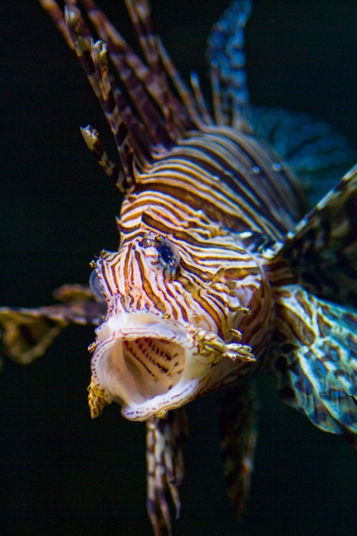
Invasive Species
Plants and animals brought into an area from other places can become invasive species
Can multiply quickly if their new habitats lacks predators or parasites to control their numbers

Slide 36
EOC REVIEW
The number of pythons found throughout Everglades National Park has increased in recent years. These huge snakes are not native to Florida and are believed to have been released into the wild by pet owners. Wildlife biologists have initiated attempts to capture and remove these pythons. Which statement best explains the biologists' reasons for removing these pythons from the Everglades?
The pythons could upset the territorial boundaries of native organisms.
The pythons could adapt to overcome diseases common to native snakes.
The pythons could prey on native organisms and cause native population to decline.
The pythons could begin to interbreed with native snakes and produce a more successful species.

