Slide 1
Chapter 9
Smoking

Slide 2
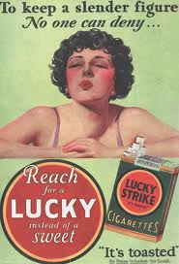
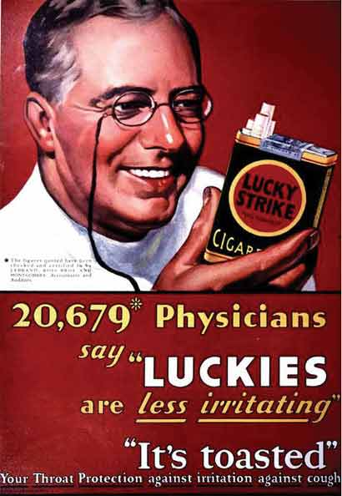
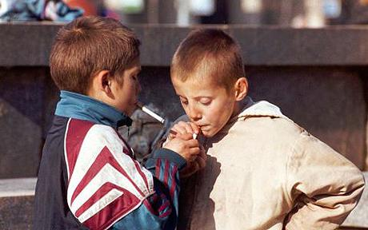
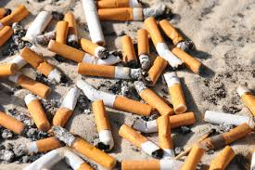
Smoking
Considered disease by Word Health Organization
Cigarettes popularized WWI
Widespread by both men and women (including children)

Slide 3
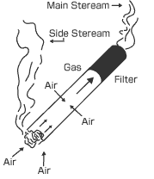
Tobacco smoke
~4000 chemicals in cigarette smoke, many toxic
Smoke composed of 2 parts:
Mainstream smoke: from filter/mouth end
Sidestream smoke: from burning tip
~85% released smoke/cigarette

Slide 4
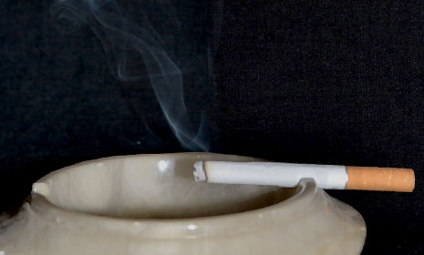
Sidestream smoke
Many toxic ingredients are in a higher concentration than in mainstream
Tar(carcinogenic), carbon monoxide, nicotine
People in the vicinity of sidestream smoke are exposed to toxins, breathing in these toxins is called passive smoking (secondhand smoke)

Slide 5
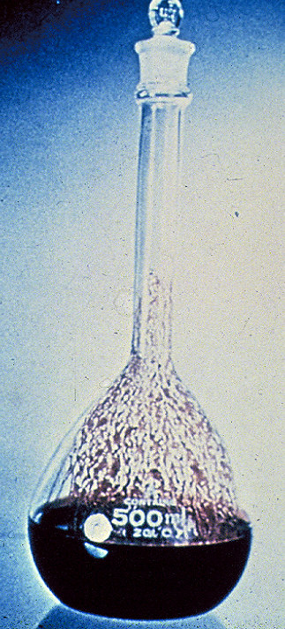
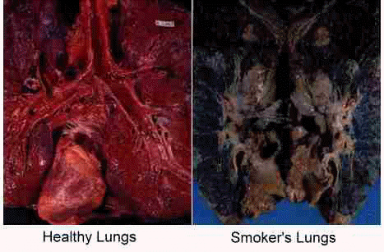
Tar
Mixture of compounds that settles on the linings of airways in the lungs and stimulates a series of changes that may lead to obstructive lung disease and cancer

Slide 6
Lung diseases
Major cause of death and illness worldwide
Air pollution, smoking, allergic reactions
Small particle not filtered out by mucus/macrophages settle in lungs and make lungs susceptible to airborne infections, as well as asthma

Slide 7
Lung disease
Each lung disease characterized by:
Signs: visible manifestation of a disease that are detected upon examination (ex: high temp)
Symptoms: senses expression of disease (ex: nausea, headache)

Slide 8
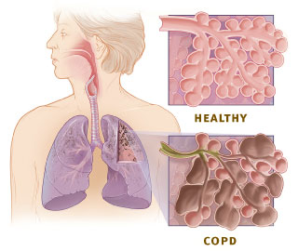
Chronic Obstructive Pulmonary Diseases (COPD)
Umbrella term for long term (chronic) lung disorders
Asthma, chronic bronchitis, emphysema
Linked to smoking and air pollution

Slide 9
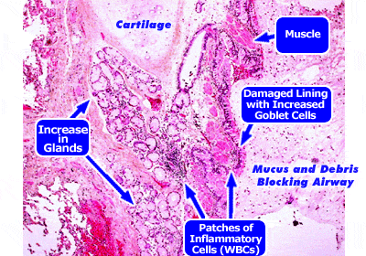
Chronic bronchitis
Tar in cigarette smoke stimulates goblet cells and mucous glands to enlarge and secrete more mucus causing it to accumulate in bronchioles
Also inhibits cleaning action of ciliated epithelium lining airways by destroying them or inhibiting their function

Slide 10
Chronic bronchitis
Mucus in bronchioles collect dirt, bacteria, and viruses which stimulates ‘smoker’s cough’ in an attempt to move mucus up airways
Over time, damaged epithelium is replaced by scar tissue, and smooth muscle around bronchioles becomes enlarged, causing airways to narrow

Slide 11
Chronic bronchitis
Infections (like pneumonia) easily develop in accumulated mucus
Infection inflames lungs, which become further narrowed
This long-term damage and obstruction of the airways is called chronic bronchitis
Sufferers have severe cough, and produce large amount of phlegm (mucus, bacteria, WBC mix)

Slide 12
Emphysema
Inflammation of constantly infected lungs cause phagocytes to leave the blood and line the airways
To reach lining of lungs, phagocytes must release elastase, an enzyme that destroys elastin in the walls of the alveoli to make a pathway for phagocytes to remove bacteria

Slide 13
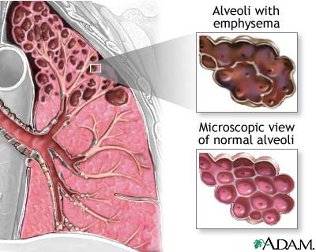
emphysema
Elastin is responsible for recoil of alveoli when we exhale
Without elastin, alveoli walls do not stretch and recoil. As a result, the bronchioles collapse during exhalation, trapping air in the alveoli, which often burst

Slide 14
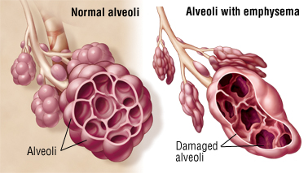
emphysema
Large space appear where alveoli burst, which reduces surface for gas exchange
Capillaries also decrease in #, so less oxygen gets to blood
This condition is called emphysema

Slide 15
emphysema
Loss of elastin makes if difficult to move air out of lungs
‘dead’ air remains in lungs permanently
People with emphysema do not oxygenate their blood well and have a rapid breathing rate

Slide 16
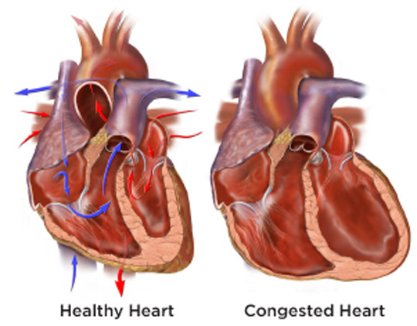
emphysema
As disease progresses, blood vessels in lungs become more resistant to blood flow
This causes the right side of the heart to enlarge due

Slide 17
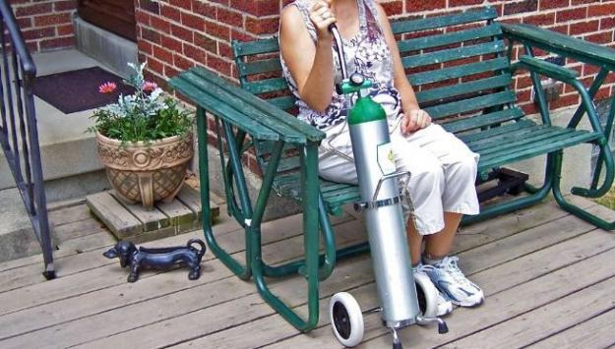
emphysema
As lung function deteriorates, wheezing and breathlessness become worse
Can cause permanent bed rest
Many people with chronic emphysema need a continuous supply of oxygen to stay alive

Slide 18
copd
Chronic bronchitis and emphysema often occur together in chronic smokers
Chronic bronchitis can be reversible, but emphysema is not
Over 60 million people worldwide affected by COPD
WHO predicts COPD to be third leading cause of death worldwide by 2030

Slide 19
Do Now 4/21
QUIETUDE (KWIE ih tude) n.
calm; tranquility; peacefulness
Gene and Chris chose their property for the air of QUIETUDE and peace that pervaded the area.
After the long illness, he had finally found QUIETUDE in death.
The QUIETUDE of the substitute teacher took the whole class by surprise.

Slide 20
Lung cancer
Tar in tobacco smoke contains several carcinogens
React with DNA in epithelial cells to produce mutations
Mutations lead to overproductions of cells (tumor)

Slide 21
Lung cancer
Cancer spread through bronchial epithelium and enters lymphatic tissues
Cells may breakaway (metastasis) and form secondary tumors
Takes 20-30 yrs to develop. Most tumor growth occurs before any symptoms are present
Most common symptom coughing up blood as result of tissue damage

Slide 22
Lung cancer
Tumors located by:
Bronchoscopy- endoscope view of bronchi
Chest x-ray
CT scan
By the time most lung cancers are discovered, they are well advanced (stage III-IV) and treatment involves surgery, radiotherapy, and chemotherapy
Stage IIIA survival rate: 14%
Stage IIIB survival rate: 5%
Stage IV survival rate: less than 1%

Slide 23
Cardiovascular disease
Diseases of heart and circulatory system
20% deaths worldwide, 50% deaths in developed countries
Multifactorial- many factors contribute tot heir development
Smoking is one of several risk factors that increase chances of developed cardiovascular diseases

Slide 24
nicotine
Drug in tobacco- absorbed readily into blood and reaches brain in seconds
Stimulates nervous system to narrow diameter of arterioles
Releases adrenaline from adrenal glands
Increases heart rate and blood pressure
Increases risk of blood clotting
Highly addictive (stimulates dopamine release)

Slide 25
Carbon monoxide
Diffuses into RBCs where is combines with hemoglobin to form very stable carboxyhemoglobin, causing Hb to not be fully oxygenated (~5-10% less in a smoker)
Increases heart rate and damages lining of arteries

Slide 26
atherosclerosis
Accumulation of fatty material (atheroma) in arterial walls
Reduces blood flow
Increases risk of blood clots
Caused by poor diet, high blood pressure, and several chemical in tobacco smoke

Slide 27
cholesterol
Tobacco damages arteries, so body produces phagocytes to repair damage
Phagocytes stimulate growth of smooth muscle and accumulation of cholesterol, a necessary lipid, but in high amount dangerous

Slide 28
cholesterol
Transported in blood plasma w/ proteins: lipoproteins
Low density lipoproteins (LDL): transport cholesterol from liver to tissues (“bad” cholesterol)
High density lipoproteins (HDL): transport cholesterol from tissues to liver (“good” cholesterol) protect arteries from atherosclerosis

Slide 29
atherosclerosis
Cholesterol rich atheroma forms rough patches called plaques in arteries blocking blood flow
Blood cannot flow and forms clot called thrombus
Coronary thrombosis: heart attack
Cerebral thrombosis: stroke

Slide 30
Coronary heart disease (CHD)
Disease to arteries that supply blood to heart.
3 forms:
Angina pectoris: shortage of blood to heart muscle, but no tissues death. Main symptom is severe chest pain during physical exertion
Heart attack (myocardial infarction): heart muscle loses blood supply and tissue dies. Main symptom: sudden and severe chest pain. May be fatal
Heart failure: blockage of main coronary artery. Gradual weakening of heart over time

Slide 31
stroke
Occurs when artery in the brain becomes blocked and bursts
Surrounding brain tissue is deprived of oxygen and dies
May be fatal or cause mild to severe disability
Severity depends on location and amount of brain tissue death, and time to treatment

Slide 32
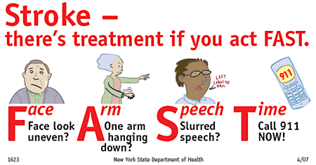
Recognizing a stroke

Slide 33
Link between smoking and lung disease
General
~50% smokers may die of smoking related disease
Smoker 3x more likely to die in middle age than nonsmokers
COPD
Very rare in nonsmokers
90% COPD deaths attributed to smoking
98% people w/ emphysema are smokers
Death from influenza & pneumonia 2x more likely in smokers
Lung cancer
Smokers 18X more likely to develop lung cancer
20% smokers die from lung cancer
Risk increases exponentially with years and amount of use (smoking 1 pack/40 years 8x more deadly than 2 packs/day for 20 years)
Risk starts decreasing immediately upon quitting

Slide 34
Prevention and cure
Obvious prevention: don’t start smoking!
Stop smoking asap
Alter diet
Add exercise to daily regiment
Drugs to lower blood pressure
Drugs to curb LDL formation
Heart surgery (by-pass, implant)
Lung surgery

Slide 35
Prevention and cure
Early screening is important!
Risk factors decrease with time

