Slide 1
Do Now 4/2
PANDEMIC (pan DEM ik) adj.
widespread; general
AIDS has spread in PANDEMIC proportions around the world.
Disco’s PANDEMIC popularity was short-lived in the 1970s.
Boating is a PANDEMIC form of outdoor recreation in Florida.
Please complete and turn-in your HR and blood pressure labs

Slide 2
Chapter 8.3
Inb pg 45

Slide 3
Hemoglobin
Major role of cardiovascular system is to transport oxygen from lungs to tissues over body
Body cells need oxygen for cellular respiration (ATP generation)
Oxygen is transported on RBCs via hemoglobin protein

Slide 4
Hemoglobin
Each molecule made up of four polypeptides containing one heme group each.
Each heme group can combine with one oxygen molecule (O₂)
$$Hb+4O_{2}↔HbO_{8}$$
Hemoglobin oxygen oxyhemoglobin

Slide 5
Hemoglobin dissociation curve
Hemoglobin has to be able to not only pick up oxygen at the lungs but also release oxygen into the tissues

Slide 6
Hemoglobin dissociation curve
Oxygen concentration measured in partial pressure
Partial pressure measured against %saturation of hemoglobin
Sample of hemoglobin with max # oxygen molecule is said to be saturated
Hemoglobin sample saturation is measured at different partial pressures to give S-shaped curve

Slide 7
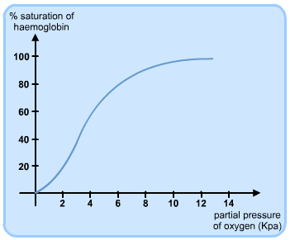
Hemoglobin dissociation curve

Slide 8
Hemoglobin dissociation curve
In lungs, partial pressure of oxygen is greatest, so hemoglobin molecules will be mostly saturated
In actively respiring tissues, partial pressure of oxygen is low so hemoglobin loses oxygen molecules to surrounding tissues

Slide 9
S-shaped curve
When only one oxygen molecule is attached to hemoglobin, whole molecule is slightly distorted.
This distortion makes it easier for additional oxygen molecules to combine with hemoglobin
Hemoglobin is most stable with 4 oxygen molecules

Slide 10
The bohr shift
Amount of oxygen carried by hemoglobin is affected not only by partial pressure of oxygen, but also partial pressure of carbon dioxide
Carbon dioxide is produced by respiring cells into blood plasma, where an enzyme carbonic anhydrase is present that catalyzes:

Slide 11
The bohr shift
Hemoglobin readily combine with H+ ions, forming hemoglobic acid, HHb, in so releasing any oxygen it is carrying
Hemoglobin acts as a buffer to maintain blood pH: Hemoglobin “mops up” excess H+ ions when carbon dioxide dissociates. High H+=low pH. If left in blood, H+ ions would make blood very acidic.

Slide 12
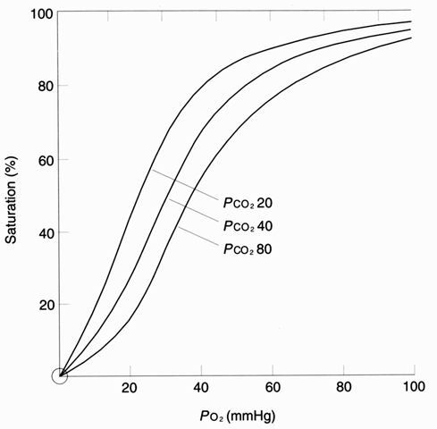
The bohr shift
The presence of a high partial pressure of carbon dioxide causes hemoglobin to release oxygen, causing a shift in the hemoglobin dissociation curve called the Bohr effect
High CO₂ concentrations cause hemoglobin to release oxygen more readily

Slide 13
Carbon dioxide transport
Carbon dioxide is catalyzed into hydrogen carbonate ions, HCO₃-, in the blood
Most ions diffuse into blood plasma where they are carried in solution (~85%)
Blood travels to lungs where ions are released
Some carbon dioxide does not dissociate and remains as CO₂ and combines with terminal amine groups on hemoglobin to form carbamino-hemoglobin
When carbamino-hemoglobin reaches lungs CO₂ is release

Slide 14
Problems with oxygen transport- carbon monoxide
Hemoglobin combines very readily with carbon monoxide, CO, to form carboxyhemoglobin
CO is formed when carbon containing compounds burn incompletely, like exhaust fumes and cigarette smoke
Hemoglobin combines with CO 250x more readily than with oxygen
Thus even at very low CO concentrations it can drastically affect how much oxygen our RBCs carry
1% CO can cause death by asphyxiation

Slide 15
Problems with oxygen transport- carbon monoxide
Treatment of carbon monoxide poisoning includes administration of a mixture of pure oxygen and carbon dioxide
Oxygen favors combination of hemoglobin with oxygen molecules (think S shaped curve)
Carbon dioxide increases breathing rate to “flush” CO faster

Slide 16
Problems with oxygen transport- carbon monoxide
Cigarette smoke contains up to 5% CO. If you breathed in pure cigarette smoke for a short period of time you would asphyxiate
~5% of smokers blood is permanently combined w/ CO, considerably reducing oxygen carrying ability of RBCs

Slide 17
Problems with oxygen transport- high altitude
At sea level, partial pressure of oxygen is highest, and decreases as we increase in altitude due to lowered air pressure
At high altitudes, hemoglobin will become only about ~70% saturated
Less oxygen will be carried in the body, and person may experience shortness of breath

Slide 18
Problems with oxygen transport- high altitude
If someone travels quickly from low to high altitudes, their bodies don’t have time to adjust to lowered oxygen so they suffer from altitude sickness
Symptoms include: increase in rate and depth of breathing, general feeling of weakness and dizziness, arteriole dilation leading to fluid leakage into brain and lung (death)

Slide 19
Problems with oxygen transport- high altitude
If body is given plenty of time to adapt to altitude, body will compensate for lowered oxygen by generating more RBCs
RBCs are still less saturated, but more RBCs=more oxygen
Athletes often prepare themselves for important competitions by spending several months training at high altitudes. How does this improve their performace?

Slide 20
Problems with oxygen transport- high altitude
People who are permanently at high altitudes have a number of adaptations for living in low-oxygen environments
Broad chests (large lung capacity)
Large hearts
More hemoglobin in blood

