Slide 1
Do Now 3/11
WOD: OBTRUDE (aub TROOD) v.
to impose oneself or one’s ideas on others; to stick out
Ross’s OBTRUSIVE parents forced him to attend the same college as they had.
Tanya hoped her parents wouldn’t OBTRUDE upon her wedding plans.
Tina’s OBTRUSIVE personality made it hard for her to make friends.
STUDY ISLAND QUESTIONS DUE TONIGHT!!!!

Slide 2
Chapter 8.2: Blood composition
INB PG 43

Slide 3
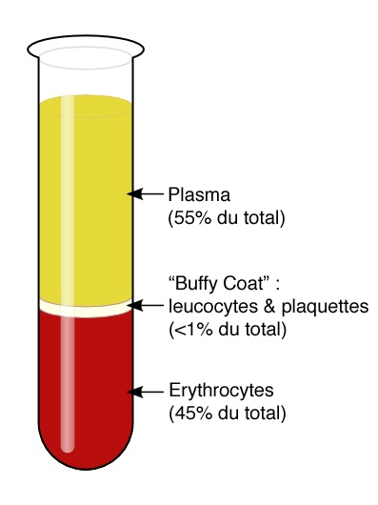
Plasma
Blood is composed of cells floating in a pale yellow liquid called plasma
Blood plasma is mostly water, with solutes dissolved in it
Ex: glucose and waste products (like urea)
Also include plasma proteins that remain in the blood at all times

Slide 4
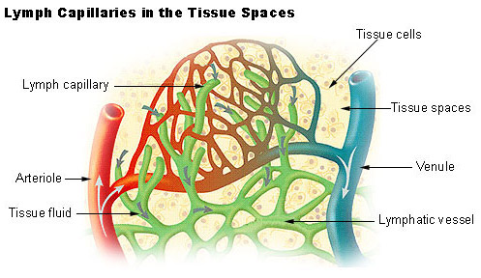
Tissue fluid
As blood flows through capillaries, some plasma leaks through gaps between cells in the walls of capillaries and seeps into body tissues
This fluid, known as tissue fluid, fills the spaces between your cells (1/6 of your body)
Aka interstitial fluid

Slide 5
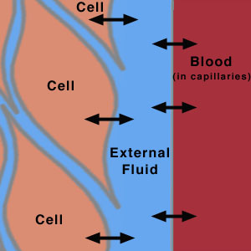
Tissue fluid
Almost identical in composition to plasma, however it contains less proteins (too large to fit between gaps in capillary walls)
Does not contain RBCs (way too large)
Contains some WBCs

Slide 6
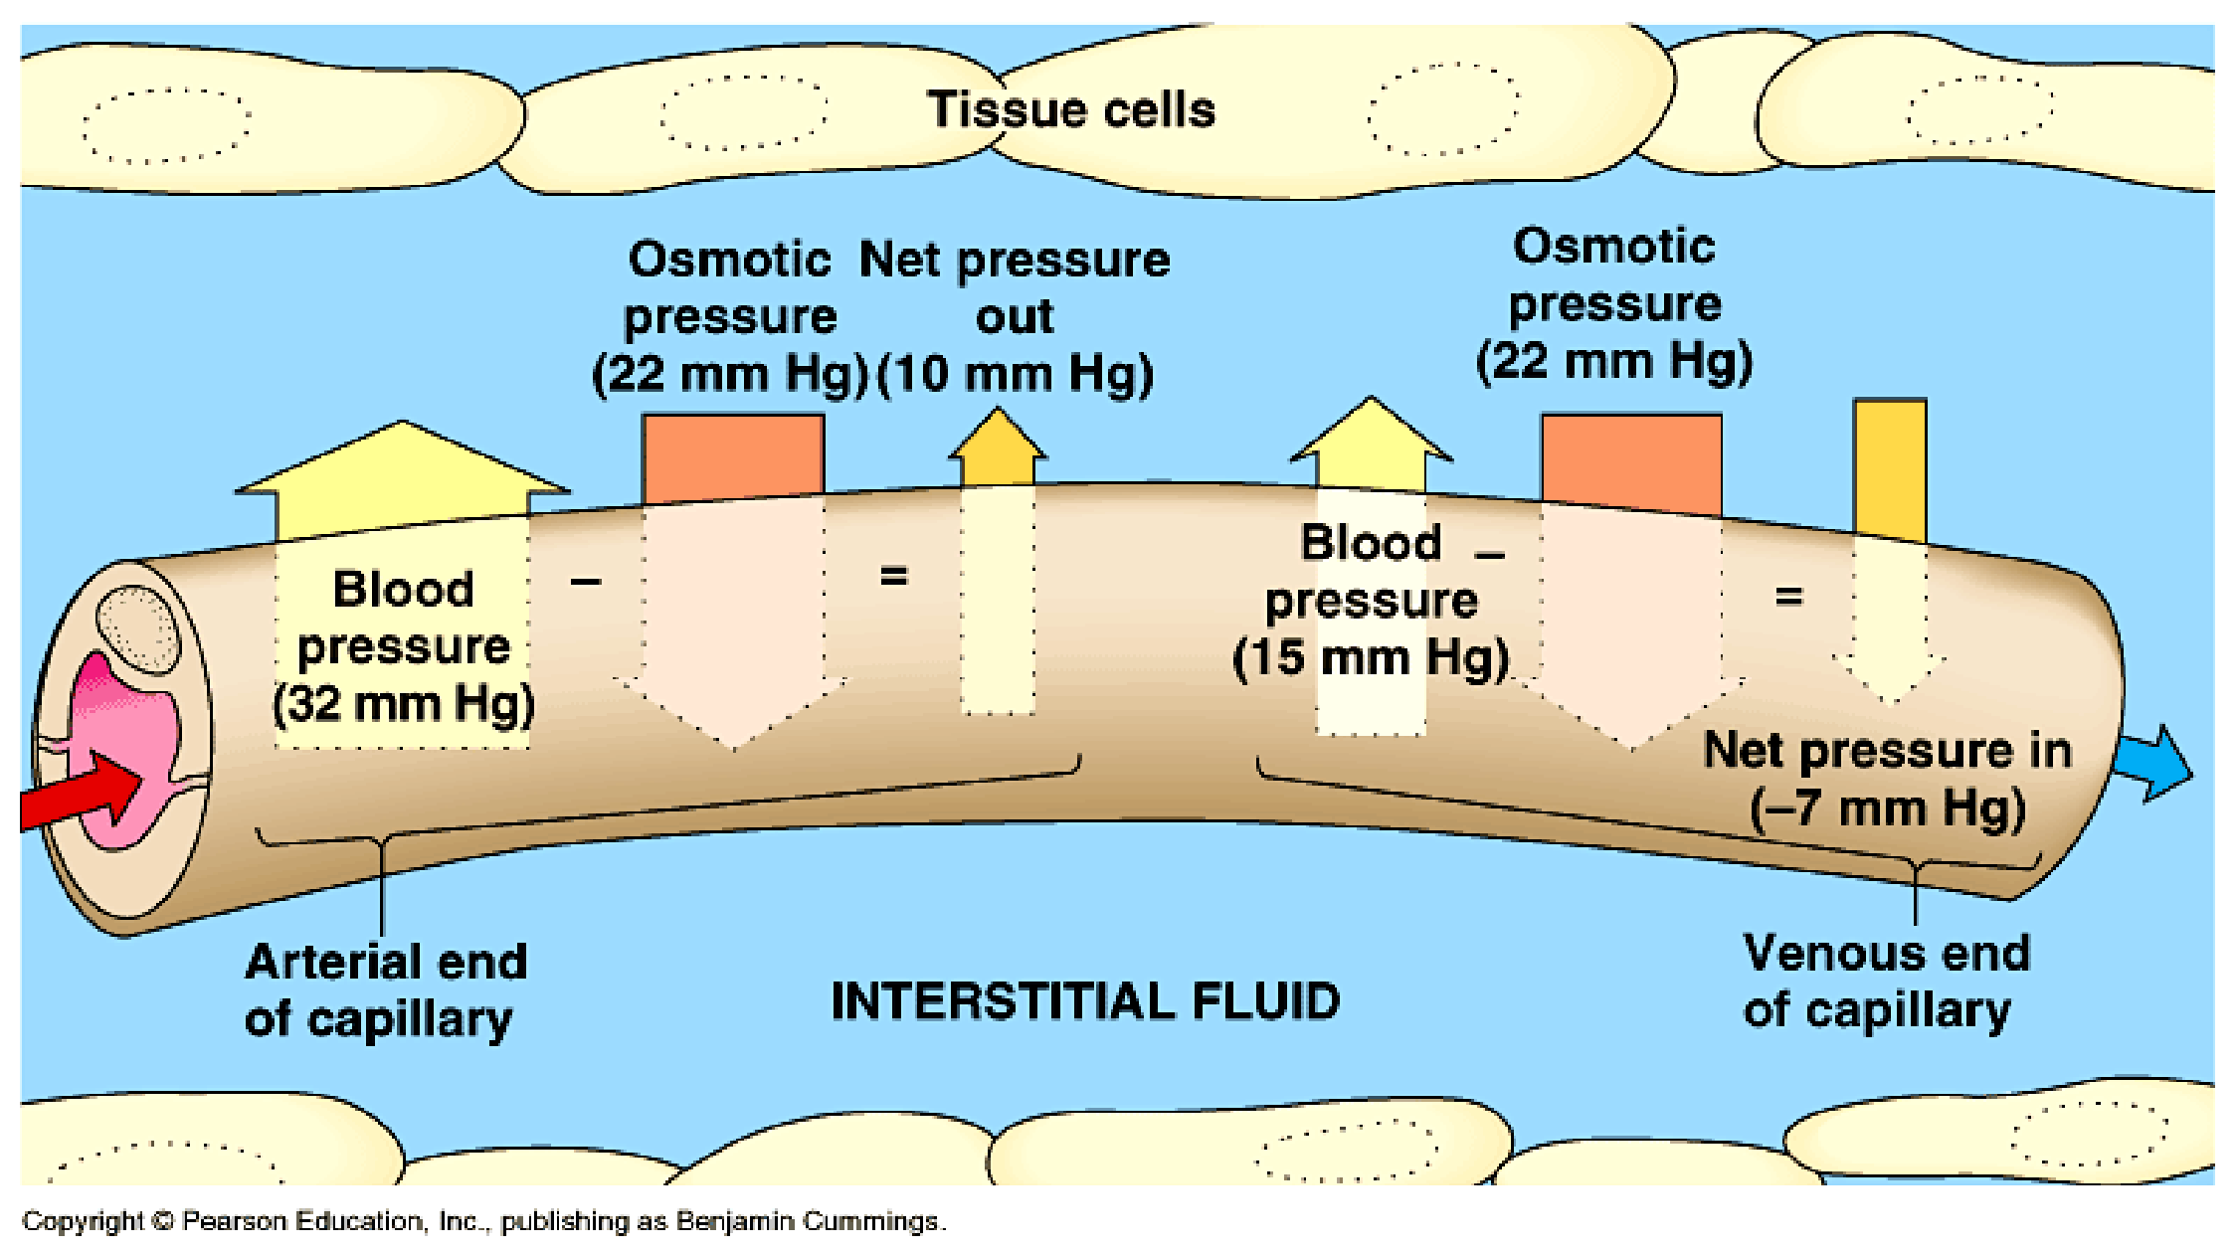
Tissue fluid
Flows from capillaries to tissues by two methods:
1.) Pressure from arterial end of capillary beds
2.) Osmosis from high ψ to low ψ
Overall result is fluid tends to flow out of capillaries at the arterial end and in to capillaries at the venous end (Net flow = out)

Slide 7
Tissue fluid
Immediate environment of each individual body cell
Responsible for exchange of material between cells and blood
Composition maintained by homeostasis
Maintenance of constant internal environment (pH, temp, glucose concentration, water)

Slide 8
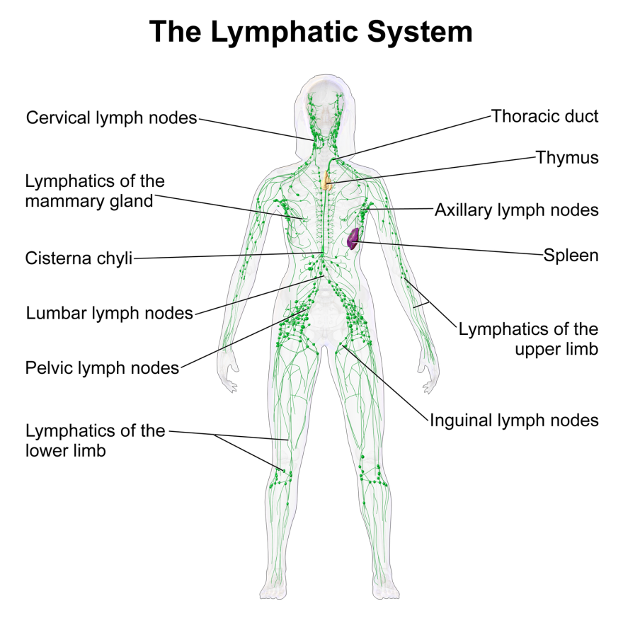
Lymph
~90% of fluid that leaks from capillaries eventually seeps back in
Remaining 10% is collected and returned via series of tubes called lymph vessels, or lymphatics

Slide 9
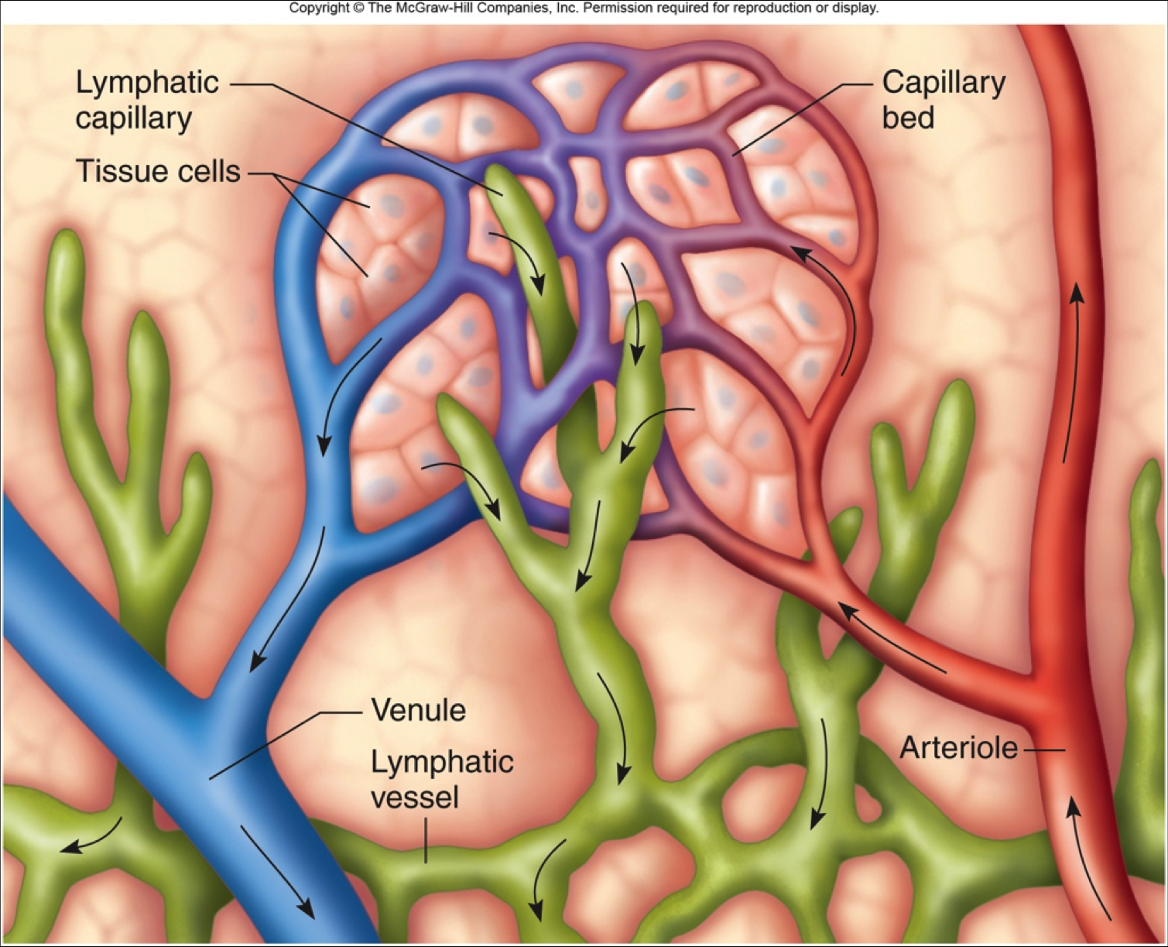
Lymph vessels
Blind-ending: has a sealed end
Valves lining vessels allow fluid to flow in, but not out, of lymph vessels
Large opening allows proteins to enter vessels to be carried away from tissues

Slide 10
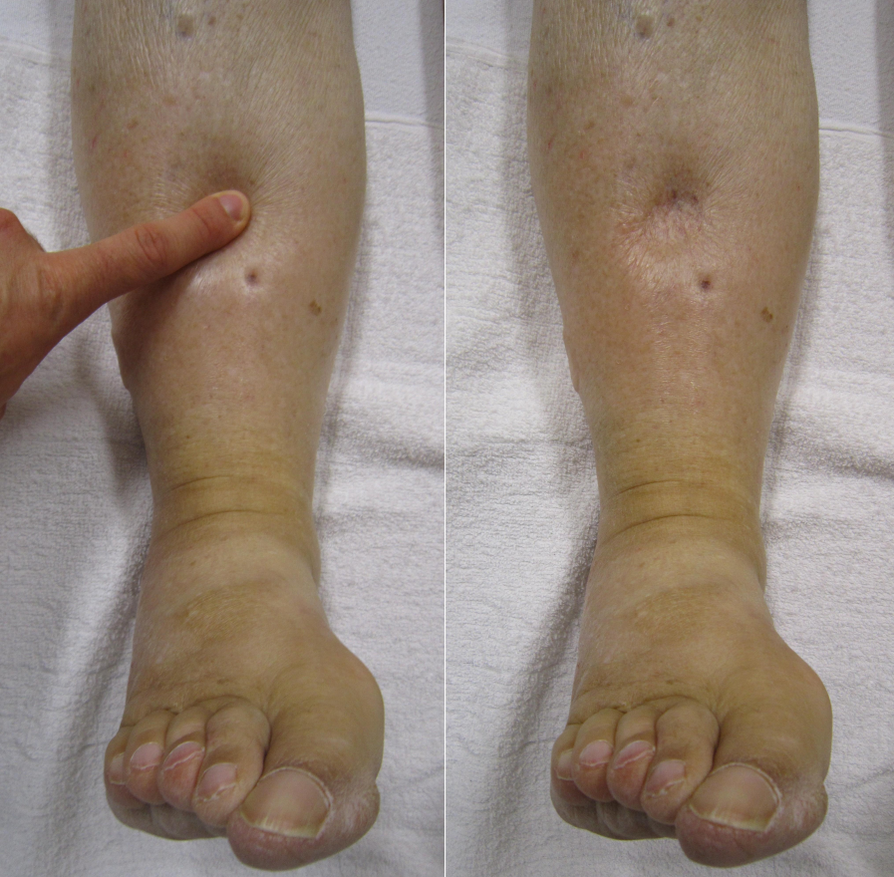
Lymph
If protein concentration and rate of loss from plasma are not in balance with the rate of loss from tissue fluid, there can be a build-up of tissue fluid, called edema (oedema)

Slide 11
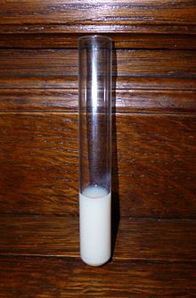
Lymph
Fluid inside lymphatic vessels is called lymph
Virtually identical to tissue fluid in same areas
Different tissues have different compositions of tissue fluid and lymph (Ex: Liver = high protein conc., intestine = high lipids)

Slide 12
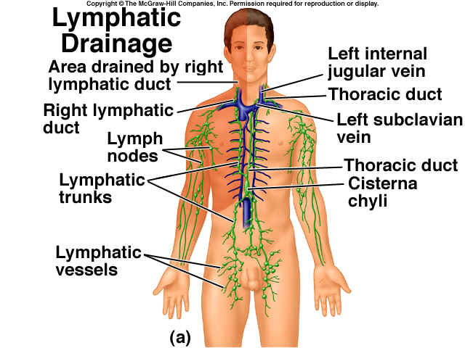
Lymph vessels
Small lymphatics eventually join together and gradually transport lymph back to large veins just beneath the collarbone, the subclavian veins
Movement of lymph is aided by smooth muscle contractions (hence very slow movement)

Slide 13
Lymph nodes
At intervals along lymph vessels are lymph nodes which are involved in immune response
Bacteria and other harmful particles are removed from lymph by WBCs as lymph passes through nodes
Some WBCs in nodes secrete antibodies

Slide 14
WOD 3/17
OPAQUE (oh PAYK) adj.
Impervious to light; dull; hard to understand; unclear
Jean put an OPAQUE blue glaze on her ceramic teapot.
The photographer’s use of OPAQUE lighting enhanced the family portrait.
The ballerina’s tights were an OPAQUE pink, revealing none of her skin.

Slide 15
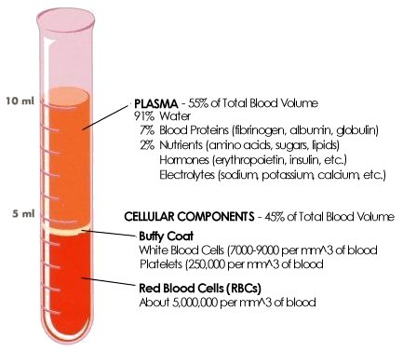
blood
Just under 5L of blood in avg. human
Suspended in plasma you have ~2.5 x 10 ¹³ red blood cells (RBCs) and 5 x 10 ¹¹ white blood cells

Slide 16
Red blood cells
RBCs are called erythrocytes
Red color is caused by hemoglobin: globular protein that carries oxygen from lungs to tissues
In utero: produced by liver. By birth: produced by bone marrow (primary in long bones)
Only live 90-120 days, so you have a new supply of blood every 3-4 months

Slide 17
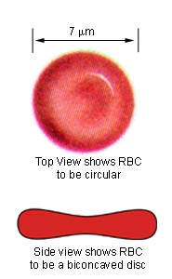
Red blood cells
Shaped like a biconcave disc: increases surface area (can carry more oxygen)
Very small: ~7µm. Means oxygen exchange can happen more quickly
Very flexible: blood cells can squeeze and bend through capillaries
No nucleus, mitochondria or ER: more room for hemoglobin (to carry oxygen)

Slide 18
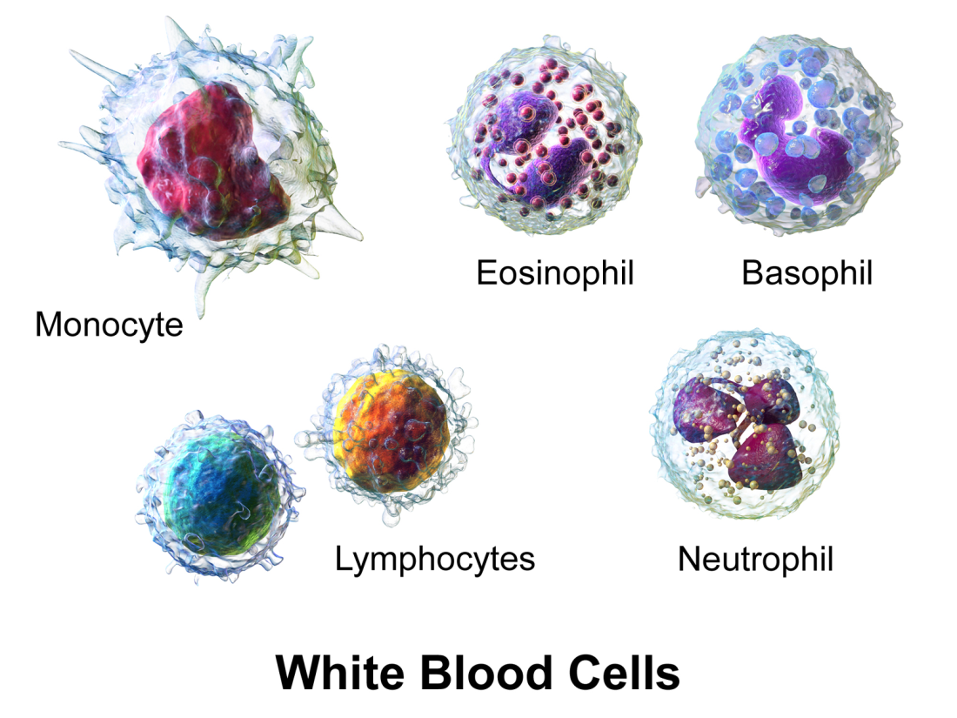
White blood cells
Aka leukocytes
Made in bone marrow
All have nuclei
Many different types, although all involved with fighting disease

Slide 19
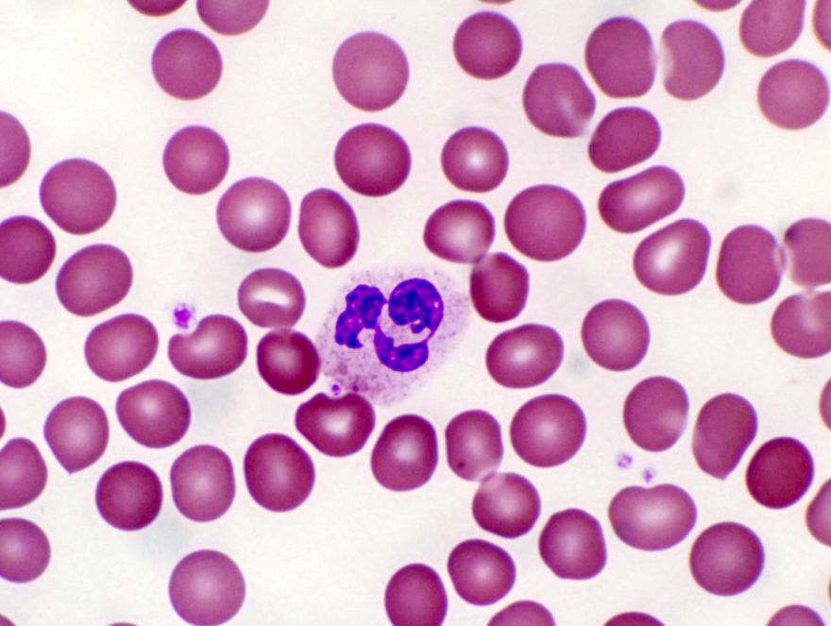
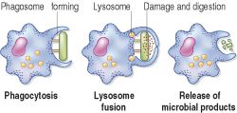
phagocytes
Cells that destroy invading microorganisms by phagocytosis
Can be recognized by lobed nuclei and granular cytoplasm

Slide 20
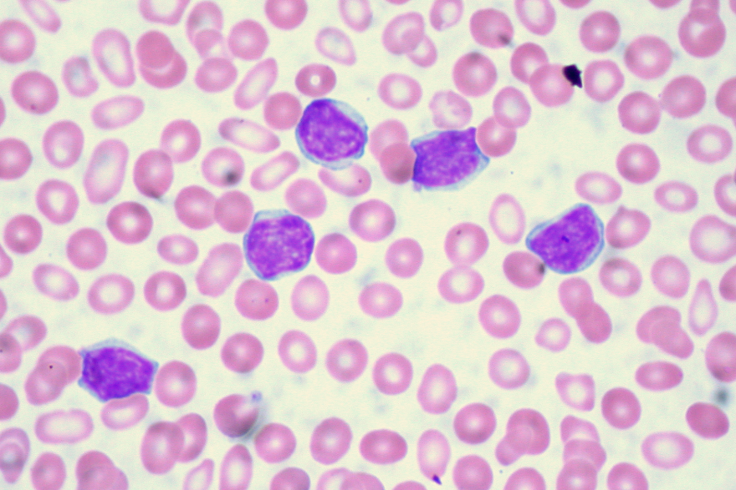
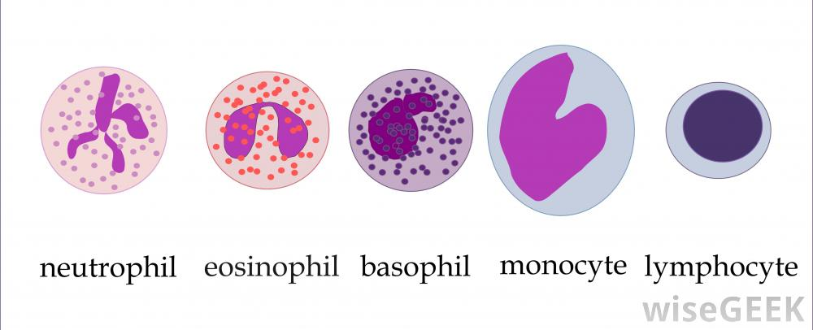
lymphocytes
Also destroy microorganisms, but NOT by phagocytosis
Some secrete antibodies, which attach to and destroy invading cells
Smaller than phagocytes, large round nucleus, small amount of cytoplasm

