Slide 1
Chapter 8.1: The mammalian cardiovascular system

Slide 2
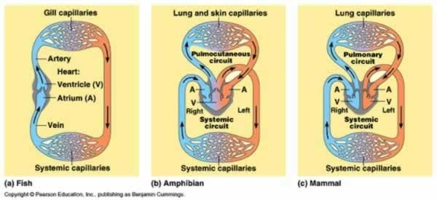
How does the circulatory system of a mammal differ from a fish, and what effects might this have on its metabolism?
Suggest a list of essential features of a mammalian transport system.

Slide 3
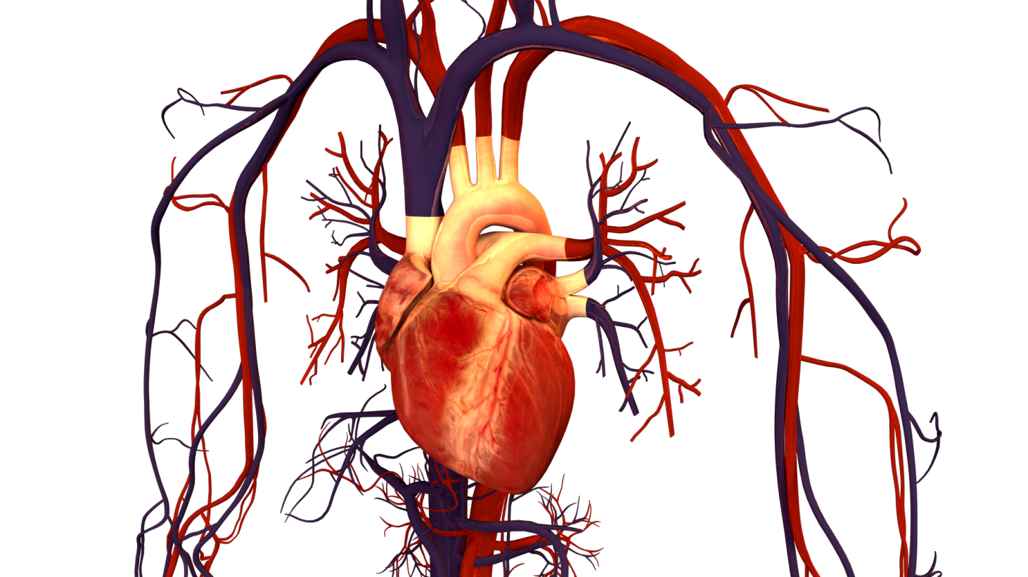
Cardiovascular system
Made up of a pump (heart) and system of interconnecting tubes (blood vessels)
Closed system: blood always remains within vessels

Slide 4
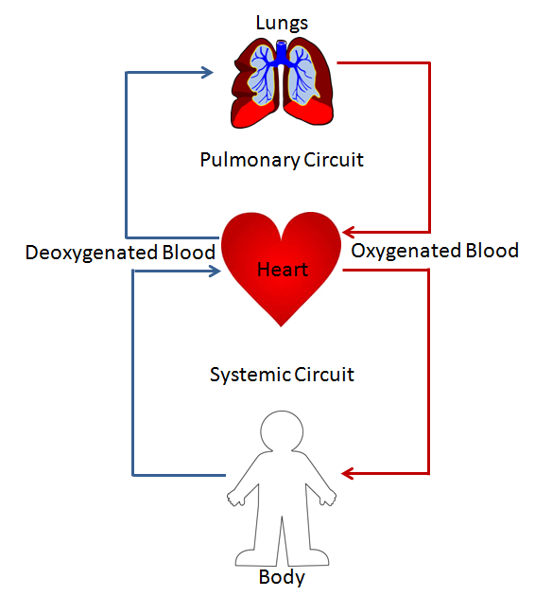
Blood circulation
Blood travels twice through the heart to complete one “circuit” through the body, known as double circulation
Systemic circulation: oxygen-rich blood circulation throughout body
Pulmonary circulation: oxygen deficient blood circulation between the lungs

Slide 5
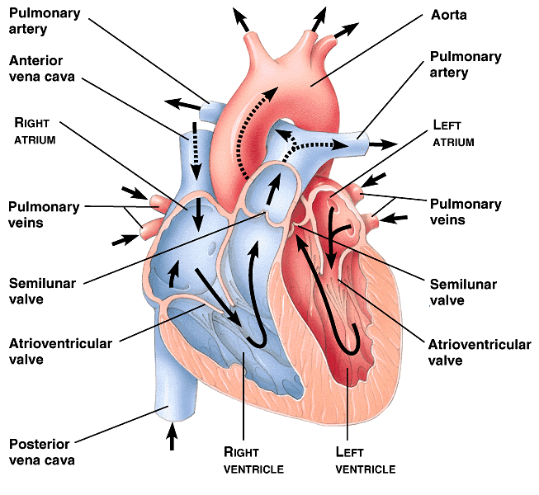
The mammalian heart

Slide 6
Systemic circulation
Oxygen-rich blood is pumped out of the left atrium via the left atrioventricular valve (aka bicuspid or mitral valve) into the left ventricle
It is pumped into the aorta via the aortic semilunar valve (aka aortic valve) and travels to all parts of the body
Returns to the right side of the heart via the vena cava

Slide 7
Pulmonary circulation
Oxygen-deficient blood is returned to right atrium via the vena cava
Pumped into right ventricle via the right atrioventricular valve (aka tricuspid valve)
Pumped through pulmonary artery via the right semilunar valve (aka pulmonary valve)

Slide 8
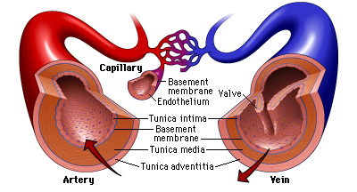
Blood vessels
Arteries: always carry blood AWAY from the heart (can be oxygenated/deoxygenated)
Veins: always carry blood TOWARDS the heart (can be oxygenated/deoxygenated)
Capillaries: link systemic arteries to veins. Responsible for carrying blood to individual cells

Slide 9
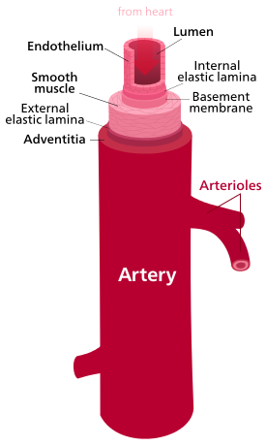
Arteries
Function: transport blood (swiftly at high pressures) to tissues
Walls made up of 3 basic layers: inner endothelium, middle tunica media, outer tunica extrema

Slide 10
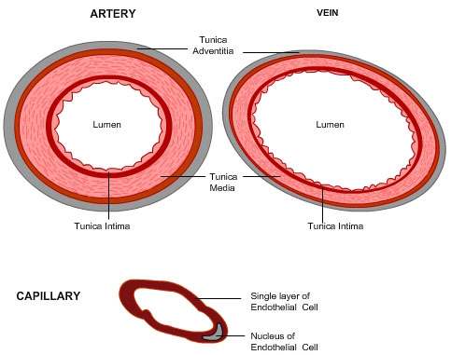
Endothelium
Inner lining tissue of arteries and veins made up of a layer of flat (squamous epithelium)cells fitting together like a puzzle
Aka tunica intima
Very smooth: minimizes friction with moving blood
Contains elastic fibers

Slide 11
Tunica media
Middle layer of veins/arteries containing smooth muscle, collagen, and elastic fibers

Slide 12
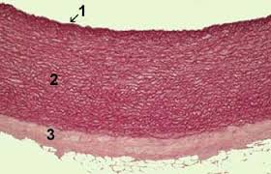
Tunica externa
Outer layer of veins/arteries containing elastic fibers and collagen

Slide 13
Arterial pressure
Blood leaving heart is very high (~120mm Hg or 15kPa during systole)
To withstand such pressure, arterial walls must be very elastic and thick
Arteries have the thickest walls of any blood vessels

Slide 14
Arterial pressure
Walls of arteries have high levels of elastic fibers and collagen to allow them to ‘give’ which reduces the chance of them bursting
Blood is pumped in pulses, so arteries are stretched and blood is pumped through them
Closer to the heart= higher pressure & velocity (more elastic fibers)
Farther from the heart = lower pressure & velocity (more muscle fibers)

Slide 15
Arterial pressure
Arteries expand and contract to normalize pressure
Expand = reduce pressure
Contract = increase pressure
Not 100% effective - feel your radial (wrist) or carotid (neck) artery. You can feel the pulses from your heart expanding and contracting these arteries

Slide 16
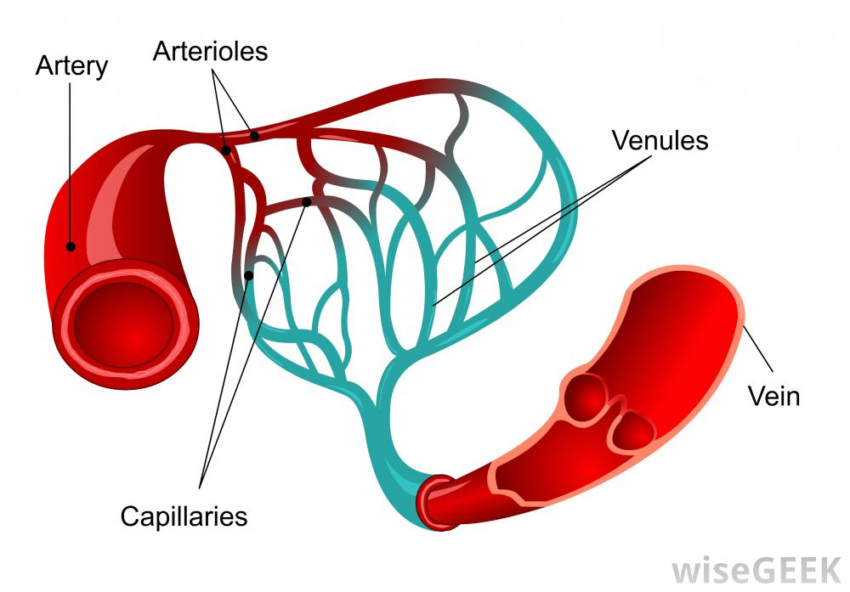
Arterioles
As arteries reach their transport tissues, they narrow into arterioles
Similar in composition to arteries, but higher % of smooth muscle
Controls volume of blood flowing to a tissue at a given time by expanding/contracting

Slide 17
Capillaries
Arterioles continue to branch into the smallest of all blood vessels: capillaries
Capillaries function to take blood as close as possible to all cells, allowing rapid transfer of substances between cells and blood
Oxygen, nutrients, waste, carbon dioxide

Slide 18
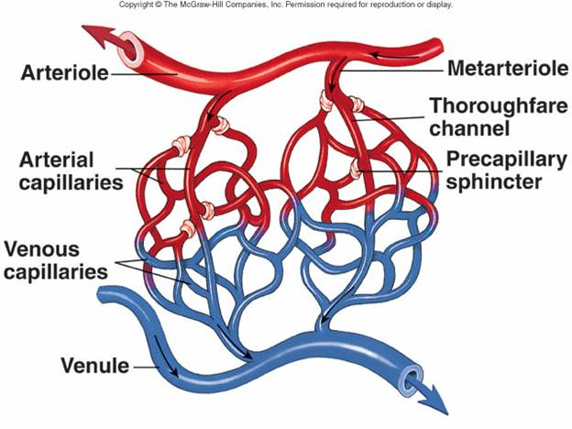
Capillaries
Form networks called capillary beds in all body tissues, except the cornea and cartilage
hence these tissues will not bleed
Your cornea gets oxygen directly from the air

Slide 19
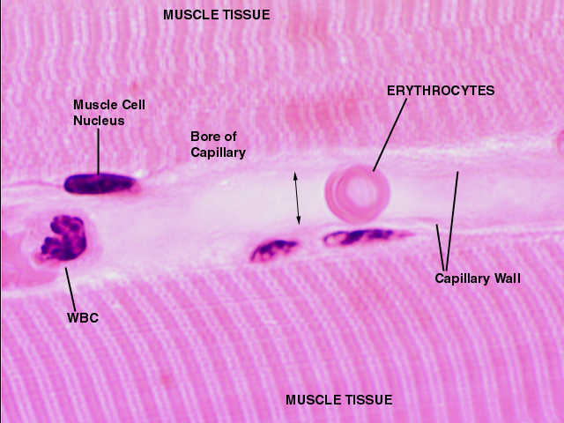
capillaries
Small size allows them to bring blood as close as possible to cells in the body
Capillaries ~7μm in diameter (same size as red blood cell)
Walls are made of single layer of endothelial cells

Slide 20
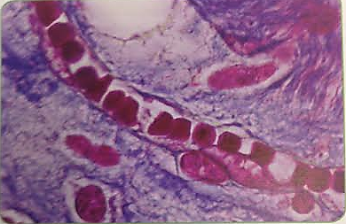
capillaries
Cells in endothelium most often have tiny gaps between them which allow certain components of blood to seep through to body tissues
Blood pressure drops immensely across capillaries (~ 33 mmHg)

Slide 21
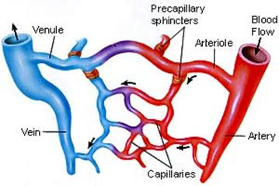
Veins
As blood leaves capillary beds, capillaries gradually re-join with each other, forming larger vessels called venules
Venules join to form veins
The function of veins is to return blood to the heart

Slide 22
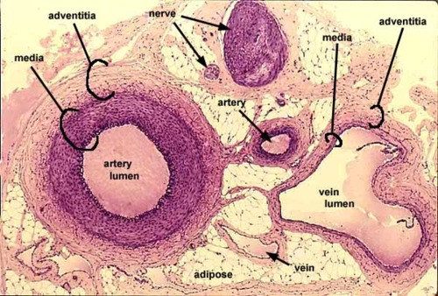
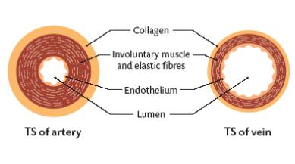
veins
Typical venous blood pressure is ~5 mmHg or less
This very low pressure means veins don’t need to have as thick walls as arteries
Veins have the same 3 layers, but tunica media is much smaller and there are less elastic fibers

Slide 23
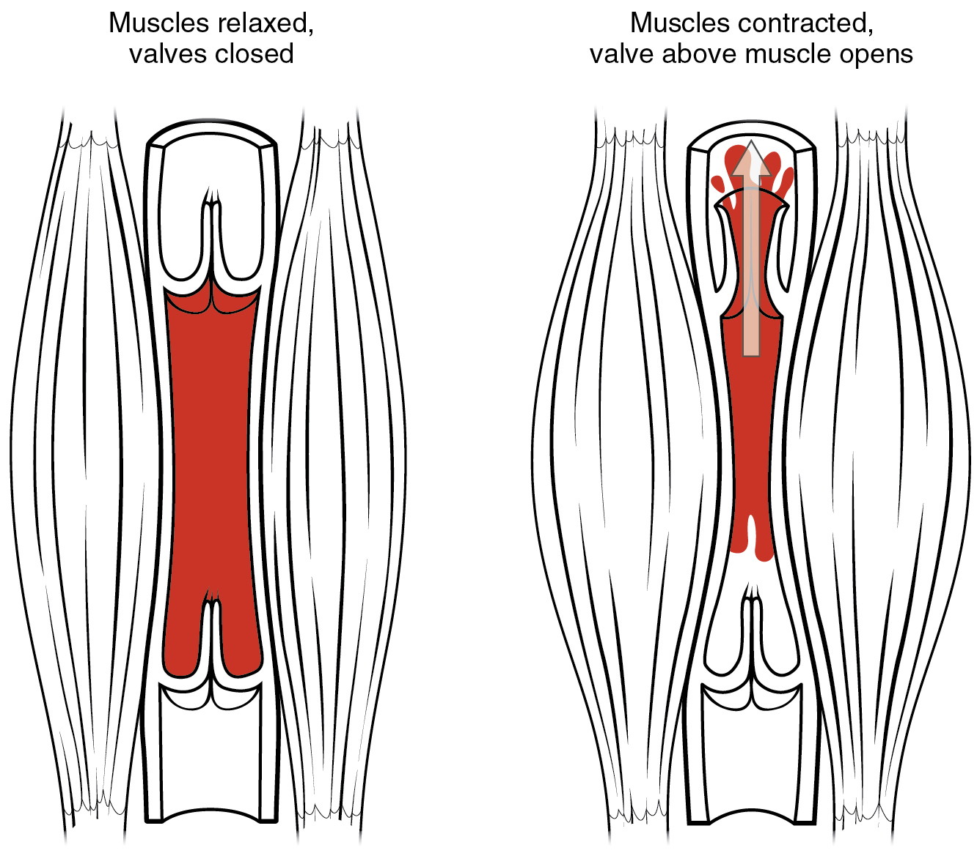
veins
Since veins are very low pressure, they need assistance from your skeletal muscles to return blood to the heart
Veins lie very close to muscle (particularly in lower extremities) so when these muscle contract, the increased pressure pushes venous blood to the heart

Slide 24
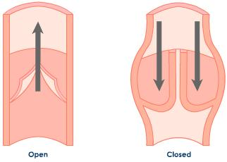
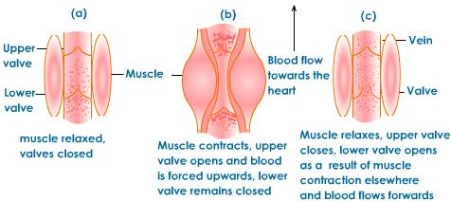
veins
In addition to skeletal muscle help, veins also contain semilunar valves that prevent the backflow of blood in veins
Formed from specialized endothelium tissue

Slide 25
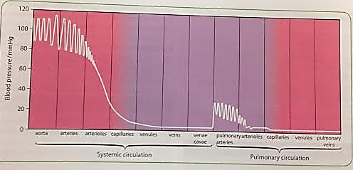
Blood pressure through cardiac cycle

Slide 26
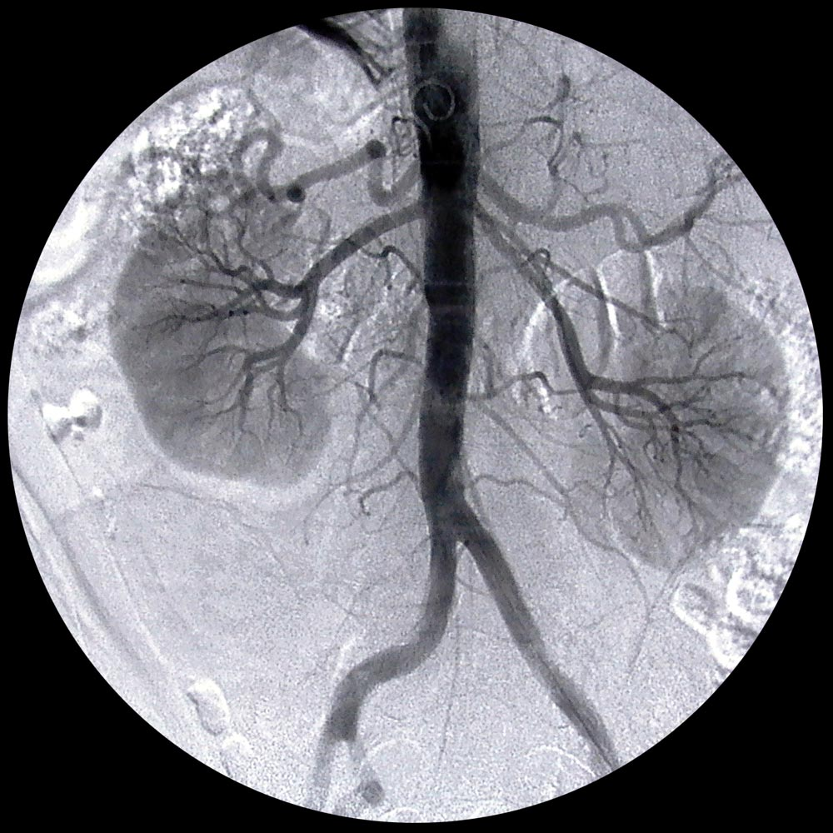
This is a contrast x-ray of the kidneys and the mighty aorta.

