Slide 1
Chapter 6 Humans in the Biosphere
Sections 6.1, 6.2, 6.3

Slide 2
6.1 A Changing Landscape
Section 6.1
A. Earth’s organisms share limited resources
They rely on ecological processes, such as the water cycle, to sustain the resources
Understanding how humans interact with the biosphere can help to protect these resources and processes

Slide 3
B. Humans are the main source of environmental change
C. Some of the human activities that affect the biosphere are:
Hunting and gathering – prehistoric hunters and gatherers changed the environment by hunting some animal species to extinction
Agriculture – farming increased the amount of food produced. This allowed cities to develop. People in cities produced wastes.
Pesticides were developed – which pollute the ecosystem
Farms used monoculture – planting fields with the same crop year after year
Advances in agriculture led to the Green Revolution, a great increase in the world food supply.

Slide 4
Industry
After the Industrial Revolution, human impact on the biosphere grew
Industry used more resources and produced more pollution than ever before
Urban development – the spread of cities uses up ecological resources like habitat space, food, & water and creates more waste & pollution

Slide 5
Sustainable Development
In economic terms, ecosystems are providers of goods and services (natural resources)
Healthy ecosystems produce or replace renewable resources.
Ex. a single southern white pine that dies or is cut down
Humans must be careful about the use of nonrenewable resources, such as fossil fuels, which cannot be replaced
Sustainable development provides for human needs while preserving the ecosystem that provide renewable resources

Slide 6
Create a Compare/Contrast table with three columns and three rows. Label each row as follows: Agriculture, Development, and Industrial Growth. Label the second and third columns Positive Effects and Negative Effects. Fill in the table with a summary statement about the negative and positive effects of each activity

Slide 7
6.2 Using Resources Wisely
A. Soil is a renewable resource, but it must be managed properly
Soil erosion is the wearing away of surface soil by water and wind
In dry climates, farming and overgrazing change farmland into deserts, a process called desertification
Deforestation is the loss of forests.
Because healthy forests hold soil in place, deforestation increases erosion
B. Sustainable uses include leaving stems and roots of previous crops in place, crop rotation, contour plowing, terracing, selectively harvesting mature trees, and tree farms

Slide 8
Freshwater Resources
The amount of fresh water is limited, and some sources cannot be replaced
A pollutant is a harmful material that can enter the biosphere.
Water pollutants come from industrial chemicals, residential sewage, and other sources
Many chemical pollutants become concentrated in organisms at higher trophic levels of the food chain through biological magnification
Sustainable uses include conservation, pollution control, and watershed protection

Slide 9
Atmospheric Resources
Clean air is important to human health and Earth’s climate.
Pollution reduces air quality
Smog is a mixture of chemicals formed from emissions from cars and industry
Burning of fossil fuels releases compounds that join with water in air, forming acid rain
Greenhouse gases, such as carbon dioxide and methane, can cause global warming
Particulates are microscopic particles that cause health problems.
One way of sustaining air quality is controlling automobile emissions

Slide 10
6.3 Biodiversity
A. Biological diversity, or biodiversity, is the sum of all the kinds of organisms in the biosphere. There are several types of diversity:
Ecosystem diversity – all the habitats, communities, and ecological processes in ecosystems
Species diversity – the number of different species in the biosphere
Genetic diversity – the genetic information carried in all living things on Earth

Slide 11
B. Biodiversity is one of Earth’s great natural resources
Human activity can reduce biodiversity by:
Altering habitats
Hunting species to extinction
Introducing pollution into food webs
Introducing foreign species into new environments

Slide 12
As humans destroy habitats, the species living in those habitats may die out
Human development can split habitats – habitat fragmentation
The smaller pieces of habitat, the less likely its species can survive
Extinction is the disappearance of a species from all or part of its range
Endangered species – one whose population size is declining in a way that places it in danger of extinction

Slide 13
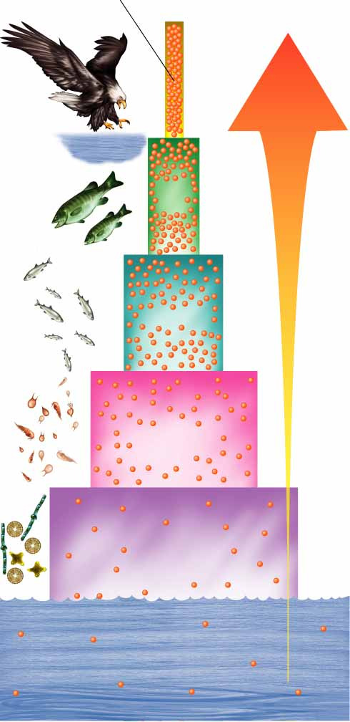
Toxic compounds build up in the tissues of organisms
These concentrations get larger in living things at higher trophic levels – biological magnification
Fish-Eating Birds
Magnification of
DDT Concentration
10,000,000
100,000
10,000
1,000,000
1
1000

Slide 14
Plants and animals brought into an area from other places can become invasive species
Can multiply quickly if their new habitats lacks predators or parasites to control their numbers

Slide 15
C. Conservation is the wise management of natural resources
Today, conservation efforts focus on protecting entire ecosystems as well as single species
Protecting an ecosystem will ensure that the natural habitats and the interactions of many different species are preserved at the same time

