Slide 1
Do Now 2/12

Slide 2
Chapter 6.2
ING Pg 40

Slide 3
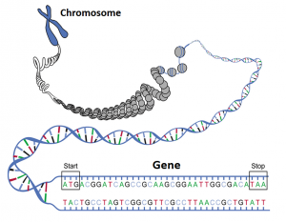
Genes and mutations
Total DNA of human is ~ 3 x 10⁹ base pairs
Only ~3% of that actually codes for proteins. Remainder is uncertain
One DNA molecule contains many genes
One gene = one polypeptide

Slide 4
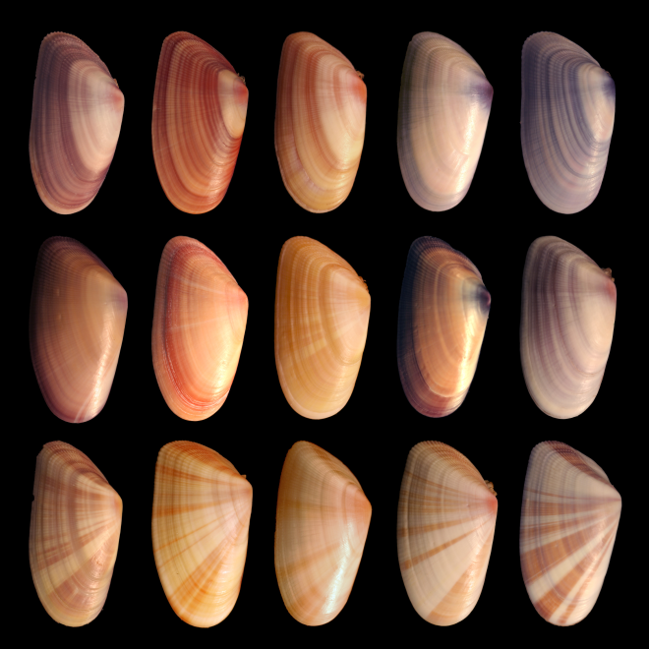
Genes and mutations
A change in the nucleotide sequence of a gene resulting in an altered polypeptide is called a mutation
Most genes have several different variants called alleles which originally arose by the process of mutation

Slide 5
DNA and protein synthesis
DNA controls all activities of cells because all cellular activity is controlled by enzymes (proteins) which are coded by DNA
DNA controls which proteins are made and in what amounts

Slide 6
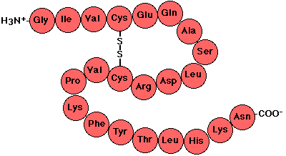
DNA and protein synthesis
Proteins molecules are made up of strings of amino acids
The structure and function of a specific protein is determined by the exact sequence of amino acids (primary structure)
DNA controls the precise order of amino acids

Slide 7
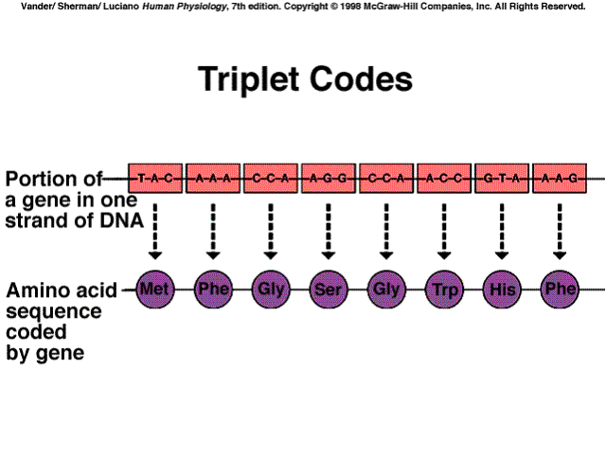
The triplet code
Sequence of nucleotide bases in DNA is a code for the sequences of aa’s
The code is a three letter, or triplet, code
Code is always read in a single direction on only one strand of the DNA molecule

Slide 8
Protein synthesis
First stage of making a protein is transcription
In the nucleus, a complementary copy of the DNA code from a gene is made by building a molecule of RNA called mRNA (messenger RNA)
Complementary base pairs use to make mRNA.
DNA | mRNA
A | U
T | A
G | C
C | G

Slide 9
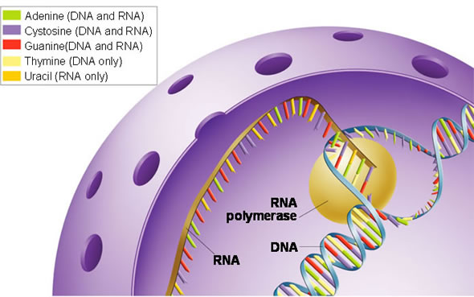
Protein synthesis
Transcription is followed by translation
mRNA code is translated into amino acids by tRNA (transfer RNA)
mRNA leaves the nucleus and attaches to a ribosome

Slide 10
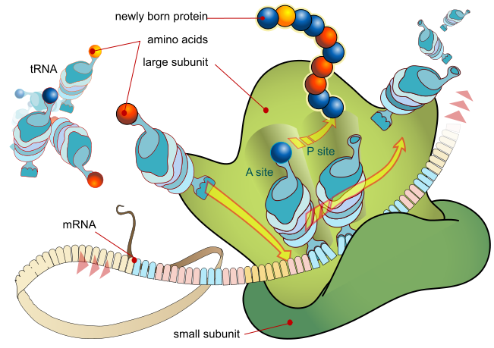
Translation
tRNA molecules contain a triplet of bases (anticodon) attached to 1 of 20 specific amino acids
The tRNA molecules match their triplets (anitocodons) with complementary mRNA triplets (codons)

Slide 11
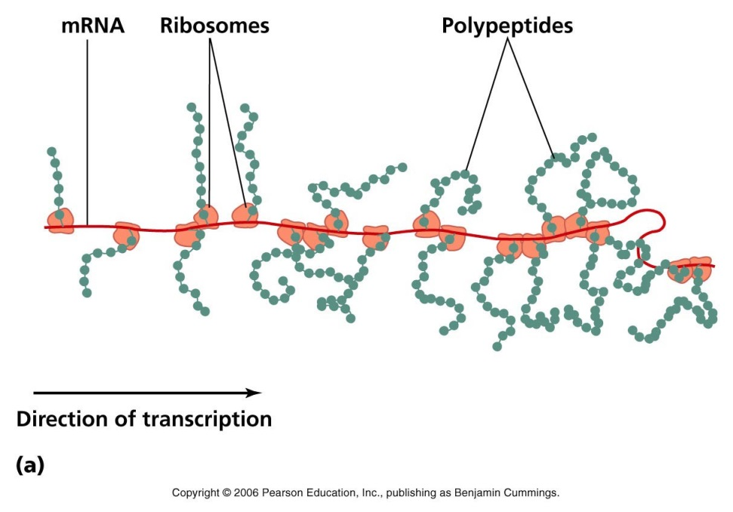
Translation
When tRNA links with mRNA, adjacent tRNA molecules form peptide bonds between their amino acids
This process occurs repeatedly until a complete polypeptide is made
Usually several ribosomes work together on a single mRNA molecule, forming a polyribosome

Slide 12
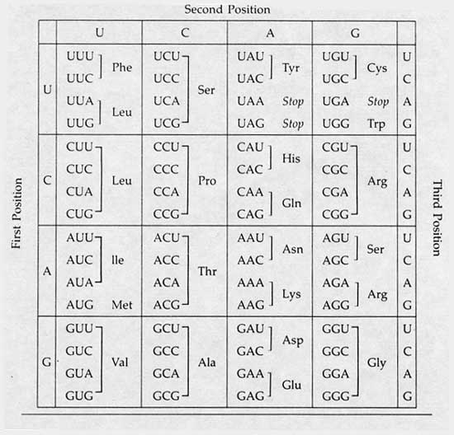

Slide 13
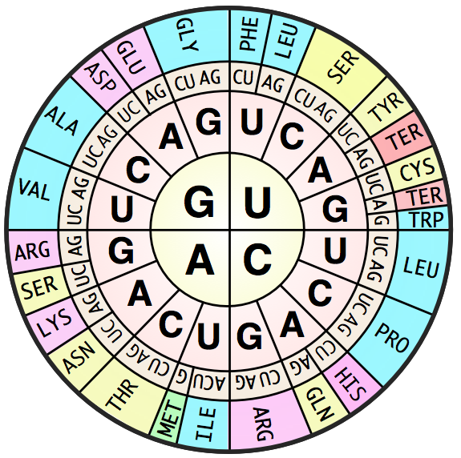

Slide 14
Mutations
Substitution: exchanges one base for another (such as switching an A to a G)
Substitutions can cause:
change a codon to one that encodes the same amino acid and causes no change in the protein produced. These are called silent mutations
change a codon to one that encodes a different amino acid and cause a small change in the protein produced. (Ex: sickle cell anemia)
change an amino-acid-coding codon to a single "stop" codon and cause an incomplete protein. This can have serious effects since the incomplete protein probably won't function.

Slide 15
Mutations
Insertion: mutations in which extra base pairs are inserted into a new place in the DNA.
Deletion: mutations in which a section of DNA is lost, or deleted.

Slide 16
Mutations
Frameshift: Since protein-coding DNA is divided into codons three bases long, insertions and deletions can alter a gene so that its message is no longer correctly parsed.
Ex: consider the sentence, "The fat cat sat." Each word represents a codon. If we delete the first letter and pair the sentence in the same way, it doesn't make sense.
In frameshifts, a similar error occurs at the DNA level, causing the codons to be paired incorrectly.

