Slide 1
Do Now 2/10
List and describe 4 factors that can increase carcinogenic mutation rates
WOD: LITHE(lythe) adj.
bending easily and gracefully
The LITHE ballerina stretched her muscles before her performance.
The gymnast was so LITHESOME that she dismounted without a sound.
The dancer was as LITHE as a cat as he leapt across the stage.

Slide 2
Do Now 2/10
List and describe 4 factors that can increase carcinogenic mutation rates

Slide 3
Chapter 6.1
INB Pg39

Slide 4
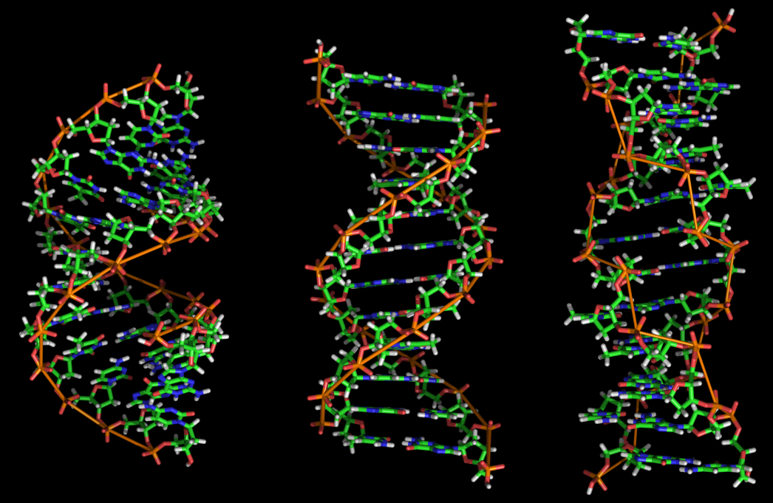
Genetic Control
DNA must be able to:
Carry instructions- construction and behavior of cells
Can be copies perfectly- nucleus must pass on exact copy of genetic material to daughter cell

Slide 5
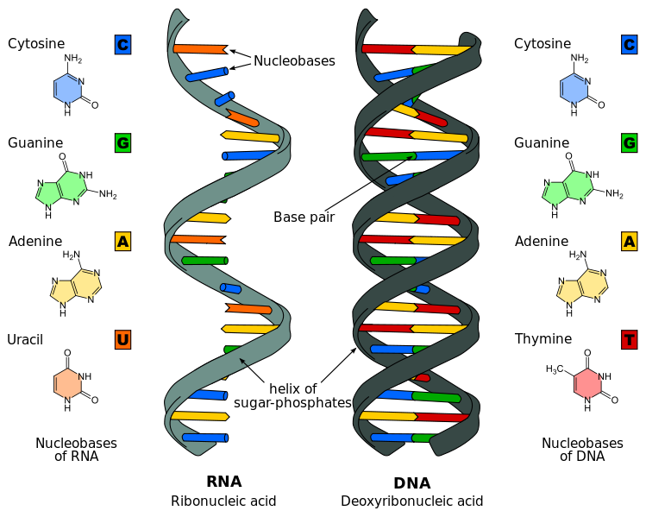
DNA and RNA Structure
Deoxyribonucleic acid (DNA) and Ribonucleic acid (RNA)
Polymers of nucleotides
Aka polyneucleotides

Slide 6
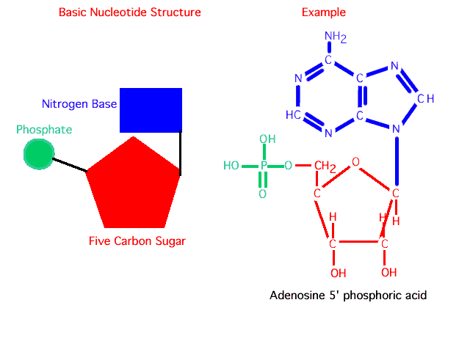
Nucleotides
Nucleotides are made up of:
A nitrogen-containing base
A pentose sugar (deoxyribose or ribose)
A phosphate group

Slide 7
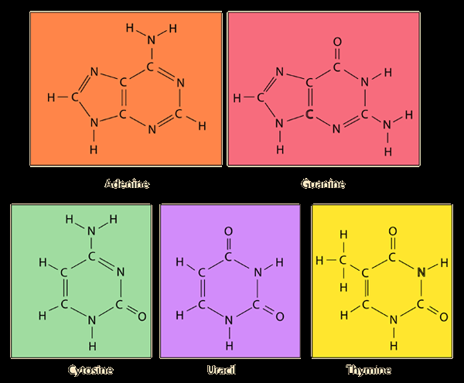
Nucleotides
Nitrogen-containing bases
Adenine (A)
Thymine (T) (DNA only)
Guanine (G)
Cytosine (C)
Uracil (U) (RNA only)

Slide 8
Polynucleotides
Alternating sugars and phosphate are linked together with bases projecting sideways
DNA molecules are made from two polynucleotide strands lying parallel to each other in opposite directions
Strands are held together by H-bonds between bases

Slide 9
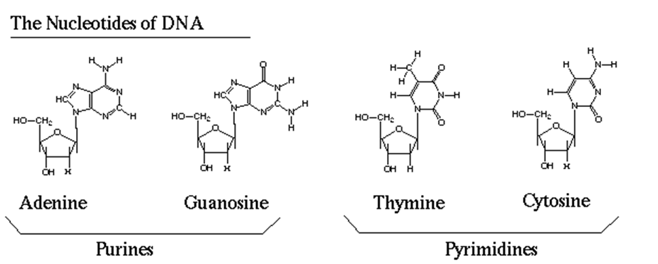
Polynucleotides
Purine bases: adenine and guanine (Pure as gold)
Pyrimidine bases: cytosine, thymine
Complementary base pairing:
A always pairs with T in DNA and U in RNA
G always pairs with C

Slide 10
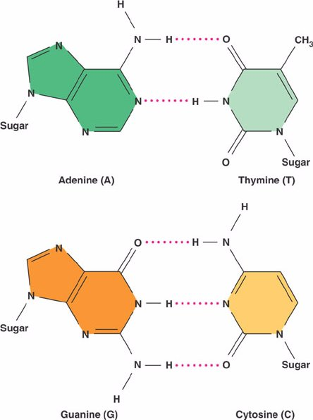
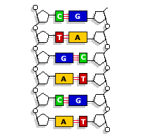

Slide 11
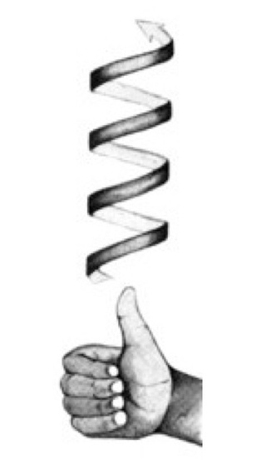
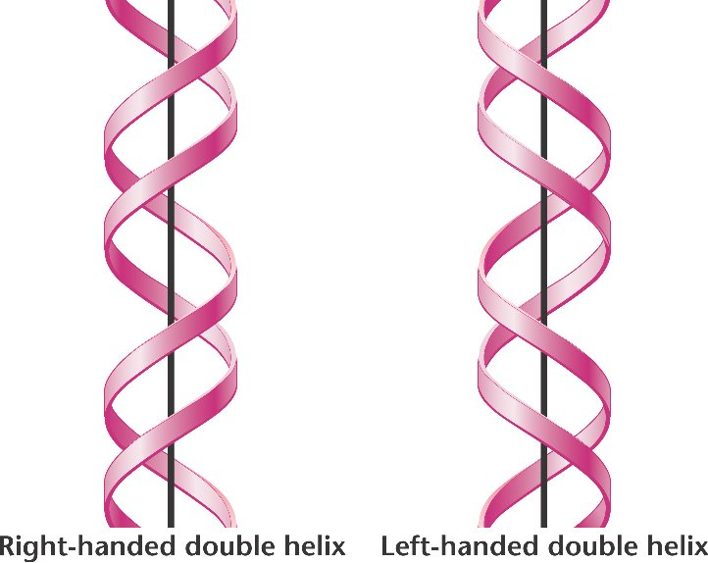
Polynucleotides
DNA is referred to as a double helix (right handed)
RNA is a single polynucleotide strand

Slide 12
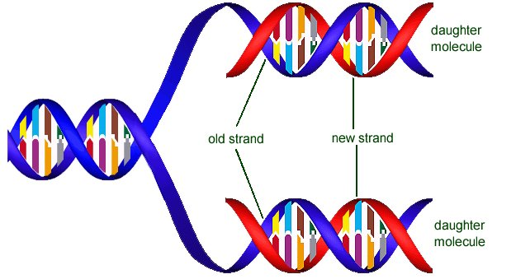
DNA replication
Semi-conservative replication: half of the original DNA molecule is kept in each of the new molecules
Replication takes place in the S phase of interphase

Slide 13
Semi-conservative replication
In 1950’s, it was unknown how DNA replicated. Three possibilities were suggested:
Conservative replication: one completely new helix is made from an existing one
Semi-conservative replication: each new helix contains one new, one old strand
Dispersive replication: each new molecule is made of scattered new and old bits

Slide 14
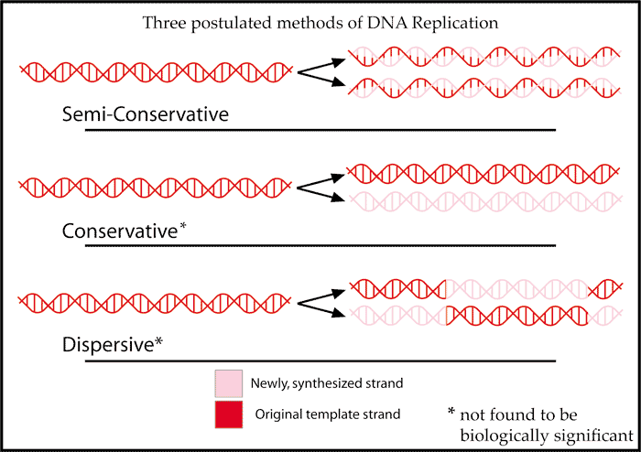
Semi-conservative replication

Slide 15
Meselson and Stahl experiment
Provided nitrogen-15 isotopes to E. Coli bacteria
The bacteria used 15N to make their DNA and over time the isotope replaced all existing nitrogen
This DNA would be ‘heavier’ than normal nitrogen-14 DNA

Slide 16
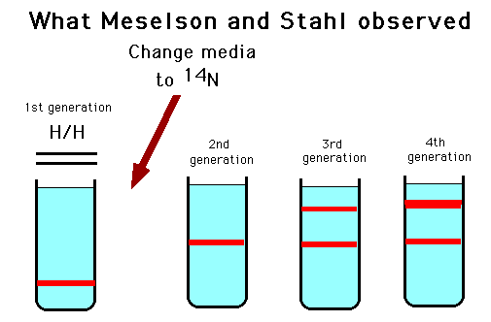
Meselson and Stahl experiment
Some 15N bacteria was transferred to a food source containing 14N and left long enough for their DNA to replicate once
DNA was removed from both sample of bacteria and spun in a centrifuge
Heavier DNA settles towards bottom

