Slide 1
Chapter 5: Populations
Sections 1 and 2

Slide 2
5.1 How Populations Grow
Three important characteristics of a population are:
1. Geographic distribution, or range, is the area in which a population lives
2. Population density is the number of individuals per unit area
e.g. the number of people per square kilometer; 500 people/km2
3. Growth rate is how quickly a population increases or decreases in size

Slide 3
B. Four factors affect population size
1. Birth rate – how many new individuals are born; ↑ Pop
2. Death rate – how many individuals die; ↓ pop
3. Immigration – the movement of individuals into an area; ↑ pop
4. Emigration – the movement of individuals out of an area; ↓ pop
Growth rate = birth – death + immig - emig

Slide 4
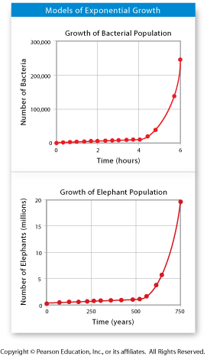
C. Exponential growth occurs when members of a population reproduce at a constant rate
This growth pattern is shown by a J-shaped curve.
As the population grows, the number of reproducing members keeps rising
The population grows faster and faster

Slide 5
D. Under ideal conditions with unlimited resources, a population will grow exponentially
In nature, exponential growth does not go on for long
Resources are used up in over time and growth slows or stops
Predators and disease may also slow growth

Slide 6
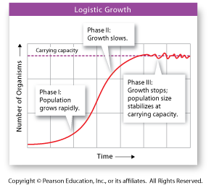
E. Logistic growth is when limited resources slow or stop population growth
Growth pattern is shown by an S-shaped curve
Usually follows a period of exponential growth
When growth stops, the population size has reached its carrying capacity
The number of individuals of a specific species an environment can support
The growth rate is zero

Slide 7
During which phase does the population grow most rapidly?
During which phase does the population size stabilize?
What is the carrying capacity of a population?

Slide 8
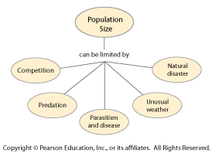
5.2 Limits to Growth
A. A limiting factor is any resource in short supply that slows population growth
Density-dependent – relies on population size; only work when pop density reaches a certain level
Competition – organisms are using the same ecological resource at the same time
• Food, water, space, sunlight, etc

Slide 9
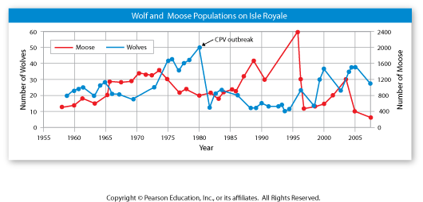
Density independent – does not rely on Population size
Natural disasters
Human activities; damming rivers; clearing forests
Results in rapid drop in population size

Slide 10
Predation – one organism captures and eats another; can affect the predator and prey populations
• Often nature’s way of controlling populations
• predator-prey simulation (worksheet-project) http://www.biologycorner.com/worksheets/pred_prey.html
Parasitism – one organism feeds off a host
Disease – can increase the death rate

Slide 11
What general trends are shown in this graph?
What factors other than the predator-prey relationship affected the size of these populations during the time period represented in the graph?

