Slide 1
Chapter 5.2: Cancer

Slide 2
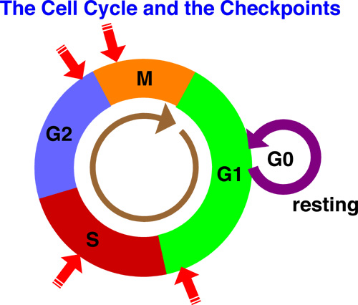
Cancer
Results from uncontrolled mitosis and cell division
Cells divide repeatedly and a tumor develops
Developed countries: 1 in 4 deaths
more than 200 different forms

Slide 3
Mutations
Cancer starts when mutations occur in the genes that control cell division.
Takes many mutations (not just 1) to cause cancer
Mutated gene called oncogene
Genes mutate regularly, but most mutations are either destroyed by our immune systems or do note survive to undergo mitosis

Slide 4
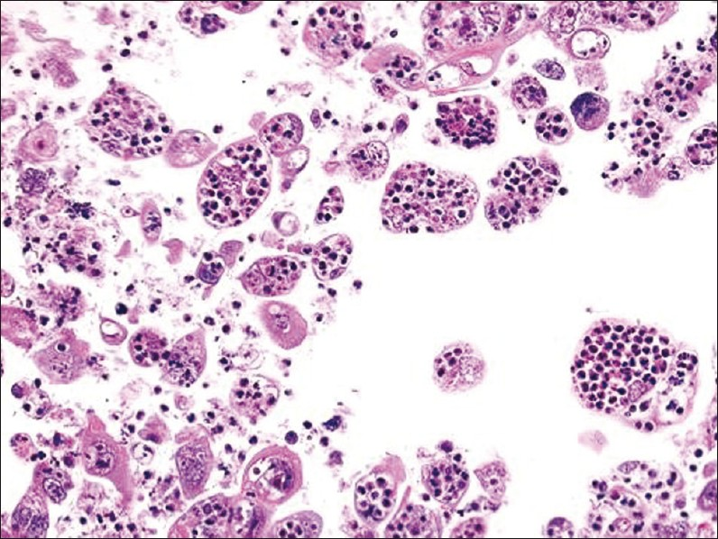
Mutations
Cancer cells escape are not killed by immune system and survive to reproduce identical daughter cells
By detection, a tumor can contain ~1 billion cancerous cells

Slide 5
Carcinogens
A factor which brings about any mutation is called a mutagen, and is described as mutagenic
Any agent that causes cancer is called a carcinogen, and is described as carcinogenic
Some mutagens are carcinogenic

Slide 6
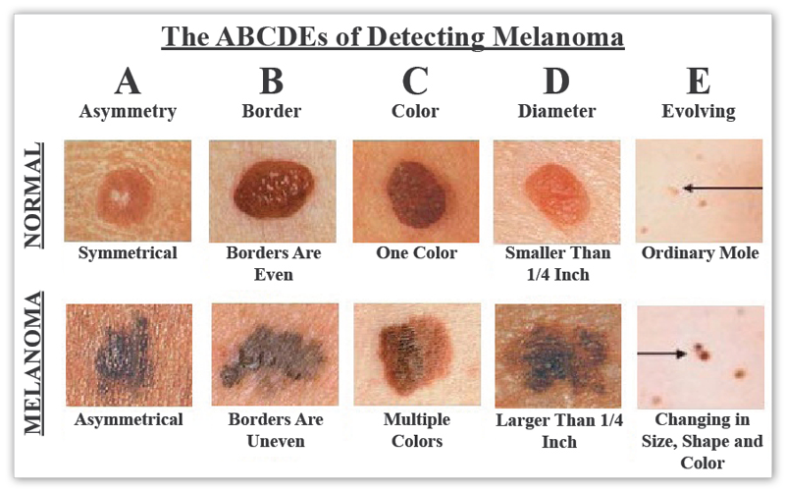
Carcinogens
Ionizing radiation and UV light
X-rays, gamma rays, radioactive decay, sunlight
Cause formation of damaging ions in cells which can break DNA strands (w/ exception of sunlight)

Slide 7
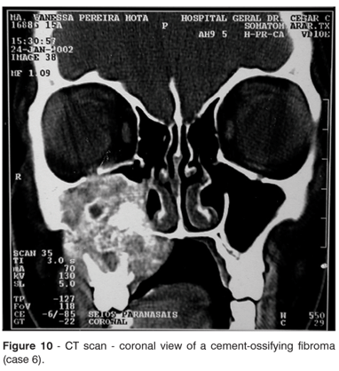
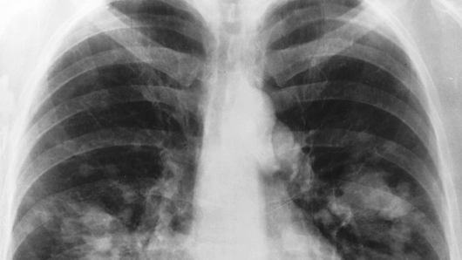
Carcinogens
Chemicals
Tobacco smoke, aniline dyes, asbestos, dioxins
Act by damaging DNA molecules

Slide 8
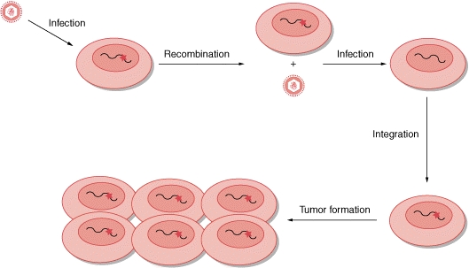
Carcinogens
Virus infection
Ex: Burkitt’s lymphoma, papilloma viruses (HPV)
Viruses carry oncogenes, or regulatory genes that become oncogenes

Slide 9
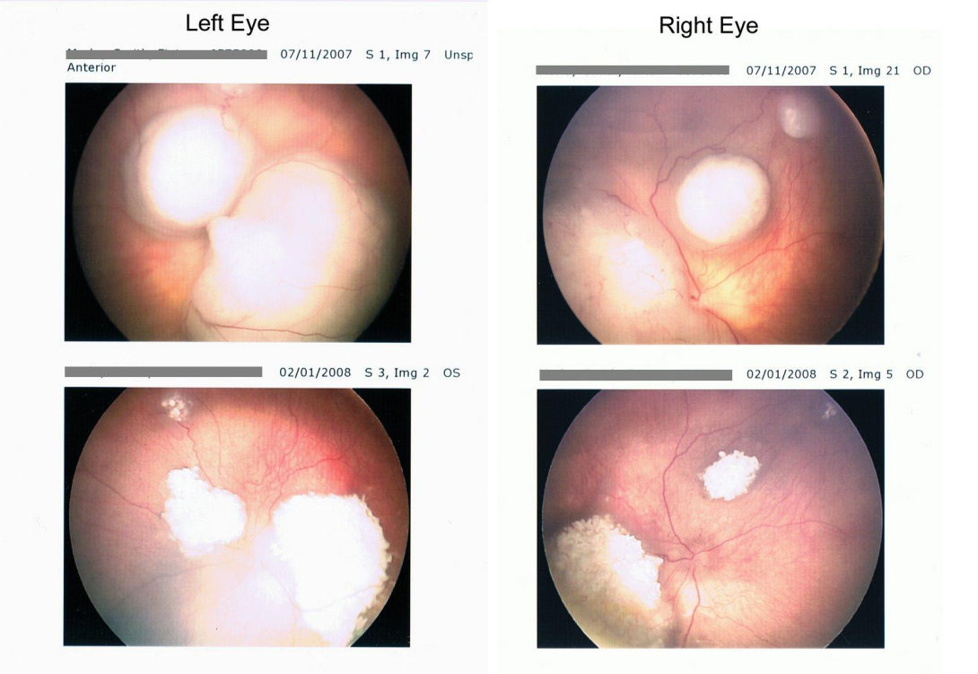
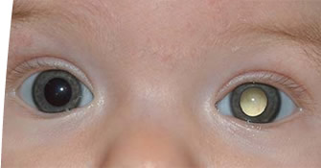
Carcinogens
Hereditary predisposition
Cancer tends to be more common in some families
The disease itself is often not inherited, but susceptibility to risk factors that create oncogenes are
Some oncogenes, however, are directly inherited (ex: retinoblastoma)

Slide 10
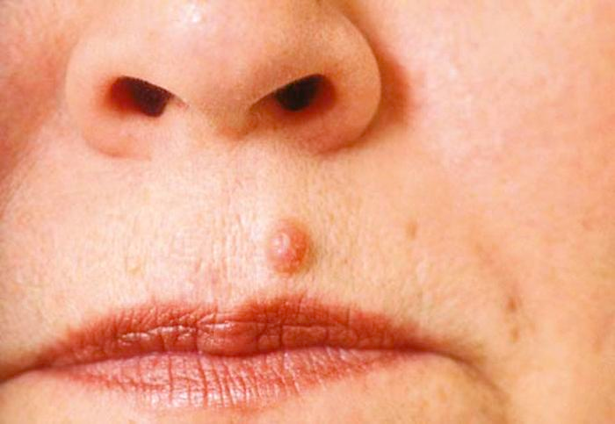
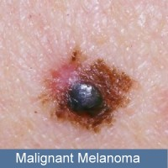
Tumors
Small group of tumor cells = primary growth
Benign: do no spread from site of origin, but can compress and displace surrounding tissue
Malignant: cancerous tumors. Spread throughout body and invade other tissues, eventually destroying them

Slide 11
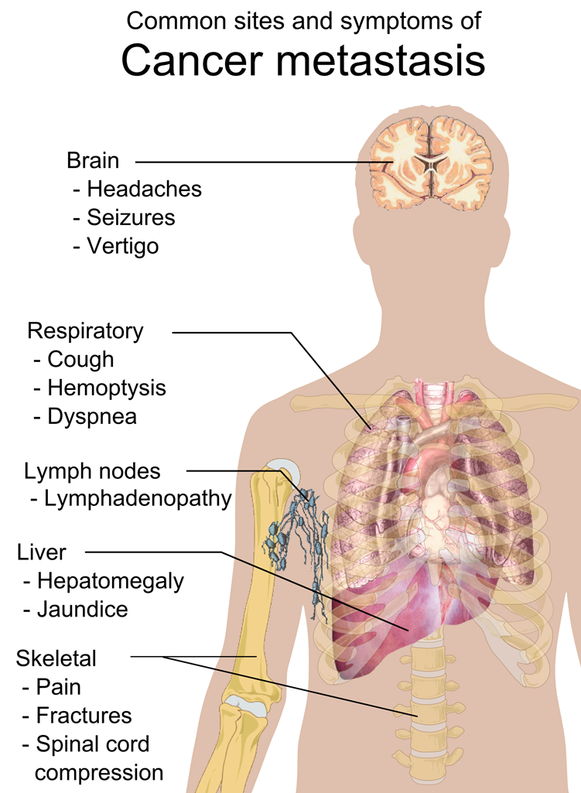
Malignant tumors
Interfere with normal functioning of tissue where they grow
Cells can break off and spread through the blood and lymph to form secondary growths
Spread of cancer by secondary growths is called metastasis

