Slide 1
Chapter 5-1: Nuclear division
Pages 86-93

Slide 2
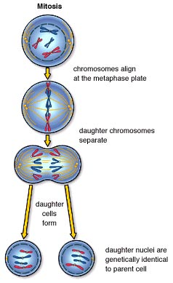
Cell & nuclear division
Cells reproduce by dividing and passing on their genes to daughter cells
Nucleus always divides before cell divides
Each daughter cell contains its own nucleus

Slide 3
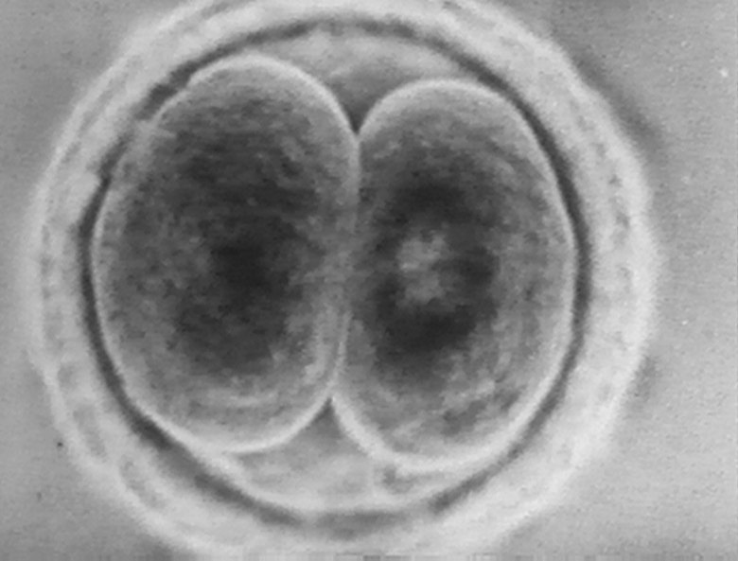
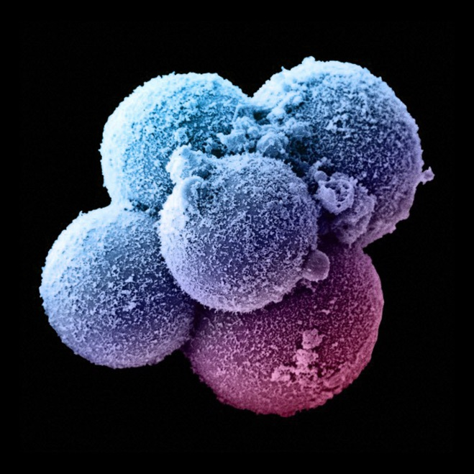
Cell & nuclear division
Nuclear division combined with cell division allows cells (and whole organisms) to reproduce themselves, and to grow
All cells in your body are all genetically identical (except for gametes – reproductive cells)
All cells derived from one cell - zygote

Slide 4
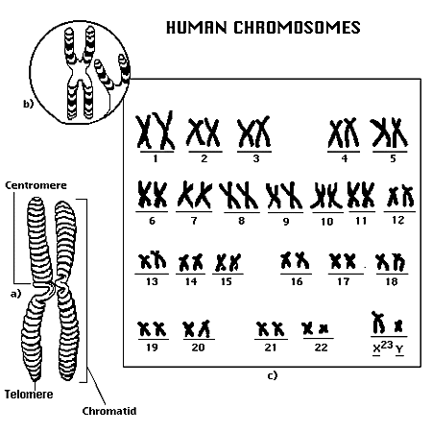
Chromosomes
Before division in eukaryotic cells, thread-like structures called chromosomes become visible
# chromosomes depends on species
Ex: Humans = 46, Flies = 8

Slide 5
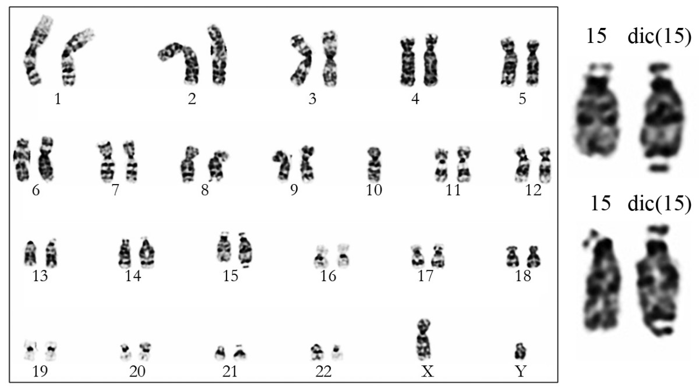
Chromosomes
Stain very intensely
Prepared photograph of chromosomes called a karyogram

Slide 6
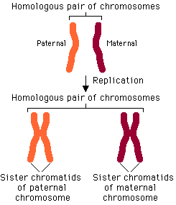
Chromosomes
Matching pairs are called homologous pairs.
In humans, there are two sets of 23 paired chromosomes. One set from the mother and one from the father

Slide 7
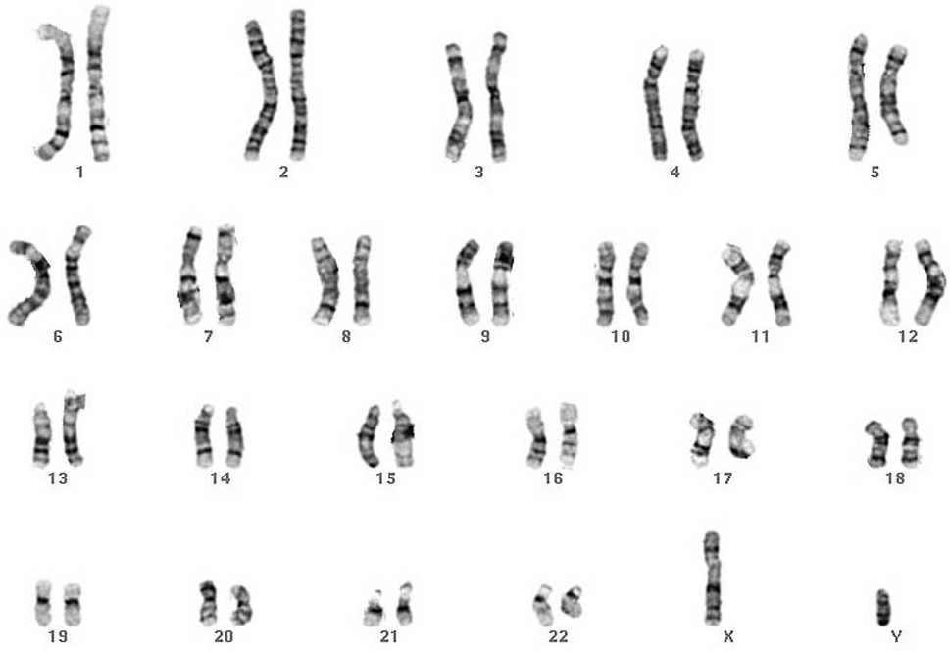
Chromosomes
Autosomes are numbered 1-22
Sex chromosomes are not numbered and determine the sex of an individual
XY = male, XX=female

Slide 8
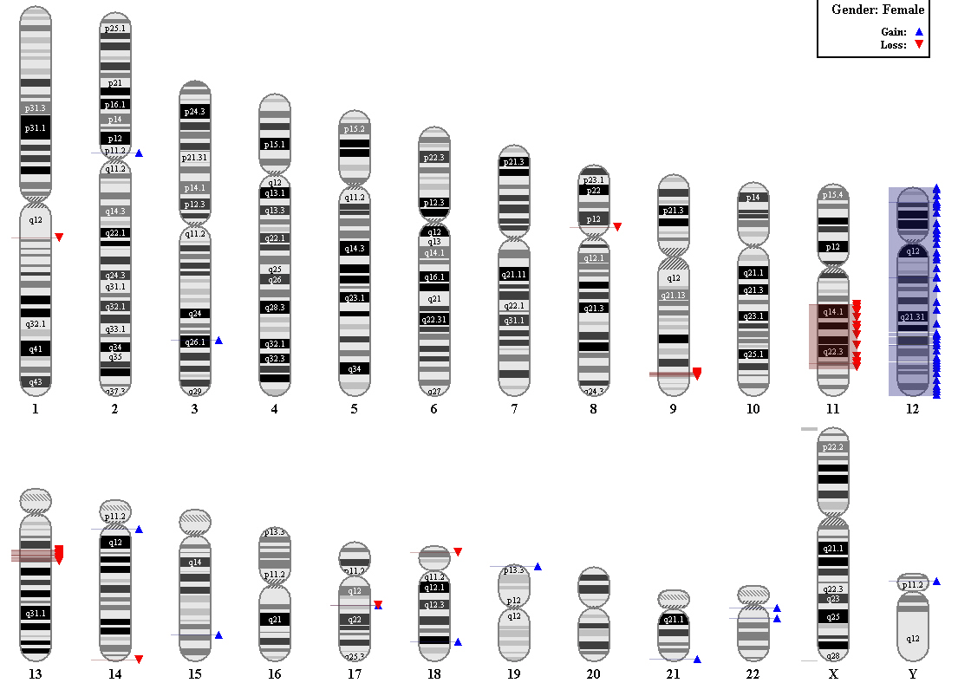
Chromosomes
Each chromosome has a characteristic set of genes which code for different features

Slide 9
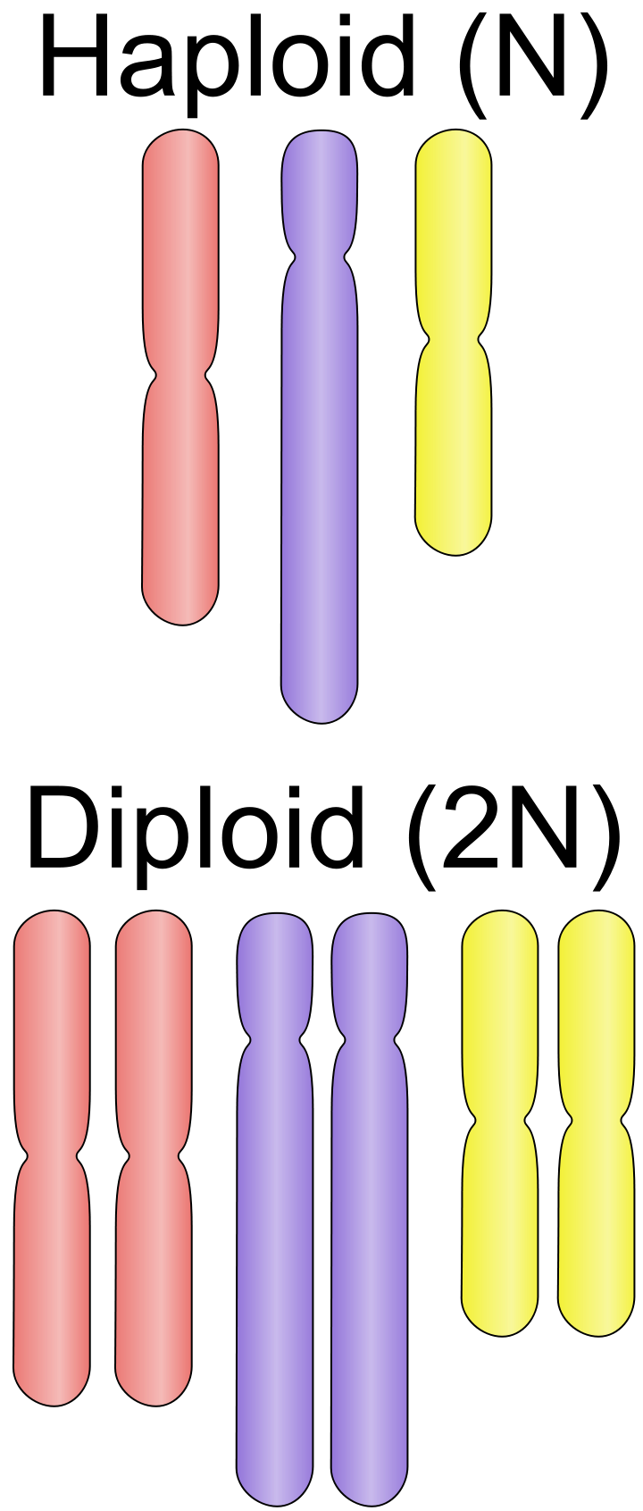
Haploid and diploid cells
Cells that contain 2 sets of chromosomes are described as diploid, as represented by 2n
n= number of chromosomes in one set
A cell which contains only one set of chromosomes is described as haploid, as represented by n
Ex“: gametes

Slide 10
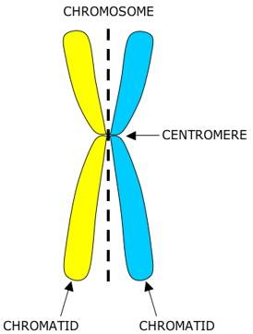
Chromosomes
Double structure made of two identical structures called chromatids that are joined together
During interphase (period between nuclear divisions) each DNA molecule makes an identical copy of itself (chromatid) and joins them at the centromere

Slide 11
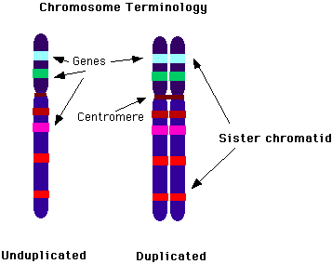
Chromatids
Each chromatid contains one molecule of DNA
DNA is the molecule of inheritance made up of a series of genes, which is one unit of inheritance.
One genes codes for one polypeptide involved in a specific aspect of the functioning of an organism

Slide 12
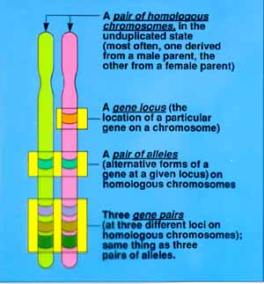
Chromatids
The gene for a particular characteristic is always found at the same position, or locus (pl. loci)
Total number of different genes in humans is thought to be ~20,000-25,000

Slide 13
Homologous chromosomes
Each member of homologous chromosomes comes from one of the parents
23 maternal + 23 paternal = 23 homologous pairs
Each member of a homologous pair possesses genes controlling the same characteristics
A gene for a different characteristic may exist in different forms (alleles) which are expressed differently

Slide 14
Cystic Fibrosis
Condition caused by a faulty allele (mutation) of a gene that codes for a chloride channel protein needed to produce normal mucus. Faulty allele causes very thick mucus.
Both homologous chromosomes have faulty allele = CF
Only one faulty copy is present = no CF
One faulty copy person is called a carrier

Slide 15
Nuclear division
Growth: as a zygote matures into adult with trillions of cells, each cell must be genetically identical
This type of nuclear division is called mitosis

Slide 16
Nuclear division
Sexual reproduction: point before fertilization where chromosomes must be halved to create haploid cells
this type of nuclear division is called meiosis, or reduction division

Slide 17
The cell cycle
Regular sequence of events that takes place between one cell division and the next
Three distinct phases: interphase, nuclear division, cell division

Slide 18
Interphase
G1 phase: Cell grows to normal size after cell division
S phase: Cell receives signal to start dividing and begins synthesizing DNA
G2 phase: DNA is checked and repaired, cell continues to grow and replicate organelles

Slide 19
Mitosis and cytokinesis
M phase (mitosis): growth stops temporarily. Nucleus divides into daughter nuclei
Cytokinesis: Whole cell division. Involved constriction of the cytoplasm between two nuclei

Slide 20
Mitosis
Early prophase: chromosomes start to coil up and become visible when stained. Centriole replicate
Late prophase: centrioles move to opposite side of nucleus. Nuclear envelope breaks up into vesicle (not visible) Chromosomes are seen as identical chromatids

Slide 21
Mitosis
Metaphase: Centrioles reach opposite ends (poles) and organize spindle microtubules. Chromosomes align at the equator of the spindle. MTs attach to centromeres

Slide 22
Mitosis
Anaphase: chromatids move to opposite poles, pulled by the centromeres
Telophase: chromatids have reached spindle and begin uncoiling. Nuclear envelope reforms.

Slide 23
Biological significance of mitosis
Growth: Daughter cells have same number of chromosomes as parent cell and are genetic clones.
This allows growth of multicellular organisms from unicellular zygotes

Slide 24
Biological significance of mitosis
Replacement of cells and repair of tissues: Cells are constantly dying and being replaced by new cells. (ex: skin)
Some animals can regenerate entire body parts

Slide 25
Biological significance of mitosis
Asexual reproduction: production of new individuals of a species by a single parent organism.
Can be from unicellular organisms or multicellular (budding)
Budding is particularly common in plants

Slide 26
Biological significance of mitosis
Cloning of B-lymphocytes and T-lymphocytes during immune response is dependent on mitosis

