Slide 1
Chapter 4: Phospholipids and Cell Membranes

Slide 2
Structure of membranes
Bilayer membrane ~7 nm wide
Contains embedded proteins

Slide 3
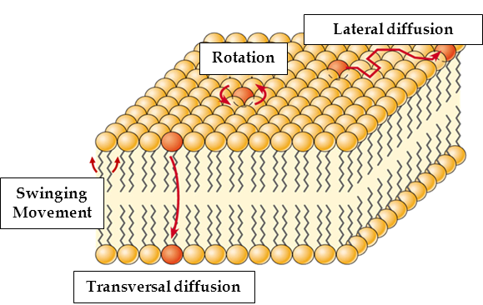
Fluid Mosaic Model
Membrane described as fluid b/c both phospholipids and proteins can move about by diffusion
Bilayer has fluidity we associate with olive oil
Move sideways in their own layers
Proteins move like icebergs in sea

Slide 4
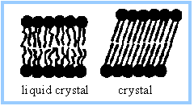
Fluid Mosaic Model
Some phospholipid tails are saturated, some are unsaturated
More unsaturated = more fluid
Tails are bent, so they fit together more loosely

Slide 5
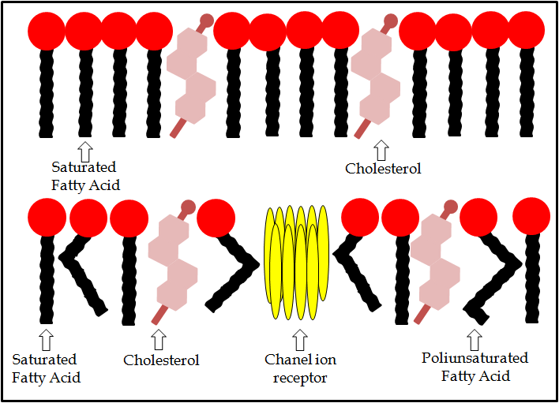
Fluid Mosaic Model
Longer tail = less fluid membrane
Lower temp. = less fluid membrane

Slide 6
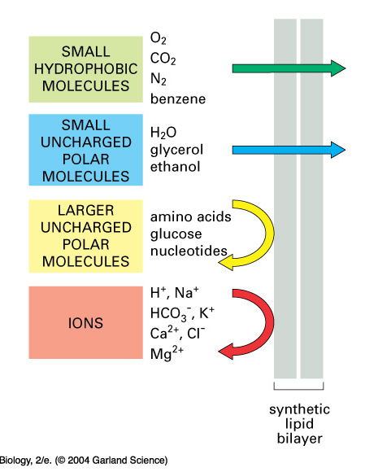
Phospholipids
Because tails of phospholipids are nonpolar, it is difficult for polar molecules (water soluble) to pass through the membrane
Ex: sugars, amino acids, and proteins cannot leak out of the cell

Slide 7
Cholesterol
hydrophilic heads + hydrophobic tails
Fits in between phospholipids
In animal cells, amount cholesterol= amount phospholipids in CSM
Regulates fluidity, stabilize membranes
Hydrophobic regions: prevent ions/polar molecules from passing through membrane
Important in myelin sheath around nerve cells: ion leaks would slow signals

Slide 8
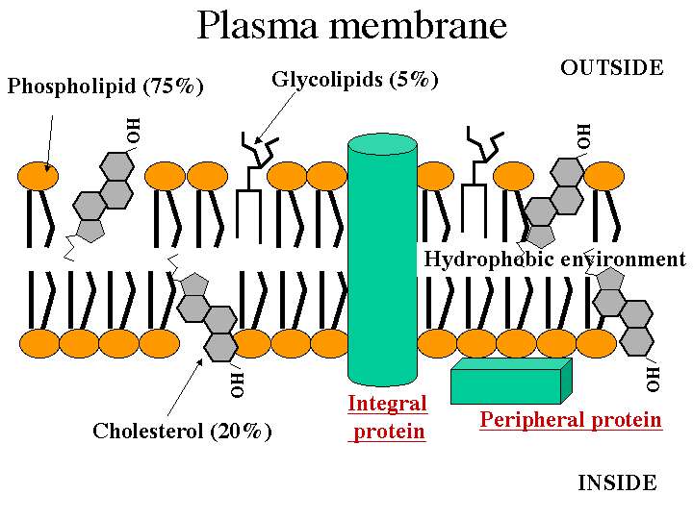
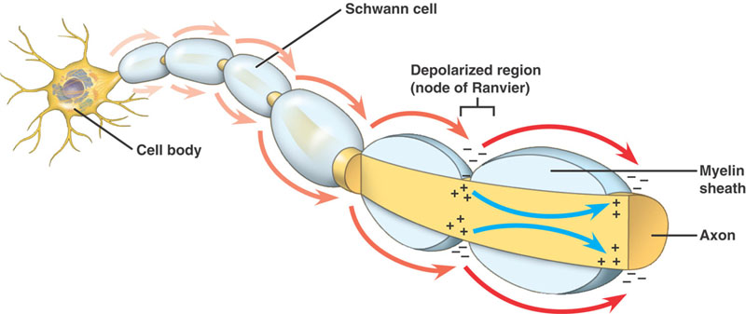
Cholesterol

Slide 9
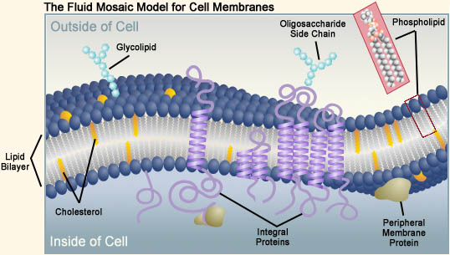
Fluid Mosaic Model
Two types of proteins in membrane:
Intrinsic (aka integral): found in inner layer, outer layer, or most commonly spanning the entire membrane (transmembrane proteins)
Extrinsic (aka peripheral): found on inner or outer surface of the membrane

Slide 10
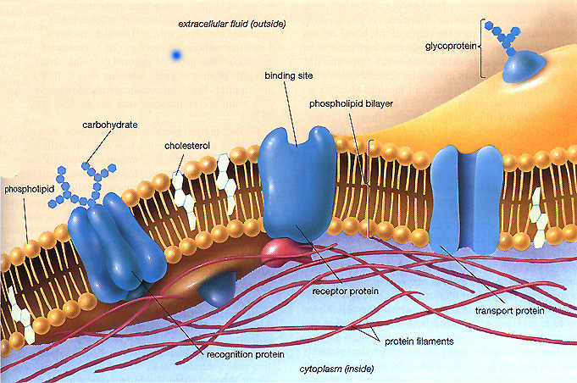
Intrinsic Proteins
Stay in membrane due to its hydrophobic and hydrophilic regions
Most float like mobile icebergs although some are fixed like islands to structures inside or outside the cell and do not move about

Slide 11
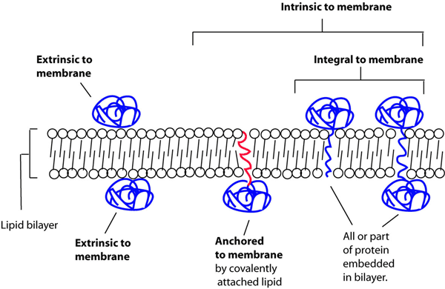
Extrinsic proteins
Many are bound to intrinsic proteins
Some are held in place by binding to molecules inside or outside the cell

Slide 12
Proteins’ roles in membranes
Transport proteins: hydrophilic channels
Ions, polar molecules
Enzymes: on plasma membrane on small intestine surface hydrolyze disaccharides
Proteins in organelle membranes for photosynthesis + cell respiration

Slide 13
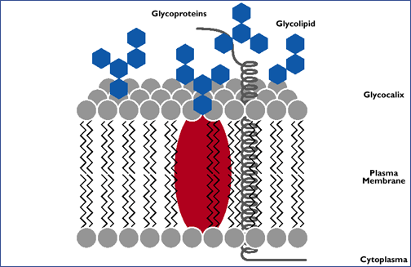
Glycolipids and Glycoproteins
Many proteins and lipids in membrane have carbohydrate chains attached that face the outside of the membrane
Glycolipids = carb. attached to lipid
Glycoproteins = carb. attached to protein

Slide 14
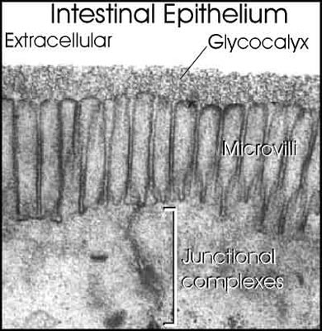
Glycolipids and Glycoproteins
Form H-bonds with water to stabilize the membrane
Form sugary coating on membrane called glycocalyx
Act as receptor molecules

Slide 15
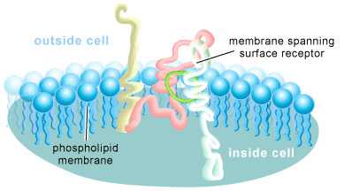
Cell Surface Receptors
Carbohydrate chains help glycoprotein and glycolipids act as receptor molecules, which bind with particular substances at the CSM

Slide 16
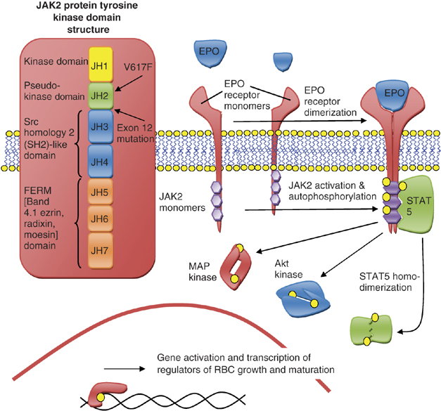
Signaling Receptors
Coordinate activities of animal cells
Recognize messenger molecules like hormones and neurotransmitters
When molecule binds with receptor, it triggers a series of chemical reactions in the cell

Slide 17
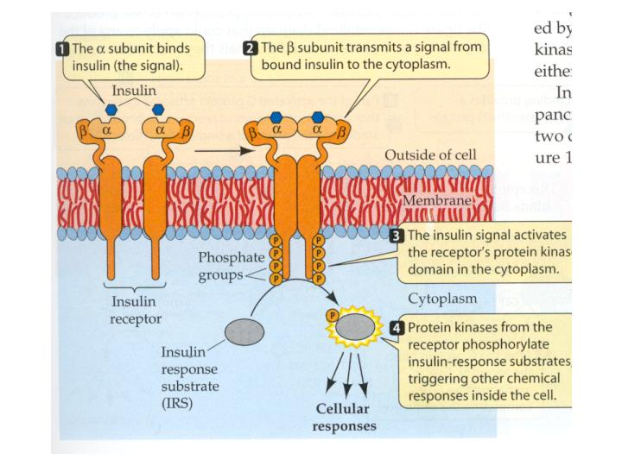
Insulin Receptor

Slide 18
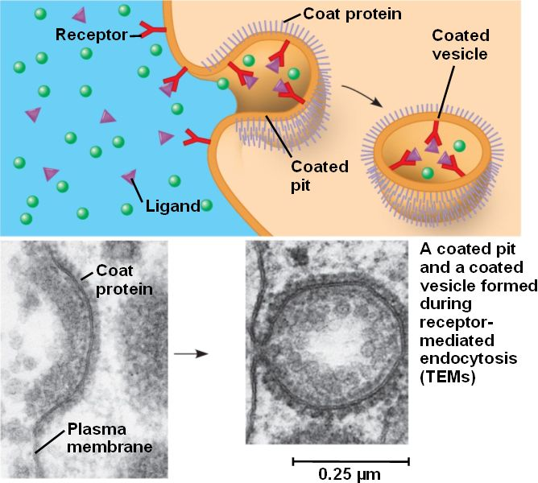
Endocytosis receptors
Bind to molecules that are parts of the structures that are to be engulfed by CSM

Slide 19
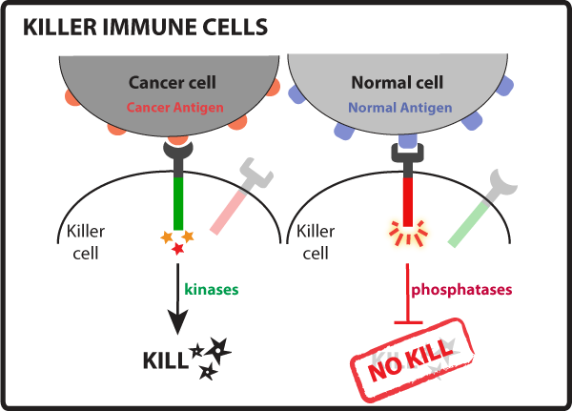
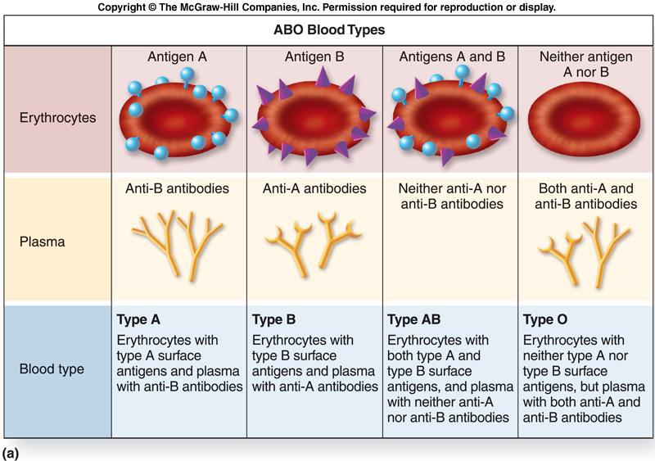
Cell Marker Receptors
Aka antigens
Allow cell-cell recognition
Each cell type has its own specific antigen (similar to how different countries have different flags)
Ex: ABO blood types

Slide 20
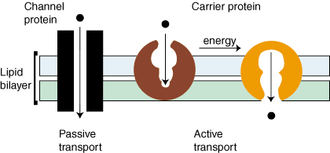
Transport Proteins
Provide channels or passageways for ions and polar molecules to pass through CSM
Two main types: channel proteins and carrier proteins

