Slide 1
Chapter 2.4: Proteins

Slide 2
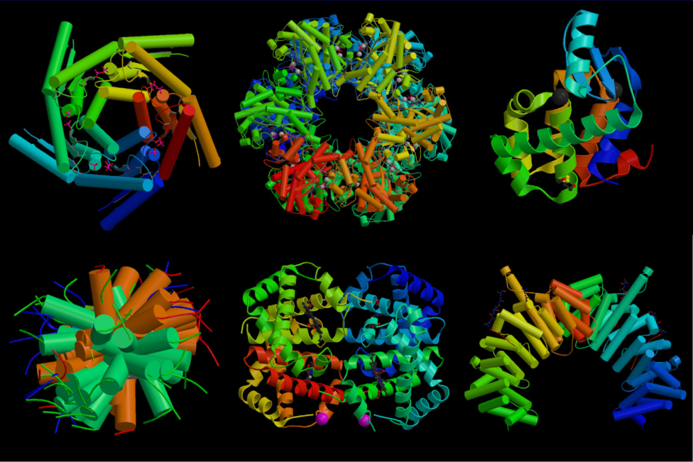
Proteins
Composed of monomers called amino acids
Extremely important macromolecule
  More than 50% dry mass of cell is protein

Slide 3
Functions of Proteins
All enzymes are proteins
Essential in cell membranes
Hormones (ex: insulin)
Hemoglobin
Antibodies
Structural component (collagen, keratin, etc…)
Muscle contraction

Slide 4
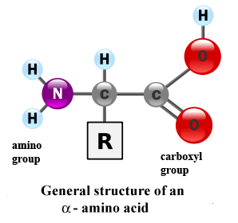
Amino Acids
All amino acids have the same general structure:
  Central carbon atom bonded to an amine group
  (-NH2) and a carboxylic acid group (-COOH)
  Differ in chemical composition of the R group bonded to central carbon

Slide 5
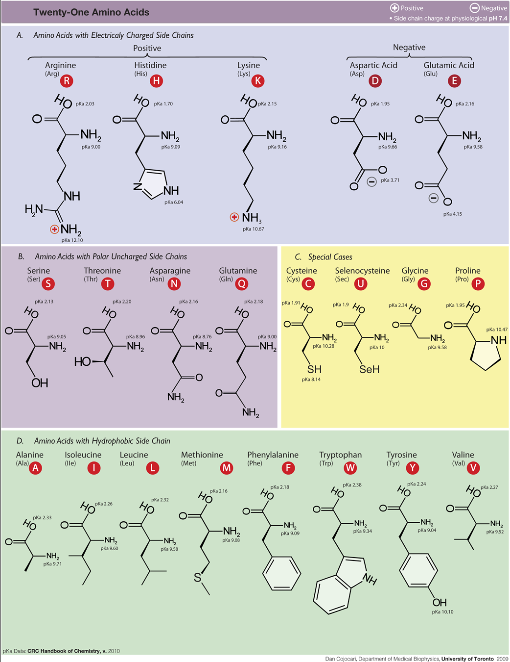
Amino acids
20 diff. amino acids all with diff. R groups
Commonly abbreviated as three letters
(ex glycine=gly) or by single letter (glycine=G)

Slide 6
The peptide bond
One amino acid loses a hydroxyl (-OH) group from is carboxylic acid group, while another amino acid loses a hydrogen atom from its amine group
  This leaves a carbon atom free to bond with a nitrogen atom forming a link called a PEPTIDE BOND

Slide 7
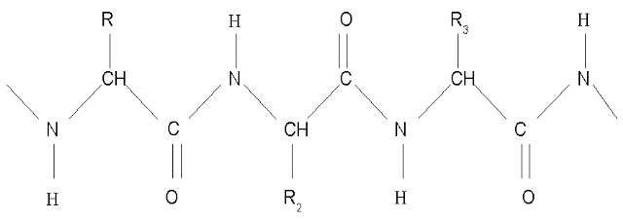
Peptide bond
Strong covalent bonds
Water is removed (condensation rxn!!)
2 amino acids= dipeptide
More than 2= polypeptide
  A complete protein may contain just one polypeptide chain, or many that interact with each other

Slide 8
Peptide bond
In living cells, ribosomes are the sites where amino acids are joined together to from polypeptides
  This reaction is controlled by enzymes
Polypeptides can be broken down (hydrolysis) to amino acids.
  Happens naturally in stomach and small intestine during digestion

Slide 9
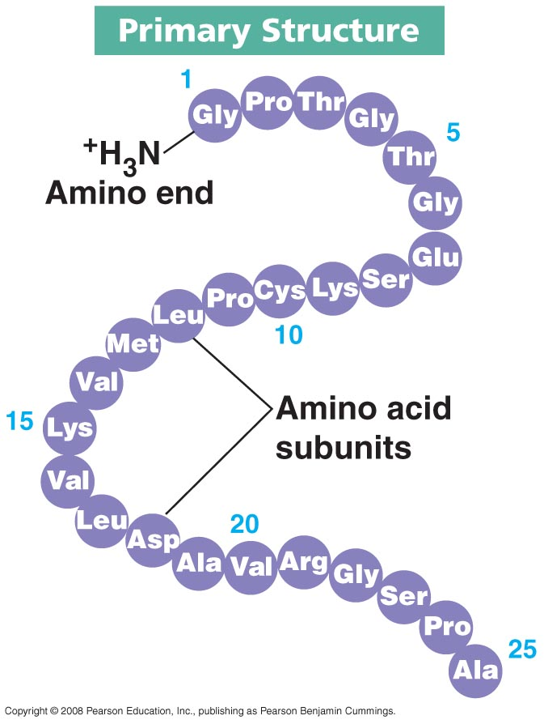
Primary Structure
Polypeptide chains may contain several hundred amino acids linked by peptide bonds
The particular amino acids and their ORDER in the sequence is called the primary structure of the protein

Slide 10
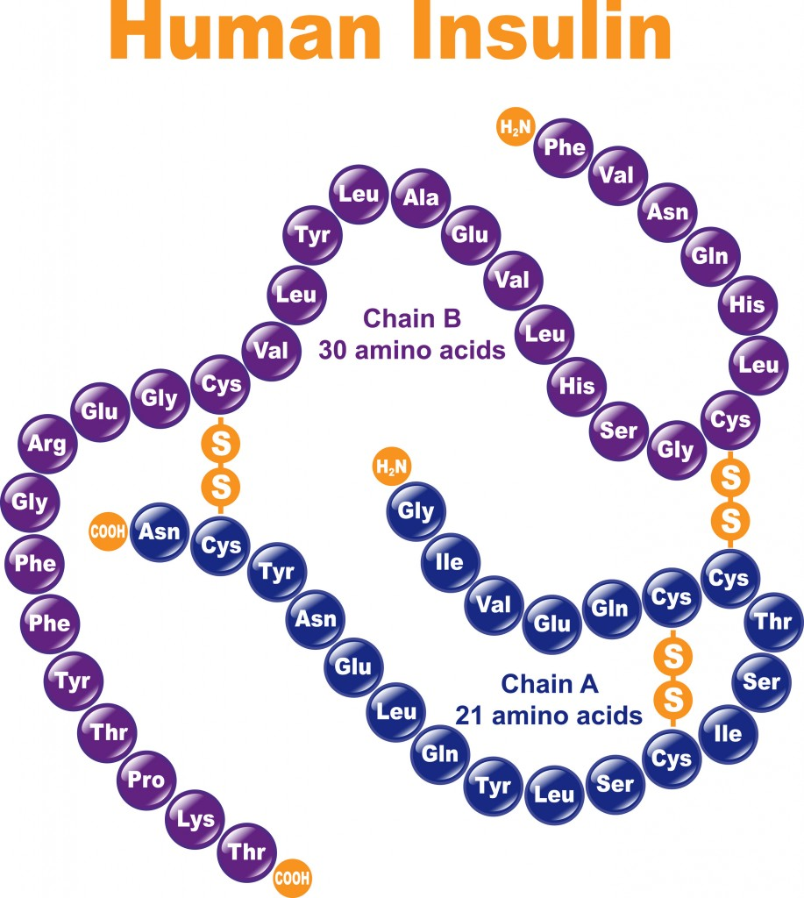
Primary Structure
There are enormous numbers of different primary structures possible
  A change in a single amino acid in a polypeptide can completely alter the structure and function of the final protein

Slide 11
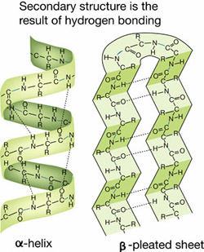
Secondary Structure
The particular amino acids in the chain have an effect on each other even if they are not directly next to one another

Slide 12
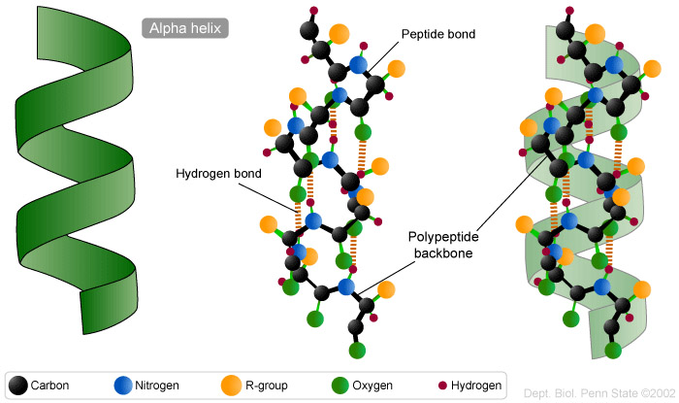
Secondary Structure
Polypeptides often coil into a corkscrew shape called an α-helix
  Forms via hydrogen bonding between the oxygen of the –CO group of one amino acid and the –NH group of an amino acids four places ahead of it
  Easily broken by high temperatures and pH changes

Slide 13
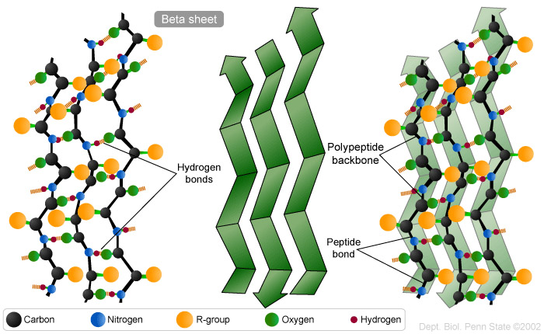
Secondary Structure
Hydrogen bonding is also responsible for the formation of β-pleated sheets
  Easily broken by high temperatures and pH changes

Slide 14
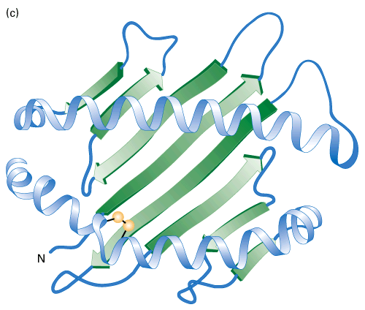
Secondary Structure
Some proteins show no regular arrangement; depends on which specific R groups are present
In diagrams, β-sheets are represented by arrows and α-helices are represented by coils or cylinders. Random coils are ribbons.

Slide 15
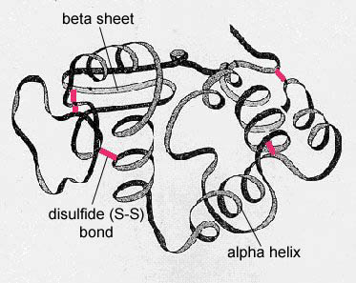
Tertiary Structure
In many proteins, the secondary structure itself it coiled or folded
Shapes may look “random” but are very organized and precise
The way in which a protein coils up to form a precise 3D shape is known as its tertiary structure

Slide 16
Tertiary Structure
4 bonds help hold tertiary structure in place:
1.) Hydrogen bonds: forms between R groups
2.) Disulfide bonds: forms between two cysteine molecules
3.) Ionic bonds: form between R groups containing amine and carboxyl groups
4.) Hydrophobic interactions: occur between R groups which are non-polar (hydrophobic)

Slide 17
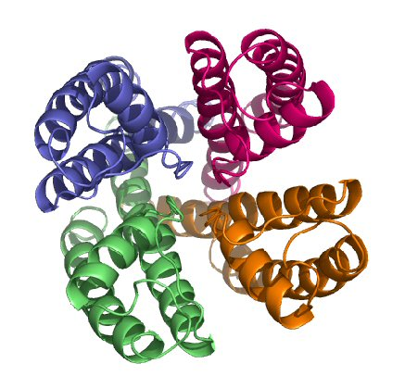
Quaternary Structure
Most protein molecules are made up of two or more polypeptide chains (Ex: hemoglobin)
The association of different polypeptide chains is called the quaternary structure of the protein
Chains are held together by same types of bonds as tertiary structure

Slide 18
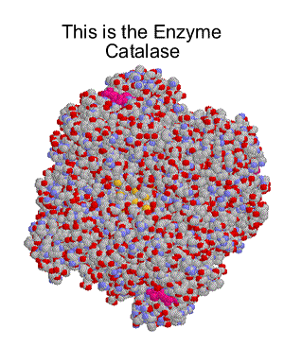
Globular Proteins
A protein whose molecules curl up into a “ball” shape is known as a globular protein
Globular proteins usually play a role in metabolic reactions
Their precise structure is key to their function!
Ex: enzymes are globular proteins

Slide 19
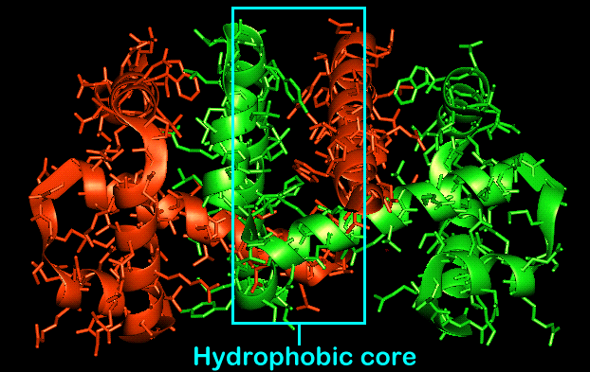
Globular Proteins
Globular proteins usually curl up so that their nonpolar (hydrophobic) R groups point into the center of the molecule, away from aqueous surroundings
Globular proteins are usually water soluble because water molecules cluster around their outward-pointing hydrophilic R groups

Slide 20
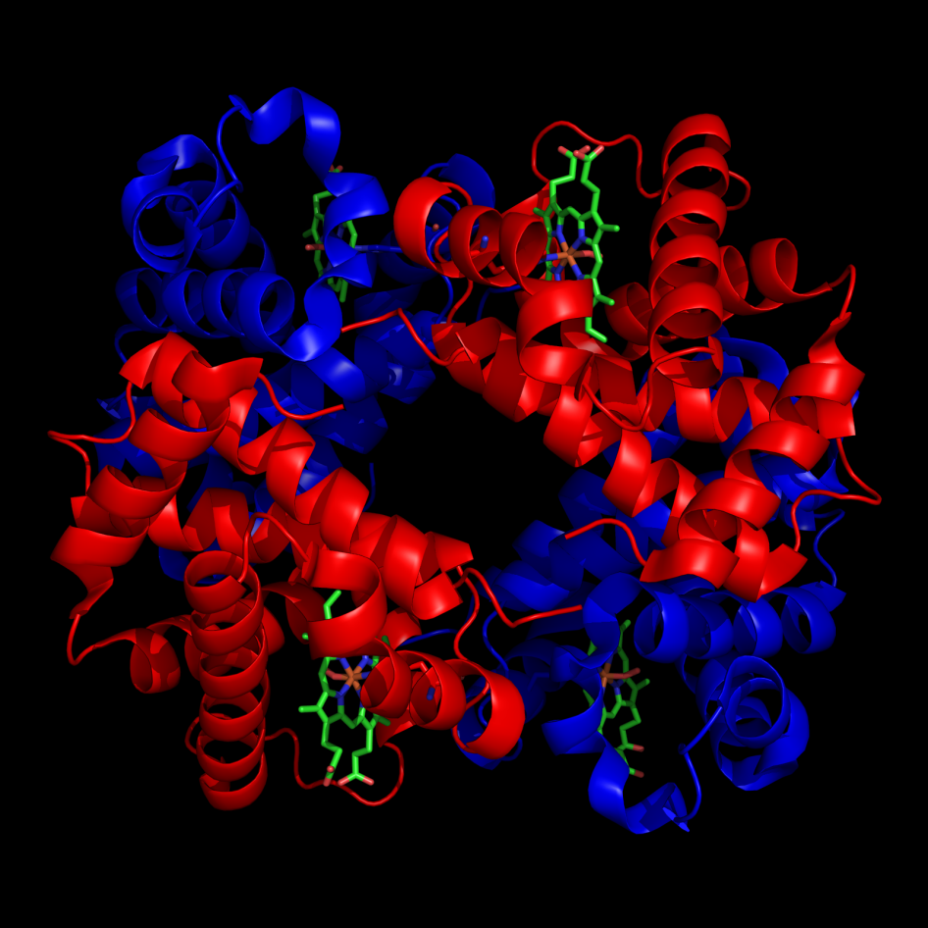
Hemoglobin
Hemoglobin is the oxygen carrying pigment found in red blood cells, and is a globular protein
Made up of four polypeptide chains (has quaternary structure)
  Each chain known as globin.

Slide 21
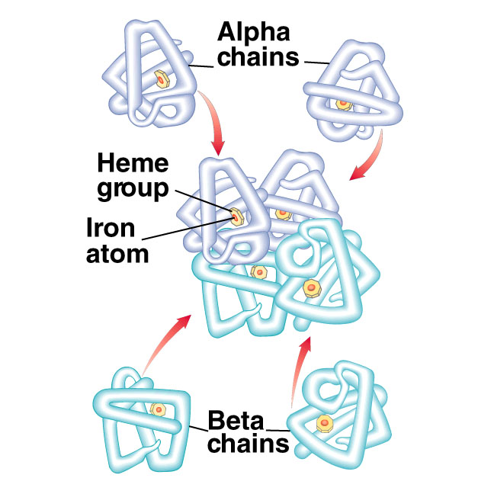
Hemoglobin
Two types of globin used to make hemoglobin:
  2 α-globin (make α-chains)
  2 β-globin (make β-chains)

Slide 22
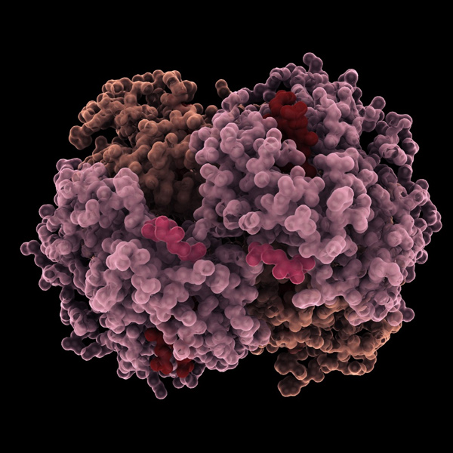
Hemoglobin
Nearly spherical due to tight compaction of polypeptide chains
Hydrophobic R groups point toward inside of proteins, hydrophilic R groups point outwards
Hydrophobic interactions are ESSENTIAL in holding shape of hemoglobin

Slide 23
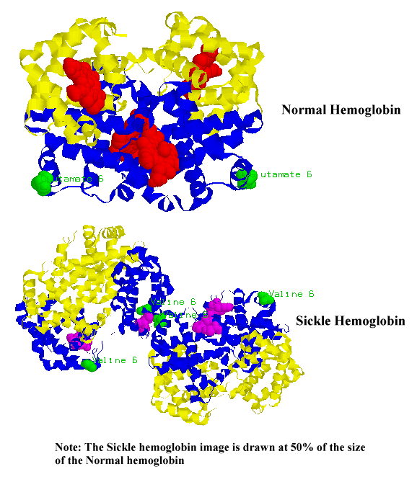
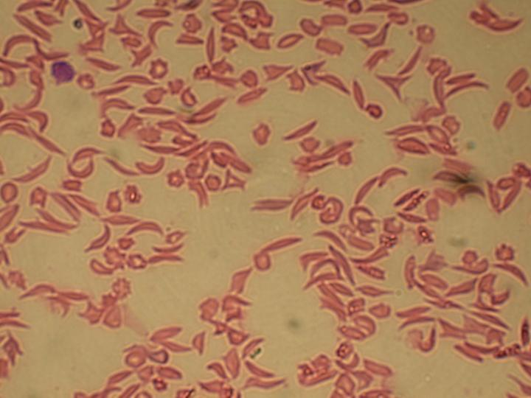
Sickle cell anemia
Genetic condition in which one amino acids on the surface of the β-chain, glutamic acid, which is polar, is replaced with valine, which is nonpolar
Having a nonpolar (hydrophobic) R group on the outside of hemoglobin make is less soluble, and causes blood cells to be misshapen

Slide 24
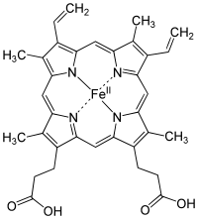
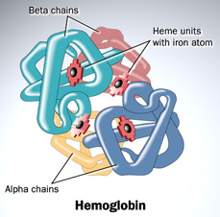
Hemoglobin
Each polypeptide chain of hemoglobin contains a heme (haem) group
  Important, permanent part of a protein molecule but is NOT made of amino acids
  Each heme group contains an Fe atom that can bind with one oxygen molecule
  A complete hemoglobin molecule can therefore carry FOUR oxygen molecules

Slide 25
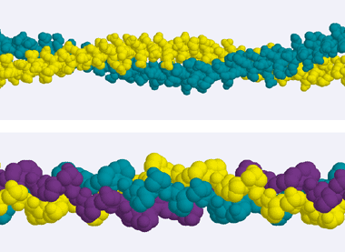
Fibrous Proteins
Proteins that form long strands are called fibrous proteins
Usually insoluble in water
Most fibrous proteins have structural components in cells (ex: keratin and collagen)

Slide 26
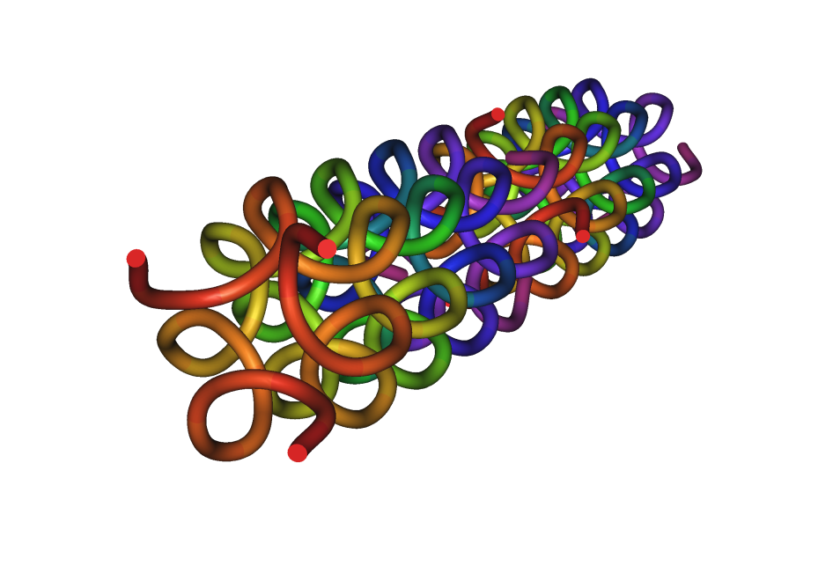
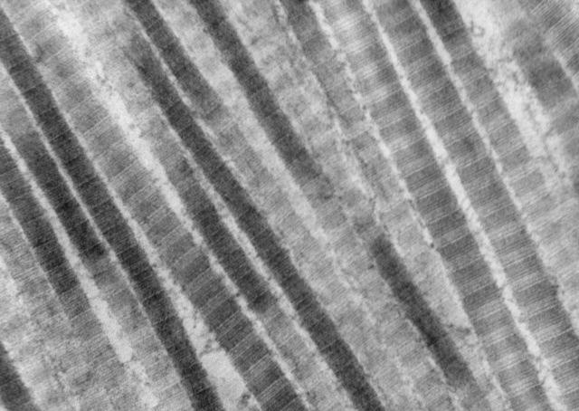
Collagen
Most common protein found in animals (~25% total protein)
Insoluble fibrous protein found in skin, tendons, cartilage, bones, teeth, and walls of blood vessels
Important structural protein

Slide 27
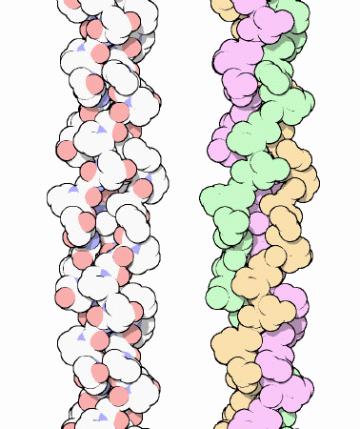
Collagen
Consist of three helical polypeptide chains that form a three-stranded “rope” or triple helix
Three strands are held together by hydrogen bonds and some covalent bonds

Slide 28
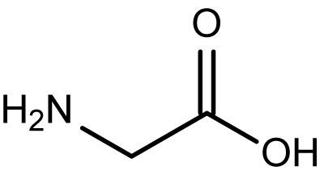
Collagen
Almost every third amino acid is glycine (very small aa) allowing the strands to lie close and form a tight coil (any other aa would be too large)

Slide 29
Collagen
Each complete collagen molecule interacts with other collagen molecules running parallel to it
These cross-links hold many collagen molecules together side by side, forming fibrils
The ends of parallel molecules are staggered to make fibrils stronger
Many fibrils together = fibers

Slide 30
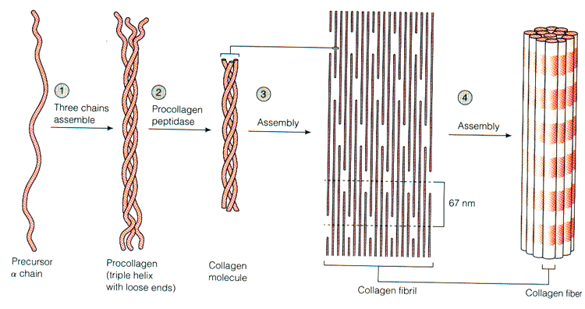
Collagen

Slide 31
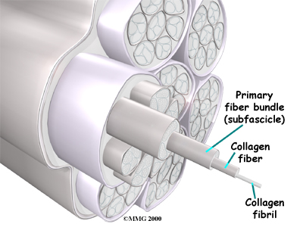
Collagen
Tremendous tensile strength (can withstand large pulling forces without stretching or breaking) and is also flexible
  Ex: Achilles tendon (almost pure collagen) can withstand a pulling force about ¼ that of steel

Slide 32
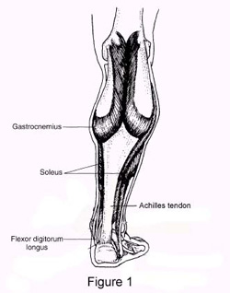
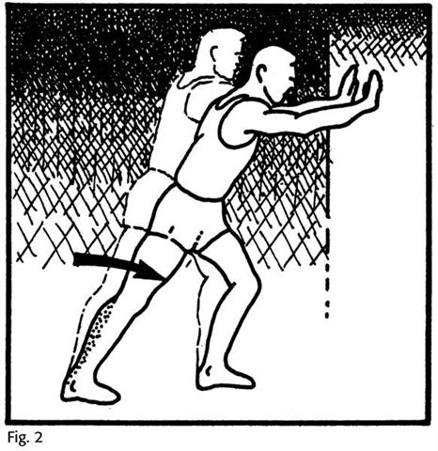
Collagen
Fibers line up in the direction in which they must resist tension. Ex: parallel bundles along the length of Achilles tendon, cross layered in skin to resist multiple directions of force

