Slide 1
Chapter 2.3: Lipids

Slide 2
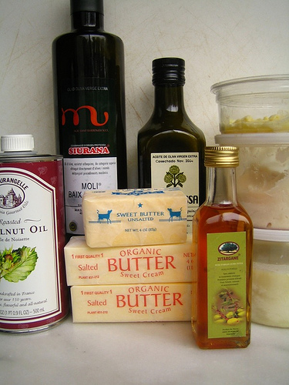
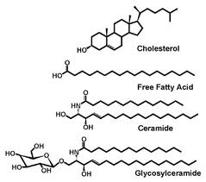
Lipids
Very diverse group of chemicals
Most common: triglycerides
  Usually known as fats and oils

Slide 3
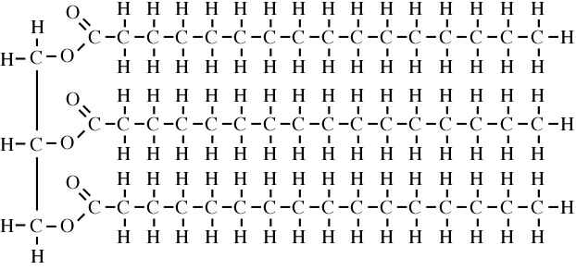
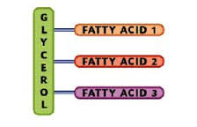
Triglycerides
Triglycerides are made by the combination of three fatty acid molecules with one glycerol molecule
  Fatty acids: organic molecules with a –COOH group attached to a hydrocarbon tail
  Glycerol: type of alcohol

Slide 4
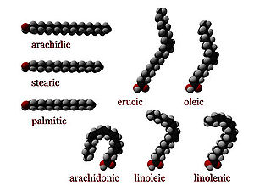
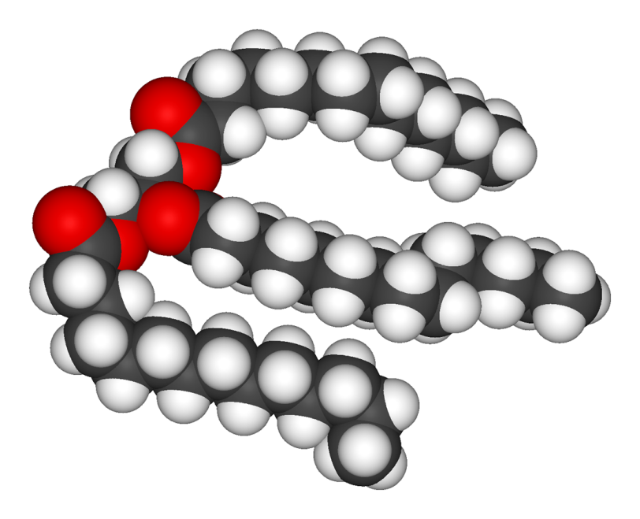
Triglycerides
Tails differ in length depending on the specific type of fatty acid

Slide 5
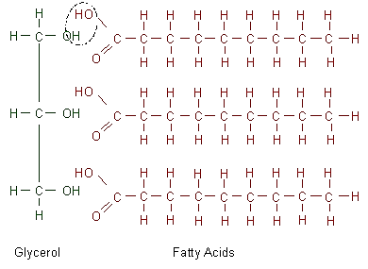
Triglycerides
Each fatty acid molecule joins to glycerol by a condensation reaction
  When a fatty acid combines with glycerol it forms a glyceride, hence 3 fatty acids + glycerol = triglyceride

Slide 6
Triglycerides
Insoluble in water, but soluble in some nonpolar organic solvents (ether, chloroform, ethanol)
  Fatty acid tails are NONPOLAR so they will not dissolve in polar solvents like water. There are therefore said to be hydrophobic

Slide 7
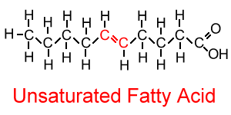
Unsaturated fatty acids
Some fatty acids have double bonds between neighboring carbon atoms: -C=C
  Describe as unsaturated (as they do not contain the maximum possible amount of hydrogen)

Slide 8
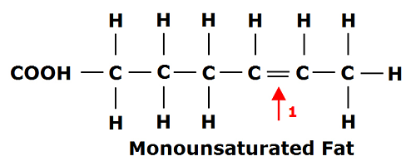
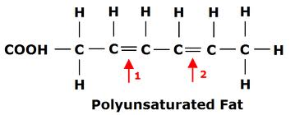
Unsaturated fatty acids
Double bonds make lipids melt more easily, making them liquids (oil) at room temperature
If there is 1 double bond, the fatty acid is described and monounsaturated
If there is more than 1 double bond, the fatty acid is described as polyunsaturated

Slide 9
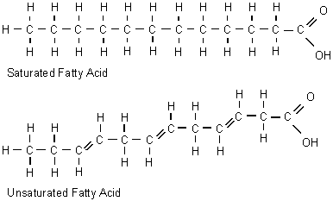
Saturated fatty acids
Fatty acids that contain all single carbon bonds (C-C) and the maximum number of hydrogen on each tail
  Occur as solids at room temperature (fat)

Slide 10
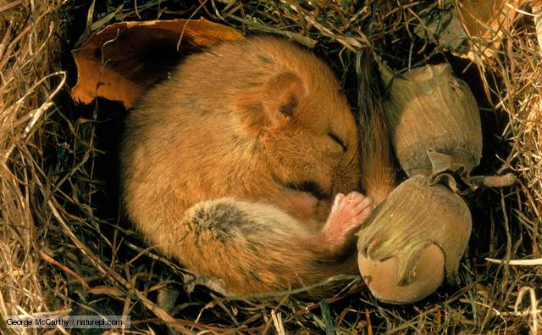
Roles of triglycerides
Lipids make excellent energy reserves because they are even richer in C-H bonds than carbohydrates
  A given mass of lipid will therefore yield more energy on oxidation than the same mass of carbohydrate (lipids = calorie dense)
Animals that hibernate store excess lipids for energy

Slide 11
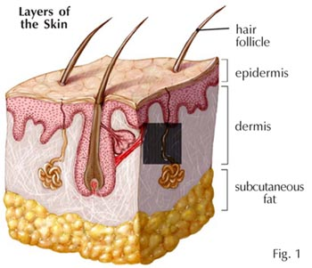
Roles of triglycerides
Fat is stored throughout human body
  Just below dermis of skin, around kidneys
Below the skin also acts as an insulator against the loss of heat (called blubber in sea mammals-also provides buoyancy)

Slide 12
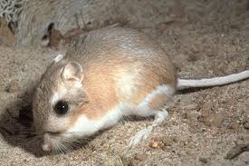
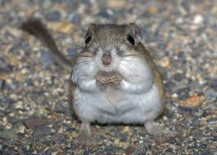
Roles of triglycerides
Lipids also act as a metabolic source of water:
  When oxidized in respiration, they are converted to carbon dioxide and water
  VERY important in dry habitats!
  This furry lil guy legit NEVER drinks water! CRAY!

Slide 13
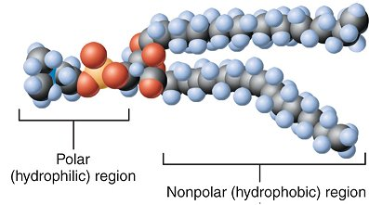
Phospholipids
Phospholipids are a special type of lipid because one end is soluble in water
  B/c one of the three fatty acids is replaced with a phosphate group, which is polar (like dissolves like)

Slide 14
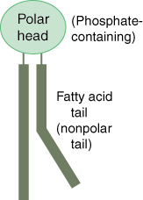
Phospholipids
The phosphate group is hydrophilic and makes the head of a phospholipid molecule hydrophilic, although the two remaining tails are still hydrophobic
  This biological significance is in Ch 4 yayyyyy

