Slide 1
Chapter 2: Water pgs. 46-47

Slide 2
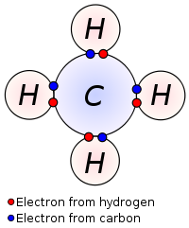
Covalent bonds
When atoms in a molecule are held together by covalent bonds, they share electrons with each other
Each shared pair of electrons forms on covalent bond

Slide 3
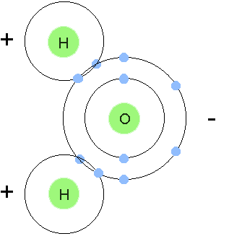
Covalent bonds
In a water molecule, two hydrogen atoms each share a pair of electrons with an oxygen atom, forming a molecule with the formula H2O

Slide 4
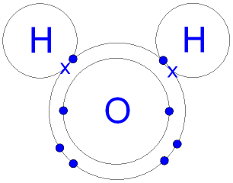
Polar covalent bonds
Electrons in covalent bonds aren’t always shared equally
In water, oxygen is more electronegative, so its basically an electron hog
More time with electrons = negative charge

Slide 5
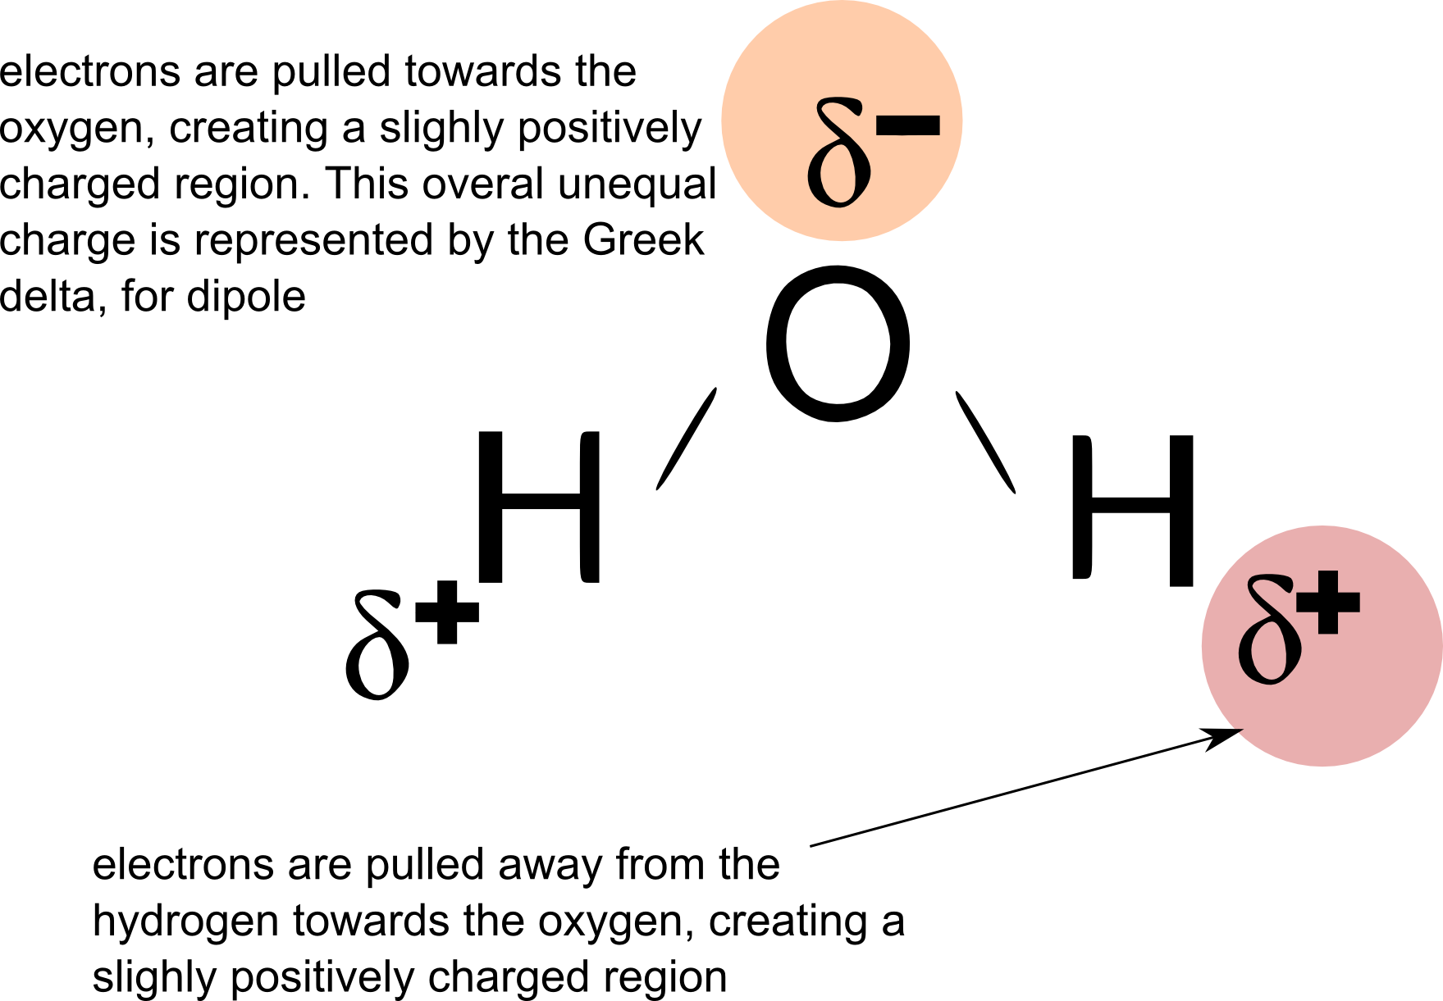
Polar covalent bonds
This unequal distribution of charge is called a dipole

Slide 6
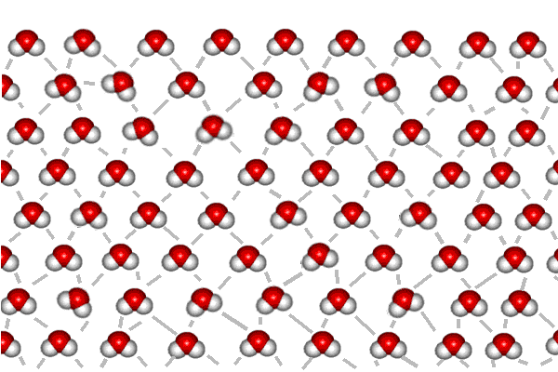
Hydrogen bonds
In water, the negatively charged oxygen of one molecule is attracted to the positively charged hydrogen of another water molecule. This attraction is called a hydrogen bond

Slide 7
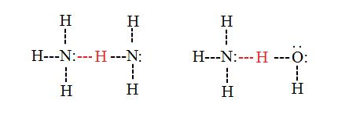
Dipoles
Occur in many different molecules, particularly whenever there is an –OH, -C=O, or =N-H group present
Hydrogen bonds can form between these groups because the oppositely charged regions are attracted to each other

Slide 8
Dipoles
Molecules with dipoles are said to be polar
Polar molecules are attracted to water
Hydrophilic (water loving)
Water soluble
Molecules without dipoles are said to be non-polar
Not attracted to water
Hydrophobic (water-hating)
Soluble only in nonpolar solvents

Slide 9
Water
Arguable most important biochemical (no water = no life)
75% planet Earth = water
70%-90% mass of cell
Humans= ~60% water

Slide 10
Water
Without hydrogen bonds, would exist as a gas at room temperature
Liquid= provides medium for molecules and ions to mix in, and hence a medium in which life can evolve

Slide 11
Hydrogen bonding
Hydrogen bonding in water makes molecules more difficult to separate and affects the physical properties of water
Ex: energy needed to break hydrogen bonds make it more difficult to convert water from a liquid to a gas than to convert similar compounds which lack hydrogen bonds, like H2S

Slide 12
Water as a solvent
Solute = substance being dissolved
Solvent= substance solute in being dissolved into
Water is an excellent solvent for ions and polar molecules because the charges in water are attracted to the charges in ions and polar molecules

Slide 13
Water as a solvent
When a chemical dissolves in water, the opposite charges collect and separate around the charges in water
Once a chemical is in solution, it is free to move about and react with other chemicals
Most processes in living organisms take place in solution this way

Slide 14
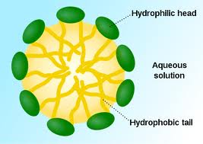
Hydrophobic interactions
Nonpolar substances do not dissolve in water
When surrounded by water, nonpolar molecules tend to be pushed together by the water
Ex: micelle formation and hydrophobic interactions in membrane structure

Slide 15
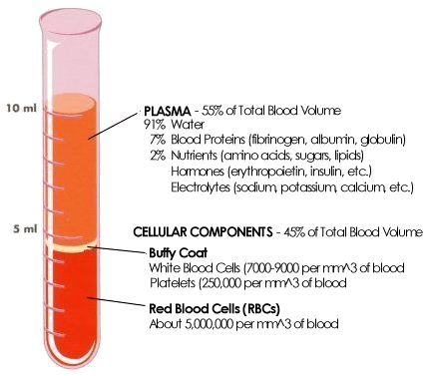
Transport medium
Water is the transport medium of the blood, lymphatic system, excretory and digestive systems of animals, and vascular tissues of plants

Slide 16
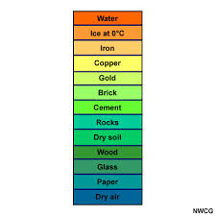
Thermal properties of water
Because of hydrogen bonding, water has a high specific heat
Takes a lot of energy to raise the temperature of water
Large bodies of water (lakes, oceans) are slow to change temperature as atmospheric temperature changes

Slide 17
Thermal properties of water
Due to the high proportion of water in the bodies of living organisms, internal changes in temperature are minimized, making homeostasis easier to maintain

Slide 18
Thermal properties of water
Process of evaporation transfers a correspondingly large amount of thermal energy, and therefore is an effecting cooling method
Since it takes a lot of energy to freeze water, keeps our bodies from freezing

Slide 19
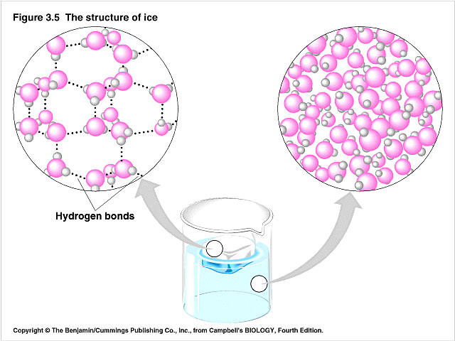
Density and freezing properties
Water is less dense in solid state than liquid state (ice floats on water and insulates water below)
This decreases the likelihood that large bodies of water will completely freeze over

Slide 20
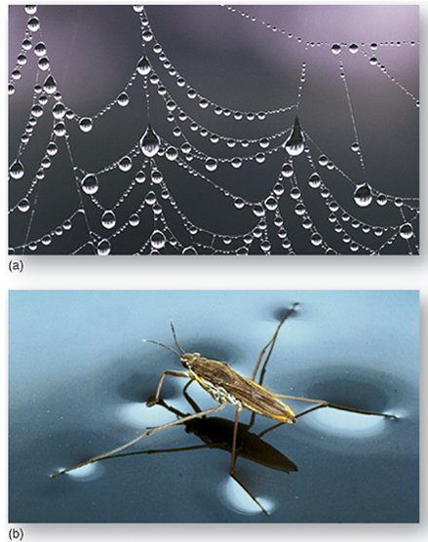
Cohesion
Water molecule have high cohesion (tend to stick together)
Allows water to move in long, unbroken columns in the vascular tissue in plants

Slide 21
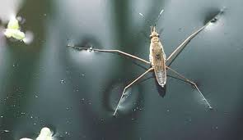
Surface tension
High cohesion = high surface tension
Provides surfaces of water with think film-like covering, allowing water droplets to forms and organisms to use as habitat

Slide 22
Water as a reagent
Essential for hydrolysis reactions (breaking down large molecules into smaller molecules)
Water takes part as a reagent (substance consumed in chemical reaction) in some chemical reaction in cells
photosynthesis

