Slide 1
Turn in both BioZone and Bozeman Carbohydrate

Slide 2
Chapter 2.1: Carbohydrates

Slide 3
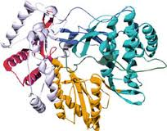
Biological Molecules
The study of biological molecules is called molecular biology
Closely linked with biochemistry, the study of the chemical reactions of biological molecules
The sum total of all the biochemical reactions in the body is known as metabolism

Slide 4
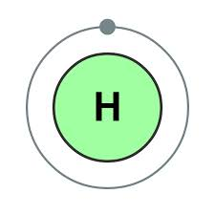
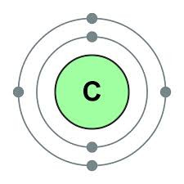
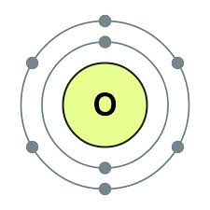
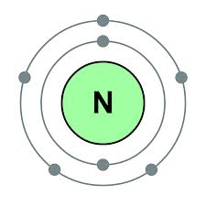
Building blocks of life
4 most common elements in life: H, C, O, N (99% of all atoms found in living things)

Slide 5
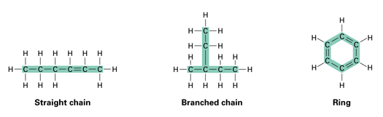
Carbon
Particularly important because carbon atoms can join together to form long chains or ring structures
Basic skeletons of all organic molecules, to which other groups of atoms attach
Organic molecule = carbon containing

Slide 6
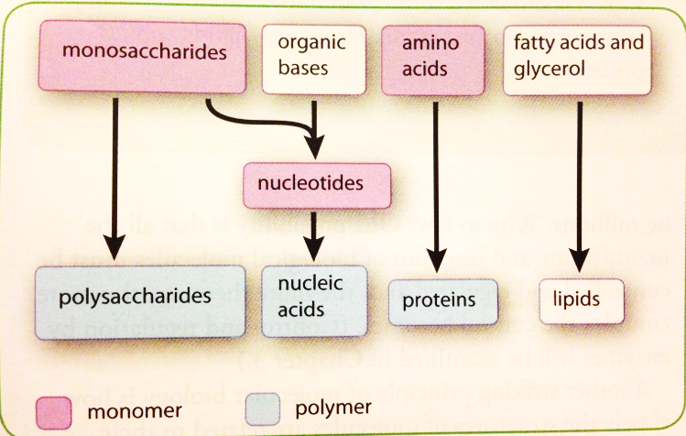
Building blocks of life
Believed that before life evolved there was a period of chemical evolution in which thousands of carbon-based molecules evolved from the more simple molecules that existed on early Earth

Slide 7
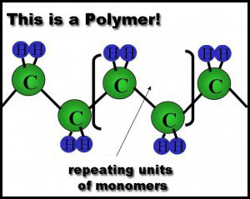
Monomers, polymers, and macromolecules
Monomers= similar or identical individual organic subunits
Polymers= many repeating monomers
Macromolecule= “giant molecule”
  Polysaccharides, polypeptides, polynucleotides

Slide 8
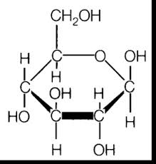
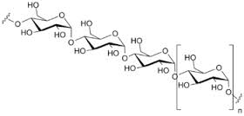
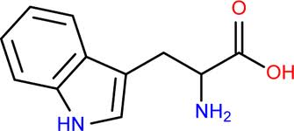
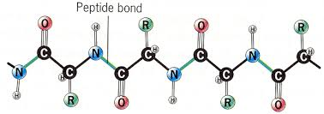
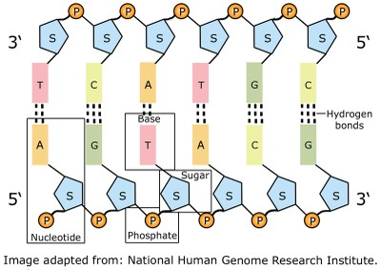
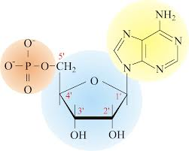
Monomer | Polymer
Monosaccharides | Polysaccharides
Amino acids | Polypeptides (proteins)
Nucleotides | Polynucleotides (nucleic acids)

Slide 9
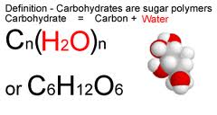
Carbohydrates
General formula C_{x}(H₂O)_{y}
  1:2:1 of CHO
  Divided into three main groups:
  Monosaccharides, disaccharide, polysaccharides

Slide 10
Monosaccharides
Monosaccharides are single sugars (mono=1)
Dissolve easily in water to produce sweet tasting solutions
General formula (CH₂O)_{n}
Classified according to number of C atoms
  Trioses (3C) Ex: glyceraldehydes
  Pentoses (5C) Ex: ribose, deoxyribose
  Hexoses (6C) Ex: glucose, fructose, galactose

Slide 11
Check your understanding
What type of sugar is the following monosaccharide
(CH₂O)₆
Triose
Pentose
Hexose

Slide 12

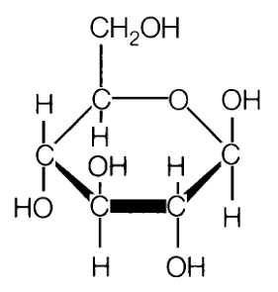
Glucose
Molecular formula | Structural formula (straight chain) | Structural formula (ring)
C₆H₁₂O₆

Slide 13
Ring structures
Pentoses and hexoses can form themselves into stable ring structures
When glucose forms a ring, carbon atom 1 joins to carbon atom 5
The ring therefore contains oxygen, and carbon atoms number 6 is not part of the ring

Slide 14
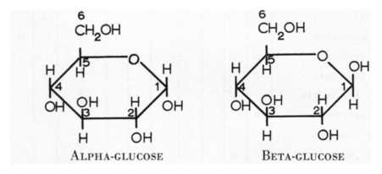
Glucose isomers
  Hydroxyl group on carbon 1 can be below(α-glucose) or above(β-glucose) the plane of the ring
  The same molecule can switch between two forms. Known as isomers

Slide 15
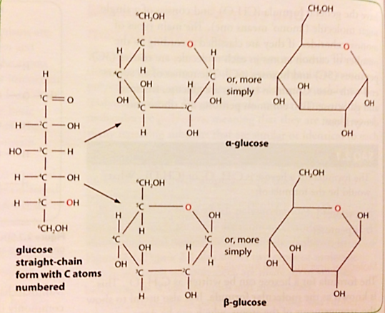

Slide 16
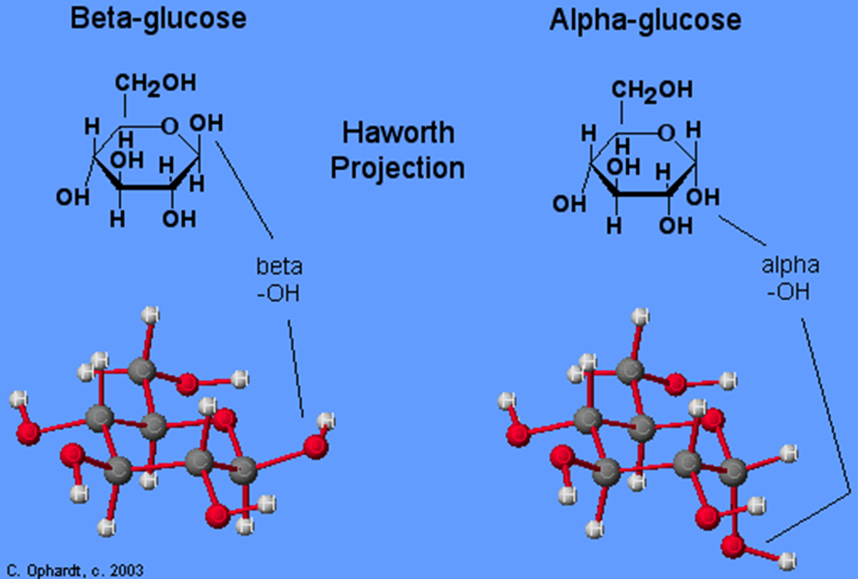

Slide 17
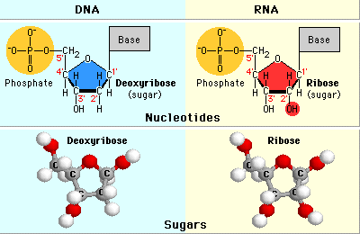
Roles of monosaccharides
Source of energy in respiration
  Carbon-hydrogen bonds can be broken to release a lot of energy which is then transferred to make ATP from ADP
Building blocks of larger molecules
  Used to build larger carbohydrates (starch, glycogen, cellulose) or complex molecules like RNA, DNA and ATP

Slide 18
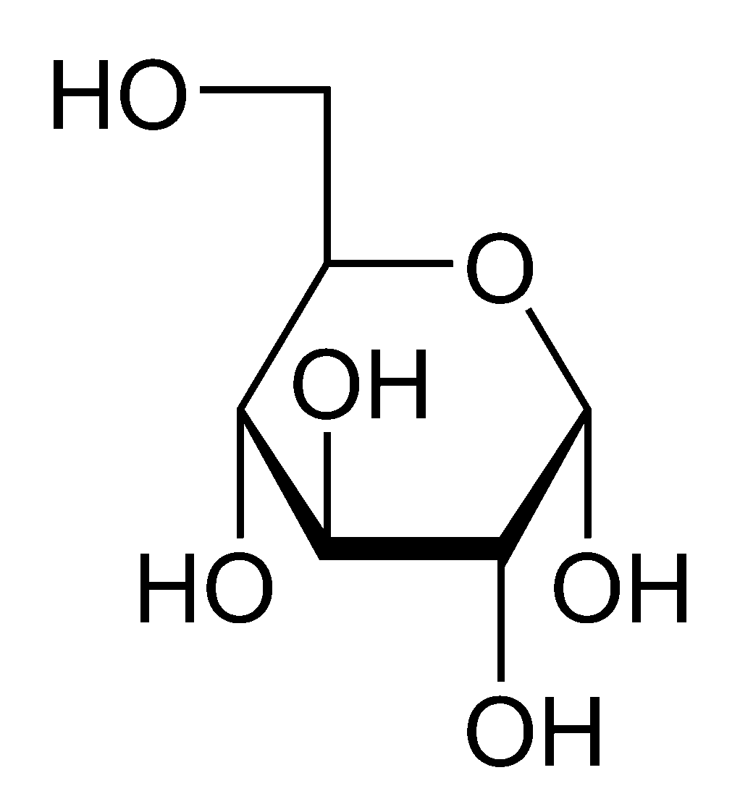
  Is the following β-glucose or α-glucose?

Slide 19
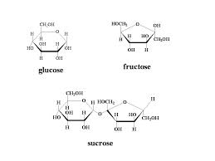
Disaccharides
Like monosaccharides, are sugars
Formed by two (di=2) monosaccharides joining together
  Maltose = glucose + glucose
  Sucrose = glucose + fructose
  Lactose = glucose+galactose

Slide 20
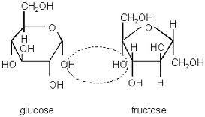
Disaccharides
The joining of two monosaccharides takes place by a process known as condensation

Slide 21
Condensation
For the reaction, two hydroxyl (-OH) groups line up alongside each other
One combined with a hydrogen atom from the other to form a water molecule
This allows an oxygen “bridge” to form between the two molecules, forming disaccharide
This bridge is called a glycosidic bond
http://www.youtube.com/watch?v=b7TdWLNhMtM

Slide 22
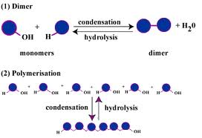
Hydrolysis
Reverse of condensation is the additions of water, hydrolysis
Takes place during the digestion of dissacharides and polysaccharides, when they are broken down to monosaccharides

Slide 23
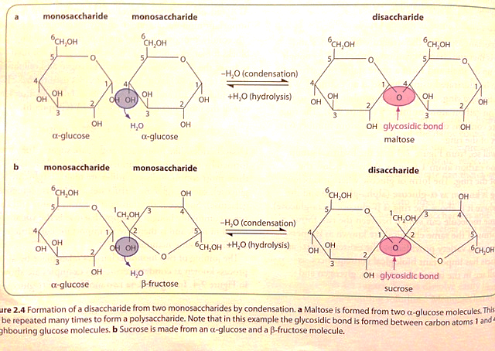

Slide 24
Polysaccharides
Polymers of monosaccharides
Made by condensation rxns
NOT sugars
Starch, glycogen, cellulose

Slide 25
polysaccharides
Condensation/dehydration synthesis
Glucose cannot accumulate in the cell
  Dissolve and affect osmosis
  Reactive: interfere with cell chemistry
Store as polysaccharides
  Compact, inert + insoluble
  Glycogen: animals, starch: plants

Slide 26
Check your understanding
What type of reaction would be involved in the formation of glucose from starch or glycogen?

Slide 27
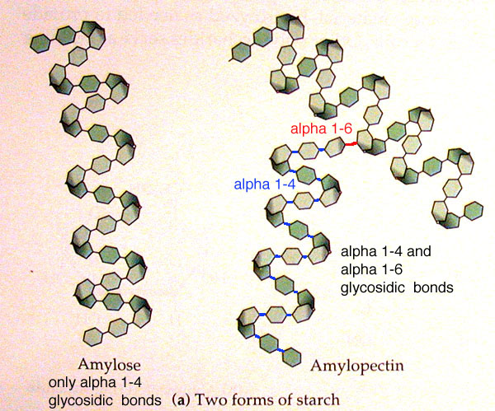
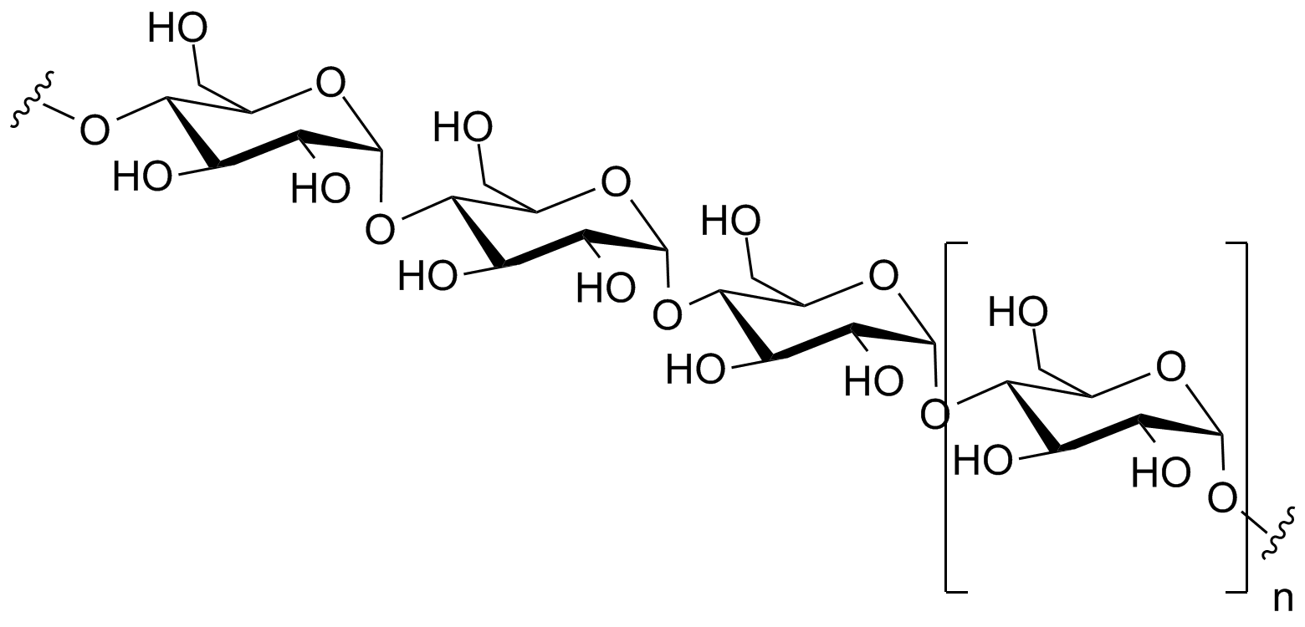
Starch= amylose + amylopectin
Amylose: condensation between α-glucose molecules
  1,4 linked: meaning that they are linked between carbons 1 and 4
  Chain coil into helical structures. Very compact
  Amylopectin: 1,4 linked
  α-glucose with 1,6 linked
  branched

Slide 28
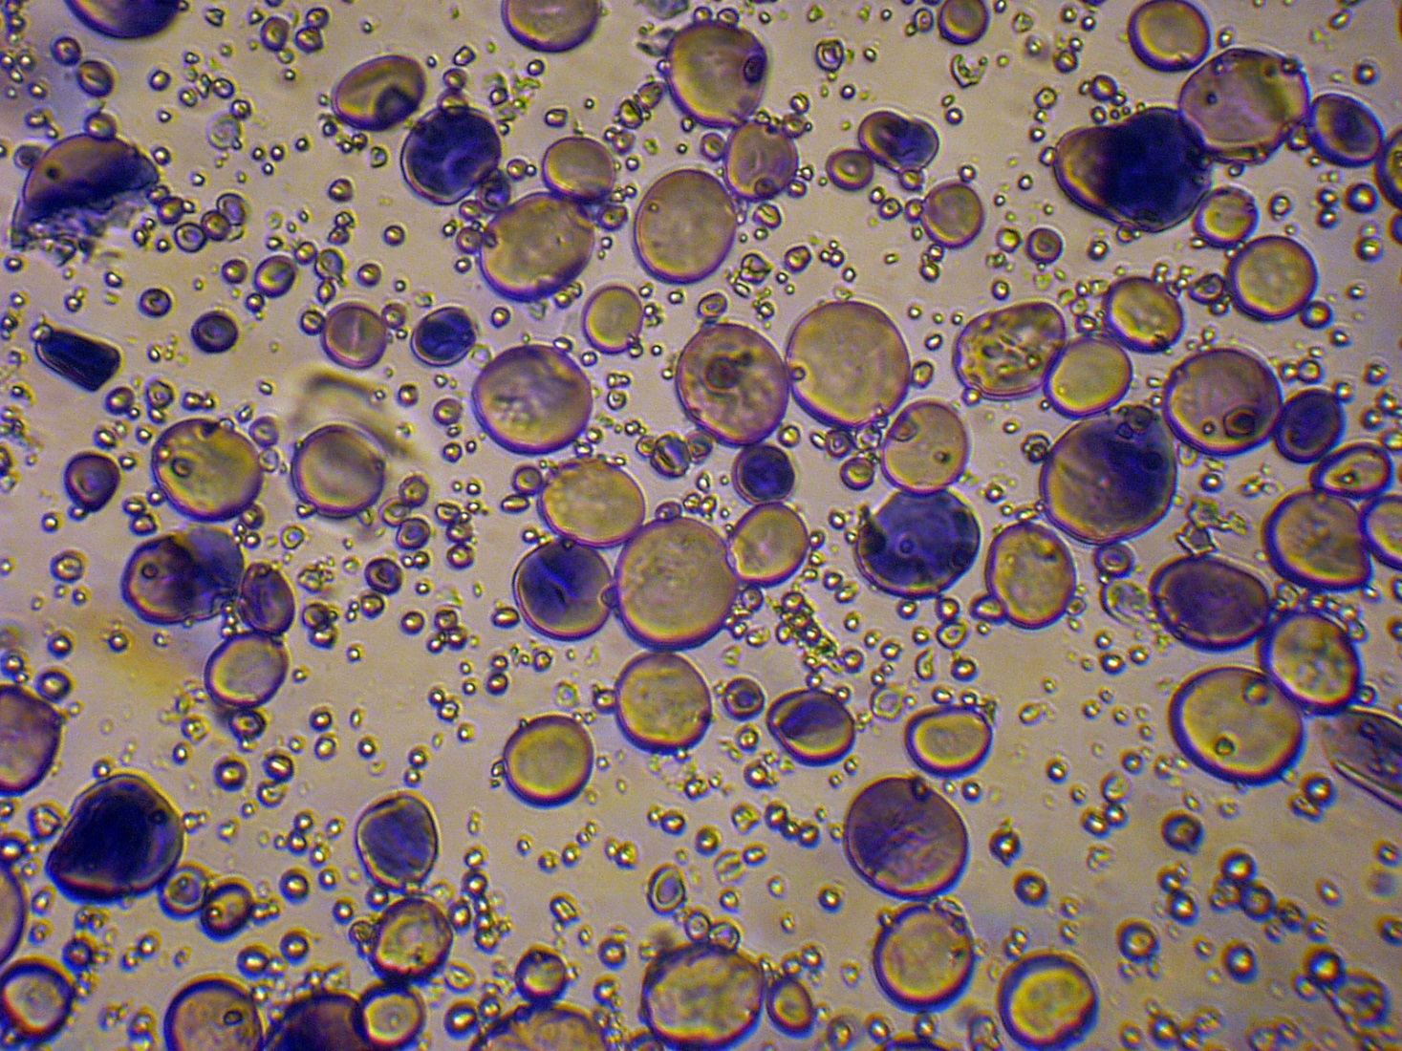
starch
Amylose and amylopectin molecules build up to relatively large starch grains
  Commonly found in chloroplasts and storage organs
Easily seen with light microscope (Esp. is stained)
NEVER found in animal cells

Slide 29
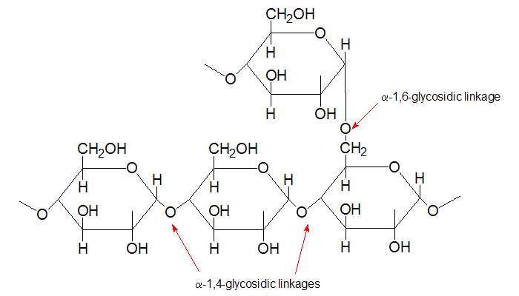
glycogen
Like amylopectin, is made of chains of 1,4 linked α-glucose with 1,6 linkages forming branches
Tend to be more branched than amylopectin

Slide 30
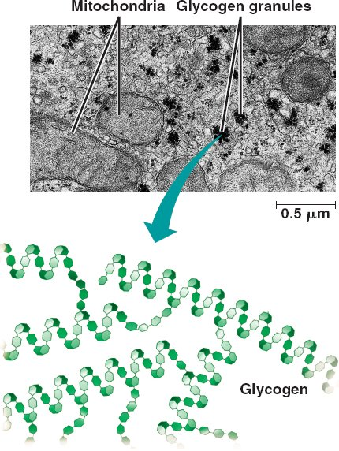
glycogen
Clump together to form granules (visible in liver and muscle cells)

Slide 31
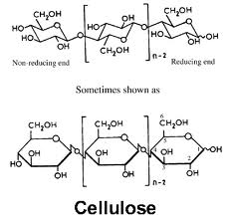
cellulose
Most abundant organic molecule of the planet
Due to its presence in plant cell walls and is slow rate of breakdown
Mechanically very strong
Polymer of 1,4 linked β-glucose

Slide 32
cellulose
Since the -OH group on carbon 1 of β-glucose is above the ring, it must flip 180˚ to form a glycosidic bond with carbon atom 4, where –OH is below the ring

Slide 33
cellulose
60-70 cellulose molecules cross-link to form microfibrils, held together as fibers by hydrogen bonding
Cellulose: 20-40% cell wall
High tensile strength (almost ~steel)
Fiber arrangement determines shape
Freely permeable: water + solutes can reach plasma membrane

Slide 34
