Slide 1
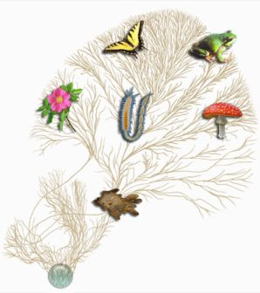
18.1 Systematics
The classification of life

Slide 2
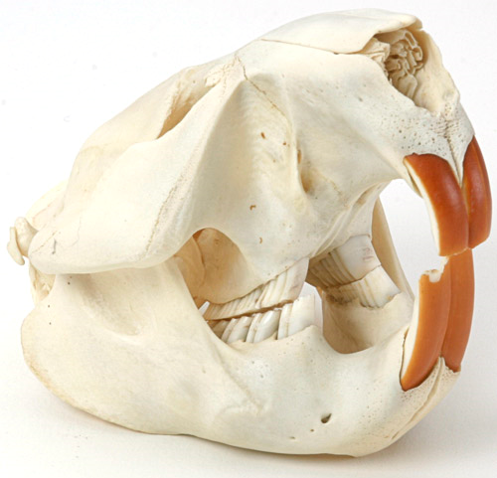
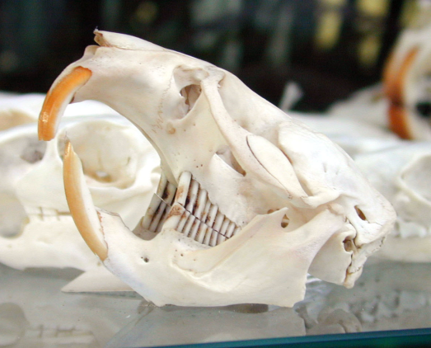
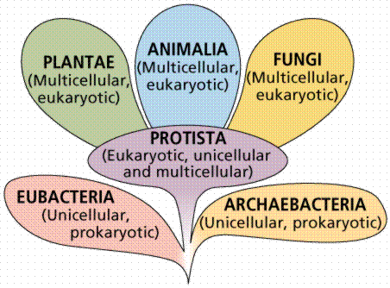
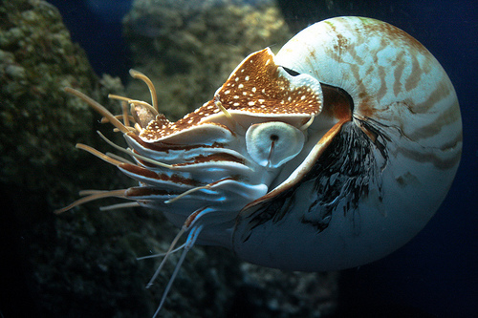
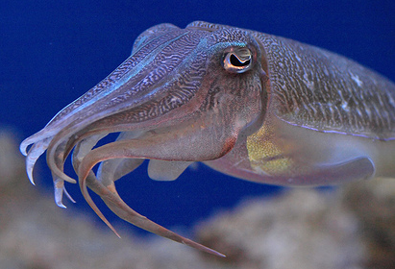
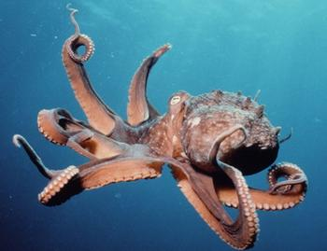
Introduction
Systematics is the science of classifying organisms
Goal: to organize living things into groups (taxa) that have biological meaning
Taxonomy is often used interchangeably with systematics

Slide 3
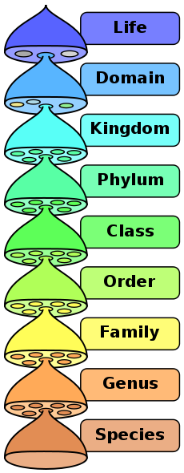
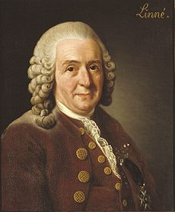
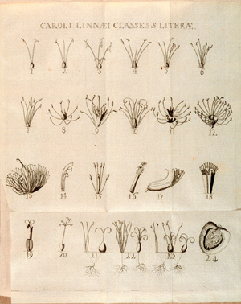
Linnaean Taxonomy
The Swedish botanist Carolus Linnaeus invented binomial nomenclature in the 1730’s
Scientific 2-word name
Genus species
Ex. Canis lupus or C. lupus
Based on observable physical similarities
First hierarchical system
Levels of grouping
Became modern system →

Slide 4
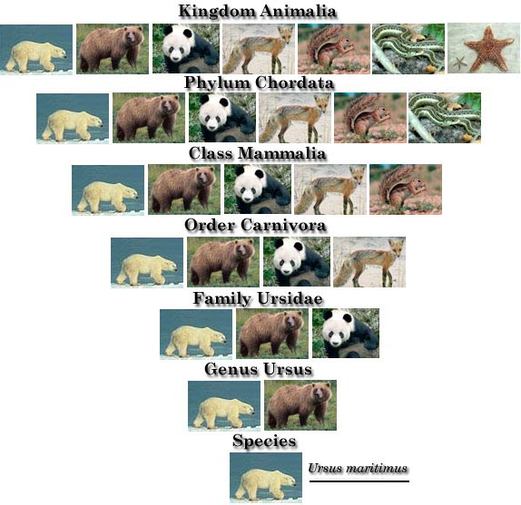

Slide 5
Why use confusing scientific names?

Slide 6
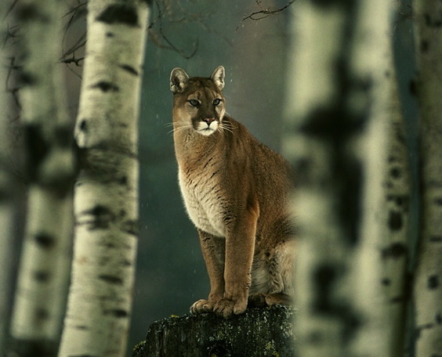
Mountain Lion

Slide 7
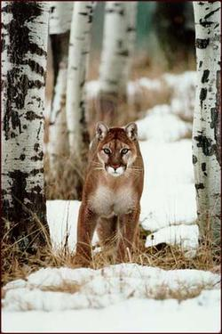
Puma

Slide 8
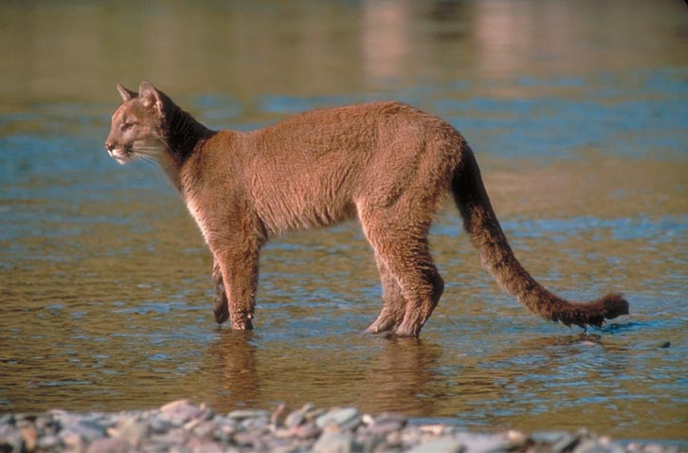
Panther

Slide 9
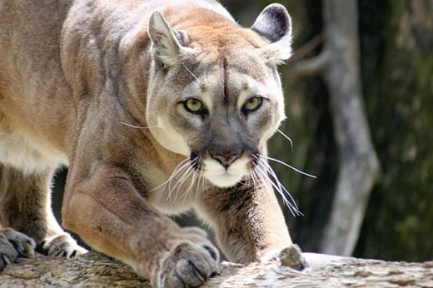
Cougar

Slide 10
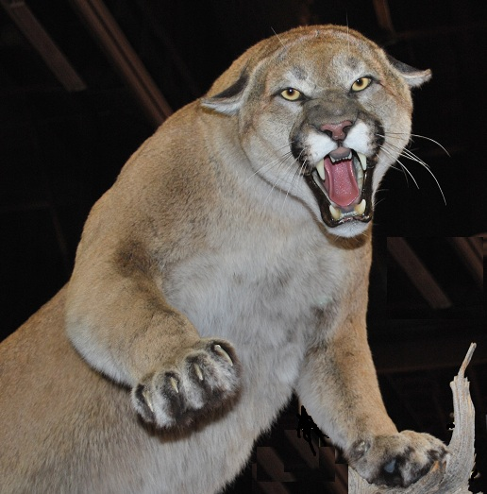
Devil Cat

Slide 11
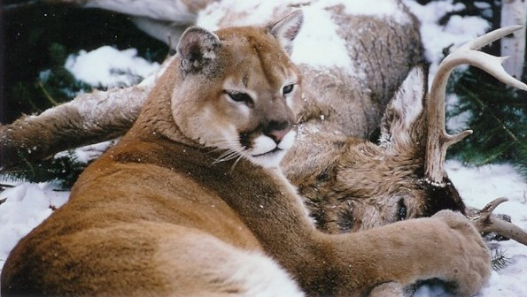
Ghost Cat

Slide 12
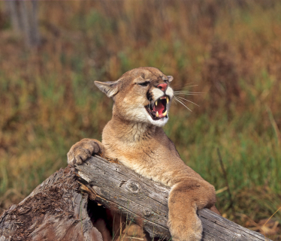
Screaming Cat

Slide 13
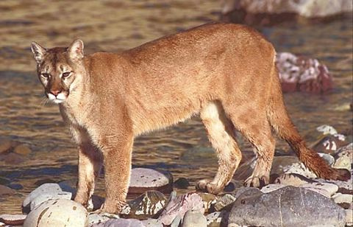
Why do we use Latin scientific names?
Names vary with language, region, etc.
Two-part name is unique and gives some classification
Latin is a dead language
Not spoken so it doesn’t change
Two parts: Genus species
Italicized
Genus is always capitalized and species is always lower case
Puma concolor

Slide 14
Scientific Name

Slide 15
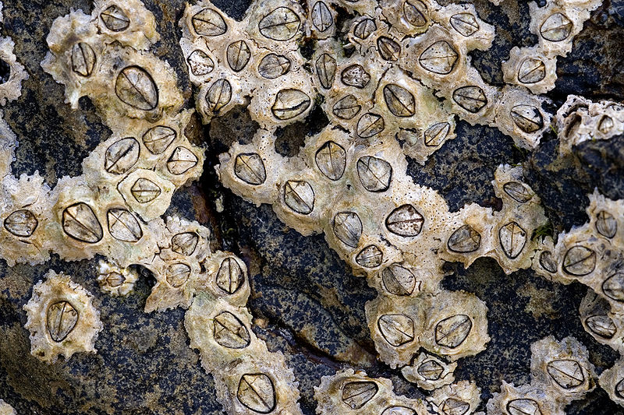
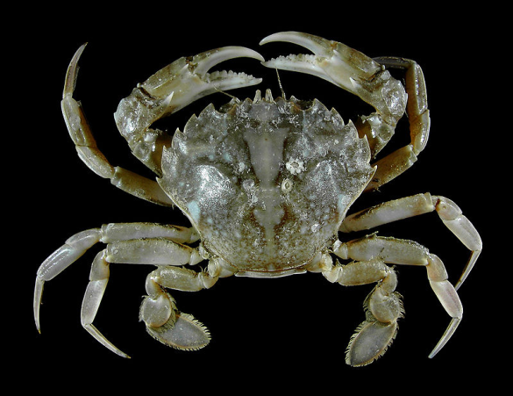
Problems With Traditional Classification
Observable characteristics are not always reliable
Ex: behavioral, physical, etc.
Convergent evolution caused confusion
Systematics predated the Theory of Evolution
Evolutionary relationships are most important

Slide 16
Kingdom: Animalia
Phylum: Arthropoda
Subphylum: Crustacea
Class: Malacostraca
Order: Decapoda
Infraorder: Brachyura
Family: Portunidae
Genus: Liocarcinus
Species: L. vernalis
Kingdom: Animalia
Phylum: Arthropoda
Subphylum: Crustacea
Class: Maxillopoda
Order: Sessilia
Family: Chthamalidae
Genus: Chthamalus
Species: C. stellatus
Kingdom: Animalia
Phylum: Mollusca
Class: Gastropoda
Order:
Patellogastropoda
Family: Lottiidae
Genus: Lottia
Species: L. pelta

Slide 17
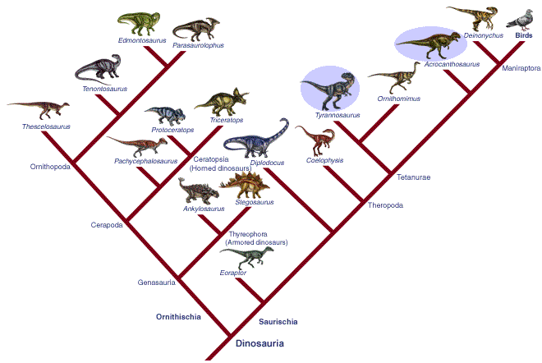
18.2 Modern Evolutionary Classification
Phylogenetic Systematics and Cladograms

Slide 18
Modern Systematics = Phylogenetic Systematics
Focus: evolutionary relationships (phylogeny)
Not physical similarities
Cladograms show evolutionary lineages

Slide 19
Cladograms
Oldest ancestors at the bottom, most recently evolved at the top

Slide 20
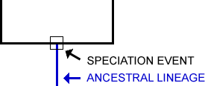
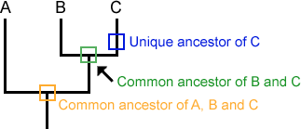
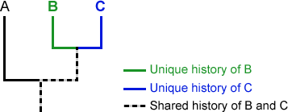
Cladograms
Speciation occurs at nodes (branching points)
Represents the last common ancestor of descendants that follow
(NODE)

Slide 21
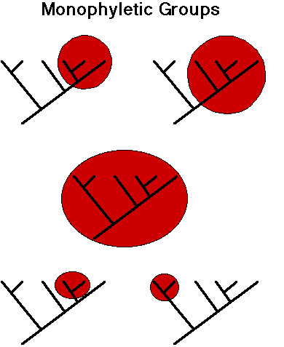
Clades
Groups that share a common ancestor are called clades
Includes ALL descendants of that ancestor
AKA monophyletic group

Slide 22
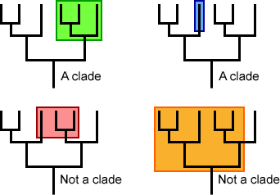
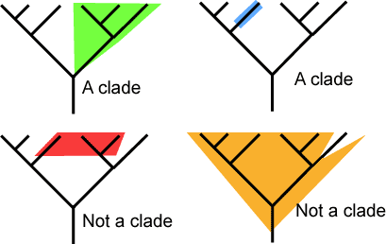
Clades
Paraphyletic groups exclude one or more groups of descendants
Not clades

Slide 23
Clades
Clades are nestled within other clades

Slide 24
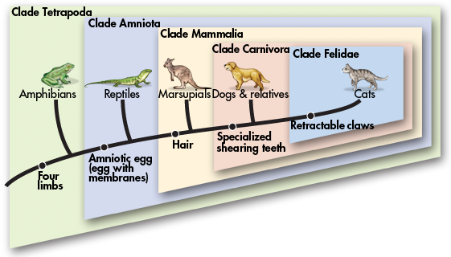
Derived Characters
Organisms are assigned to clades based on derived characters
Trait that arose in most recent common ancestor

Slide 25
Derived Characters
Shared characteristics are only called “derived” if they don’t belong to any other groups

Slide 26
Derived Characters
Example: Four limbs is a derived character of tetrapods but a derived character of wolves, lions, or even all amniotes

Slide 27
Derived Characters
Hair is a derived character of mammals, not carnivores

Slide 28
Derived Characters
What is a derived character for cats?

Slide 29
Derived Characters
Retractable claws is a derived character of felines

Slide 30
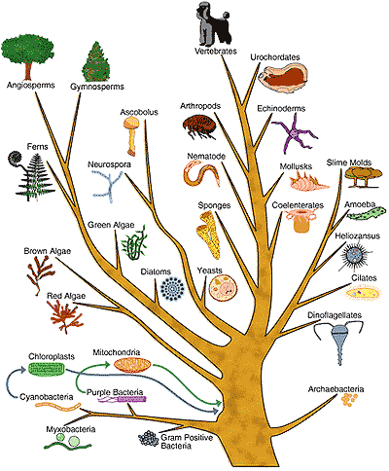
18.3 Building the Tree of Life
The Six Kingdoms

Slide 31
Progression of Systematics
Linnaeus- two kingdoms (plants & animals)
Modern six kingdom system was adopted in the early 1990’s

Slide 32
The 6 Kingdoms
Eubacteria
Archaebacteria
Protista
Fungi
Plantae
Animalia

Slide 33
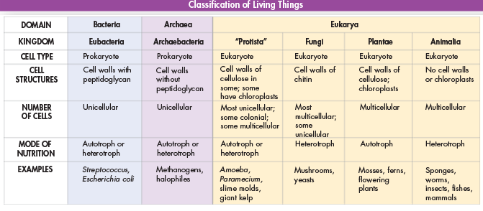
Classification and Characteristics
Unicellular: Eubacteria, Archaebacteria
Multicellular: Plantae, Animalia
Both: “Protista,” Fungi

Slide 34
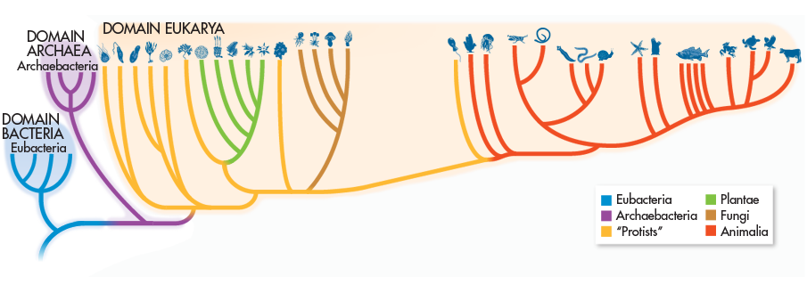
The Tree of Life
Kingdom Protista is not a true clade
Paraphyletic group
Does not include all descendants

