Slide 1
EVOLUTION OF POPULATIONS Evolution as Genetic Change
17–2

Slide 2
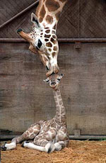
Each time an organism reproduces,
it passes its genes on to the next
generation.
So __________
= success in passing on genes
FITNESS
http://www.cleanfunny.com/pics/animal-giraffe-mother-baby-kiss-kissing.jpg

Slide 3
NATURAL SELECTION
____________________ on
single-gene frequencies can lead to changes in ____________________ and thus to EVOLUTON
ALLELE FREQUENCIES
EX: A population of normally brown lizards. Mutations produce new color choices.
If red lizards are more visible to predators, they might be less likely to survive.
Bird image from: http://www.germanlis.com/creatures/TN_bird_eating_fish.JPG
Chart from BIOLOGY by Miller and Levine; Prentice Hall Publishing ©2006

Slide 4
Black lizards absorb more heat to warm up faster on cold days so they can move faster to get food and avoid predators. The allele for black may increase in frequency.
Chart from BIOLOGY by Miller and Levine; Prentice Hall Publishing ©2006

Slide 5
When traits are controlled by _______ than one gene, the effects are more complex.
Remember ______________ traits show a bell-curve distribution
more
POLYGENIC
Graph from BIOLOGY by Miller and Levine; Prentice Hall Publshing©2006

Slide 6
FITNESS
The ___________ of individuals near each other will not be very different, but fitness may vary from one end of curve to the other.
Where fitness varies,
________________
can act!
NATURAL SELECTION
Graph from BIOLOGY by Miller and Levine; Prentice Hall Publshing©2006

Slide 7
Natural selection can affect the
distribution of phenotypes in 3 ways:
______________________
______________________
______________________
DIRECTIONAL selection
STABILIZING selection
DISRUPTIVE selection

Slide 8
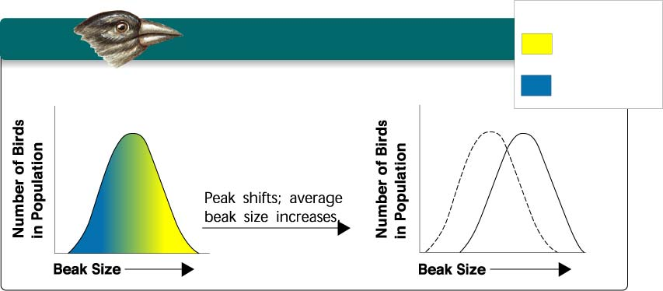
Graph from BIOLOGY by Miller and Levine; Prentice Hall Publshing©2006
DIRECTIONAL SELECTION
KEY
Low mortality,
high fitness
High mortality,
low fitness
Food becomes scarce.
Individuals at _____________ of the curve
have higher fitness than individuals in
middle or at other end.
Graph shifts as some individuals fail to survive at one end
and succeed and reproduce at other
ONE END

Slide 9
EXAMPLE OF DIRECTIONAL SELECTION
Beak size varies in a population
Birds with bigger beaks can feed
more easily on harder, thicker
shelled seeds.
Suppose a food shortage causes small and medium size seeds to
run low.
Birds with bigger beaks would be
selected for and increase in numbers
in population.
http://www.animalbehavior.org/ABS/Stars/ONI/Podos_-_finch_graphic.jpg

Slide 10
Graph from BIOLOGY by Miller and Levine; Prentice Hall Publshing©2006
STABILIZING SELECTION
Individuals in _____________ of the curve
have higher fitness than individuals at
either end
Graph stays in same place but narrows as more organisms
in middle are produced.
CENTER

Slide 11
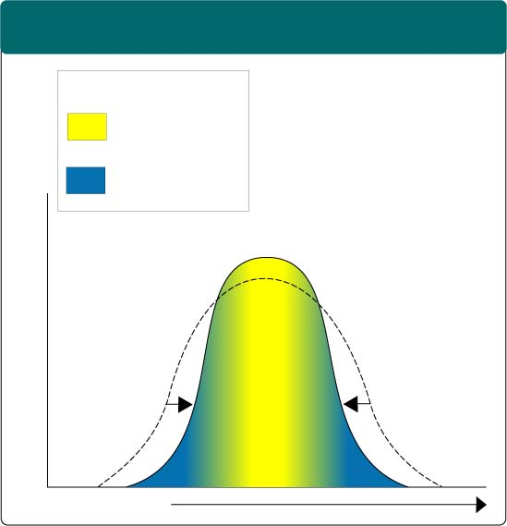
STABILIZING SELECTION
Section 16-2
Male birds use their plumage to attract mates. Male birds in the population with less brilliant and showy plumage are less likely to attract a mate, while male birds with showy plumage are more likely to attract a mate.
Stabilizing Selection
Male birds with
showier, brightly-
colored plumage
also attract
predators, and are
less likely to live
long enough to
find a mate.
The most
fit, then, is the male
bird in the middle--
showy, but not too
showy.
Key
Low mortality, high fitness
High mortality, low fitness
Selection against both extremes keep curve narrow and in same place.
Percentage of Population
Brightness of
Feather Color
Graph from BIOLOGY by Miller and Levine; Prentice Hall Publshing©2006

Slide 12
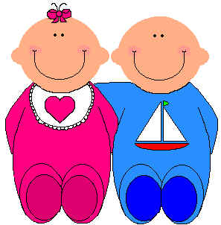
EXAMPLE OF STABILIZING SELECTION
Human babies born with low birth
weight are less likely to survive.
Babies born too large have difficulty being born.
Average size babies are selected for.
http://www.animalbehavior.org/ABS/Stars/ONI/Podos_-_finch_graphic.jpg

Slide 13
Graph from BIOLOGY by Miller and Levine; Prentice Hall Publshing©2006
DISRUPTIVE SELECTION
EXTREMES
Individuals at _____________ of the curve
have higher fitness than individuals in middle.
Can cause graph to split into two.
Selection creates __________________PHENOTYPES
TWO DISTINCT

Slide 14
EXAMPLE OF DISRUPTIVE SELECTION
Suppose bird population lives in area
where climate change causes medium
size seeds become scarce while large
and small seeds are still plentiful.
Birds with bigger or smaller beaks
would have greater fitness and the
population may split into TWO
GROUPS. One that eats small
seeds and one that eats large seeds.
http://www.animalbehavior.org/ABS/Stars/ONI/Podos_-_finch_graphic.jpg

Slide 15
http://www.arborsci.com/CoolStuff/CoinFlip.jpg
Natural selection is NOT the only source of evolutionary change.
REMEMBER ! Genetics is controlled by
_________________
PROBABILITY
The smaller the population . . .
the farther the ________results may be
from the ___________ outcomes.
actual
predicted

Slide 16
Genetic Drift
In a small population RANDOM, CHANCE changes can cause the population to change in allele frequencies
There are 2 types
Founder Effect
Bottleneck
http://www.ucmp.berkeley.edu/fosrec/Filson.html

Slide 17
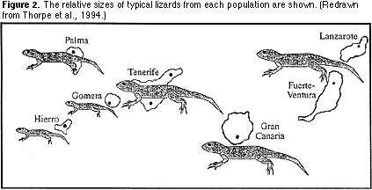
Founder Effect
Genetic drift can occur when a _______ group of individuals colonizes a _____habitat.

Slide 18
A situation in which allele frequencies change as a result of the
migration of a small subgroup of the
population = _________________
FOUNDER EFFECT
Graph from BIOLOGY by Miller and Levine; Prentice Hall Publshing©2006

Slide 19
Individuals may carry alleles in ______________ relative frequencies than in the larger population.
The population they “found” will be different from the parent population
. . . not through
natural selection
but by _________
different
chance
http://www.ucmp.berkeley.edu/fosrec/Filson.html

Slide 20
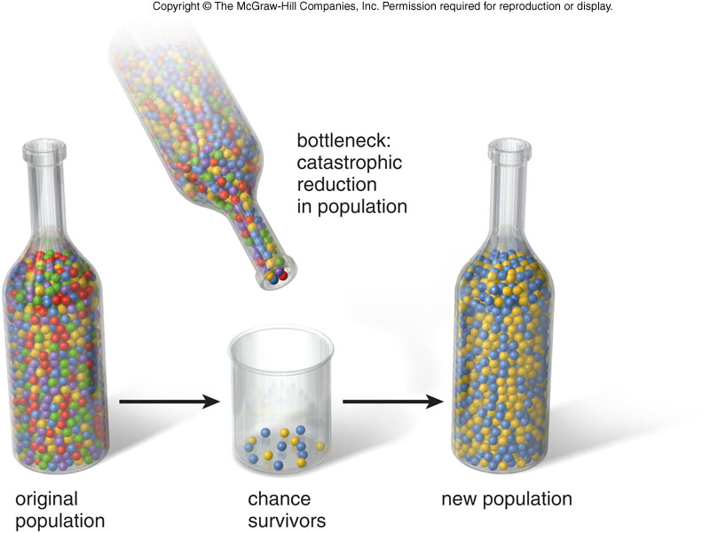
Genetic Drift - Bottleneck
Bottleneck
A change in allele frequency after a dramatic reduction in the size of the population
The new population will only have the genes of the survivors
This is still caused by a chance occurrence

Slide 21
ARE THERE ANY CONDITIONS IN WHICH EVOLUTION WILL NOT OCCUR?
IS THERE A WAY TO TELL IF THIS IS HAPPENING?
__________________________
HARDY-WEINBERG PRINCIPLE
Graph from BIOLOGY by Miller and Levine; Prentice Hall Publshing©2006

Slide 22
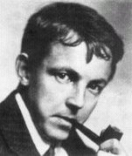
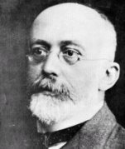
Hardy & Weinberg
Who?
Godfrey Hardy
1877-1947
Wilhelm Weinberg
1862-1937
They developed an equation that predicted the relative frequency of alleles in a population based on the frequency of the phenotypes in a population.

Slide 23
Gene Frequency & the Hardy-Weinberg Equation
The Hardy-Weinberg Equation
p² + 2pq + q² = 1
p² = the frequency of homozygous dominant genotype
2pq = the frequency of heterozygous genotype
q² = the frequency of homozygous recessive genotype

Slide 24
HARDY-WEINBERG PRINCIPLE states that allele frequency in a population will remain __________ unless one or more ________ cause the frequency to __________.
In a situation in which allele frequencies remain constant
( = _________________ )
populations will NOT EVOLVE!
constant
factors
change
Genetic equilibrium

Slide 25
5 CONDITIONS REQUIRED TO
MAINTAIN GENETIC EQUILIBRIUM
FROM GENERATION TO GENERATION
1. _________________________
2. _________________________
3. _________________________
4. _________________________
5. _________________________
Must be random mating
Population must be large
No movement in or out
No mutations
No natural selection

Slide 26
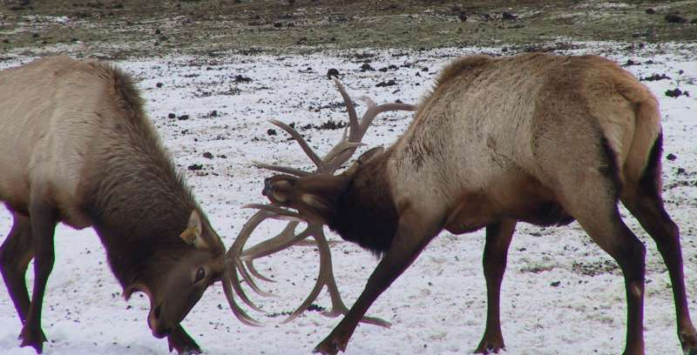
Random mating
In order for ______ ______ to occur,
all members of the population must
have equal opportunity to produce
offspring.
In natural populations, like
____, ______, ___, or _____________,
members compete or even fight for the
opportunity to mate
so mating is _______________
lions
wolves
elk
mountain sheep
NOT RANDOM
http://www.wasatchcomputers.net/gallery/elk_fight.jpg

Slide 27
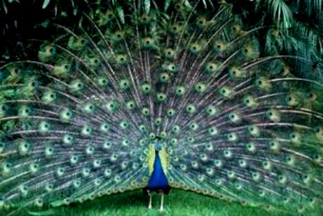
http://ideiasemdesalinho.blogs.sapo.pt/arquivo/Peacock%20with%20its%20tail%20fanned%20out_Tony%20Ruta.jpg
random
Mating in populations is rarely ________
Many species select mates based on
certain _______ such as size or strength.
traits

Slide 28
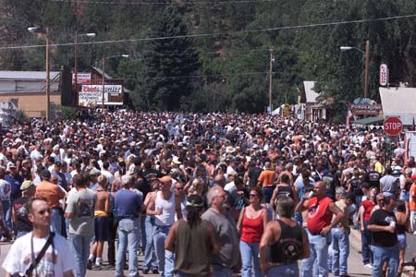
For _______ __________ to occur, a
population must be ________,
so ____________ doesn’t cause
changes in allele frequency by
random chance.
genetic equilibrium
large
genetic drift
http://www.sturgisrallydaily.com/gallery/full/crowd.jpg

Slide 29
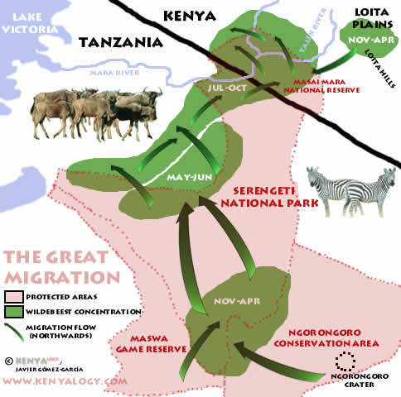
________________ can occur, since
movement in and out of the population
__________ the frequency of ______.
NO MIGRATION
changes
alleles
http://whiteafrican.com/wp-content/Wildebeast%20Migration-East%20Africa.jpg

Slide 30
genetic equilibrium
For _______ __________ to occur,
there must be ____________, which
introduce new ______, and
________________ can take place
which gives any one _________ a
survival advantage over another.
NO mutations
alleles
NO natural selection
phenotype

Slide 31
In some populations, these conditions
may be met or nearly met over long
periods of time, and little or no
________ occurs.
BUT in most populations it is _______
for ____ conditions of Hardy-Weinberg
to be met.
Evolution vs. Genetic Equilibrium
evolution
difficult
ALL
In MOST populations . . .
EVOLUTION happens !

