Slide 1
Chapter 16.1: ATP and Work

Slide 2
Energy
All life needs energy (light or chemical)
Photosynthesis: transfers light energy to chemical potential energy
All life directly or indirectly depends on photosynthesis
Energy supply and useable carbon compounds

Slide 3
Photosynthesis
Supplies energy and useable carbon compounds
Autotrophs: can use inorganic carbon in form of carbon dioxide
Heterotrophs: need ready-made organic carbon

Slide 4
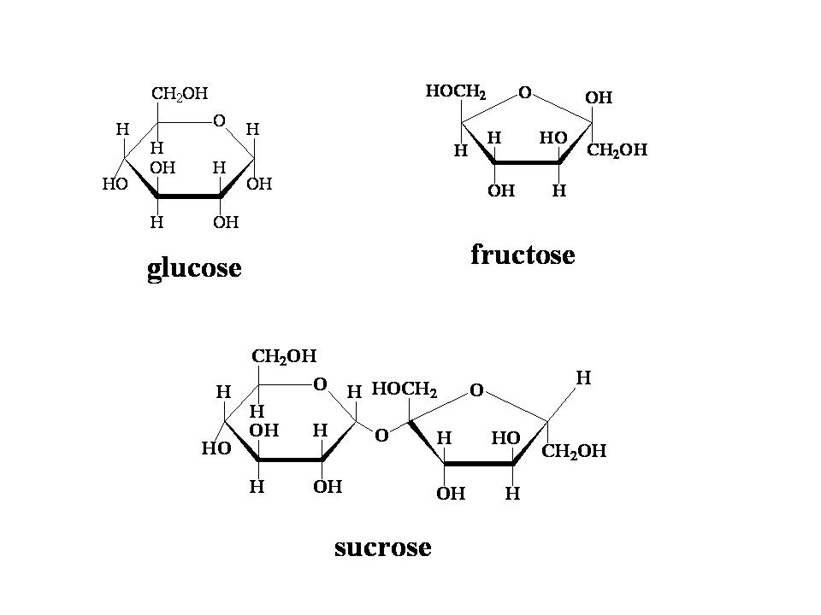
Organic molecules
Can serve as “building blocks” for macromolecules
Can be used for energy in respiration
This energy can be used for all forms of work

Slide 5
Work
Work in a living organism includes:
Anabolic reactions: Synthesis of complex substances from simpler ones
Active transport
Mechanical work (ex: muscle contraction, cellular movements)
Bioluminescence and electrical discharge (some organisms)

Slide 6
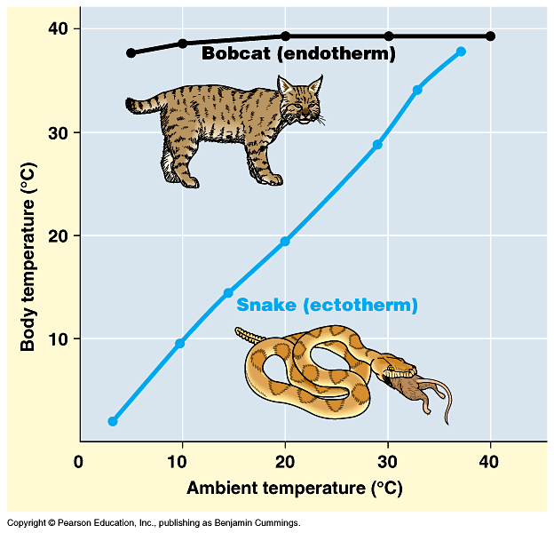
Work and Heat
Endotherms: use heat released from metabolic rxns maintain internal temperatures. Can be controlled via negative feedback loops
Ectotherms: internal temp. maintained from external heat

Slide 7
Energy release
Chemical energy from respiration (C₆H₁₂O₆ + 6O₂ → 6CO₂ + 6 H₂O + energy) releases energy in a series of steps
Allows for precise control via feedback mechanisms
Cell cannot use all energy if released at once

Slide 8
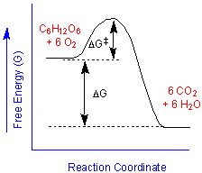
Energy release
Even though glucose yields a lot of energy, it is quite stable due to the large activation energy that must be overcome in its rxns
Activation energy lowered by use of enzymes
Energy level of glucose raised by phosphorylation

Slide 9
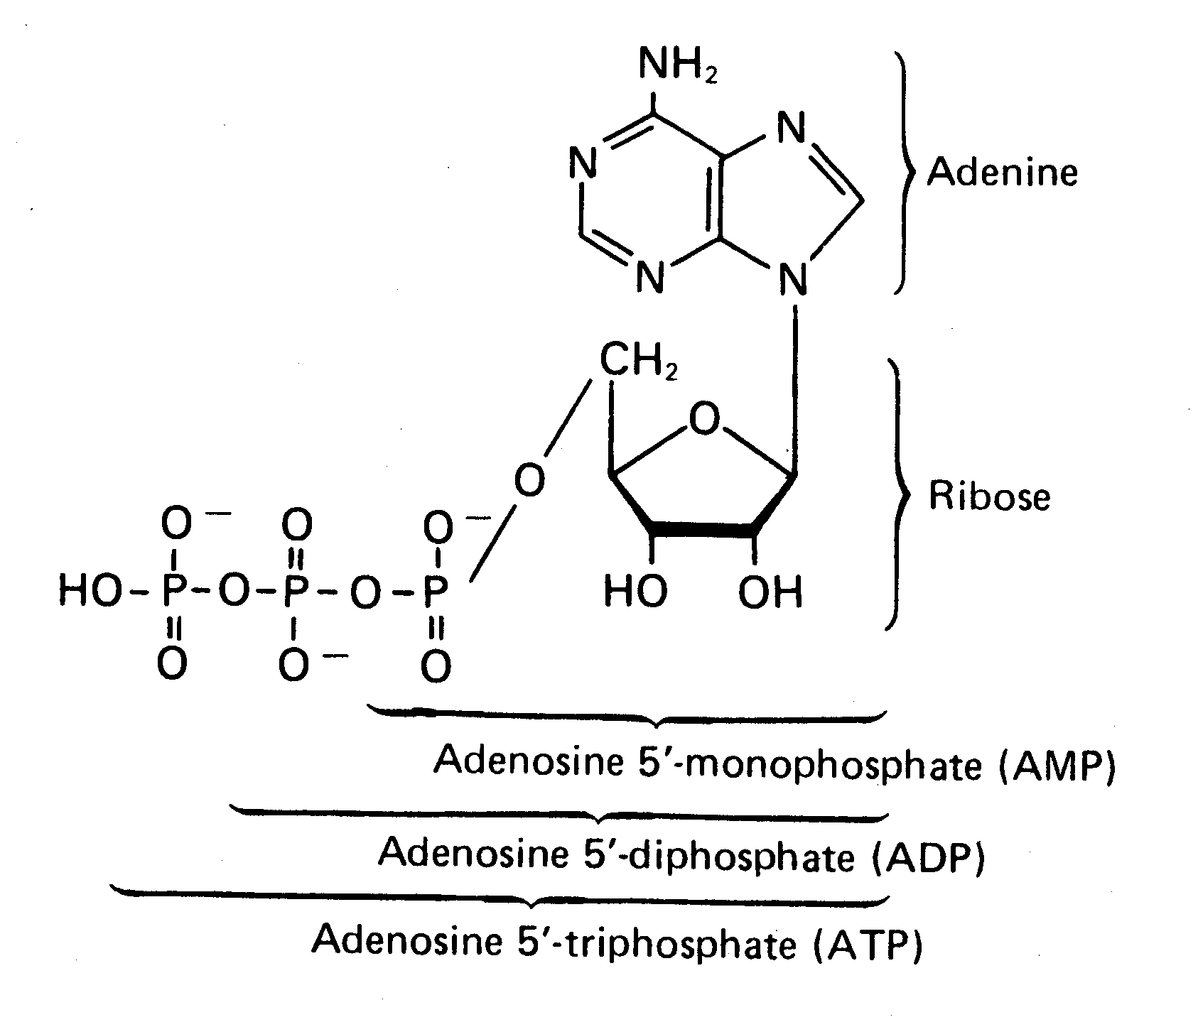
ATP
ATP (adenosine triphosphate) is used as energy currency
Adenine (organic base) + ribose (pentose sugar) =adenosine
Combined with 2 phosphate molecules to make ATP
Small and water soluble (easy to transport)

Slide 10
ATP
Removal of phosphate groups 1&2 releases energy (30.5 kJ/mol)
Last phosphate group releases 14.2 kJ/mol
All reactions are reversible
We use 40kg of ATP a day but only have 5g at any given time (That’s an 8000% turnover people!)

Slide 11
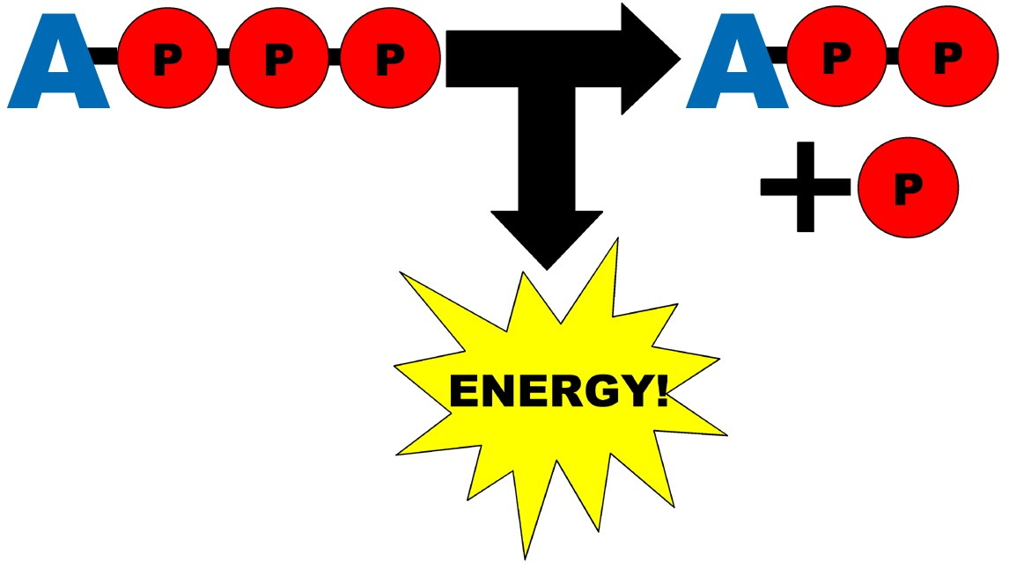
ATP
All energy-yielding reactions are linked to ATP synthesis
ATP then used by cell in all forms of work
Universal intermediate between energy-yielding and energy-requiring reactions in a cell

Slide 12
Energy transfers
Inefficient b/c of thermal energy loss
Always some energy released by heat due to friction
Energy requiring actions use less energy than released by ATP

Slide 13
Energy currency vs. storage
ATP: energy currency. DIRECTLY traded for useable energy in reactions
Glucose/sucrose/glycogen/starch: energy storage. Stores potential energy

Slide 14
Synthesis of ATP
Glycolysis and Krebs cycle: ATP made by reorganizing chemical bonds (chemical potential energy)
Electron transport chain: ATP made by using electrical potential energy

Slide 15
Electrical potential energy
Stored as a difference in proton (H+) concentration across a membrane
Move across membrane down concentration gradient through transmembrane protein
Part of this protein acts as an enzyme that synthesizes ATP (ATP synthase)
Three protons = one ATP molecule
Occurs in mitochondria and chloroplasts

Slide 16
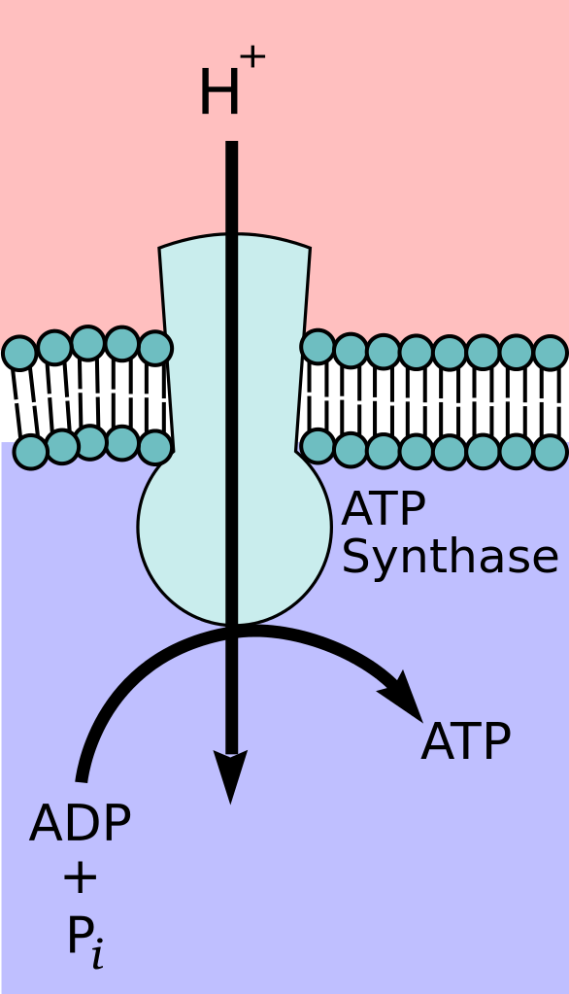
ATP synthase

Slide 17
ATP synthesis
Called chemiosmosis
ATP synthase has 3 binding sites and a central γ group that rotate as H+ ions pass allowing the 3 binding sites to pass through the phases:
Binding ADP and phosphate (P_{i} ) group
Forming tightly bound ATP
Releasing ATP
https://www.youtube.com/watch?v=XI8m6o0gXDY

Slide 18
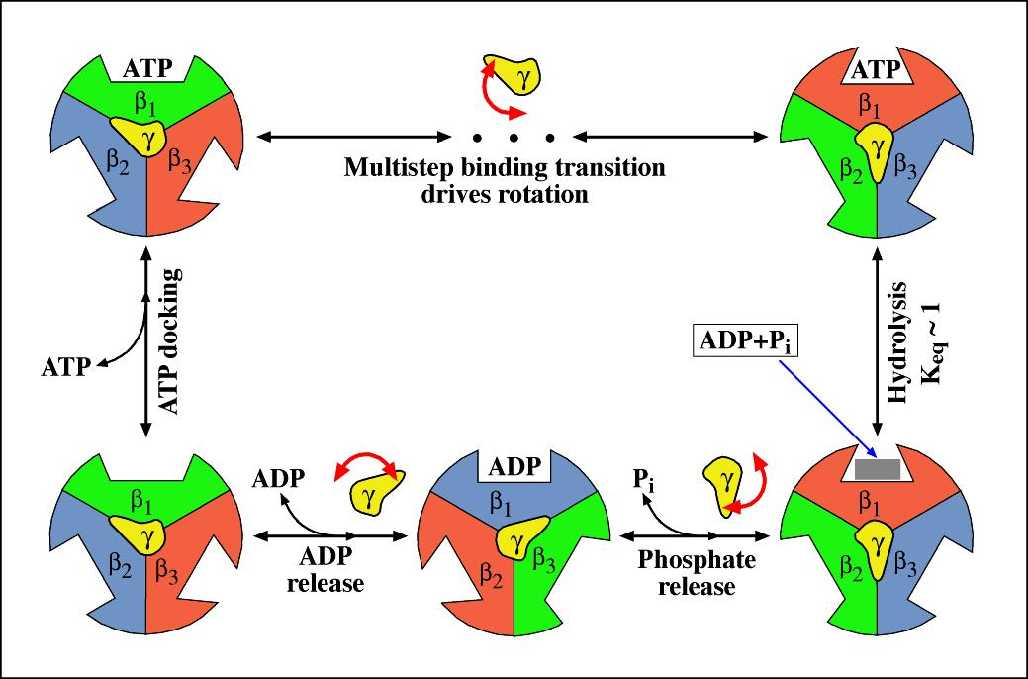

Slide 19
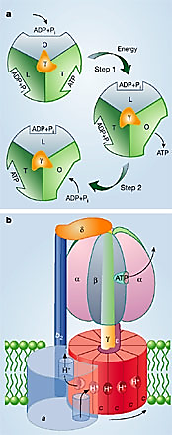
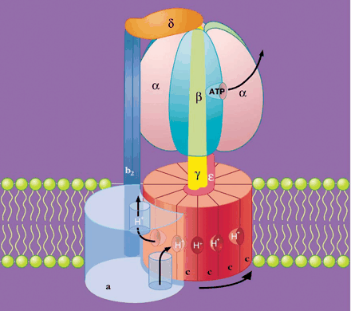

Slide 20
Active transport
Movement of ions or molecules across membrane against concentration gradient
Energy is needed in the form of ATP
Ex: sodium-potassium pump

Slide 21
Sodium-potassium pump
Transmembrane proteins that has binding sites for Na+ and K+
Protein catalyzes ATP to ADP to move Na and K across membrane (protein called ATPase)
1 ATP = 2 K into cell and 3 Na out of cell
https://www.youtube.com/watch?v=P-imDC1txWw

Slide 22
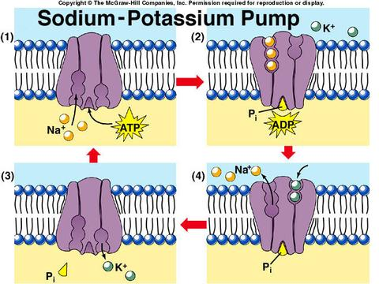
Sodium-potassium pump

Slide 23
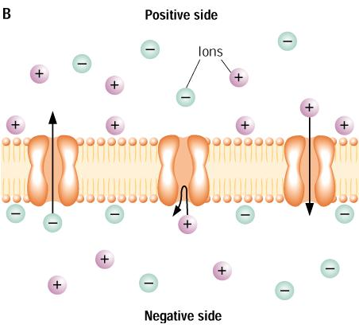
Sodium potassium pump
Creates potential difference across membrane b/c more + charges are moved outside of cell
This potential can be used to generate an electrical nerve cell impulse

Slide 24
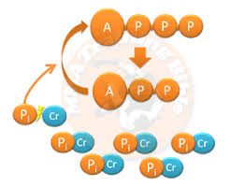
Muscle contraction
ATP needed for muscles to contract
ATP amount same in resting and contracting muscle
ATP quickly regenerating in contracting muscle due to creatine phosphate (PCr)
ADP is converted back to ATP by transferring a phosphate group from PCr to ADP

