Slide 1
Chapter 15
Coordination

Slide 2
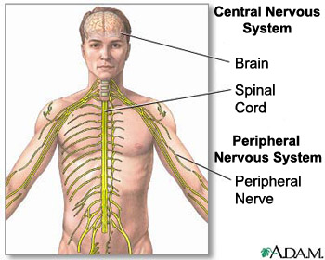
Nervous communication
Nervous system provides fast communication and coordination
Mammalian nervous system:
Central nervous system (CNS): brain and spinal cord
Peripheral nervous system (PNS): nerves

Slide 3
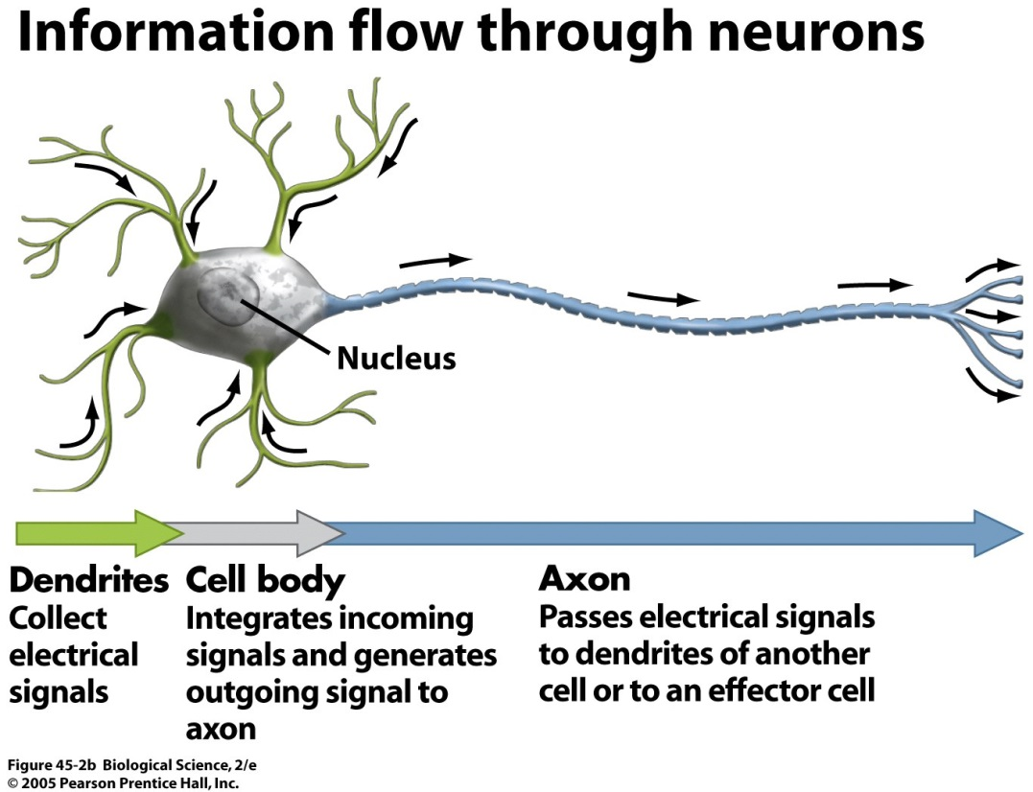
Nervous communication
Information is transferred in the form of nerve impulses which travel along nerve cells (neurons) at high speeds
Neurons carry information directly to target cells

Slide 4
Neurons
3 types:
Sensory neurons: transmit impulses from receptors to the CNS
Intermediate neurons: aka relay or connector neurons, transmit impulses from sensory neuron to motor neurons
Motor neurons: transmit impulses from CNS to effectors

Slide 6
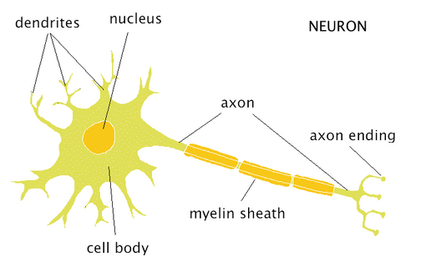
Motor Neurons

Slide 7
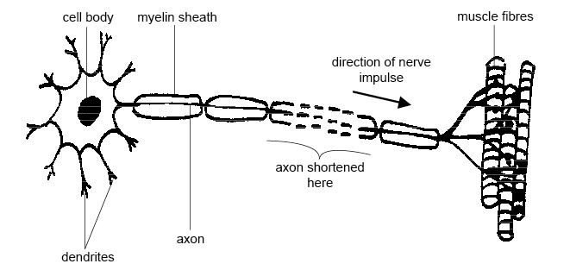
Motor neurons
Cell body of motor neuron lies within the spinal cord or brain
Nucleus is always in body of neuron
Cytoplasm of body: patches of RER that contain ribosomes to make protein

Slide 8
Motor neurons
Dendrites (dendrons) extend from cells body
Provide surface area for endings of other neurons
Axon: long cytoplasmic process that conducts impulses away from the cell body
Within cytoplasm of axon: some mitochondria
end of axon: many mitochondria and vesicle containing neurotransmitters

Slide 9
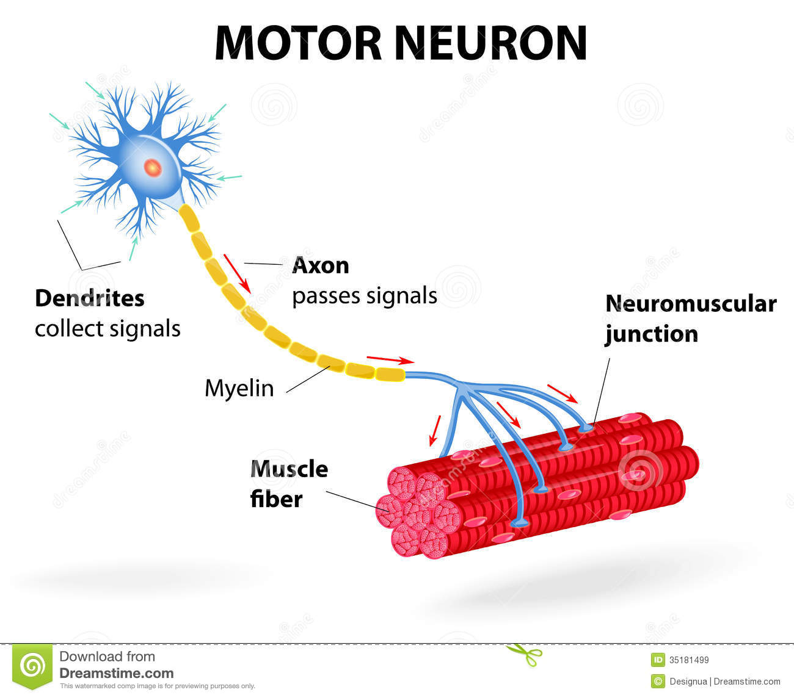
Motor neurons

Slide 10
Sensory neurons
Same basic structure as motor neurons, but one long dendron conducts nerve impulses towards the cell body
Axon often shorter than dendron
Cell body in a swelling of spinal nerve known as ganglion

Slide 11
Relay neurons
Found entirely in CNS
Connect sensory and motor neurons

Slide 12
Neurons
Axons and dendrites of motor and sensory neurons are protected within nerves
Some axons and dendrites are surrounded by myelin, which is made by specialized Schwann cells

Slide 13
Myelin
1/3 neurons are myelinated
Myelin is made when Schwann cells wrap themselves around the length of an axon or dendron enclosing axon in many layer of cell membrane
Called myelin sheath, made largely of lipid with some protein

Slide 14
Myelin
Myelin sheath increases speed of conduction of nerve impulses
Uncovered areas of axon between Schwann cells are called nodes of Ranvier
2-3µm long, occur every 1-3mm

Slide 15
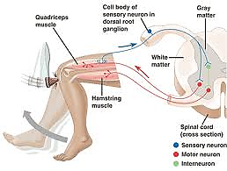
A reflex arc
A reflex arc is the pathway along which impulses are transmitted from a receptor to an effector without involving ‘conscious’ regions of the brain

Slide 16
A reflex arc
Input is received from receptor (nerve impulse)
Signal is sent via sensory neuron
Cell body located in the dorsal root of the spinal nerve
Signal is relayed through intermediate neuron (some reflex arcs do not involve intermediate neurons)
Cell body located in grey matter of spinal cord
Within spinal cord, pulse is passed to motor neuron which will cause a response in the effector
Cell body located in spinal cord (grey matter)

Slide 17
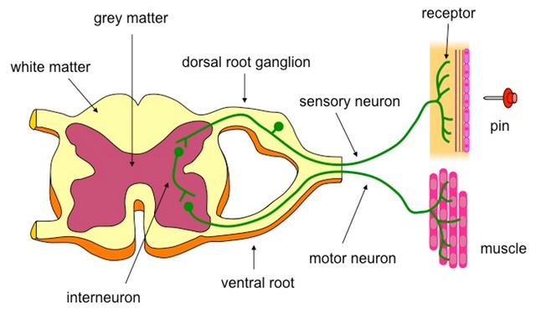
A reflex arc

Slide 18
A reflex arc
Within spinal cord, impulse is also passed on to neurons that will carry the signal to the brain
Effector responds before stimulus of any voluntary response involving conscious regions of the brain
This type of reaction is called a reflex action
Fast, automatic response to a stimulus. Response to a particular stimulus is always the same
Aka “knee jerk” reaction

Slide 19
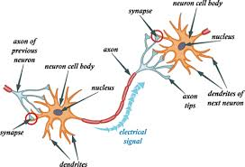
transmission OF NERVE IMPULSES
Neuron transmit electrical impulses
Impulses travel very rapidly along the CSM from one end of the cell to the other
NOT a flow of electrons like an electric current

Slide 20
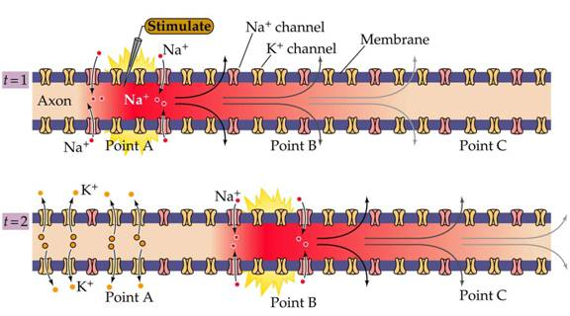
transmission OF NERVE IMPULSES
Signals are very brief changes in distribution of electrical charge across the CSM called action potentials, caused by the rapid movement of Na+ and K+ ions into/out of the cell

Slide 21
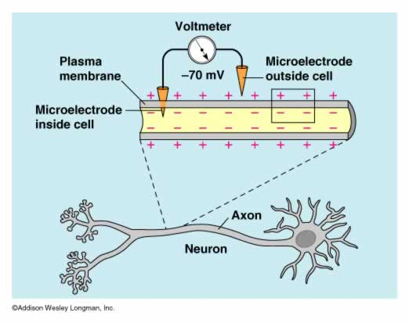
Resting potential
In a resting axon, the inside of the axon has a slightly negative electrical potential compared to the outside
The difference between electrical potential is called the potential difference and is often between -60mV and -70mV
This is the resting potential

Slide 22
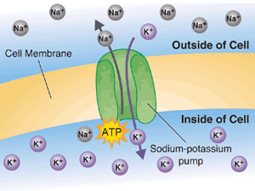
Resting potential
The resting potential is produced and maintained by the sodium-potassium pumps in the CSM
The Na/K pumps constantly move Na+ ions out of the axon and K+ ions into the axon

Slide 23
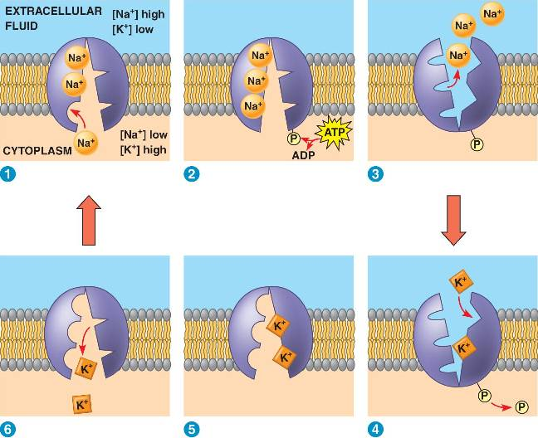
Resting potential
Use energy from hydrolysis of ATP to move ions against their concentration gradients
Three Na+ ions are removed for every two K+ ions brought in

Slide 24
Resting potential
Membrane has protein channels for K+ and Na+ which are open all the time, so some ions are constantly diffusing with concentration gradient
Many more K+ channels than Na+ channels so more K+ ions diffuse out than Na+ diffuses in
also, there are many large, negatively charged molecules inside the cell that attract K+ to stop it from diffusing out
Result of these effect is an overall excess of negative ions inside the membrane compared with the outside

Slide 25
Resting potential
Membrane is relatively impermeable to sodium but there are 2 factors that influence inward movement of Na+ ions during an action potential:
Inside of membrane is negatively charged
Steep concentration gradient
A double gradient like this is known as an electrochemical gradient

Slide 26
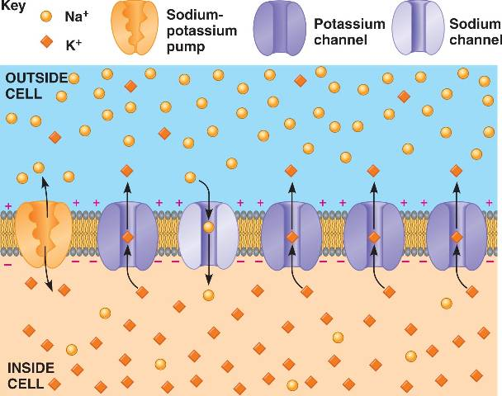
Resting potential

Slide 27
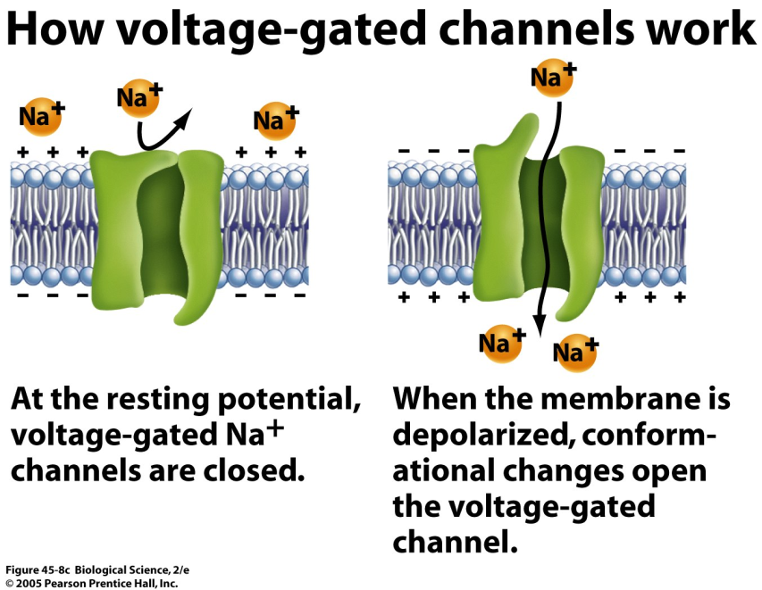
Action potentials
Change in permeability of CSM to Na+ and K+ causes a rapid change in potential difference across the membrane called an action potential
Voltage-gated channels open and close depending on electrical potential
Resting potential: channels are closed

Slide 28
Action potentials
Electrical current stimulates axon, causing voltage-gated channels to open, allowing Na+ to enter axon
As more Na+ flows in, membrane becomes less negative on the inside
This depolarization triggers more channels to open until the inside reaches a potential of about +30mV
What type of feedback is this?

Slide 29
Action potentials
Action potentials are only generated if the potential difference reaches a value between -60mV and -50mV
This value is the threshold value

Slide 30
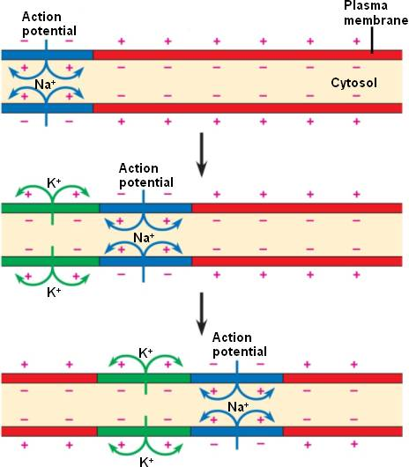
Action potentials
After about 1ms, all sodium ion voltage-gated channels close, so Na+ stop diffusing into the axon
Simultaneously, K+ ion channels open, and diffuse out of the axon
Repolarization: returns potential difference to normal -70mV

Slide 31
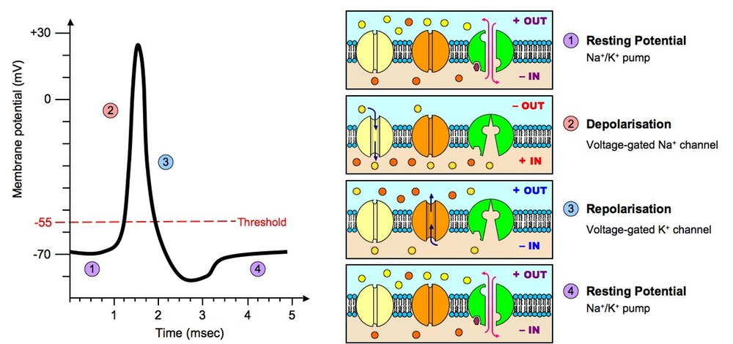
Action potentials

Slide 32
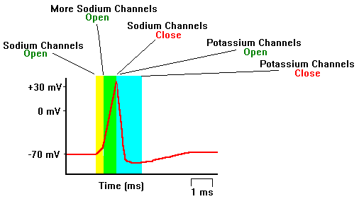
Action potentials

Slide 33
Transmission of Action potentials
Refractory period: period of time after action potential when axon is unresponsive to further stimuli
Sodium ion voltage-gated channels are shut tight and cannot be stimulated to open

Slide 34
Refractory period consequences
Action potentials are discrete events; they do not merge into one another
There is a minimum time between action potentials occurring at any one place on a neuron
The length of the refractory period determines the maximum frequency at which impulses are transmitted along neurons

Slide 35
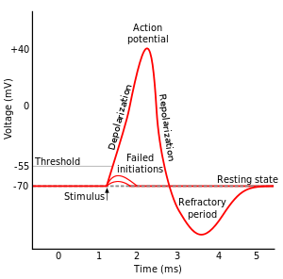
How action potentials carry information
Action potentials do not change in size as they travel, or according to the intensity of the stimulus
However long an axon is, the action potential will continue to reach a peak of +30mV inside
Also, speed at which action potentials travel is always the same in any one axon

Slide 36
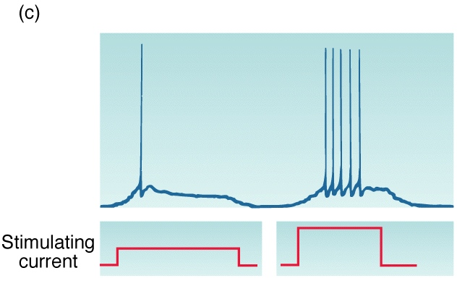
How action potentials carry information
What is different about axn potential resulting from a strong or weak stimulus is their frequency
A strong stimulus produces a rapid succession of axn potentials
A strong stimulus is also likely to stimulate more neurons than a weak stimulus

Slide 37
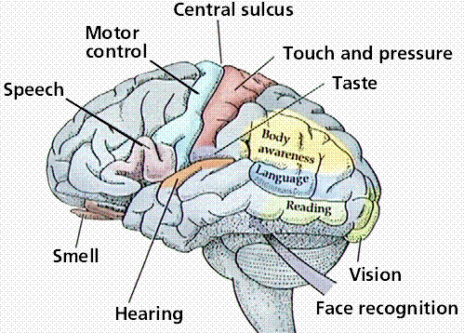
How action potentials carry information
The brain can interpret the frequency of action potentials arriving along the axon of a sensory neuron, and the number of neurons carrying action potentials to get info about the strength of the stimulus

Slide 38
How action potentials carry information
The nature of the stimulus (light, heat, touch, etc…) is deduced from the position of the sensory neuron bringing the information
If the neuron is from the retina of the eye, the brain will interpret the information as meaning “light”
This is why rubbing your eyes when they are shut can cause you to “see” patterns of light

Slide 39
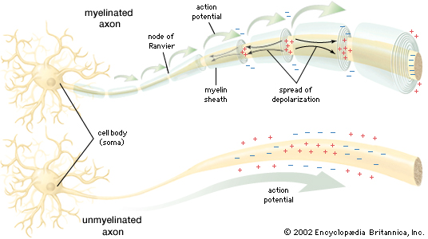
Speed of conduction
In unmyelinated neurons, the speed of conduction is slow (as slow as 0.5m/s and up to 100m/s)
Myelin speeds up the rate at which action potentials travel, by insulating the axon membrane

Slide 40
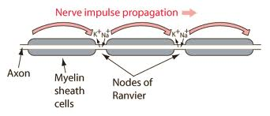
Speed of conduction
Sodium and potassium ions cannot flow through the myelin sheath, so it is not possible for depolarization or action potentials to occur in parts of the axon which are surrounded by the myelin sheath
Action potentials can only occur at the nodes of Ranvier, where all the channel proteins and pump proteins are concentrated

Slide 41
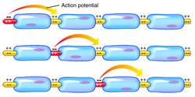
Speed of conduction
Action potential along a myelinated axon travel by “jumping” from one node to the next. This is called saltatory conduction
Can increase speed of transmission by up to 50x

Slide 42
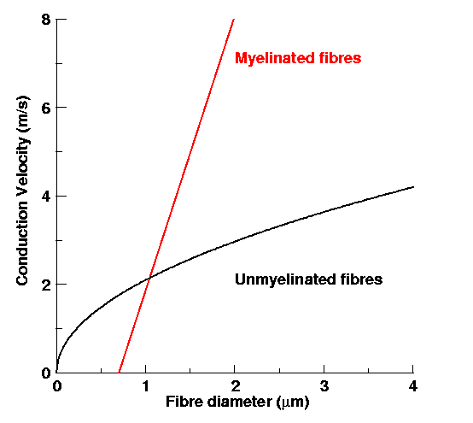
Speed of conduction
Diameter can also affect speed of conduction
Thick axons transmit impulses faster (less resistance)
Thin axons have more resistance, so impulses are slower

Slide 43
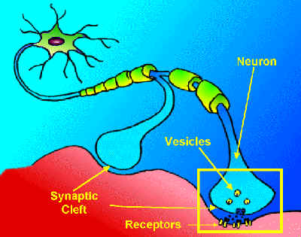
Starting an action potential
Action potentials are generated by a wide variety of stimuli
Light, touch, sound, temperature, or chemicals
A cell that responds to a stimulus by initiating an action potential is called a receptor cell

Slide 44
Starting an action potential
Receptor cells are often found in sense organs (eyes, ears, etc.)
Receptor cells are transducers, meaning they convert energy in one form (light, heat, sound) into energy in an electrical impulse in a neuron

Slide 45
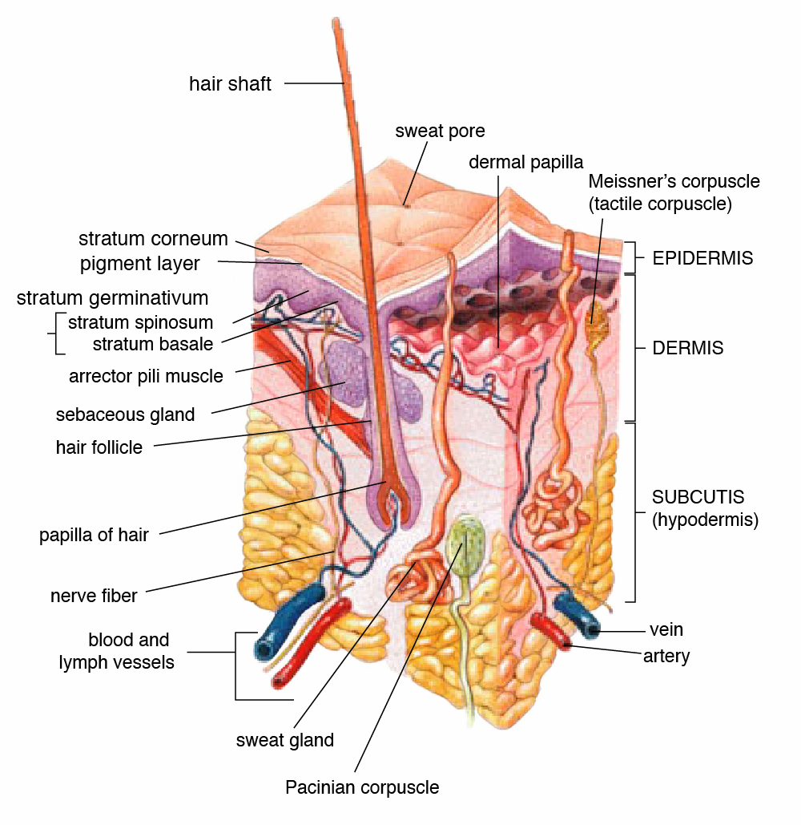
Starting an action potential- Pacinian corpuscle
One receptor found in the dermis of the skin is a Pacinian corpuscle
Contains an ending of a sensory neuron surrounded by several layers of connective tissue, called a capsule
The ending of the sensory neuron in the capsule has no myelin

Slide 46
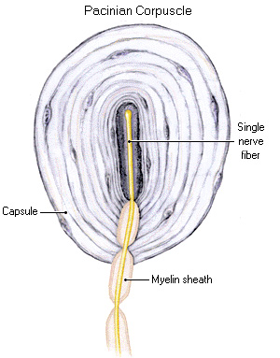
Starting an action potential-Pacinian corpuscle
When pressure is applied to a Pacinian corpuscle, the capsule is pressed out of shape and deforms the nerve ending
This deformation causes sodium and potassium channels to open in the CSM, which depolarizes the membrane

Slide 47
Starting an action potential-Pacinian corpuscle
The increased positive charge inside the axon is called a receptor potential and the amount of potential is directly related to the pressure on the capsule
If pressure is great enough, the receptor potential becomes large enough to trigger an action potential

Slide 48
Starting an action potential-Pacinian corpuscle
Below a certain threshold, the pressure stimulus only causes local depolarization, but not enough to trigger an action potential, and no signal is sent to the brain
Example of the all-or-nothing law: neurons either transmit impulses or they don’t. An action potential will either be generated or will not, no partial potentials.

Slide 49
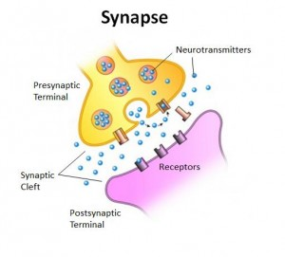
Synapses
Two adjacent neurons have a small (~20nm) gap between them called the synaptic cleft
Synapse: two parts of neurons near cleft plus cleft

Slide 50
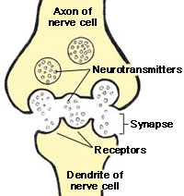
Synaptic transmission
Impulses cannot use saltatory conduction across synapse
Instead, they use transmitter molecules (neurotransmitters)

Slide 51
Synaptic transmission
Action potential occurs as CSM of 1st neuron called presynaptic neuron
Action potential causes release of neurotransmitters from vesicles into the cleft
Neurotransmitters diffuse across cleft and bind to receptors on postsynaptic neuron
Postsynaptic neuron responds to arriving impulses

Slide 52
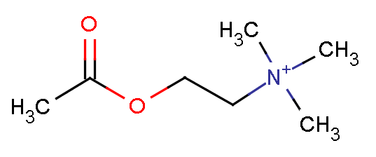
Synaptic transmission
Cytoplasm of presynaptic neuron contains vesicles of neurotransmitters
More than 40 NTs are known.
Dopamine and glutamic acid are found only in brain
Noradrenaline and acetylcholine (ACh) are found throughout nervous system
Synapses that use ACh are known as cholinergic synapses

Slide 53
Synaptic transmission
In presynaptic neuron, axn potential causes calcium ion voltage-gated channels to open
Ca++ ions diffuse down gradient into cytoplasm of presyn neuron
Ca++ ions stimulate Ach vesicles to fuse with CSM, releasing contents into cleft via exocytosis
Ach diffuses across cleft in less than 0.5 ms

Slide 54
Synaptic transmission
CSM of postsynaptic neuron contains receptor proteins that have complementary shapes to part of ACh (think like enzymes and substrates)
ACh temp. binds with receptor which causes receptor to change shape, causing Na+ channels to open, which depolarizes membrane
Think: what happens when a membrane is depolarized?

Slide 55
Synaptic transmission
CSM of postsynaptic neuron contains receptor proteins that have complementary shapes to part of ACh (think like enzymes and substrates)
ACh temp. binds with receptor which causes receptor to change shape, causing Na+ channels to open, which depolarizes membrane
Think: what happens when a membrane is depolarized? That’s right! An action potential could be generated!

Slide 56
Synaptic transmission
If ACh remained permanently to receptors, Na+ channels would always be open so CSM would constantly be depolarized, so no more axn potential can be generated
So, ACh is recycled
Synaptic cleft contains an enzyme acetylcholinesterase which catalyzes hydrolysis of ACH into acetate and choline
Choline is taken pack to presyn. Neuron where is it combined with acetyl CoA to reform ACh
Whole process, from arrival of axn potential to regeneration of ACh, takes about 5-10ms

Slide 57
Synaptic transmission
Depolarization of postsyn. Neuron must meet threshold for axn potential to be generated (~-55mV)
The more ACh, the greater the depolarization

Slide 58
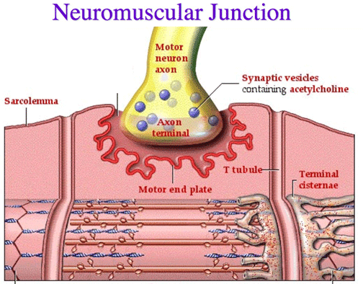
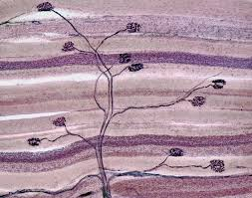
Neuromuscular junction
Synapse between a motor neuron and a muscle
Here, motor neuron forms motor end plates
Action potential produced in the muscle causes it to contract

Slide 59
Other chemicals at synapses-nicotine
Part of nicotine is similar in shape to ACh molecules, so they can fit in ACh receptors
Produces similar effects to that of ACh, initiating axn potentials, but it is not readily broken down the ACh so it accumulates in the cleft
Large doses of nicotine can be fatal

Slide 60
Other chemicals at synapses-botulin toxin (botox)
Produced by bacteria that often breed in contaminated canned foods
Inhibits release of ACh from presyn. neurons
Consuming this toxin is frequently fatal because it stops synaptic communication

Slide 61
Other chemicals at synapses- botulin toxin (botox)
Botox does have non-fatal medical uses
Ex: to allow people with permanently contracted eyelids to open their eyes via botox injections around the eyes, widely used to smooth skin wrinkles

Slide 62
Other chemicals at synapses- organophosphorus insecticides
Inhibits acetylcholinesterase so ACh is not broken down, causing it to generate continual axn potentials in the postsyn. neuron
May lead to muscular paralysis, convulsions, bronchial constriction, and death by asphyxiation
Found in many flea sprays and collars
Several nerve gases also act this way

