Slide 1
Chapter 14.1: Homeostasis

Slide 2
Regulation and control
Due to division of labor (compartmentalization) in multicellular organisms, different parts of organism perform different functions
Essential that information must pass between different parts
Ex: blood glucose control

Slide 3
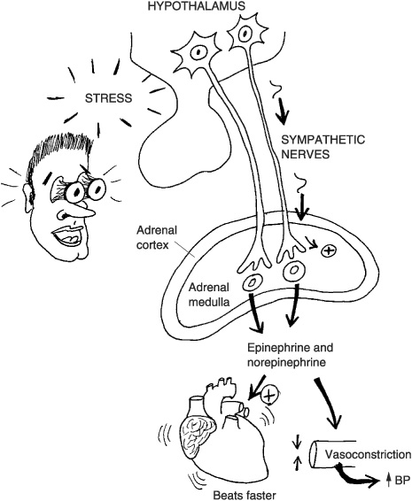
Information transfer
In animals, there are 2 types of information transfer used to coordinate the body’s activities
Nerves that transmit information in the form of electrical impulses
Chemical messengers called hormones that travel in the blood

Slide 4
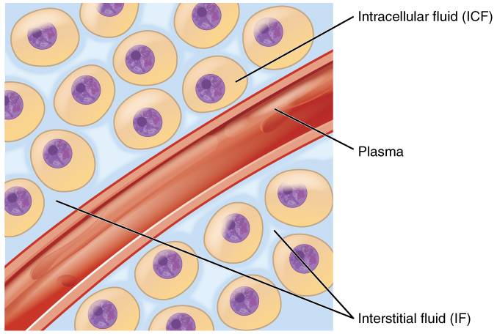
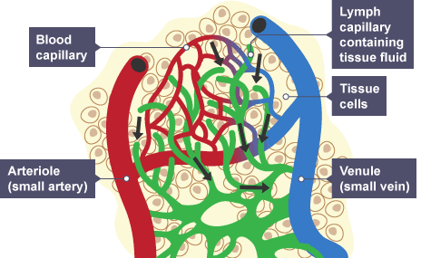
Homeostasis
Maintaining stable internal environment (conditions inside body)
For cells: immediate environment is tissue fluid surrounding it

Slide 5
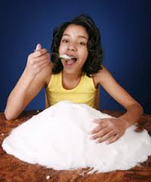
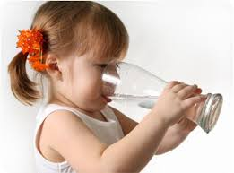
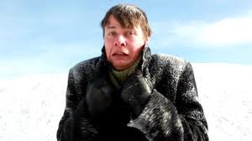
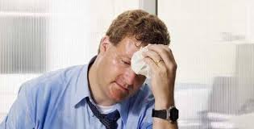
Tissue fluid
3 factors of tissue fluid that affect cells:
Temperature: low slows down metabolism, high denatures proteins
Water potential: water gain or loss by osmosis
Concentration of glucose: fuel for respiration. Too little= no ATP. Too much= change in water potential

Slide 6
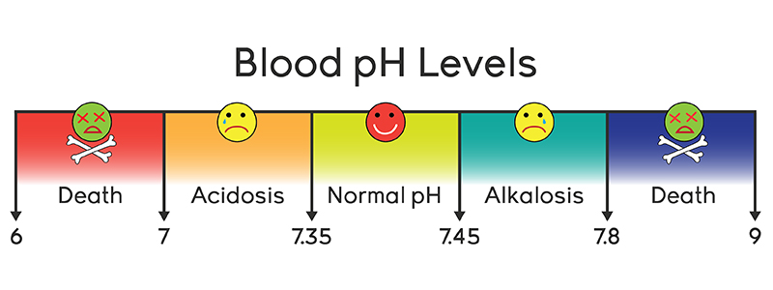
Homeostasis
In general, homeostatic mechanisms work by controlling the composition of blood, which therefore controls the composition of tissue fluid

Slide 7
Negative feedback loops
Most control mechanisms in living organisms use a negative feedback control loop to maintain homeostatic equilibrium
This involves a receptor (or sensor) and an effector
The receptor detects changes in the parameter being regulated. Known as input
The inputs sets off a series of events culminating in some action, by the effector , which is called output

Slide 8
Negative feedback
Continuous monitoring of the parameter by receptors produces continuous adjustment of the output, which keeps the parameter fluctuating around a particular ‘ideal’ value

Slide 9
Negative feedback
In negative feedback loops, a rise in the parameter results in a reaction pathway that makes the parameter decrease
Vice-versa w/ a decrease in parameter

Slide 10
Positive feedback
Very few instances of positive feedback control loops
Does not keep homeostasis
Will keep parameter increasing or decreasing in single direction

Slide 11
Excretion
Many metabolic rxns in the body produce unwanted waste (can be toxic!)
Removal of unwanted waste products is called excretion

Slide 12
Excretion
Most common excretory products in humans:
Carbon dioxide: produced continuously by aerobically respiring cells. Waste is transported via blood (see ch8 for refresher)
Urea: produced in the liver from excess amino acids and transported to kidneys. Dissolved in water and excreted as urine

Slide 13
Deamination
Excess protein cannot be stored, but getting rid of it is a waste, so the liver removes amino groups to provide energy
This process known as deamination

Slide 14
Deamination
In liver cells, amino group (-NH₂) of amino acid is removed with a H atom to produce ammonia (NH₃)
The remainder of the amino acid, a keto acid, may enter the Krebs cycle and be respired, converted to glucose, or stored as glycogen

Slide 15
Deamination
Ammonia is very soluble and highly toxic
Damage to tissues is prevented by converting ammonia into urea, which is less soluble and less toxic

Slide 16
Urea
Urea is the main nitrogenous excretory product of humans
Other small excretory products include creatinine(made from creatine) and uric acid (made from nucleotides)

Slide 17
Do Now 10/9
What is meant by the term “deamination”?

Slide 18
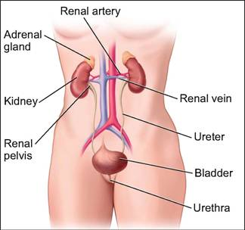
Kidneys
The kidneys are bean-shaped organs that are located against the back muscles in the upper abdominal area.
They sit opposite each other on both the left and right side of the body; the right kidney, however, sits a little lower than the left to accommodate the size of the liver.

Slide 19
Kidneys
Each kidney receives blood from a renal artery, and returns blood via a renal vein.
A narrow tube called the ureter carries urine from the kidney to the bladder
From the bladder, a single tube, the urethra, carries urine to the outside of the body

Slide 20
Kidneys
3 main areas:
Capsule: tough outer covering
Cortex: outer portion of kidney
Medulla: central area of the kidney
Ureter joins at area known as the pelvis

Slide 21
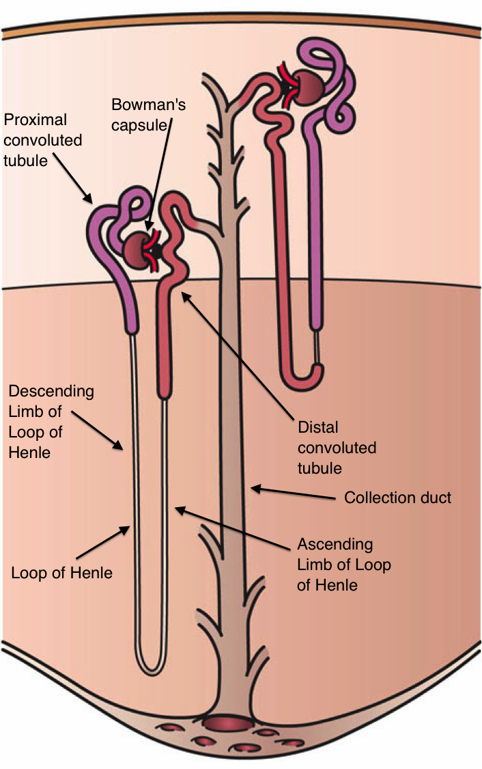
Kidneys
Microscopically made up of thousands of tiny tubes called nephrons and many blood vessels
One end of the tube forms a cup shaped structure called Bowman’s capsule, which surrounds a tight network of capillaries called a glomerulus

Slide 22
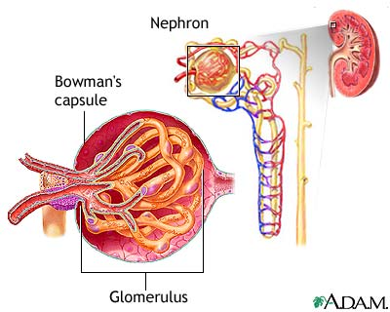
Kidneys
The glomeruli and capsules of all the nephrons are located in the cortex of the kidney
From the capsule, the tube runs towards the center of the kidney

Slide 23
Kidneys
From the capsule, the tube first forms a twisted region called the proximal convoluted tubule (PCT), and then a long hairpin loop in the medulla, called the loop of Henle
The tubule then runs back upwards into the cortex, where it forms another twisted region called the distal convoluted tubule (DCT)

Slide 24
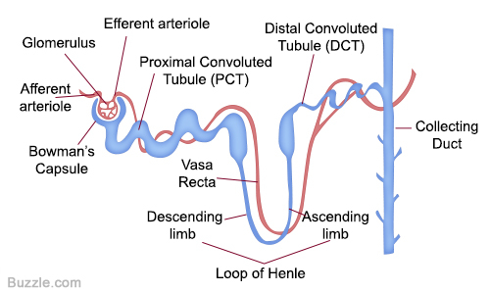
Kidneys
The DCT joins a collecting duct that leads down through the medulla and into the pelvis of the kidney

Slide 25
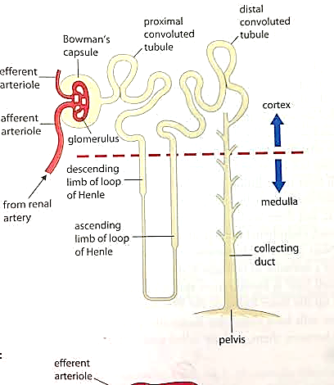
Kidneys

Slide 26
Kidney blood supply
Blood vessels are closely associated with the nephrons
Each glomerulus is supplied with blood by a branch of the renal artery called an afferent arteriole
The capillaries of the glomerulus rejoin to form an efferent arteriole.
The efferent arteriole leads off to form a network of capillaries running closely alongside the rest of the nephron.

Slide 27
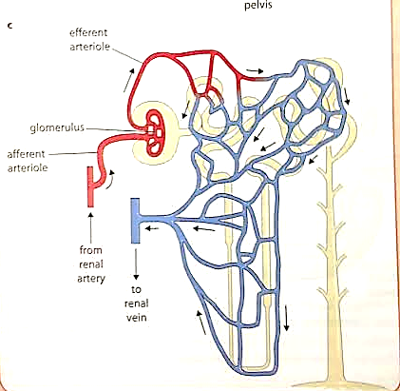
Kidney blood supply

Slide 28
Ultrafiltration
The kidney makes urine in a 2-stage process:
Ultrafiltration: filtering small molecules out of the blood and into the Bowman’s capsule (start of nephron)
Reabsorption: taking back any useful molecules from fluid in nephron

Slide 29
Ultrafiltration
Blood in glomerular capillaries is separated from the lumen of the Bowman’s capsule by 2 cell layers and a basement membrane
1st layer: lining, or endothelium, of the capillary. Perforated by thousands of tiny gaps
Basement membrane: made up of network of collagen and glycoproteins
2nd layer: epithelial cells which make up inner lining of the Bowman’s capsule

Slide 30
Ultrafiltration
Epithelial cells in the Bowman’s capsule has many tiny finger-like projections with gaps between them, called podocytes
The holes in the capillary endothelium and gaps between podocytes are large enough for dissolved molecules in blood to easily get from blood to capsule
Basement membrane stops large protein molecules from getting through

Slide 31
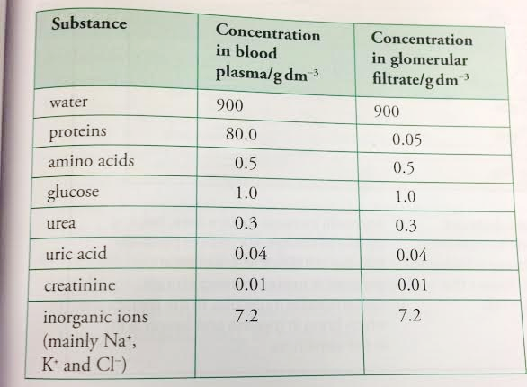
Ultrafiltration
Relative concentrations of substances in the blood and glomerular filtrate

Slide 32
Factors affecting glomerular filtration rate
Glomerular filtration rate: rate at which fluid filters from the blood in glomerular capillaries into the Bowman’s capsule
In humans, rate is ~125 mL/min
Rate determined by differences in water potential between plasma in glomerular capillaries and filtrate in Bowman’s capsule

Slide 33
Factors affecting glomerular filtration rate
Capillaries: pressure is high (b/c small diameter), increases water potential in glomerulus
However, presences of solutes decreases water potential in glomerulus because plasma protein molecules are too large to filter through basement membrane

Slide 34
Factors affecting glomerular filtration rate
Overall, the positive effect of pressure potential in the glomerulus outweighs the negative effect of solute potential
Water potential in glomerulus is greater than in the Bowman’s capsule, so water continues to moves down potential gradient from blood into the capsule

Slide 35
Reabsorption in the PCT
Many substances in filtrate need to be kept in body, so they are reabsorbed into the blood as the fluid passes along the nephron
Only certain substances are reabsorbed, so it is selective reabsorption

Slide 36
Reabsorption in the PCT
Most reabsorption takes places in the proximal convoluted tubule
The lining is made of a single layer of cuboidal epithelial cells that are adapted by:
Microvilli: increase surface area for reabsorption
Tight junctions: hold adjacent cells together so fluid cannot pass between them
Many mitochondria: provide energy for sodium/potassium pump
Co-transporter proteins: in the membrane facing the lumen

Slide 37
Reabsorption in the PCT
Blood capillaries are very close to the outer surface of the tubule
Blood comes directly from the glomerulus, so it has much less plasma and has lost a lot of water and ions
The basal membrane of the cells lining the PCT actively transport sodium ions out of cells into the blood

Slide 38
Reabsorption in the PCT
Lowered concentration of sodium ions in cells causes sodium from lumen of PCT to diffuse via co-transporter proteins into living cells down their concentration gradient
This passive movement allows for the transport of glucose into lining cells, which then is transported into the blood through a transport protein in the basal membrane

Slide 39
Reabsorption in the PCT
All of the glucose in the glomerular filtrate is transported out of the PCT into the blood (leaving no glucose in urine)
The removal of solutes from filtrate greatly increases its water potential, so a gradient exists between filtrate and blood

Slide 40
SAQ 18.2 – Page 309
A. Where has the blood in the capillaries surrounding the PCT come from?
B. What solutes will this blood contain that are not present in the glomerular filtrate?
C. How might this help in the reabsorption of water from the PCT?
D. State the name of the process by which water is reabsorbed.

Slide 41
SAQ 18.2
A. from the glomerulus via the efferent arteriole
B. proteins
C. It will increase the solute concentration of the blood plasma, therefore lowering its water potential and increasing the water potential gradient between the filtrate and the blood.
D. osmosis

Slide 42
Reabsorption in the PCT
Urea is reabsorbed (small and uncharged, diffuses easily)
Uric acid and creatinine are not reabsorbed (creatinine is actually secreted by PCT lining cells into lumen)
Reabsorption greatly reduces volume remaining
125 mL fluid enter PCT every minute, only about 80mL pass on to Loop of Henle

Slide 43
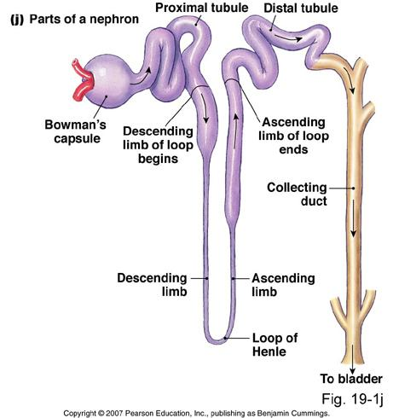
Reabsorption in the loop of Henle
About 1/3 of our nephrons contain long loops of Henle that dip down into medulla
Function is to conserve body water by creating very concentrated urine by making medulla concentrated with sodium and chloride

Slide 44
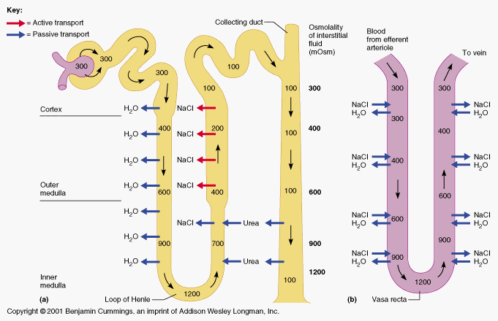
Reabsorption in the loop of Henle
Hairpin loop:
1st part: descending limb: permeable to water
2nd part: ascending limb: impermeable to water

Slide 45
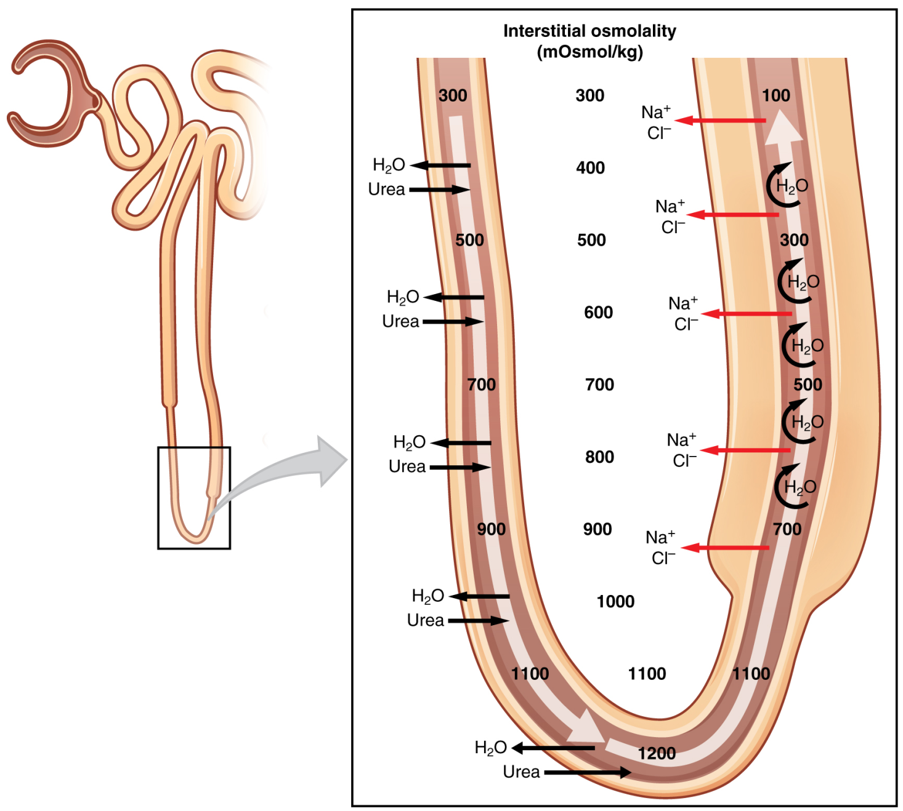
Reabsorption in the loop of Henle
The cells that line the ascending limb actively transport sodium and chloride ions out of the filtrate into the tissue fluid of the medulla
This decreases water potential in the medulla and increases water potential of the filtrate in the ascending limb

Slide 46
Reabsorption in the loop of Henle
Cells lining the descending limb are permeable to water (also Na+ and Cl- ions)
As filtrate flows down the tube, water moves down a water potential gradient into the tissue fluid by osmosis
At the same time, Na+ and Cl- flow into the tube down their concentration gradient

Slide 47
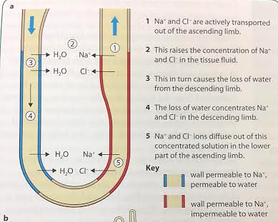
Reabsorption in the loop of Henle

Slide 48
Reabsorption in the loop of Henle
By the time fluid reaches the bottom of the hairpin, it contains much less water and many more sodium and chloride ions that it did at the started of the PCT
The longer the loop, the more concentrated the fluid can become
Can be as much as 4x as concentrated as blood plasma

Slide 49
Reabsorption in the loop of Henle
The concentrated filtrate flows up the ascending limb, and Na+ and Cl- easily leave and pass into the tissue fluid of the medulla
Very concentrated towards bottom of loop
As Na+ and Cl- leave the tube, the filtrate becomes less concentrated

Slide 50
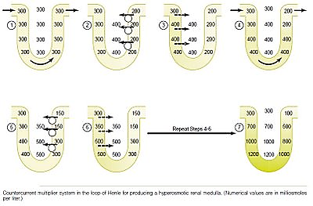
Reabsorption in the loop of Henle
Having 2 limbs of loop running side by side enables the maximum concentration of solutes to be built up both inside and outside the tube at the bottom of the loop
This mechanism is called a counter-current multiplier

Slide 51
Reabsorption in the collecting duct
After the loop of Henle, filtrate moves through the distal convoluted tubule (DCT) in the cortex and into the collecting duct in the medulla
Medulla has a very high solute concentration (low water potential) so water leaves collecting duct (via osmosis) into the medulla until the water potential of the tissue fluid is equal to the collecting duct
This process is controlled by antidiuretic hormone (ADH)

Slide 52
Reabsorption in the collecting duct
The longer the loop of Henle, the greater concentration can be set up in the medulla and greater concentration of urine can be produced
Nephrons of desert animals (kangaroo rats, gerbils, camels) are very long in relation to human’s
Humans: urine is 4x concentrated
Desert animals: urine up to 25x concentrated

Slide 53
Reabsorption in the DCT
Proximal end functions like ascending limb of loops of Henle
Distal end functions like collecting duct
Sodium ions actively pumped out
Potassium ions are actively pumped in
Rate of ions transportation varies upon blood needs

Slide 54
Kidney function – journey
1. On a separate piece of paper, write brief accounts of a journey through a kidney for each of these parts of the blood. accounts of a journey through a kidney for each of these parts of the blood.
A red blood cell.
A large protein.
A molecule of water that is essential to the body.
A molecule of urea (a toxic waste).
A molecule of glucose (sugar).
A molecule of water that needs to be removed from the body to keep the water balance right.

Slide 55
Control of water content
Osmoregulation is the control of the water potential of body fluids
Important part of homeostasis
Water potential of the blood constantly monitored by specialized sensory neurons in the hypothalamus called osmoreceptors

Slide 56
Control of water content
When osmoreceptors detect a decrease in the water potential of the blood below the set threshold, nerve impulse are sent along the neurons to the posterior pituitary gland
These impulses stimulate the release of antidiuretic hormone (ADH)
ADH= 9 amino acid peptide hormone

Slide 57
Control of water content
Molecules of ADH enter the blood in capillaries and are carried all over the body
Effect of ADH is to reduce loss of water in urine by making kidneys reabsorb max amount of water

Slide 58
How ADH affects the kidneys
ADH targets cells of the collecting duct
Increases the permeability of the CSM to water by increasing the number of water-permeable channels (aquaporins)

Slide 59
How ADH affects the kidneys

Slide 60
How ADH affects the kidneys
Collecting duct cells contain vesicles with aquaporins in their membranes
ADH molecules bind to receptor proteins on the CSMs of these cells which activates enzymes inside the cell
Once the enzymes are activated , these vesicles move toward the CSM and fuse with it

Slide 61
How ADH affects the kidneys
As fluid flows down from collecting duct, water moves through the aquaporins out of the tubule into the tissue fluid of the medulla
Fluid in the collecting duct loses water and becomes more concentrated
Less urine, but more concentrated

Slide 62
How ADH affects the kidneys
When you have more than enough water, osmoreceptors are no longer stimulated and stop secreting ADH
Without ADH, collecting duct cells’ aquaporins are moved back into vesicle in the cytoplasm
This makes the collecting duct impermeable to water, produce large volumes of dilute urine

Slide 63
How ADH affects the kidneys
Collecting duct cells do not respond immediately to reduction of ADH secretions because it takes 15-20 minutes for ADH to be broken down in the blood
Once ADH stops arrive at the collecting duct, it takes 10-15 minutes for aquaporins to be completely removed from the CSM

Slide 64
Hormonal communication
Cellular communication
Chemical messengers called hormones are secreted into blood stream in tiny quantities and dispersed throughout the body

Slide 65
Exocrine and endocrine glands

