Slide 1
Chapter 17.2: Light Independent Reactions

Slide 2
Light-independent reactions
ATP and reduced NADP are the two main products of the light-dependent reactions of photosynthesis
pass to the light-independent reactions
Cycle of events called the Calvin cycle

Slide 3
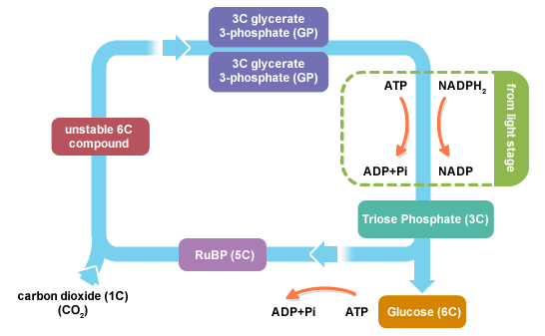
Light-independent reactions (Calvin cycle)
Fixation of carbon dioxide
$CO_{2}$ combines with 5-C sugar ribulose bisphosphate (RuBP) to produce two 3-C molecules of glycerate 3-phosphate (GP)
Enzyme ribulose bisphosphate carboxylase (rubisco) catalyzes combination of carbon dioxide and RuBP (most common enzyme in world)

Slide 4
Light-independent reactions (calvin cycle)
GP, in the presence of ATP and NADPH from LD rxns, is reduced (H added) to 3C triose phosphate
Some triose phosphates condense to form hexose phosphates, sucrose, starch, and cellulose, or are converted into acetyl CoA

Slide 5
Light-independent reactions (calvin cycle)

Slide 6
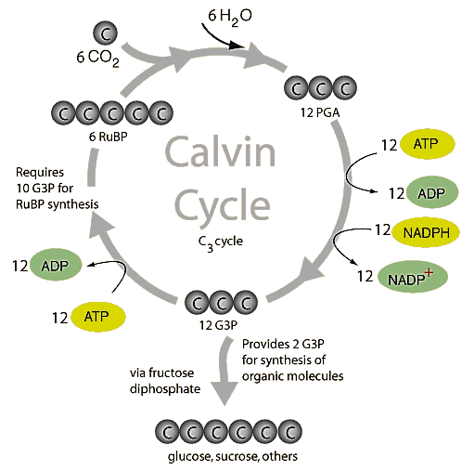
Light independent rxns

Slide 7
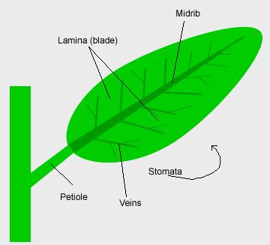
Leaf structure and function
Leaf is the main photosynthetic organ in dicotyledons
Broad, thin lamina
Midrib
Network of veins
May also have leaf stalk (petiole)

Slide 8
Leaf structure and function
To perform function leaf must:
Contain chlorophyll and other photosynthetic pigments arranged in photosystems
Absorb CO₂ and dispose of O₂
Have a water supply
Be able to export manufactured carbohydrates to rest of plant

Slide 9
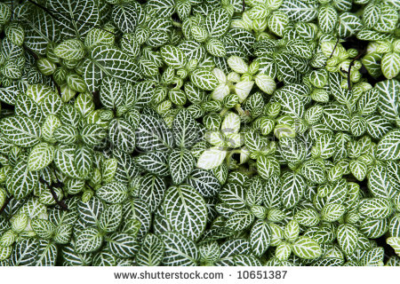
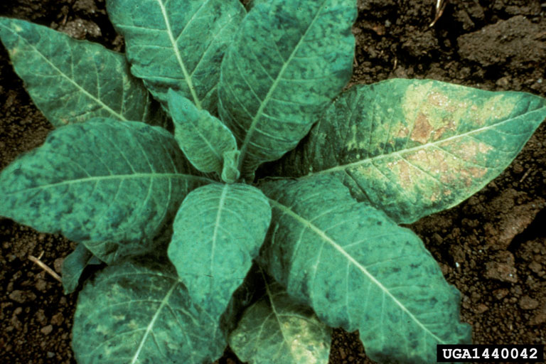
Leaf structure and function
Large surface area of lamina makes it easier for leaf to absorb light and thinness minimizes diffusion pathway for gas exchange
Arrangement of leaves on a plant (leaf mosaic) helps plants absorb as much sunlight as possible

Slide 10
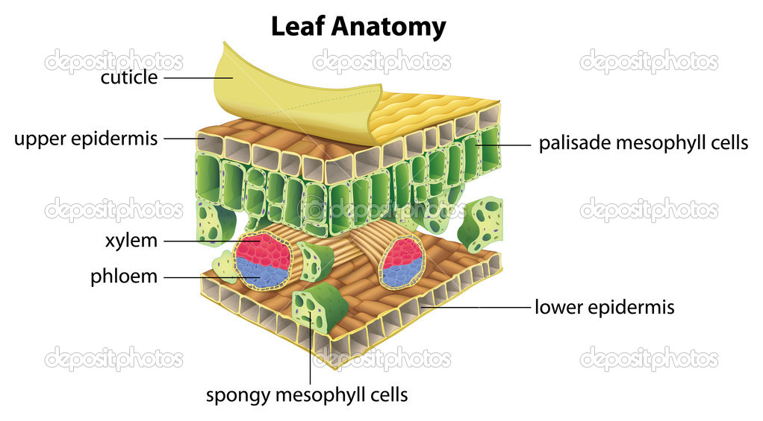
Leaf structure and function
Upper epidermis is made of thin, flat, transparent cells that allow light through the cells to the mesophyll below (where photosynthesis occurs)
Waxy
transparent
cuticle provides
a water proof
protective
layer

Slide 11
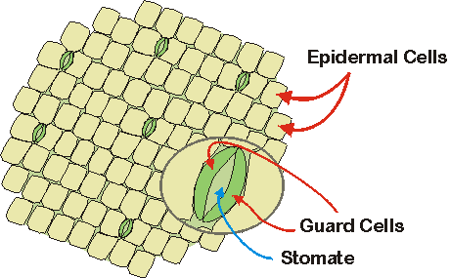
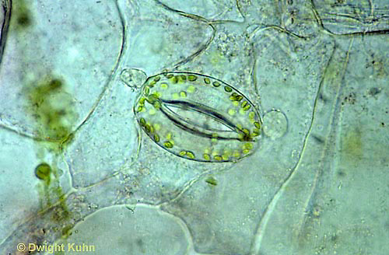
Leaf structure and function
Lower epidermis covered by several stomata
Stoma is a pore in the epidermis through which diffusion of gases occurs
Each stoma is bounded by two sausage-shaped guard cells

Slide 12
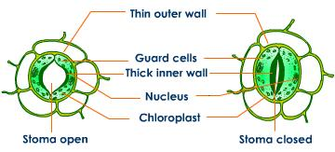
Leaf structure and function- guard cells
Changes in the turgidity (water content) of guard cells cause them to change shape so they open and close
When they gain water, pores open. When the lose water, pores close
Guard cells have unevenly thickened cell walls
Adjacent to pore= very thick
Furthest from pore= thin

Slide 13
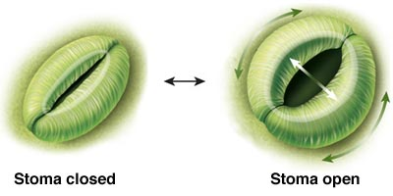
Leaf structure and function-guard cells
Bundles of cellulose microfibrils are arranged as hoops around cells
Ensures cell opens lengthwise, not widthwise (think hotdog fold vs. hamburger fold)
Guard cells become curved as they gain water, opening the pore between them

Slide 14
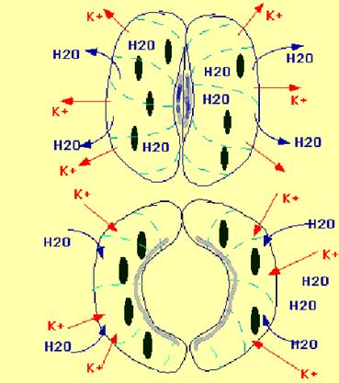
Leaf structure and function-guard cells
Guard cells gain and lose water by osmosis
A decrease in water potential is needed before water can enter cells by osmosis
Achieved by active removal of hydrogen ions using energy from ATP and intake of potassium ions

Slide 15
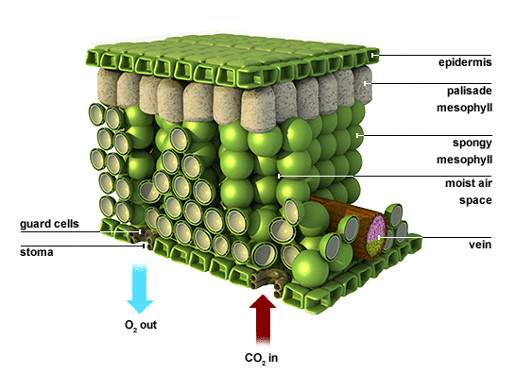
Leaf structure and function
Palisade mesophyll is the main site of photosynthesis
More chloroplasts per cell than spongy mesophyll

Slide 16
Palisade mesophyll: light absorption adaptations
Long cylinder arranged at right angles to upper epidermis
Reduced # of light-absorbing cross walls in upper leaf so as much light can reach chloroplasts as possible
Cells have large vacuole with thin peripheral layer of cytoplasm
Pushes chloroplasts to edge of cell where light can reach easier
Chloroplast can be moved by proteins in the cell to maximize light absorption

Slide 17
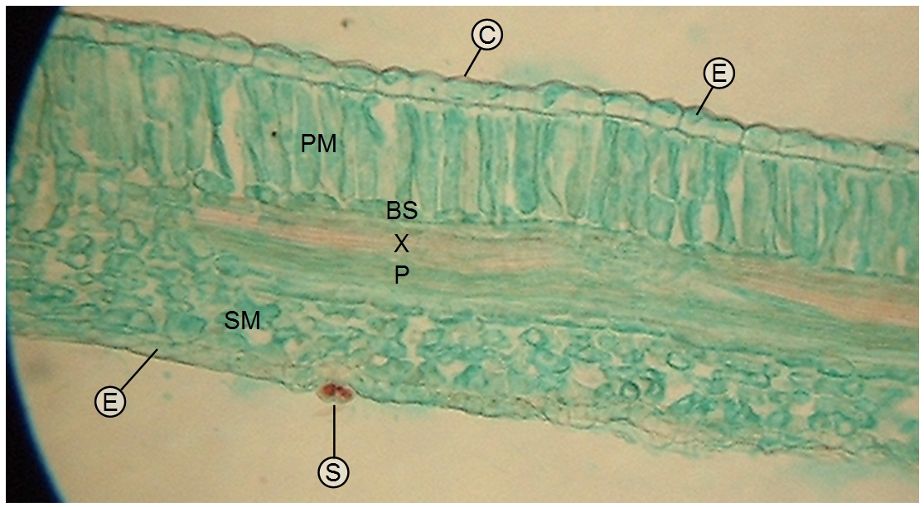
Palisade mesophyll: GAS EXCHANGE adaptations
Cylindrical cells pack together with long, narrow air spaces between them
Large surface area of contact between cells and air
Cell walls are thin
Gases can diffuse easily

Slide 18
Spongy mesophyll
Adapted for gas exchange
photosynthesis occurs only at high light intensities
Veins in the leaf support large surface area of lamina and contain xylem and phloem

Slide 19
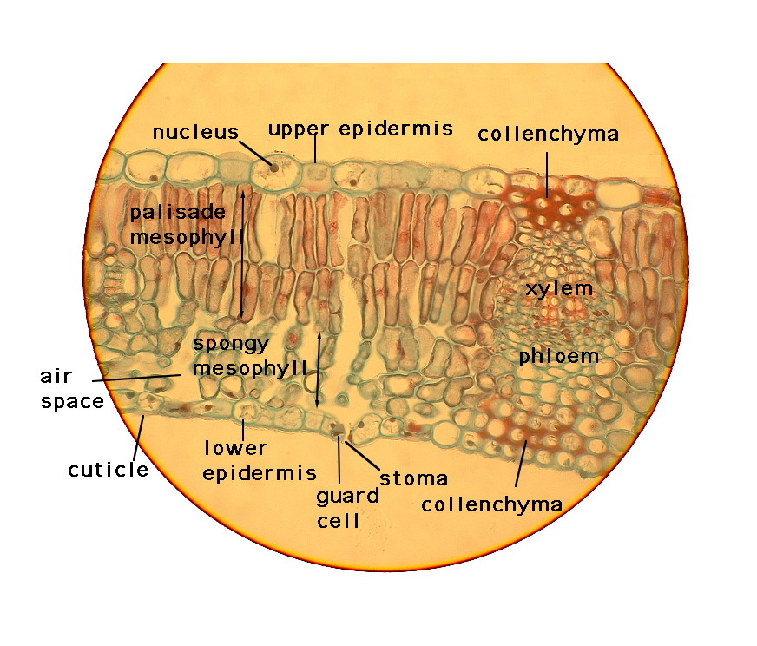
Leaf structure and function

