Slide 1
Chapter 16.3: Anaerobic Respiration

Slide 2
Anaerobic respiration
When free oxygen is not present, H cannot be disposed of by combining with oxygen
No ATP can be made with oxidative phosphorylation
Reduced NAD (NADH) from glycolysis can be used to make ATP
Ethanol pathway
Lactate pathway

Slide 3
Alcoholic fermentation
Yeast and some plants pass H from NADH to ethanal
Releases NAD allowing glycolysis to continue
1.) pyruvate is decarboxylated to ethanal
2.) ethanal is reduced to ethanol by the enzyme alcohol dehydrogenase

Slide 4
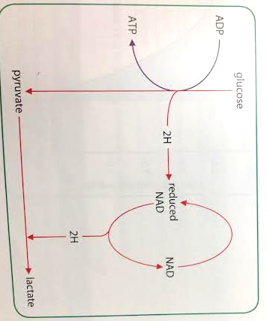
Lactic acid fermentation
Mammalian muscle and some microorganisms
Pyruvate acts as hydrogen acceptor and is converted into lactate by enzyme lactate dehydrogenase
NAD is released to allow
glycolysis to continue

Slide 5
Anaerobic respiration
These pathways “buy time”
They allowed for continue production of some ATP, but products (ethanol and lactate) are toxic so they cannot continue indefinitely
Lactate can be converted by the liver back into pyruvate and glycogen

Slide 6
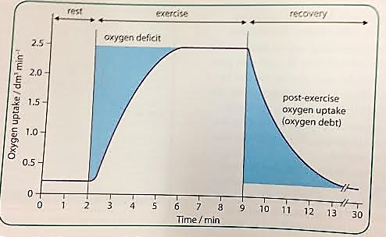
Oxygen deficit and debt
Oxygen deficit: when exercise begins, more oxygen is needed than lungs and heart can immediately supply. During this time, anaerobic respiration occurs in the muscles
Oxygen debt: post-exercise uptake of extra oxygen which is “paying back” the oxygen deficit

Slide 7
Oxygen debt
Oxygen needed for:
Conversion of lactate to glycogen in the liver
Reoxygenation of hemoglobin in the blood
High metabolic rate (as many organs are operating at above resting levels)

Slide 8
Respiratory substrates
Although glucose is the main respiratory substrate for most cells, some cells can oxidize lipids and amino acids
C atoms removed in pairs as acetyl coenzyme A in lipids, fed into Krebs cycle
C-H skeletons of amino acids converted into pyruvate or acetyl CoA

Slide 9
Energy values of respiratory substrates
Energy density: energy value per mass
More hydrogens per molecule=greater energy density
Lipids→proteins→carbohydrates

Slide 10
Respiratory quotient (RQ)
Aerobic respiration of glucose produces the same # of molecules of carbon dioxide as oxygen used
When other substrates are used, this ratio differs
Measuring this ratio (RQ) shows what substrate is being used

Slide 11
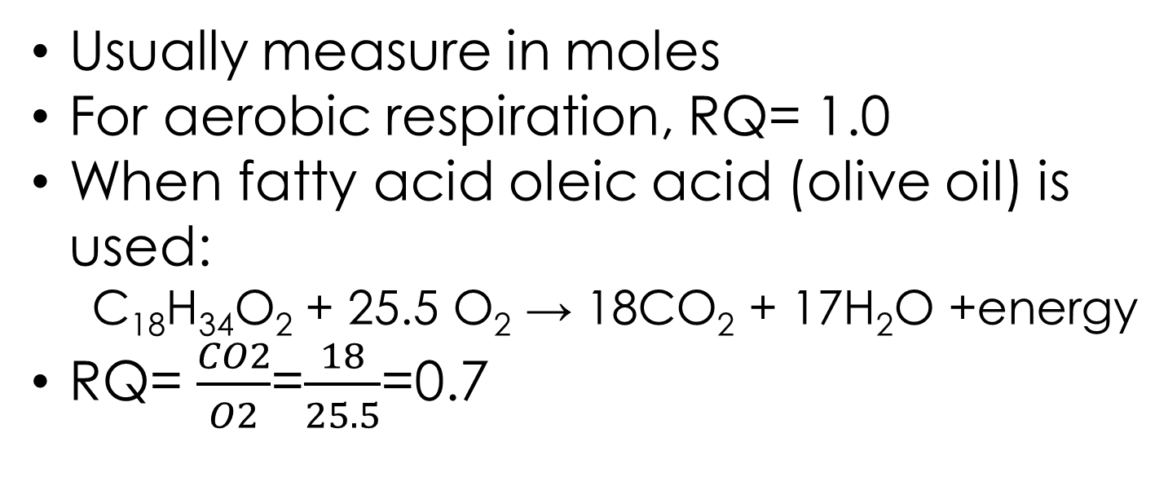
RQ
$$RQ= \frac{volume of carbon dioxide given out in unit time}{volume of oxygen taken in in unit time}$$
Usually measure in moles
For aerobic respiration, RQ= 1.0
When fatty acid oleic acid (olive oil) is used:
C₁₈H₃₄O₂ + 25.5 O₂ → 18CO₂ + 17H₂O +energy
RQ= $\frac{CO2}{O2}$=$\frac{18}{25.5}$=0.7

Slide 12
RQ values
Respiratory substrate | Respiratory quotient (RQ)
Carbohydrate | 1.0
Lipids | 0.7
Protein | 0.9

Slide 13
RQ for anaerobic respiration
Since no oxygen is being used, RQs for anaerobic respiration will be greater than 1

Slide 14
CYU
Calculate RQ for stearic acid (C₁₈H₃₆O₂)

