Slide 1
Respiration

Slide 2
Respiration
Respiration is a process in which organic molecules act as a fuel
Organic molecules are broken down in a series of stages to release chemical potential energy, which is used to generate ATP
Main organic fuel for most cells is a carbohydrate (glucose)
Others include fatty acids, glycerol, amino acids

Slide 3
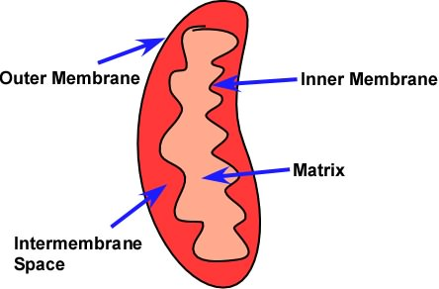
Respiration
Glucose breakdown can be divided into four stages:
Glycolysis
The link reaction
The Krebs cycle
Oxidative phosphorylation

Slide 4
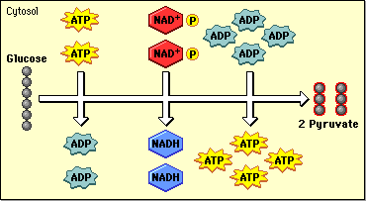
The glycolytic pathway
Glycolysis is the splitting, or lysis, of glucose
6 carbon glucose split into 3 carbon pyruvate
Energy is needed in first steps but released in later steps (net gain of 2 ATP)
Takes place in cytoplasm

Slide 5
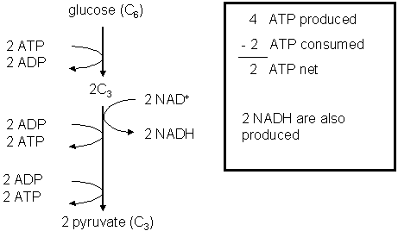
Glycolysis
First stage: phosphorylation
Glucose(6C) is phosphorylated using ATP (2 ATP/glucose)
2 phosphates to glucose creates hexose phosphate (6C) which breaks down into 2 triose phosphate (3C)

Slide 6
Glycolysis
Hydrogen removed from triose phosphate and transferred to carrier molecule NAD (nicotinamide adenine dinucleotide) to form reduced NAD (NADH)
Each NADH molecule can be used to transfer energy to other molecules during respiration
The end product of glycolysis, pyruvate (3C), still contains chemical potential energy

Slide 7
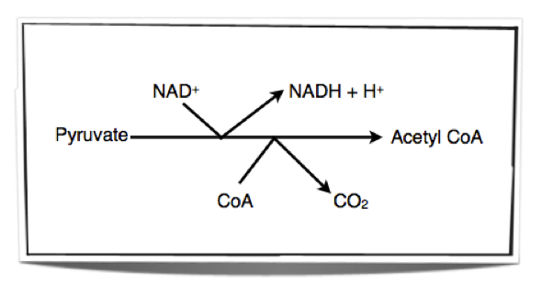
The link reaction
Pyruvate passes by active transport into mitochondrial matrix
It is decarboxylated (CO2 is removed) and dehydrogenated (H is removed) and combined with coenzyme A (CoA) to form acetyl coenzyme A (acetyl CoA)

Slide 8
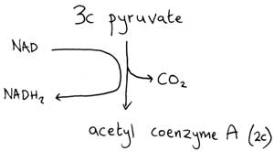
The link reaction
The hydrogen removed from pyruvate is transferred to NAD to form reduced NAD (NADH)
Fatty acids from fat metabolism can also be used to create acetyl CoA

Slide 9
The Krebs Cycle
Aka citric acid cycle aka TCA cycle
Closed pathway of enzyme controlled reactions
Acetyl CoA + oxaloacetate (4C) to form citrate (6C)
Citrate is decarboxylated and dehydrogenated to give off CO2 and H+ which are accepted by NAD and FAD
Oxaloacetate is regenerated to combine with another acetyl CoA

Slide 10
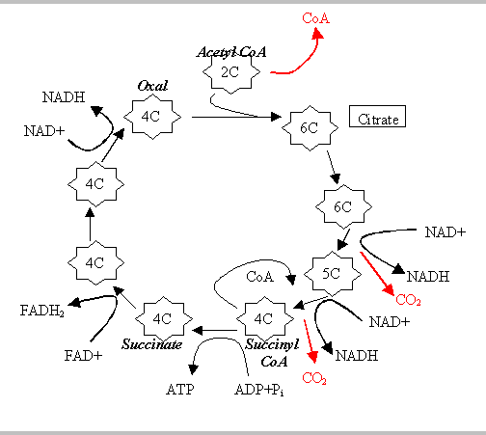

Slide 11
The krebs cycle
Part of the aerobic pathway, but does not use oxygen
Can be used in anaerobic processes like fermentation which produces lactic acid
Each turn of the cycle produces:
2 CO2 molecules
One FADH
Three NADH
One ATP

Slide 12
Oxidative phosphorylation
ADP to ATP come from activity of electron transport chain
Takes place in inner mitochondrial membrane
NADH and FADH are passed to electron transport chain where hydrogens are removed and split into H+ and e-
Electron is transferred to first series of electron carriers

Slide 13
Oxidative phosphorylation
As electrons are moved from carriers with high energy to carriers with low energy, energy is released
Some of this energy is used to move protons across the membrane (ATP synthase) to generate ATP
Net gain of 28-32 ATP

Slide 14
Oxidative phosphorylation
Oxygen acts as a final electron acceptor
Reduces oxygen to water

