Slide 1
Chapter 1.3: Structures and Functions of Organelles

Slide 2
Organelles
Organelles are functionally and structurally distinct parts of a cell
Organelles are often surround by membranes themselves so that their functions can be distinct from surrounding cytoplasm, called compartmentalization
Each cell is said to have division of labor

Slide 3
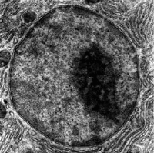
Nucleus
The nucleus is the largest cell organelle
Surrounded by two membranes known as the nuclear envelope
The outer membrane of the nuclear envelope is continuous with the endoplasmic reticulum

Slide 4
Nucleus
The nuclear envelope has many small pores called nuclear pores, which allow and control exchange between the nucleus and the cytoplasm
NE
Out
mRNA
ribosomes
In
Proteins Nucleotides
ATP Hormones

Slide 5
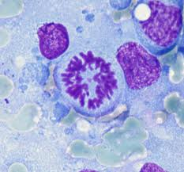
Nucleus
Within the nucleus, chromosomes are in a loosely coiled state known as chromatin
Chromatin condenses to form chromosomes during cell division
Also within the nucleus is the nucleolus, which is responsible for assembling ribosomes

Slide 6
Endoplasmic Reticulum
The endoplasmic reticulum (ER) is a system of membranes running through the cytoplasm that is continuous with the outer membrane of the nuclear envelope

Slide 7
Endoplasmic Reticulum
Two main types:
Rough Endoplasmic Reticulum (RER) | Smooth Endoplasmic Reticulum (SER)
Covered with ribosomes (sites of protein synthesis) Protein processing Vesicle formation (to Golgi) | Lacks ribosomes Makes lipids and steroids (ex: cholesterol, estrogen, testosterone)

Slide 8
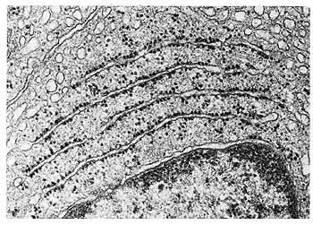
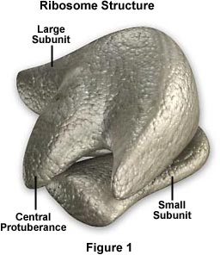
Ribosomes
Sites of protein synthesis
Found free in cytoplasm and on RER
Consists of two subunits: 1 large, 1 small
~25nm in diameter
Made of RNA and protein

Slide 9
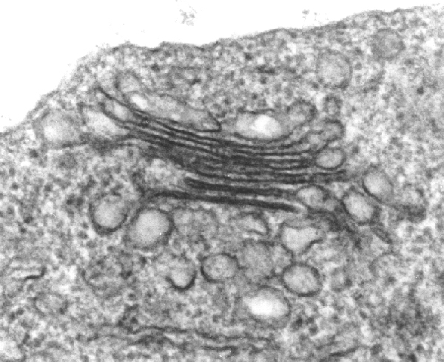
Golgi Apparatus
The Golgi apparatus is a stack of flattened sacs that is sometimes referred to as the Golgi body
More than one may be present in a cell

Slide 10
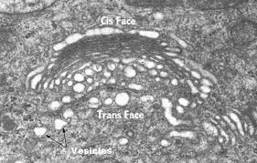
Golgi apparatus
The stack is constantly being formed at one end from vesicles which bud off from the ER, and broken down again at the other end to form Golgi vesicles

Slide 11
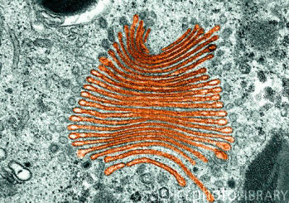
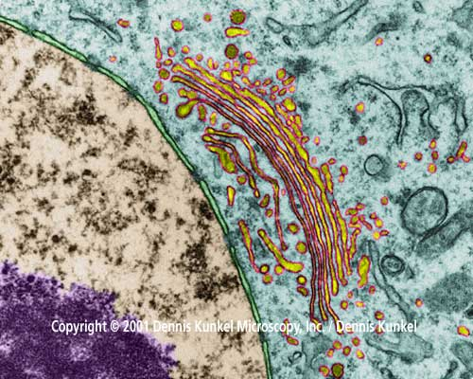
Golgi apparatus
The Golgi apparatus collects, processes, and sorts molecules (particularly proteins from the ER), ready for transport in Golgi vesicles either to other parts of the cell or out of the cell (secretion)

Slide 12
Golgi apparatus
In plants, enzymes in the Golgi apparatus convert sugars into cell wall components
Golgi vesicles are used to make lysosomes
Involved in protein processing.
  Ex: addition of sugars to proteins to make glycoproteins, removing of methionine to make functioning protein (most proteins undergo proteolytic cleavage following translation)

Slide 13
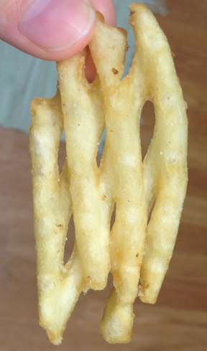
Golgi Apparatus
Look at this french fry that looks like a Golgi apparatus!

Slide 14
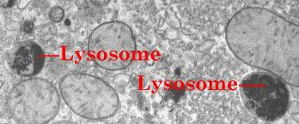
Lysosomes
Lysosomes are spherical sacs surrounded by a single membrane and have no internal structure
Commonly 0.1-0.5 µm in diameter

Slide 15
Lysosomes
Contain digestive (hydrolytic) enzymes which must be kept separate from the rest of the cell to prevent damage
Responsible for the breakdown (digestion) of unwanted structures such as old organelles or even whole cells (Ex: mammary glands post-lactation)
http://www.youtube.com/watch?v=ekdIEpSf-1I

Slide 16
Lysosomes
In white blood cells, lysosomes are used to digest bacteria
Lysosomes sometimes release enzymes outside the cell (Ex: replacing cartilage with bone during development)
Heads of sperm contain a specialized lysosome (acrosome) for digesting a path to the ovum

Slide 17
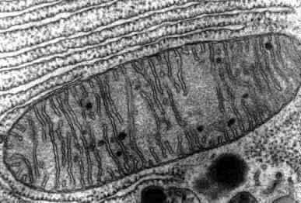
Mitochondria
~1 µm in diameter, usually “sausage” shaped
Surrounded by two membranes
  Inner in folded to form finger-like cristae which project into the interior solution called the matrix

Slide 18
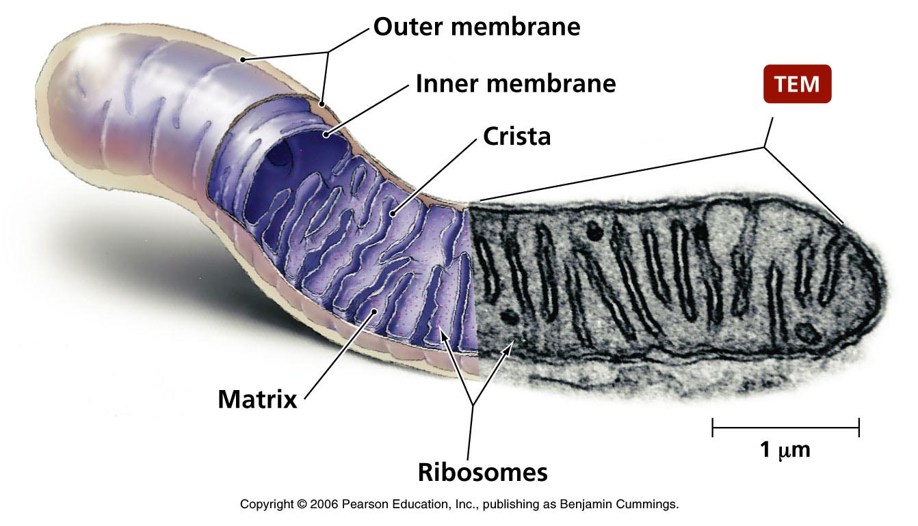
Mitochondria
Functions to carry out aerobic respiration (as a result make ATP)
Also involved in the synthesis of lipids

Slide 19
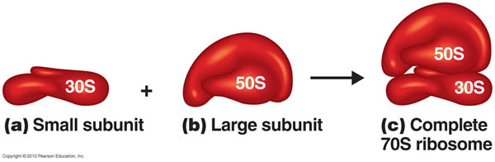
Mitochondria
1960s:
  Mitochondria and chloroplasts contain ribosomes which are 70S in size, closer to bacterial size than cytoplasmic ribosomes (80S)
  Mitochondria and chloroplasts contain small circular DNA molecules, like that found in bacteria

Slide 20
Endosymbiont Theory
  These discoveries led to the endosymbiont theory: mitochondria and chloroplasts are ancient bacteria which now live inside the larger cells typical of animals and plants
  The DNA and ribosomes of mitochondria and chloroplasts are still active and responsible for the coding and synthesis of certain viral proteins, but neither can live independently

Slide 21
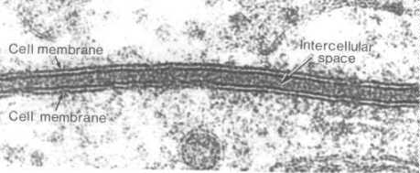
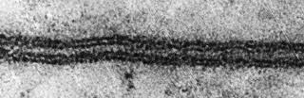
Cell surface membrane
Extremely thin (~7nm)
Trilaminar appearance at high magnifications (100,000x and higher)
Partially permeable
Controls exchange between the cell and its environment

Slide 22
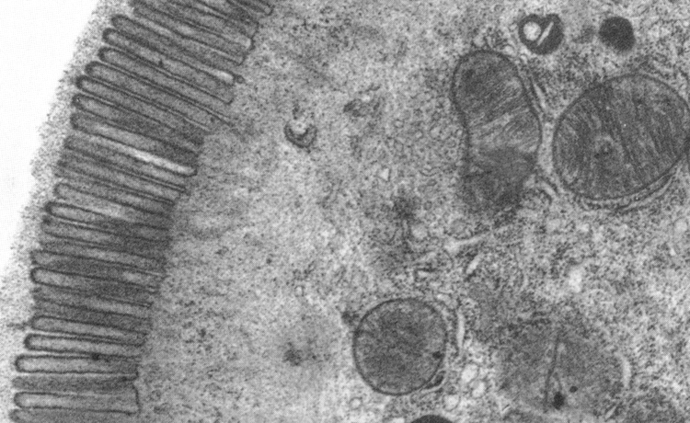
Microvilli
Finger-like extensions of the CSM
Typical of certain epithelial cells
Increase surface area of CSM (useful for absorption in gut and for reabsorption in proximal convoluted tubule in kidney

Slide 23
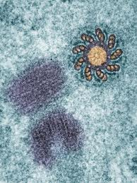
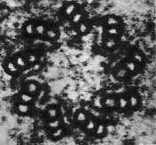
Centrioles
Hollow cylinder ~0.4µm long
Composed of 9 microtubule(MTs) triplets: tiny rings of the protein tubulin
Found in pairs that lie at right angles to each other
Used as a starting point for spindle MTs during nuclear division; organize MTs
Only found in animal cells

Slide 24
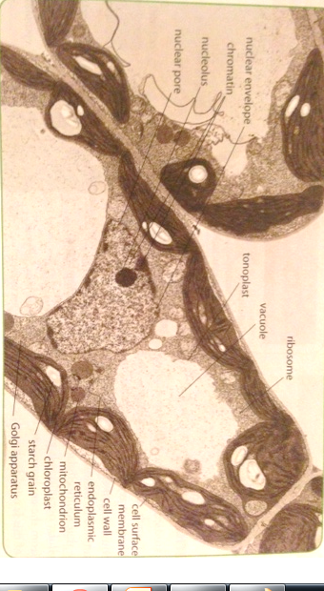
Plant Cell Ultrastructure

Slide 25
Types of cells
Two fundamentally diff. types of cells: those with a nucleus and those without
Prokaryotes are organisms that lack nuclei
  All prokaryotes now are referred to as bacteria
  Much smaller than cells with nuclei
  Very simple structure (Ex: DNA lies free in cytoplasm)

Slide 26
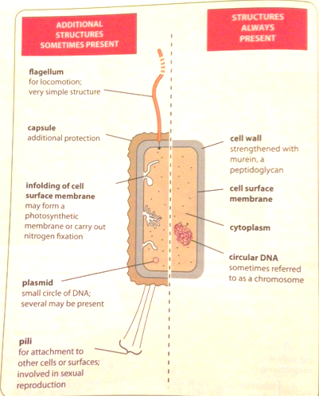
Prokaryotes

Slide 27
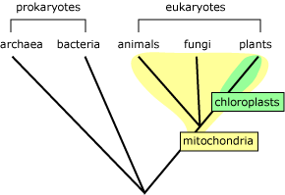
Eukaryotes
Eukaryotes are organisms whose cells possess nuclei
  DNA lies inside nucleus
  Incl: animals, plants, fungi, and protoctists (protists)
  Believed to have evolved from prokaryotes ~1500 million years after prokaryotes first appeared

Slide 28
Prokaryotes | Eukaryotes
~ diameter of 0.5-5µm | Up to 40µm in diameter and 1,000-10,000 times the volume
DNA is circular and lies freely in cytoplasm | DNA is contained in the nucleus and not circular
DNA is naked | DNA is associated with proteins
70S ribosomes (~20 nm diameter) | 80S ribosomes (~25 nm diameter)
No ER | ER present
Very few organelles- none surrounded by an envelope of two membranes | Many types of organelles present (extensive compartmentalization and division of labor)
Cell wall present- wall is strengthened with murein (a peptidoglycan) | Cell wall sometimes present (plants, fungi). Strengthening material is cellulose or lignin in plants, and chitin in fungi

Slide 29
Check Your Understanding
1.) Which type of membrane would be present in the largest quantity in a prokaryotic cell?
cell surface membrane
mitochondrial cristae
nuclear envelope
smooth endoplasmic reticulum

Slide 30
Check Your Understanding
2.) In a cell that is specialized for secreting protein, which of the following would be present in relatively large amounts?
cell surface membrane
Golgi vesicles
lysosomes
smooth endoplasmic reticulum

Slide 31
Check Your Understanding
3.) Which structure could be described as a microtubule-organizing center?
centriole
Golgi apparatus
nucleus
spindle

Slide 32
Check Your Understanding
4.) What are microtubules made of?
cellulose
DNA
lipid
protein

Slide 33
Check Your Understanding
5.) Which structure could be found in a plant cell but not in a prokaryotic cell?
20nm ribosomes
cell surface membrane
circular DNA
thylakoid

Slide 34
Check Your Understanding
6.) Which organelle makes lysosomes?
Golgi apparatus
nucleus
ribosome
smooth endoplasmic reticulum

Slide 35
Check Your Understanding
7.) A protein that is to be secreted from a cell would pass through a sequence of cell organelles in the following order:
Golgi apparatus → rough endoplasmic reticulum → secretory vesicle
Golgi apparatus → secretory vesicle → rough endoplasmic reticulum
rough endoplasmic reticulum → Golgi apparatus → secretory vesicle
secretory vesicle → Golgi apparatus → rough endoplasmic reticulum

