Slide 1
Chapter 1.2
Electron Microscopy

Slide 2
Electron Microscopes
There is a limit to how much can be seen w/light
Magnification is the number of times larger an image is, compared with the real size of the object.
$magnification=\frac{observed size of the image}{actual size}$
Or
$$M=\frac{I}{A}$$
I=observed size of the image
A= actual size

Slide 3
Magnification
I
M
×
A

Slide 4
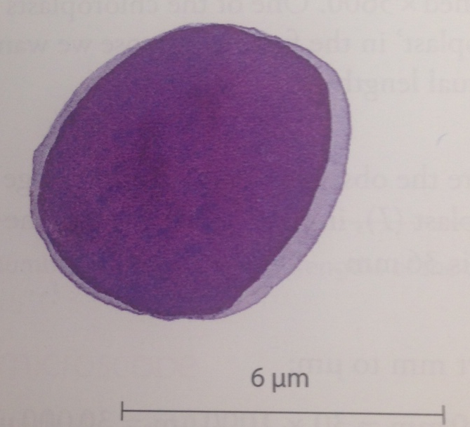
Check Your Understanding
This length of the displayed lymphocyte is 36mm. The actual length of the lymphocyte is 6µm. What is the magnification?

Slide 5
Check Your Understanding
(Pg 9, Ex2)
This length of the displayed lymphocyte is 36mm. The actual length of the lymphocyte is 6µm. What is the magnification?
1.) Convert mm → µm
$$36mm=36×1000μm=36,000μm$$
2.) Use the equation $M=\frac{I}{A}$ to calculate magnification
(M=magnification, I= image size, A=actual size)
$$M=\frac{36,000μm}{6μm}$$
$$M=×6,000$$

Slide 6
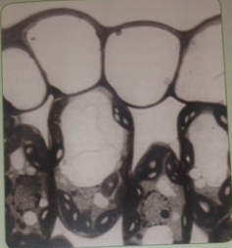
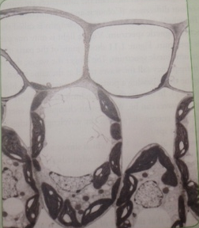
Resolution
Top photo is a light micrograph: a photograph taken with a light microscope (aka a photomicrograph)
Bottom photo is an electron micrograph (picture taken with an electron microscope) of the same cells

Slide 7
Resolution
Electron micrographs are much clearer than photomicrographs because it has greater resolution.
Resolution is the ability to distinguish between two separate points. If two points cannot be resolved, they are seen as a single point
You describe resolution as detail

Slide 8
Resolution
The max resolution of light microscopes is ~200nm, meaning points closer than 200nm cannot be resolved and will be seen and one object
**Enlarging photomicrographs does NOT increase resolution! Ignore everything you have ever learned from watching CSI!**

Slide 9
Check Your Understanding
The max resolution of light microscopes is 200nm.
What is this length expressed in µm?
What is this length expresses in pm?

Slide 10
Check Your Understanding
The max resolution of light microscopes is 200nm.
What is this length expressed in µm?
$nm= {10}^{−9}$ and $μm= {10}^{−6}$
$200 nm=0.2 μm$
What is this length expresses in pm?
$nm= {10}^{−9}$ and p$m= {10}^{−12}$
$200 nm=200,000 pm$

Slide 11
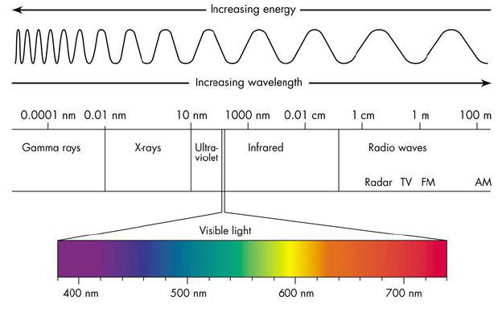
The Electromagnetic Spectrum
The wavelength of visible light varies from ~400nm (violet light) to ~700nm (red light)
The human eye detects different wavelengths and the brain translates these differences to a color

Slide 12
The Electromagnetic Spectrum
In this diagram, a stained mitochondrion and ribosomes are shown.
The mitochondrion is larger enough to interfere with light waves. However, the ribosomes are too small to have any effect on the light waves.

Slide 13
The Electromagnetic Spectrum
The limit of radiation is about one half the wavelength of the radiation used to view the specimen.
This means that the best resolution that can be obtained using a light microscope is 200 nm since the shortest wavelength of visible light is 400 nm.
In practice, this corresponds to a max M of ~×1500
Notes:
In other words, if an object is any smaller than half the wavelength of the radiation used to view it, it cannot be seen separately from nearby objects.

Slide 14
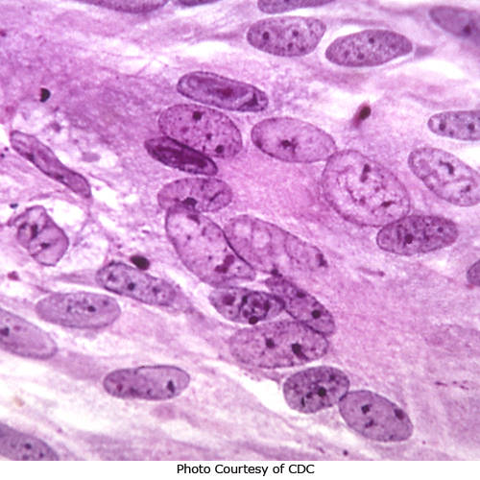
The Electromagnetic Spectrum
If an object is transparent, light will pass through it and will still not be visible (this is why biological structures have to be stained)

Slide 15
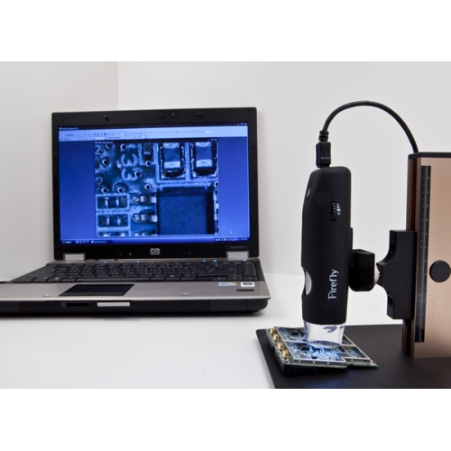
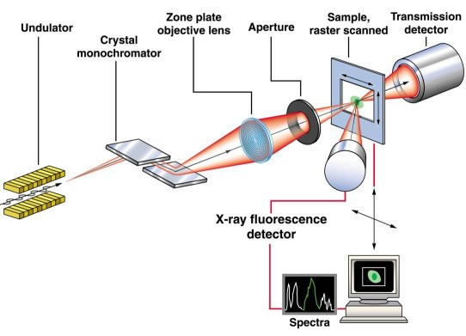
The Electron Microscope
So if visible light limits us to 200nm why not use radiation with smaller wavelengths?
Both exist, but are difficult to focus (particularly X-rays)
A much better solution is to use electrons because free electrons behave like electromagnetic radiation with a very short wavelength.

Slide 16
The Electron Microscope
A much better solution is to use electrons because:
1.) Free electrons behave like electromagnetic radiation with an extremely short wavelength.
2.)Because they are negatively charged, they can be focused easily using electromagnets.
Using an electron microscope, a resolution of 0.5nm can be obtained (400× better than a light microscope
http://www.youtube.com/watch?v=SIOOLXbwWME

Slide 17
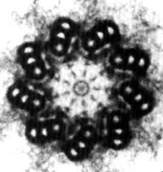
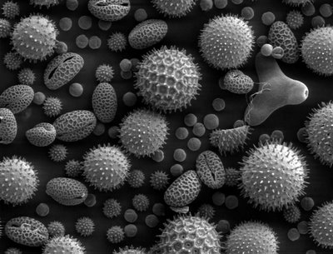
Electron Microscopes
Transmission electron microscope (TEM) | Scanning electron microscope (SEM)
beam of e⁻ passed through specimen, so only transmitted are seen. Allows us to see thin sections of specimen, and thus to see inside cells Best resolution (0.5nm) | beam of e⁻ used to scan surfaces of structures, and only the reflected beam is observed Can see surface structures Great depth of field (gives better 3D appearance) Lower resolution (3nm-20nm)

Slide 18
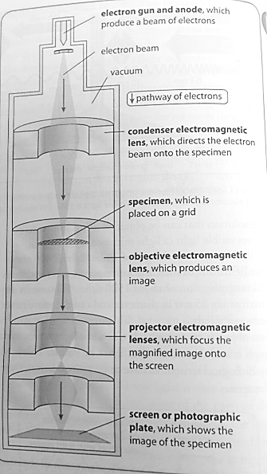
The Electron Microscope
Electron microscope capture images by projecting the electron beam on a fluorescent screen.
The areas hit by electrons shine brightly and produce a black and white image, which can be colorized to create a false-color image

Slide 19
The Electron Microscope
The electron beam and specimen must be in a vacuum. If electrons collided with air molecules, they would scatter, making it impossible to get a sharp picture.
Since water boils at room temperature in a vacuum, the specimen must be dehydrated before being placed in the microscope
Together, this means that only dead material can be examined

Slide 20
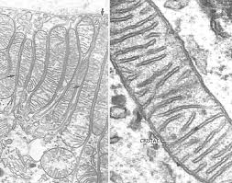
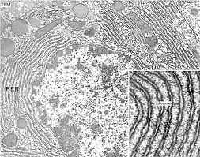
Ultrastructure
The detailed structure of a cell revealed by the electron microscope is called its ultrastructure.

