Slide 1
Chapter 1.1
Light Microscopy

Slide 2
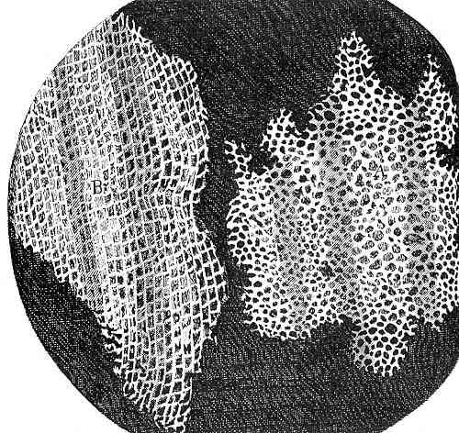
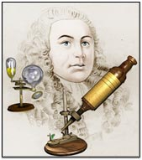
Cell History
Robert Hooke, an English scientist decided to examine thin slices of plant material, and was struck by the appearance of regular box-like structures he names “cells” (1665)
Without realizing it, Hooke discovered the fundamental unit of all living things

Slide 3
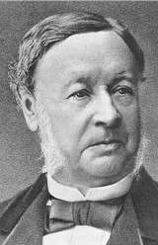
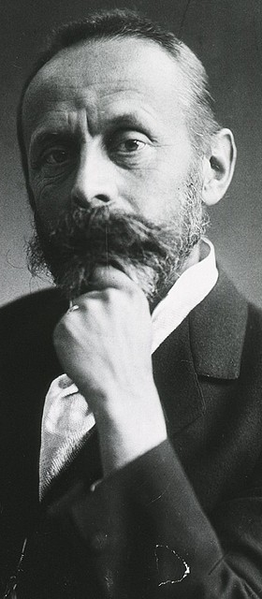
Cell Theory
The cell is the basic unit of structure and function of all living things (Schleiden 1838, Schwann 1839)
All cells arise from preexisting cells by cell division (Virchow 1855)

Slide 4
Why Cells?
What makes a cell distinct from its surroundings?
The thin membrane which surrounds all cells is essential in controlling exchange between the cell and its environment
Partially Permeable
Effective barrier
Allows for control
Freely Permeable
Chemicals of cell would mix with surroundings
No life

Slide 5
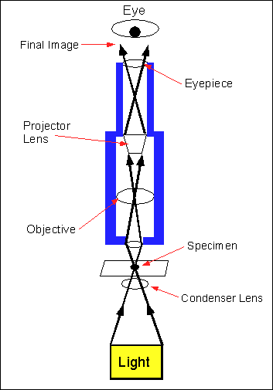
Cell Biology and Microscopy
The study of cells has given rise to the cell biology branch of biology (duh)
Cells can be studied using several diff. methods, primarily microscopy
Light microscope= uses light as a
source of radiation
Electron microscope= uses electrons
as a source of radiation

Slide 6
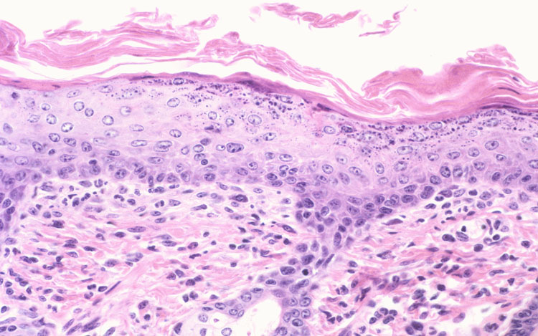
Light Microscopy
“Golden age” of light microscopy began in 19th cent.
Rapid progress in microscope design and preparing material for examination with microscopes (cytology)

Slide 7
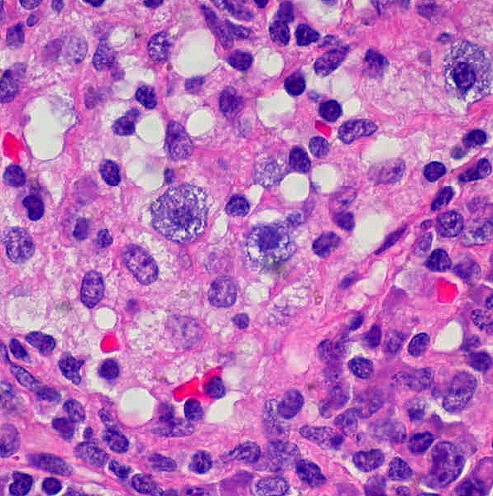
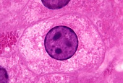
Visualizing Animal and Plant Cells
Every plant and animal cell is surrounded by a very thin cell surface membrane (aka plasma membrane)
All have a nucleus which is very large and stains very darkly (especially chromatin)
The nucleolus located within the nucleus stains even more deeply (variable amount, can be ~1-5)

Slide 8
Visualizing Animal and Plant Cells
The material between the nucleus and cell surface membrane is the cytoplasm. (aqueous: fluid to jelly)
Many small structures (organelles) can be seen within the cytoplasm
Organelles are functionally and structurally distinct parts of a cell and are often surrounded by membranes so that their activities can be separated from the cytoplasm (compartmentalization)
Compartmentalization →division of labor (sharing of work between specialized organelles)

Slide 9
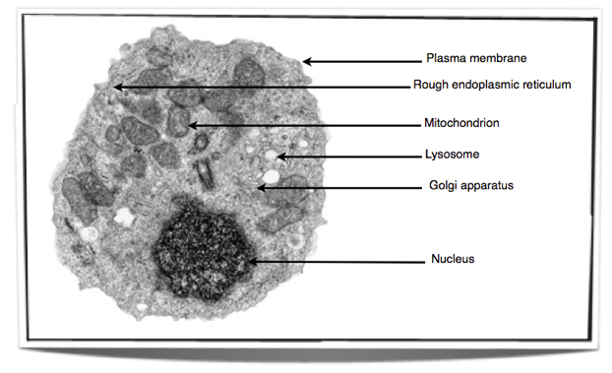
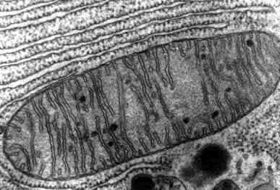
Visualizing Animal and Plant Cells
The most numerous organelles seen with light microscopes are usually mitochondria (single mitochondrion)
Golgi apparatus can only be seen with silver containing stains

Slide 10
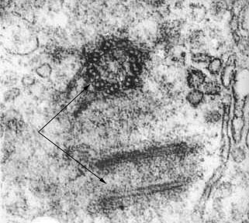
Animal Cells Only
Centriole (involved in nuclear division) appears as a small structure close to the nucleus

Slide 11
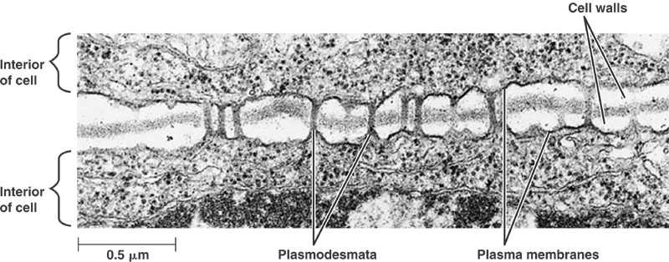
Plant Cells Only
Usually larger than animal cells
All surrounded by cell wall
Linked to neighboring cells by plasmodesmata (single plasmodesma)

Slide 12
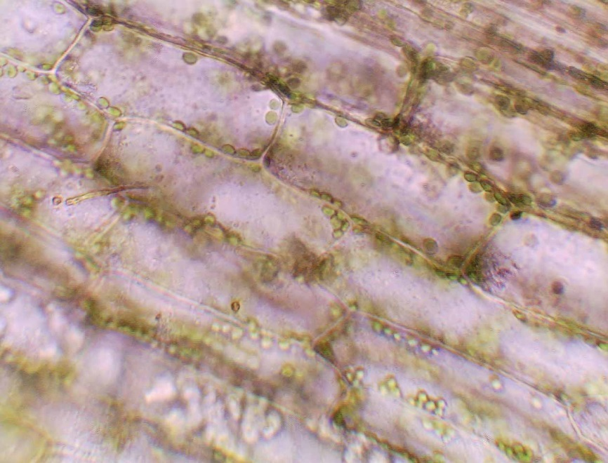
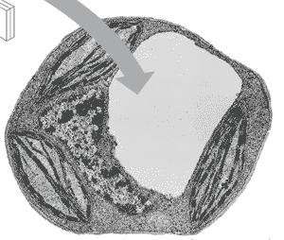
Plant Cells Only
Large central vacuole, surrounded by tonoplast
Chloroplasts: show grana (single granum) at high magnification

Slide 13
Units of Measurement
Kilometer (km) 10³
Meter (m) 1
Centimeter (cm) 10⁻²
Millimeter (mm) 10⁻³
Micrometer (µm) 10⁻⁶
Nanometer (nm) 10⁻⁹
Picometer (pm) 10⁻¹²

Slide 17
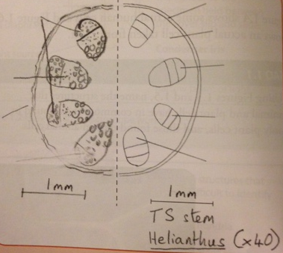
Drawing Cells
Do’s | Don’ts
HB pencil only Clear, continuous lines Accurate proportions Tissues completely enclosed by lines Label all tissues Correctly identified parts Representative portions or cells Scale bar | Shading Textbook versions Individual cells on low power Nucleus as a solid blob on high power

