Slide 1
AICE Biology Lab Review AS Paper 3
Adapted from Ms. Evans GHS

Slide 2
Metric Units (Length)
kilometer (km) = 1,000 m (1 X 10³ m)
meter (m) = 1 m
centimeter (cm) = 0.01 m (1 X 10⁻² m)
millimeter (mm) = 0.001 m (1 X 10⁻³ m)
micrometer (um) = 0.000001 m (1 X 10⁻⁶ m)
nanometer (nm) = 0.000000001 m (1 X 10⁻⁹ m)
**To convert between any, use the same method you used in stoichiometry & keep track of units

Slide 3
A. Cell Structure
Use a graticule and stage micrometer to measure cells and be familiar with units
(mm, µm, nm)
Example:
A lysosome measures 0.4 µm in diameter. What is the diameter in nm?
A 4nm
B 40 nm
C 400 nm
D 4000 nm

Slide 4
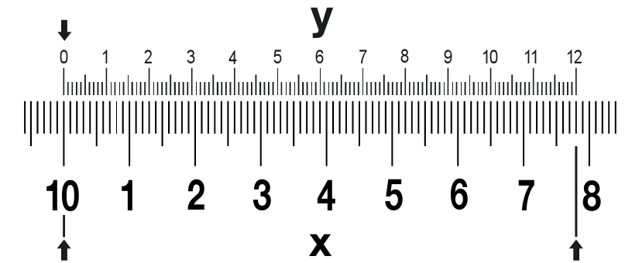
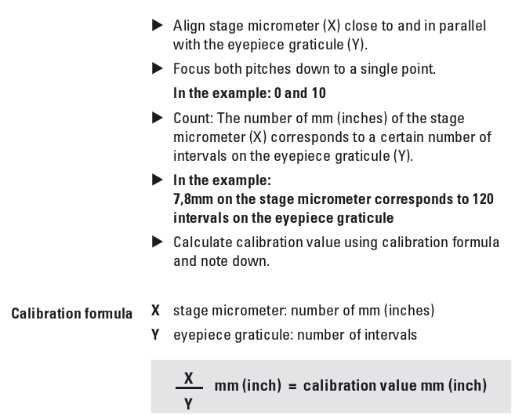
Calibrating an Eyepiece Graticule
Images from “Measuring” Leica microsystems www.leica-microsystems.com

Slide 5
Measuring With A Graticule
Images from “Measuring” Leica microsystems www.leica-microsystems.com

Slide 6
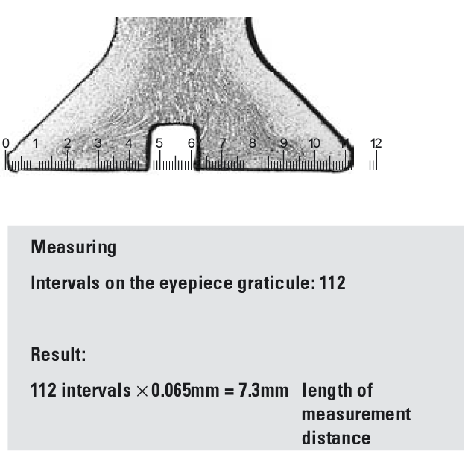
Practice measuring
Images from “Measuring” Leica microsystems www.leica-microsystems.com

Slide 7
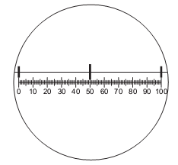
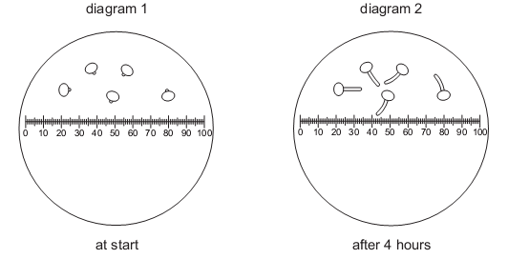
Measuring With A Graticule: PRACTICE
The diagram shows a graduated slide, with divisions of 0.1 mm viewed using an eyepiece graticule.
Pollen grains were grown in a sugar solution and viewed using the eyepiece graticule. Diagram 1 shows the pollen grains at first and diagram 2 shows them after four hours.

Slide 8
Difference Between Magnification & Resolution
Magnification: zooms in, makes small objects larger to see detail
Resolution: The shortest distance that can be distinguished between two objects

Slide 9
Calculating Magnification
Magnification = Image / Actual
Example 1:
The diagram is a plan of a transverse section through a leaf, drawn using a x 5 eyepiece and a x 8 objective lens of a microscope.
The actual distance across the leaf section is 7.5mm. What is the magnification of the diagram?
A x5 B x 8 C x 20 D x 40

Slide 10
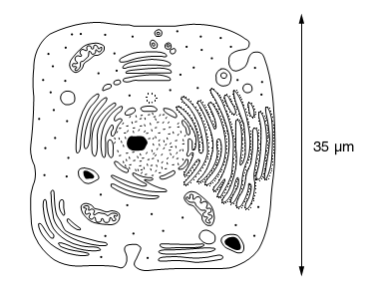
Calculating Magnification
Magnification = Image / Actual
Example 3:
The diagram shows a drawing of an electronmicrograph.
What is the approximate length of one mitochondrion in this cell? (Assume the line = 7mm)
A 5 to 6 µm
B 7 to 8 µm
C 8 to 10 µm
D 10 to 15 µm

Slide 11
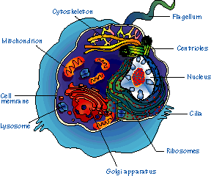
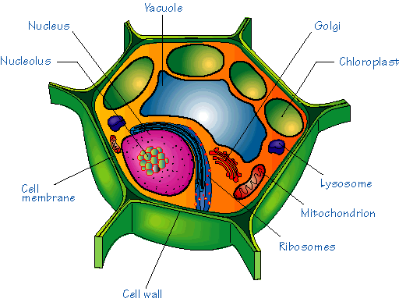
A. Cell Structure
(e) Compare & contrast the structure of typical animal & plant cells

Slide 12
A. Cell Structure
(f) Draw plan diagrams of tissues (including transverse section of a dicotyledonous leaf) and calculate the linear magnification of drawings.

Slide 13
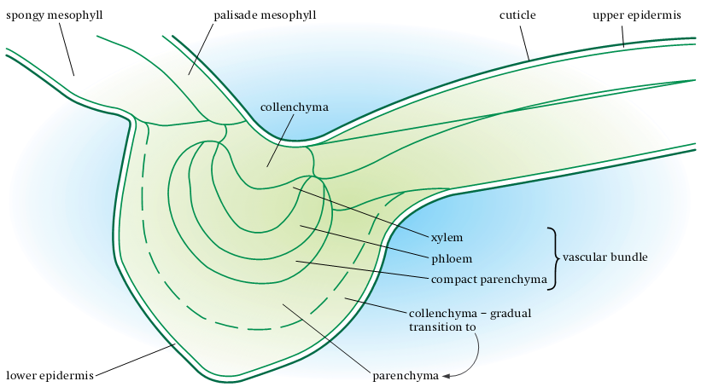

Slide 14
B. Biological Molecules
(a) Carry out tests for reducing and non reducing sugars (including semi quantitative use of the Benedict’s test), the iodine in potassium iodide test for starch, the emulsion test for lipids and the biuret test for polypeptides.

Slide 15
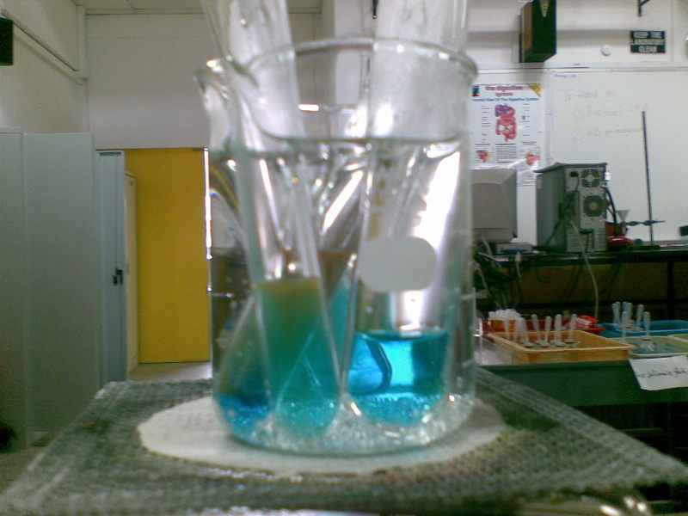
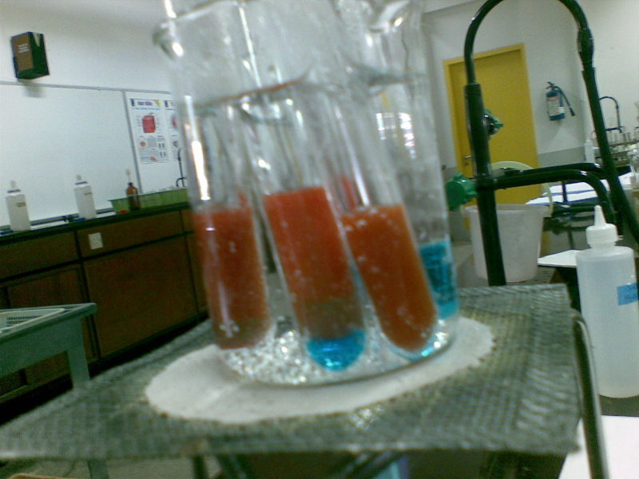
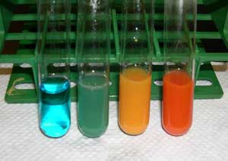
Benedict’s Test for reducing sugars
Mix equal amounts of test solution and Benedict’s.
Heat until nearly boiling for color change.
Identify relative concentrations of reducing sugars based on degree of color change.

Slide 16
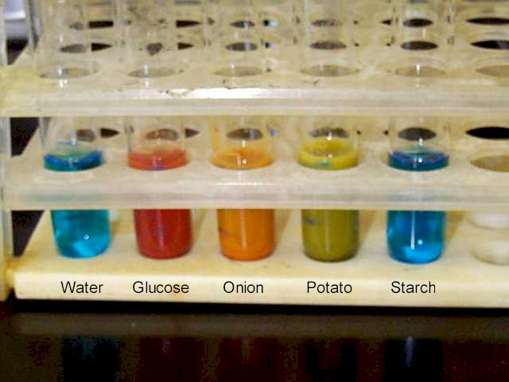
Benedict’s Test for reducing sugars
Here’s a good example of some possible test solutions

Slide 17
Testing for non reducing sugars (sucrose)
If you get a negative result for your Benedict’s test, you can rule out the presence of reducing sugars like glucose, fructose & lactose, but further testing is needed to rule out sucrose.
There are two methods to use Benedict’s test to test for Non-reducing sugars: Acid Hydrolysis & Enzyme Hydrolysis.

Slide 18
Testing for non reducing sugars (sucrose): Acid Hydrolysis
After a neg result, get a fresh solution and add dilute HCL. Heat for 10 minutes to break any glycocidic bonds present.
Then, add Hydrogen Carbonate to your sample until it ceases to fizz. This neutralizes the HCL in your sample.
Now, add Benedicts Solution to your sample and heat for 10-15 minutes.
If you see a color change where you previously had a negative test, this is a positive test for non-reducing sugars (eg. sucrose) or starches in the solution.
Use the IKI test to narrow down your results
+positive IKI means you have either starch only or a mixture of starch & sucrose
-Neg. IKI means you have sucrose only.

Slide 19
Testing for non reducing sugars (sucrose): Enzyme Hydrolysis
This is just like Acid Hydrolysis except you can use an enzyme like Amylase to break the glycosidic bonds.
When you use an enzyme you need to be more careful when you heat the solution to ensure that you do not denature the enzyme.
No hydrogen carbonate is needed when using the enzyme.
After adding the enzyme & heating gently for 10 minutes you add the Benedict’s solution and proceed as usual for any Benedict’s test.

Slide 20
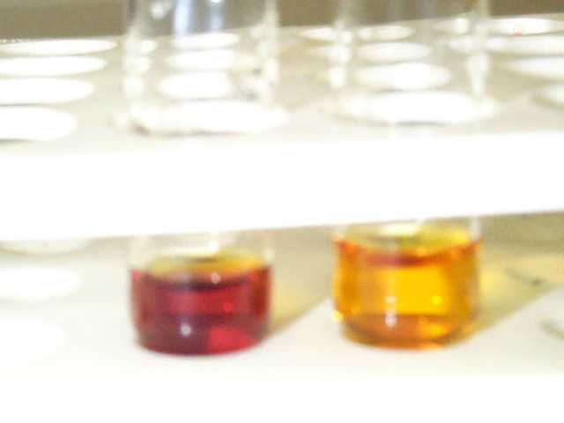
Iodine in Potassium Iodide (IKI) test for starch
Iodine solution (IKI) reacts with starch to produce a dark purple or black color.
Left: starch solution and IKI - Iodine turns dark in the presence of starch.
Right: distilled water and IKI

Slide 21
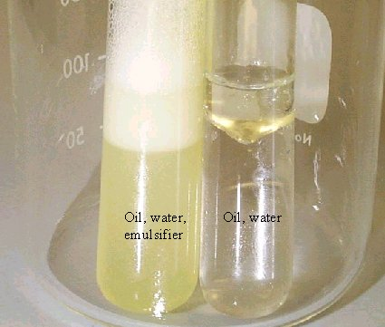
Emulsion Test for Lipids
This one can be difficult to interpret. Look closely for small droplets of oil suspended in the emulsion.

Slide 22
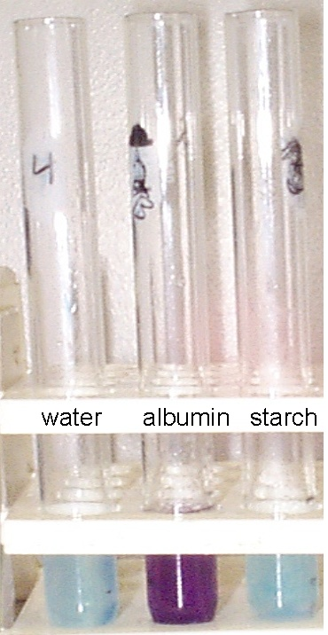
Biuret Test for peptide bonds (protein)
+ Positive test is lavender to purple,
- Negative is sky blue

Slide 23
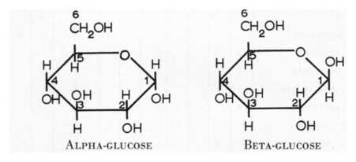
(b) describe the ring forms of alpha and beta glucose.
Alpha and beta glucose differ only in the direction that -H and -OH groups point on carbon 1. Alpha glucose has an -OH [hydroxyl] group that points "downwards", away from the ring, whereas the -OH on carbon 1 of beta glucose is above the ring.

Slide 24
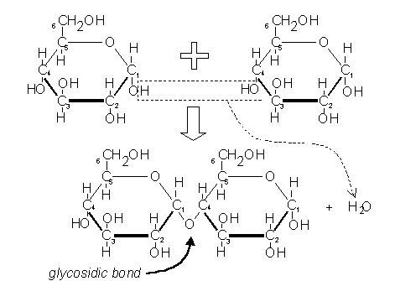
(c) Describe the formation and breakage of a glycosidic bond.

Slide 25
(d) describe the molecular structure of starch (amylose & amylopectin), glycogen & cellulose and relate these structures to their functions in living organisms.

Slide 26
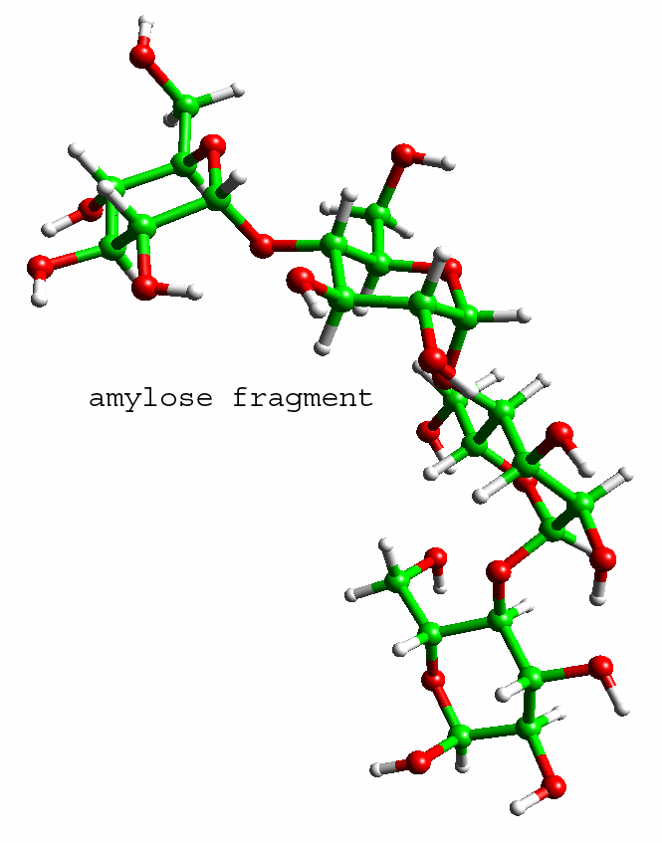
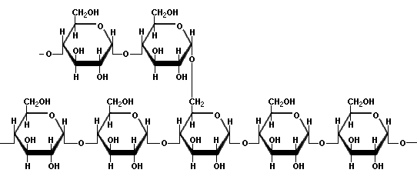
Starch (amylose & amylopectin)
Function: store energy for plants
Structure: many glucose molecules in a lattice configuration (crisscrossing)

Slide 27
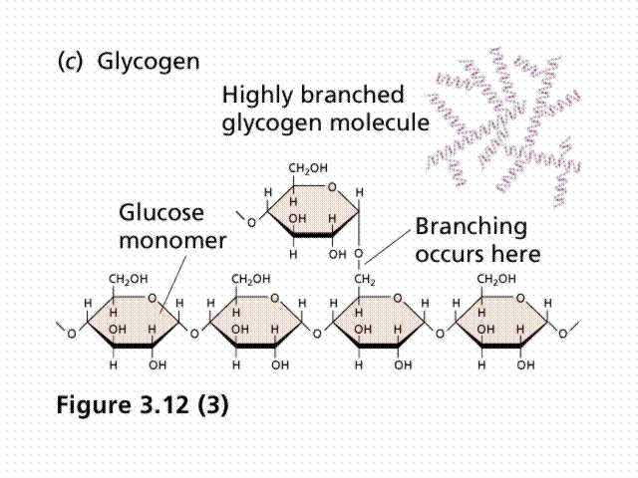
Glycogen
Function: Store glucose in animals
Structure: Highly branched glucose polymer

Slide 28
Cellulose
Function: Structural support in plants
Structure: straight chain polymer, and each cellulose molecule is long and rod-like. This differs from starch, which is a coiled molecule. This is why cellulose cannot be broken down into its glucose subunits by any enzymes produced by animals.

Slide 29
(e) describe the molecular structure of a triglyceride & phospholipid and relate these structures to their functions in living organisms.

Slide 30
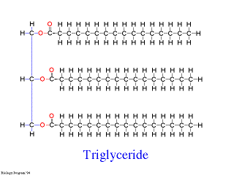
Triglyceride
Structure: glycerol & 3 fatty acids
Function: Energy storage; saturated (bad) & unsaturated (better) fats

Slide 31
Phospholipid
Structure: phosphate group as a “head” (hydrophilic) with 2 fatty acid tails (hydrophobic); both bonded to a molecule of glycerol
Function: Makes cell membranes with differing abilities to allow diffusion of materials across and allows solubilities in both oil & water

Slide 32
(f) describe the structure of an amino acid and the formation & breakage of a peptide bond.

Slide 33
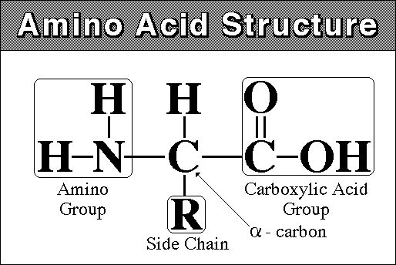
Amino Acids
20 of them

Slide 34
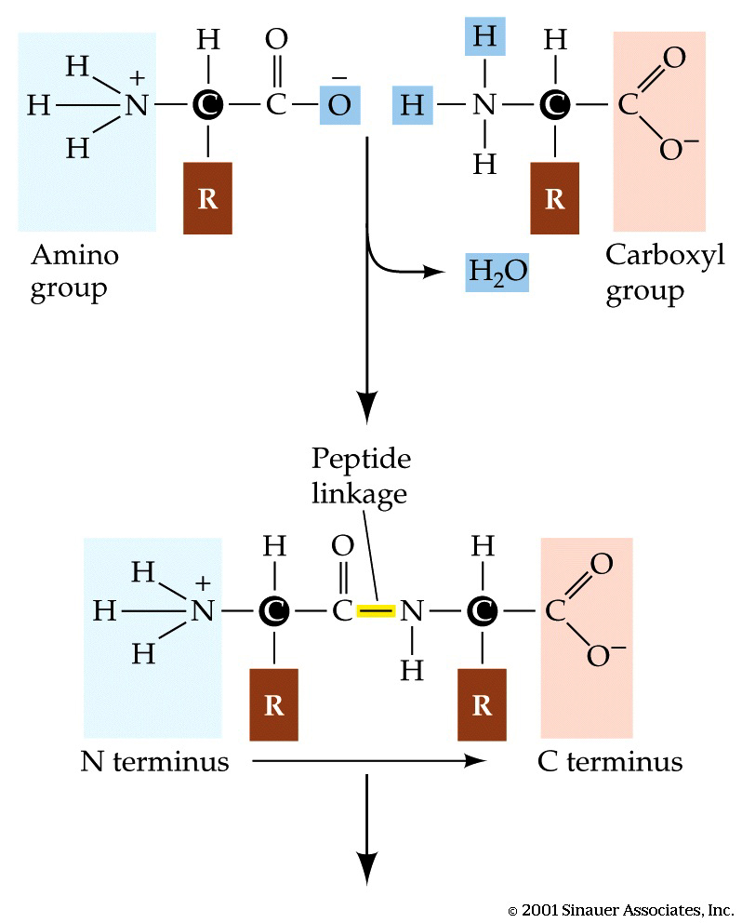
Peptide Bond

Slide 35
(g) explain the meaning of the terms primary, secondary, tertiary, and quaternary structure of proteins and describe the types of bonding (hydrogen, ionic, disulphide and hydrophobic interactions) that hold the molecule in shape.

Slide 36
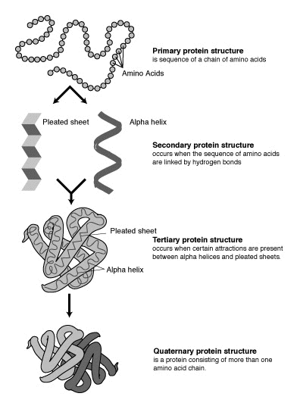

Slide 37
Primary Structure
Covalent bonding between adjacent amino acids (or peptide bonds)

Slide 38
Secondary Structure
The helix is stabilized by hydrogen bonding between amine and carbonyl groups of the same polypeptide chain. The pleated sheet is stabilized by hydrogen bonds between the amine groups of one chain and the carbonyl groups of an adjacent chain.

Slide 39
Tertiary Structure
Tertiary structure is largely maintained by disulfide bonds. Disulfide bonds are formed between the side chains of cysteine by oxidation of two thiol groups (SH) to form a disulfide bond (S-S), also sometimes called a disulfide bridge.

Slide 40
Quaternary Structure
Hydrophobic interaction is the main stabilizing force for subunits in quaternary structure. When a single monomer folds into a three-dimensional shape to expose its polar side chains to an aqueous environment and to shield its nonpolar side chains, there are still some hydrophobic sections on the exposed surface. Two or more monomers will assemble so that their exposed hydrophobic sections are in contact.
Although rare, ionic bonds can be important to protein structure because they are potent electrostatic attractions that can approach the strength of covalent bonds

Slide 41
(h) describe the molecular structure of haemoglobin as an example of a globular protein, and of collagen as an example of a fibrous protein & relate these structures to their functions.

Slide 42
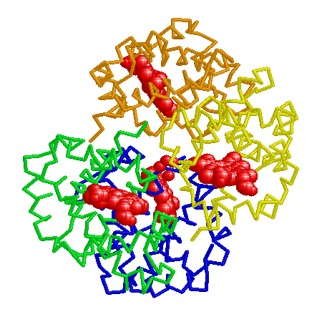
Haemoglobin
Made of 4 polypeptide chains: 2 alpha & 2 beta globin chains
Each a or b globin chain folds into 8 a helical segments (A-H) which, in turn, fold to form globular tertiary structures that look roughly like sub-microscopic kidney beans. The folded helices form a pocket that holds the working part of each chain, the heme which holds the iron.
Function: to carry oxygen to cells, which
binds to the oxygen in the heme group.

Slide 43
Collagen
Fibrous proteins generally exist as water-insoluble strands (as opposed to globular "ball-shaped" proteins which are soluble in water.) The chains have a high percentage of hydrophobic amino acids that allows them to coalesce into strong linear chains, ie. collagen exists as a "triple helix." These strands usually come together to form very strong, rope like structures that resist "where-and-tear" and have tensile strands. Hence they are found in joints, ligaments, tendon, muscle, connective tissue, the skin and other tissues that are exposed to heavy mechanical stress, examples of these proteins are the collagens found in connective tissue, cytokeratins in the epidermis, desmin in muscle tissue and elastins, which consists of a high proportion of alpha helixes that can "uncoil" and "stretch."

Slide 44
(j) state one role of each of the following inorganic ions in living organisms: calcium, sodium, potassium, magnesium, chloride, nitrate, phosphate

Slide 45
C. Enzymes
(c) Follow the time course of an enzyme-catalysed reaction by measuring rates of formation of products (for example, using catalase) or rates of disappearance of substrate (for example using amylase).

Slide 46
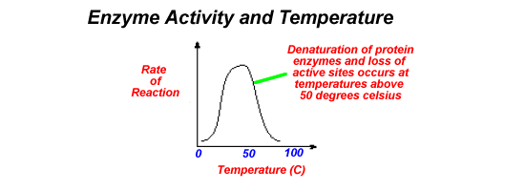
C. Enzymes
(d) Investigate and explain the effects of temperature, pH, enzyme concentration, and substrate concentration on the rate of enzyme - catalysed reactions, and explain these effects.

Slide 48
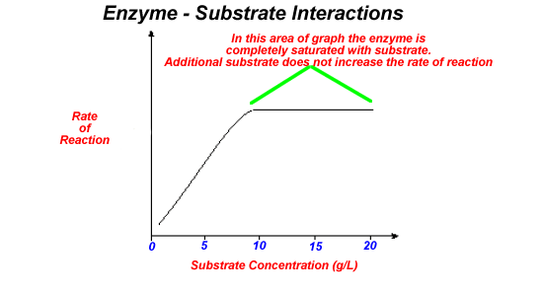

Slide 49
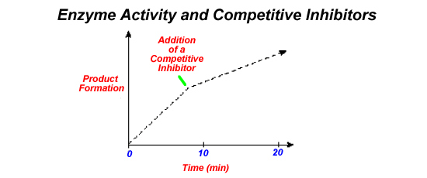

Slide 50
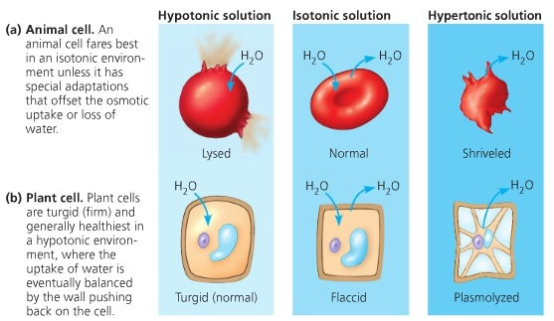
D. CELL MEMBRANES AND TRANSPORT
(d) investigate the effects on plant cells of immersion in solutions of different water potential;

Slide 51
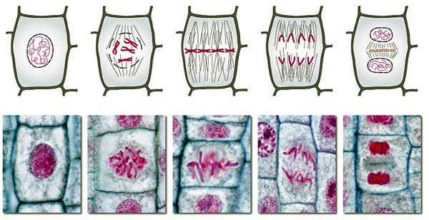
E. CELL AND NUCLEAR DIVISION (Mitosis)
(d) *describe, with the aid of diagrams, the behaviour of chromosomes during the mitotic cell cycle and the associated behaviour of the nuclear envelope, cell membrane, centrioles and spindle (names of the main stages are expected);

Slide 52
G. TRANSPORT (Plants)
(c) *describe how to investigate experimentally the factors that affect transpiration rate;
(d) *describe the distribution of xylem and phloem tissue in roots, stems and leaves of dicotyledonous plants;
(e) *describe the structure of xylem vessel elements, sieve tube elements and companion cells and be able to recognise these using the light microscope;
(i) *describe how the leaves of xerophytic plants are adapted to reduce water loss by transpiration;

Slide 53
Plants: Monocots versus Dicots
The flowering plants (angiosperms) are classified as either monocots or dicots based on characteristics of their pollen, leaves, roots, stems and flowers.
Monocots include lilies, corn, rice, palms and grasses.
Dicots include pretty much everything else- including all woody plants.

Slide 54
The three tissue systems in the plant body

Slide 55
Tracheid (xylem cell)
Sieve tube element
Vessel element (xylem cell)
Phloem tissue

Slide 56
Xylem Tissue
Tracheid
Vessel element

Slide 57
Phloem Tissue
Sieve tube element
Companion cell

Slide 58
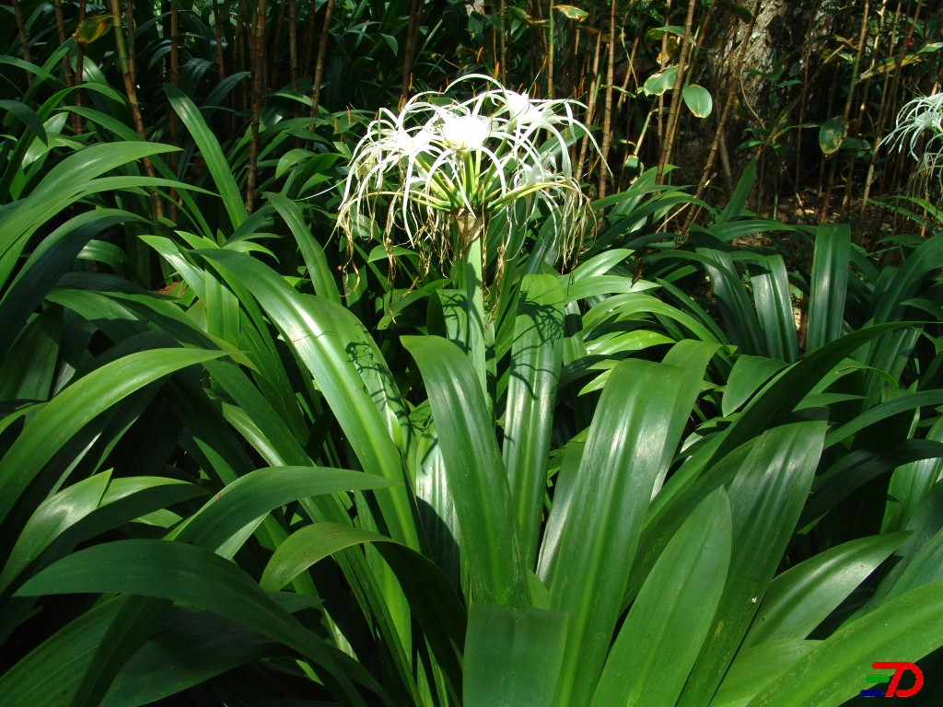
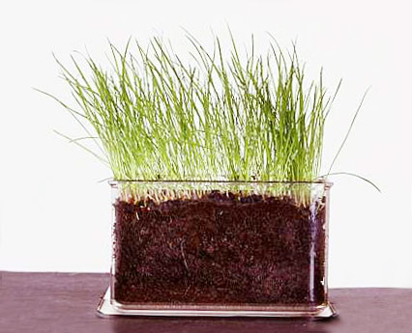
Monocots

Slide 59
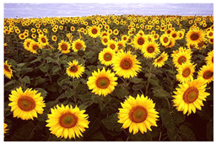
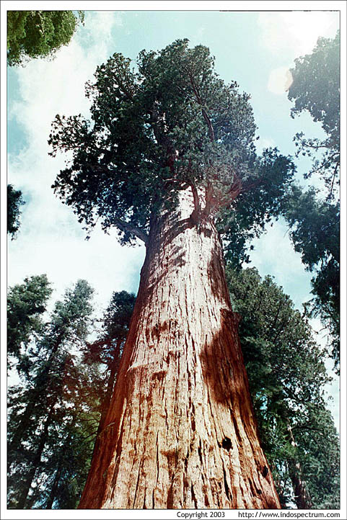
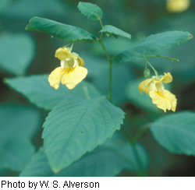
Dicots

Slide 60
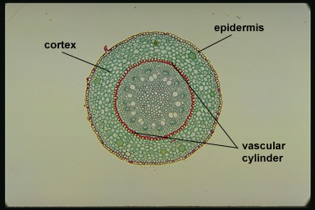
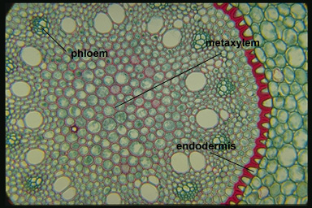
Monocot Root Cross Section (cs)

Slide 61
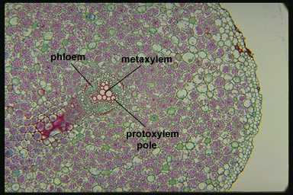
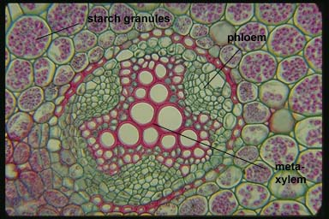
Dicot Root Cross Section (cs)

Slide 62
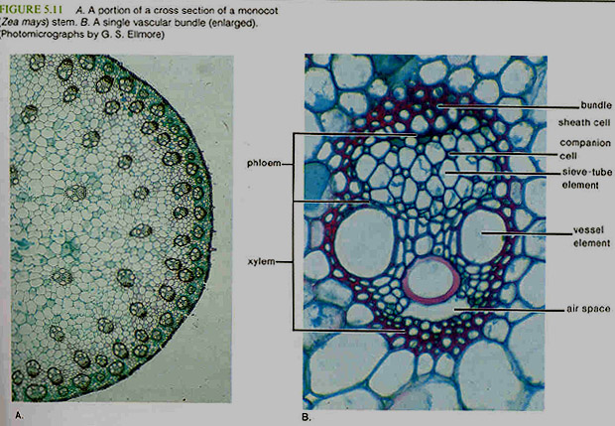
Monocot Stem

Slide 63
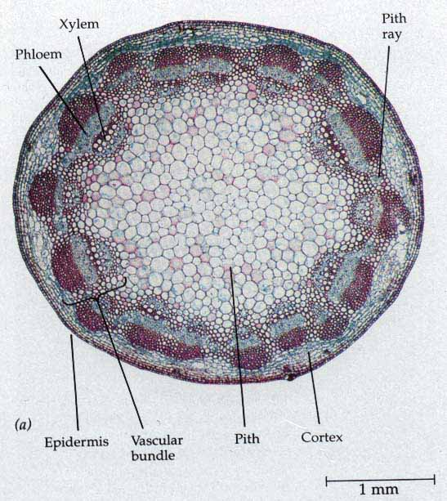
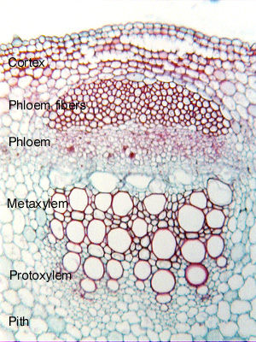
Dicot Stem

Slide 64
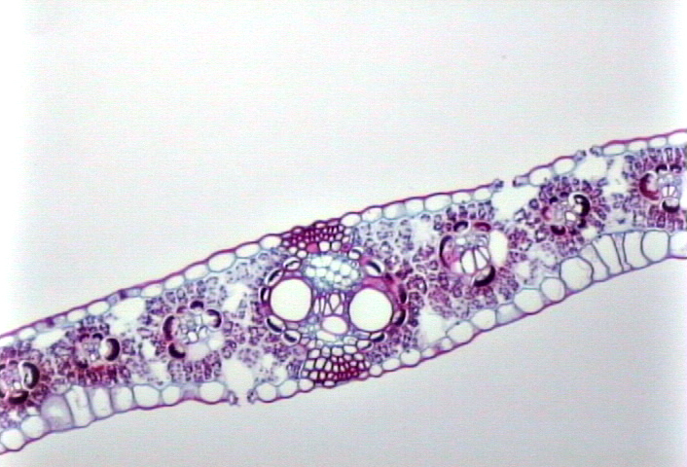
Monocot Leaf
Midrib shows vascular tissue: Can you ID?
Leaves have parallel veins (visible here)
Do you see the stomata?
Notes:
100x Image
The veins (vascular tissue) in the leaf of a monocot are parallel. So a cross section of the leaf shows a series of dark circles, each of which is a separate vein. On the bottom surface of the leaf two guard cells can be seen around each of the stomata. The white areas inside the leaf are air spaces, which allow the cells to take up carbon dioxide gas for photosynthesis.

Slide 65
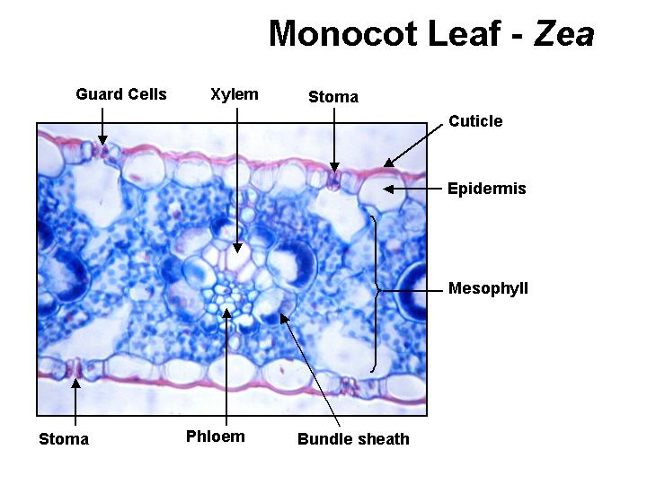
Monocot Leaf: Zea Mays (corn)
The mesophyll of Zea is undifferentiated. Note the large bundle sheath cells and that stoma are found in both the upper and lower epidermis.

Slide 66
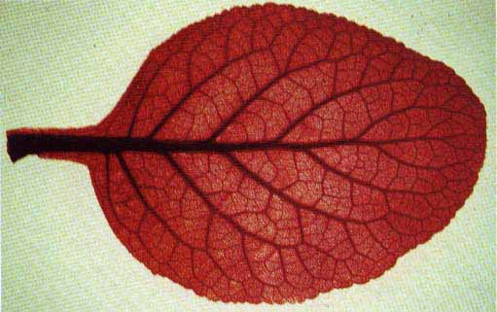
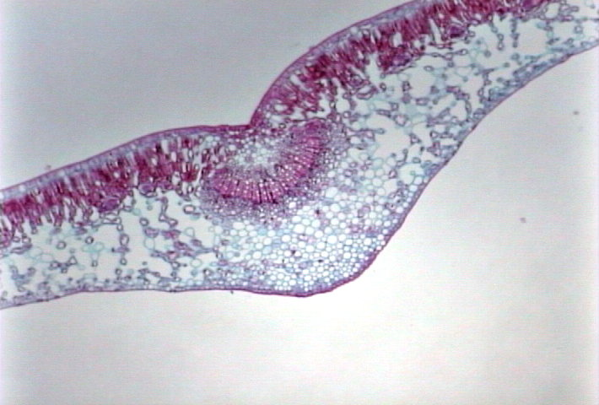
Dicot Leaf
These leaves have a more obvious mid-rib (central vein)
Veins are perpendicular to the central vein.
40x . This image shows the large central vein (vascular tissue) in the middle of a dicot leaf. The white areas inside the leaf are air spaces, which allow the cells to take up carbon dioxide gas for photosynthesis. The rows of elongated cells near the top surface of the leaf are the palisade layer, where most of the photosynthesis takes place.
Notes:
40x . This image shows the large central vein (vascular tissue) in the middle of a dicot leaf. The white areas inside the leaf are air spaces, which allow the cells to take up carbon dioxide gas for photosynthesis. The rows of elongated cells near the top surface of the leaf are the palisade layer, where most of the photosynthesis takes place.

Slide 67
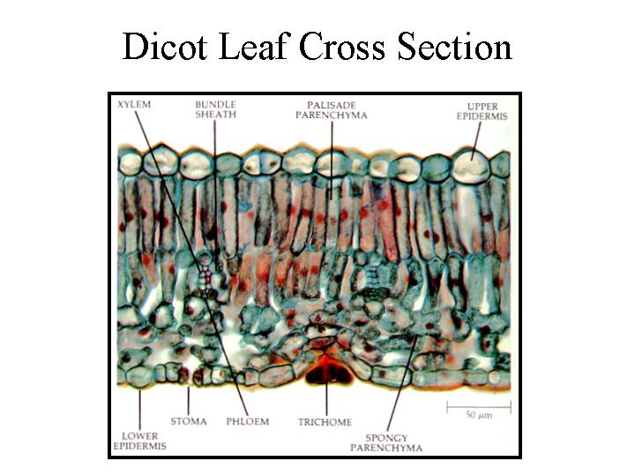
Mesophyte Dicot Leaf: Ligustrum
Mesophytic leaves are adapted to average conditions. Note the well differentiated mesophyll with a palisade mesophyll on the upper surface and the spongy mesophyll below.

Slide 68
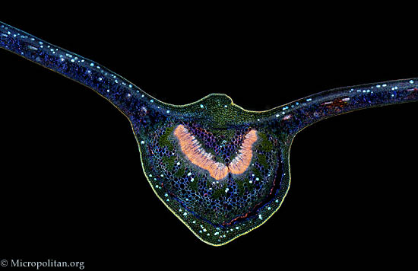
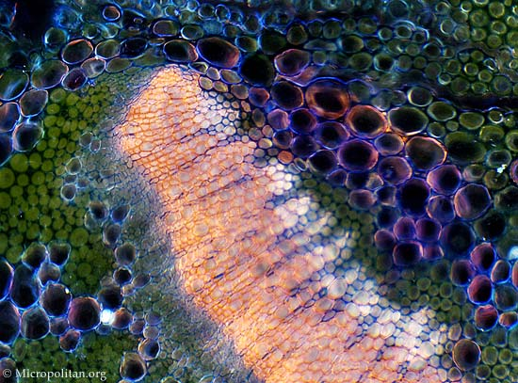
Mesophyte Leaf: Prunus (Laurel)
At 3 different magnifications

Slide 69
Stomata
Identify the guard cells that both form the stoma and regulate its size.

Slide 70
Hydrophytes: Water Loving Plants
Hydrophytic leaves are adapted to an aquatic existence. Note that the upper palisade mesophyll is well developed for photosynthesis while the lower portion of the mesophyll is very loosely arranged with considerable open space which helps the leaf float to the surface. The loosely arranged tissue of the lower mesophyll is aerenchyma. stoma are located in the upper epidermis.

Slide 71
Xerophytes : Ammophilia (Marram Grass)

Slide 72
More Xerophyte Dicot leaves: Pinus
The pine leaf is well adapted to dry conditions with a thick epidermis with stoma recessed into the surface. Beneath the epidermis is the thick walled cells of the hypodermis which helps reduce water evaporation from the leaf. The pine leaf has an endodermis inside the mesophyll which is not seen in either of the other leaf types observed.

Slide 73
More Xerophytes: Oleander 200X

Slide 74
More Xerophytes: Oleander 400X

Slide 75
G. Transport: Mammals
(l) *describe the structures of arteries, veins and capillaries and be able to recognise these vessels using the light microscope;

Slide 76
Artery & Vein Cross section Comparison

Slide 77
H. GAS EXCHANGE
(a) *describe the structure of the human gas exchange system, including the microscopic structure of the walls of the trachea, bronchioles and alveoli with their associated blood vessels;
(b) *describe the distribution of cartilage, ciliated epithelium, goblet cells and smooth muscle in the trachea, bronchi and bronchioles;

Slide 78
Trachea

Slide 79
Lung Tissue

Slide 80
J. IMMUNITY / Mammalian Transport
(n) *describe the structure of red blood cells, phagocytes and lymphocytes and explain the differences between blood, tissue fluid and lymph; (Transport)
(a) *recognise phagocytes and lymphocytes under the light microscope;
Blood smear Medium Lymphocyte (yellow)
Neutrophils (green)
Bar = 50 Microns (µm)

