Slide 1
Macromolecule Tests
INB Pg 27

Slide 2
Testing for Presence of Sugars
Reducing sugars are sugars that can carry out a process known as reduction, and become oxidized in the process
Reducing sugars include all monosaccharides (ex glucose) and some disaccharides (ex maltose)
Only common nonreducing sugar is sucrose

Slide 3
Testing for Presence of Sugars
Benedict’s test: Benedict’s reagent contains copper(II) sulfate in an alkaline solution and has a distinctive blue color
Reducing sugars will reduce soluble blue copper sulfate to insoluble red-brown copper oxide, which is seen as a precipitate

Slide 4
Testing for Presence of Sugars Procedure
Add Benedict’s reagent to the solution you are testing and heat it in a water bath (95°C)
If reducing sugar is present, solution will gradually turn through green, yellow, and orange to red-brown as precipitate is formed
As long as excess Benedict’s is used, the intensity of the red color is directly related to the concentration of the reducing sugar

Slide 5
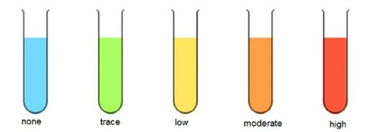
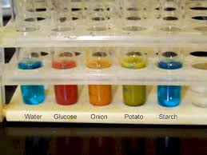
Benedict’s Test

Slide 6
Testing for Presence of Sugars
Sucrose is a non-reducing sugar, and will NOT yield a pos. Benedict’s test
To test for non-reducing sugars, the disaccharide is first broken down into monosaccharides (what chemical process is this?)

Slide 7
Testing for Presence of Sugars
Sucrose is a non-reducing sugar, and will NOT yield a pos. Benedict’s test
To test for non-reducing sugars, the disaccharide is first broken down into monosaccharides (what chemical process is this?) HYDROLYSIS!
This is accomplished with HCl

Slide 8
Testing for Presence of Non-reducing Sugars : Procedure
Only conclusive AFTER a negative Benedict’s test
Heat sugar solution with HCl
Neutralize solution with alkali (ex NaOH)
Add Benedict’s reagent and heat in hot water bath
If there is a color change and precipitate, there is a non-reducing sugar present in original solution
If both a reducing and nonreducing sugar are present, the precipitate obtained will be heavier than the one obtained in the Benedict’s test

Slide 9
Testing for Presence of Starch
Starch molecules tend to curl up into long spirals
The hole that runs down the middle of the spiral is just the right size for iodine molecules to fit into

Slide 10
Testing for Presence of Starch Procedure
Iodine solution (Iodine in potassium iodide solution) is orange-brown
Add a drop of iodine solution to the substance to be tested
A blue-black color is quickly produced if starch is present

Slide 11
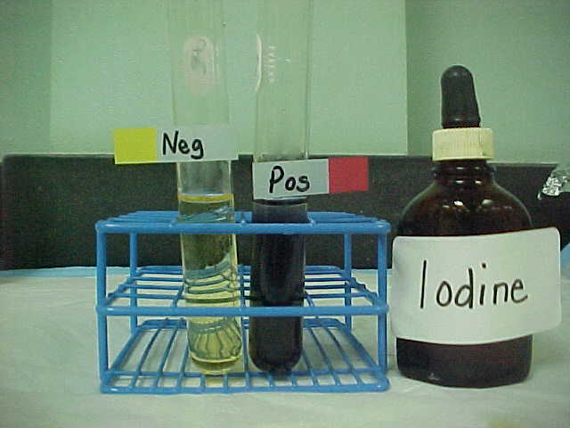
Iodide Test

Slide 12
Testing for Presence of Lipids
Lipids are insoluble in water, but soluble in ethanol (alcohol)
This fact is made use of in the emulsion test for lipids

Slide 13
Testing for Presence of Lipids Procedure
Unknown substance is added to a test tube containing absolute ethanol
Stopper test tube and shake vigorously
Test tube then poured into test tube of water
If lipids are present, a cloudy white suspension is formed
No lipid present = colorless solution in water

Slide 14
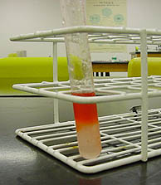
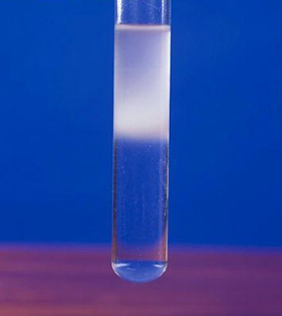
Testing for Presence of Lipids

Slide 15
Testing for Presence of Proteins
All proteins have peptide bonds which contain nitrogen atoms
These form a purple complex with copper (II) ions
The reagent used for this test is called biuret reagent

Slide 16
Testing for Presence of Proteins Procedure
Add biuret solution to unknown solution to be tested
No heating required
Purple color indicates that protein is present
Develops slowly over several minutes

Slide 17
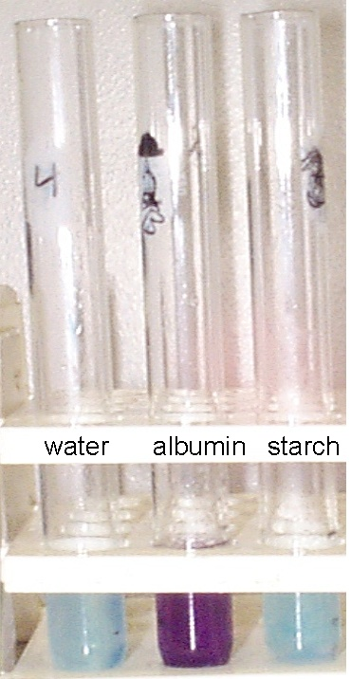
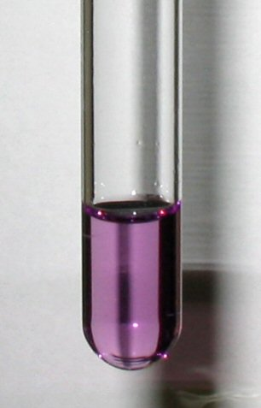
Testing for Presence of Proteins

Slide 18
Pre-Lab: Safety
Always wear protective eye goggles and gloves
Wear aprons to protect your clothing from staining
NEVER direct the open end of a test tube towards another person, including yourself
Do not put anything from the lab in your mouth
Use caution around heating plates
Never reach across test tubes in a hot water bath

Slide 19
Pre-Lab Questions
1.) What are 3 types of macromolecules? Give the monomer and polymer names for each type.
2.) What are the reactions that make polymers called? When are these reactions used in the body?
3.) What are the reactions that make monomers from polymers called? When are these reactions used in the body?

Slide 20
Table 1.1
Sample | Test Used | Observation | Conclusion
Control | Reducing sugar: Benedict’s test
 | Non-reducing sugar: Hydrolysis with HCl, neutralize with NaOH, and Benedict’s test
 | Starch: iodine in potassium iodide solution
A | Reducing sugar test
 | Non-reducing sugar test
 | Starch test
B | Reducing sugar test
 | Non-reducing sugar test
 | Starch test
C | Reducing sugar test
 | Non-reducing sugar test
 | Starch test
D | Reducing sugar test
 | Non-reducing sugar test
 | Starch test

